Slide 1
By : Alaa Abdoh Ali Barghouth
Design Patterns
Chain of Responsibility

Slide 2
Chain of Responsibility
The Goal from pattern :
Chain receiving objects and pass request along until an object
handles it.
request
Handler 1
request
Handler 2
……
Handler n

Slide 3
Chain of Responsibility
COR is a behavioral pattern:
as it in every time the request come, It will be handled in
a different way and a different class (handler) depending
on this request.
Decouple senders and receivers by giving multiple objects (in a set order) a chance to handle a request. Request passed until an object handles it

Slide 4
Chain of Responsibility
Object that makes request has no explicit knowledge of who will handle it – request has an unknown receiver.
1st object in chain receives request – either handles it or forwards to next object in chain if it cant handle it.

Slide 5
Chain of Responsibility
Common example from our life:

Slide 6

Chain of Responsibility

Slide 7
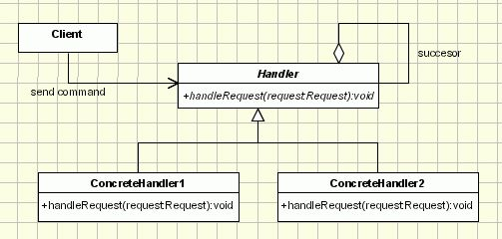
Chain of Responsibility
Class Diagram

Slide 8
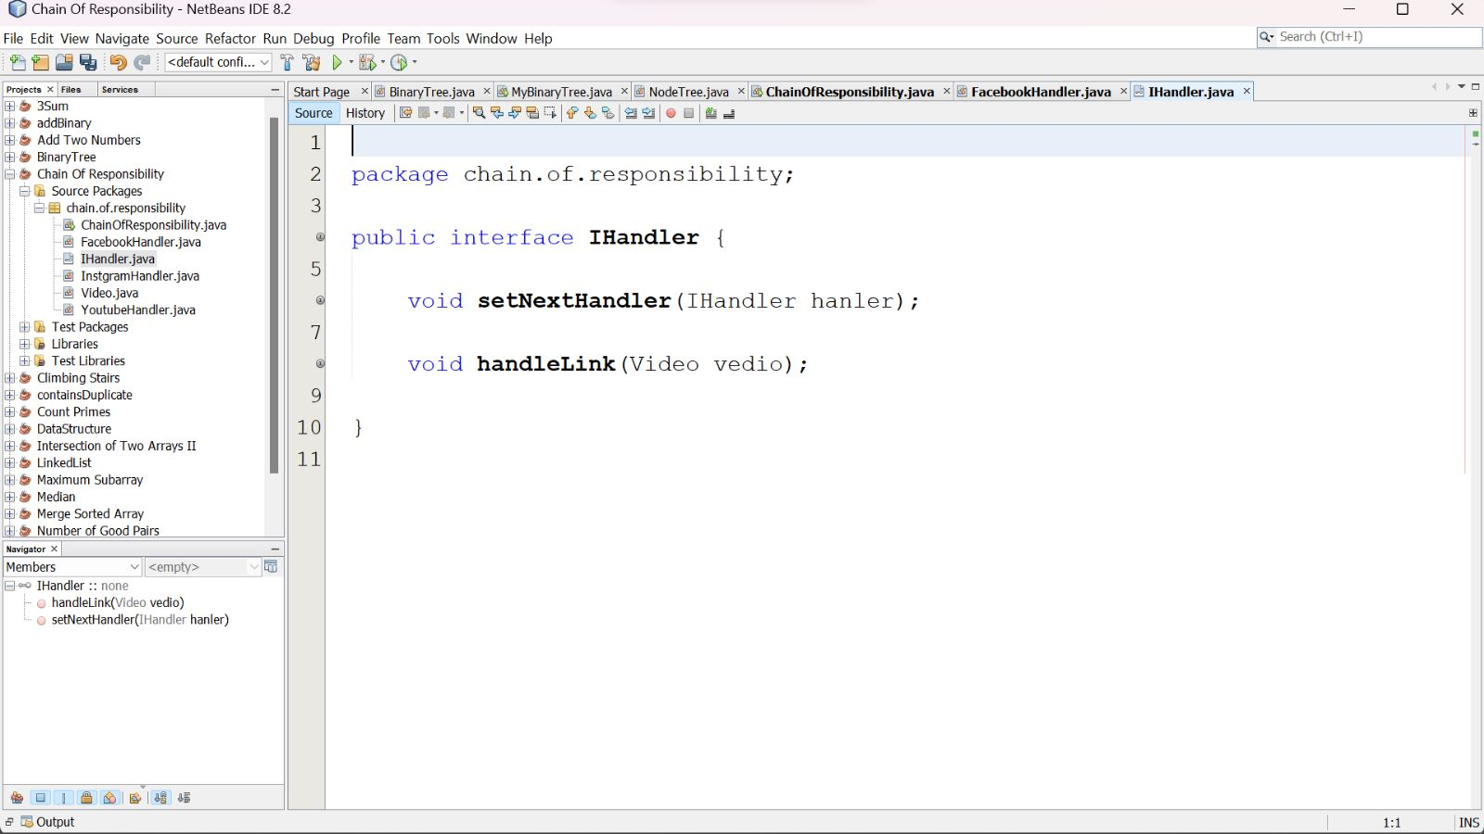
Chain of Responsibility

Slide 9
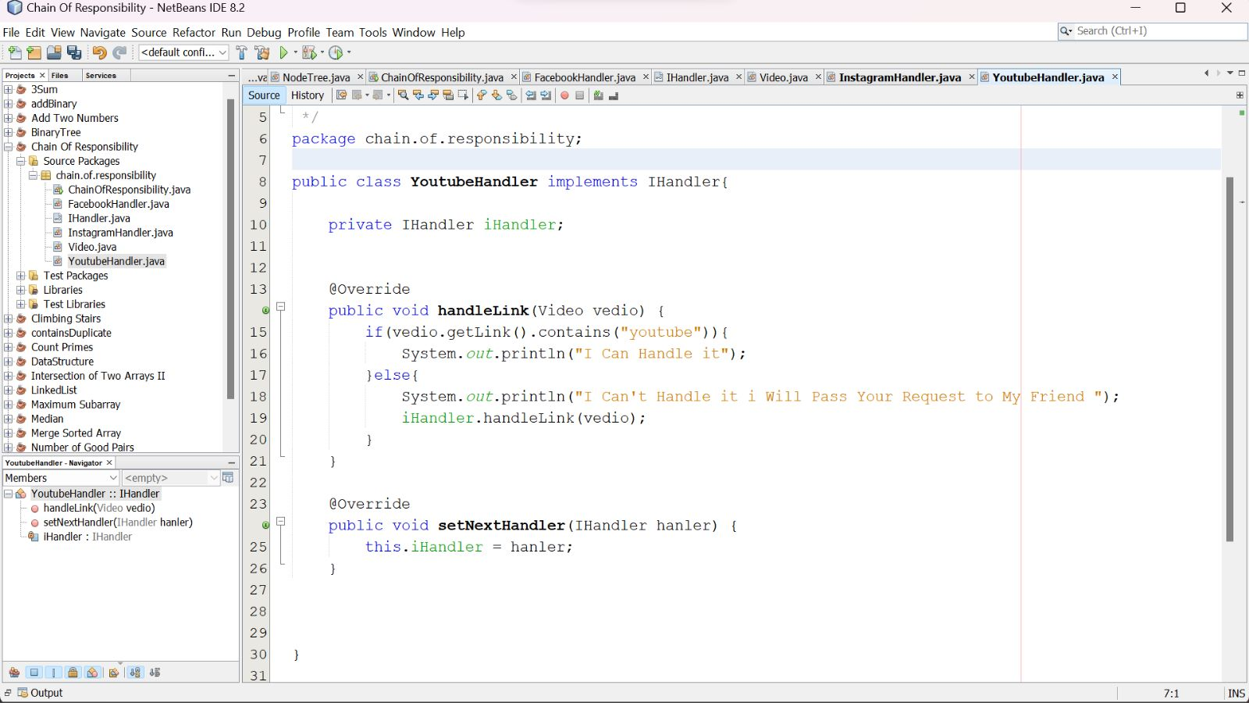
Chain of Responsibility

Slide 10
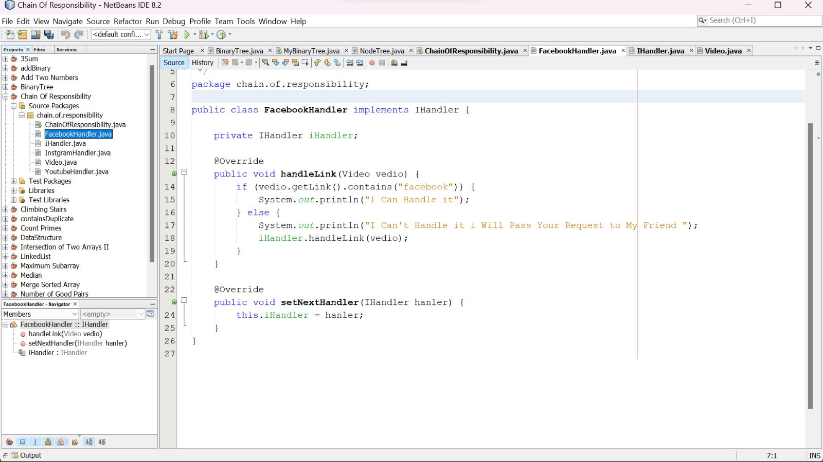
Chain of Responsibility

Slide 11
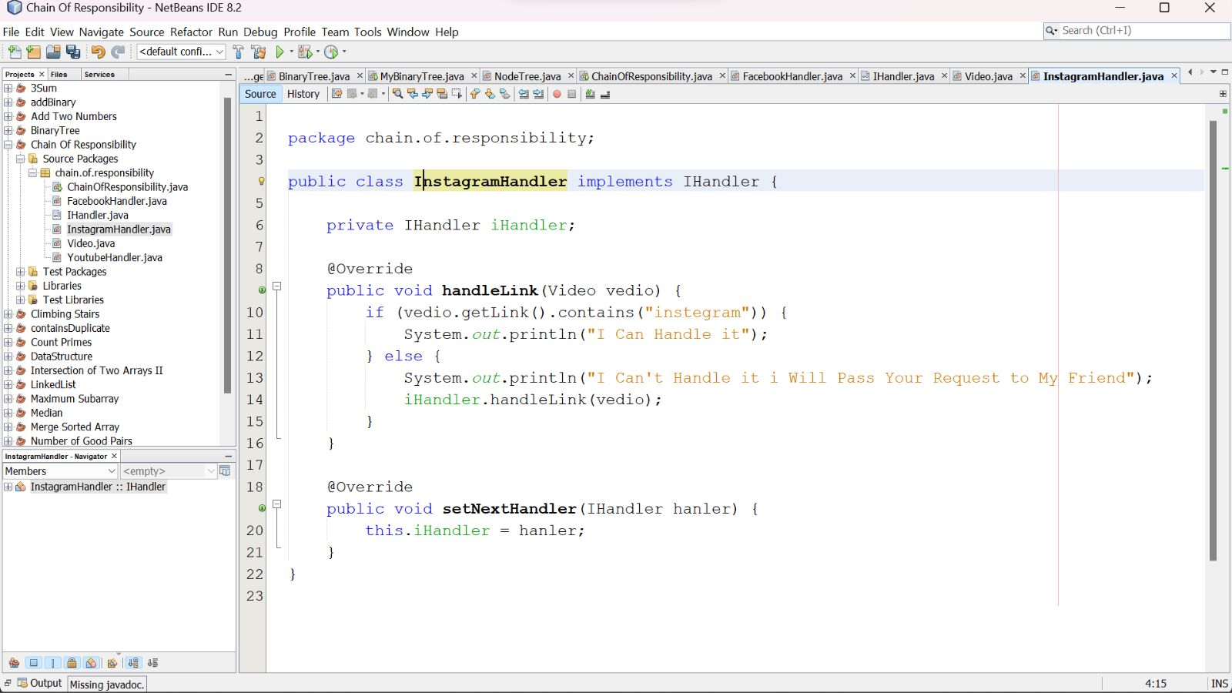
Chain of Responsibility

Slide 12
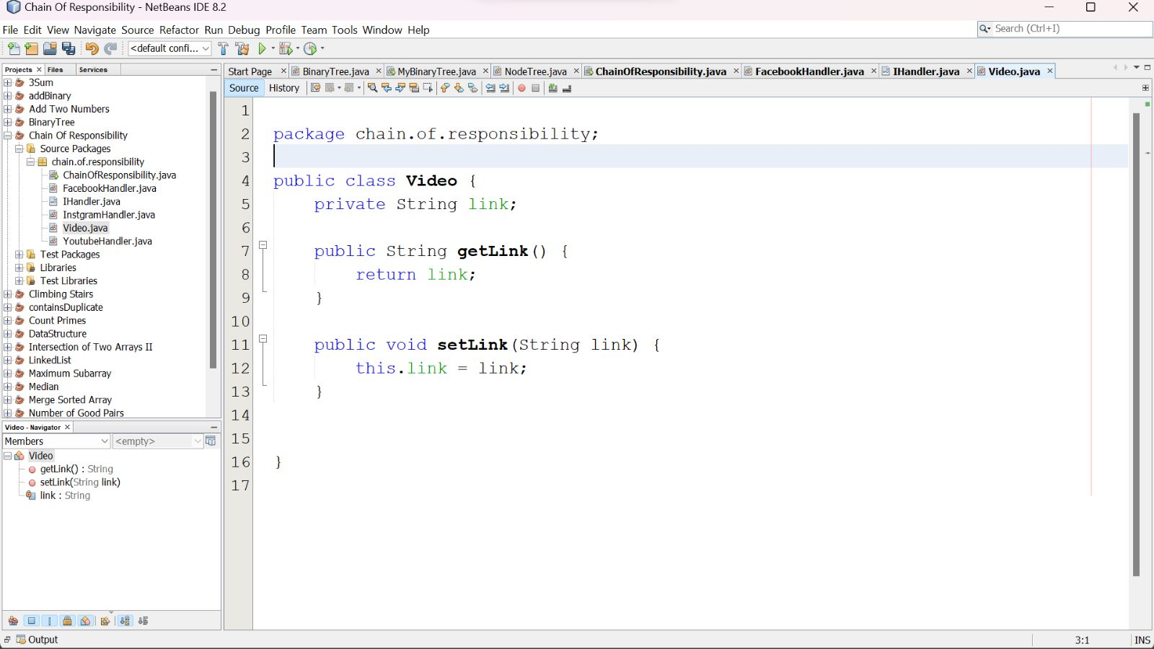
Chain of Responsibility

Slide 13
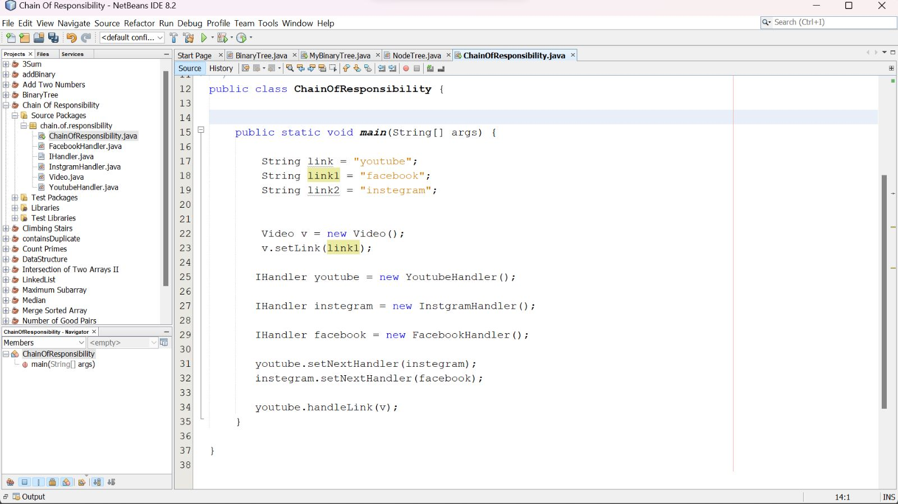
Chain of Responsibility

Slide 14
Chain of Responsibility
Time to interact with each other :
Question: in you opinion, what is the benefits from the pattern ???
Benefits: • Decoupling of senders and receivers • Added flexibility • Sender doesn’t need to know specifically who the handlers are

Slide 15
Chain of Responsibility
The End
Thank You

