Slide 1
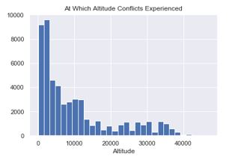
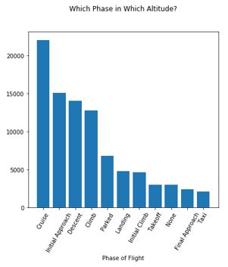
Since we only have 1s and not 0s to predict safety issues as 1 and 0 will not be a reasonable model as we discussed before. Now I checked the other information in the dataset. The safety issues was already categorized during my data cleaning effort. And I chose the air conflict issues only which covers way big chunk of the data. The best target column would be the cause of the problem column.

Slide 2
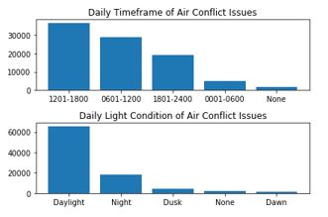
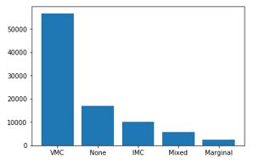
After some digging in data with this new perspective, it turns out that the current variables are not creating big differences on the Pri_Problem column and they distributed pretty homogenically on the causes. You will see in the next slides the variables are almost same effect on the target cell. For daily time, light condition, meteorological conditions, month year or altitude is the major variables I have. And they are not even consistent with the causes of safety issues.

Slide 3
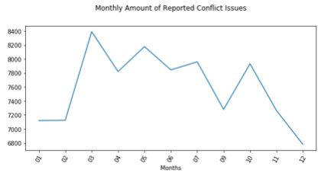
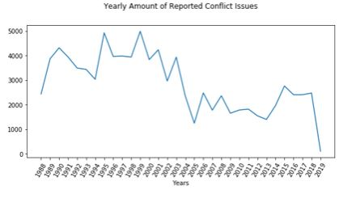

Slide 4
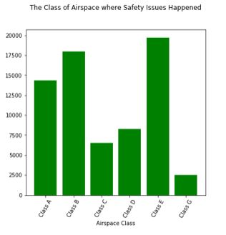
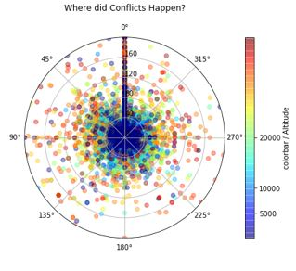
Airspace class and the location

Slide 5
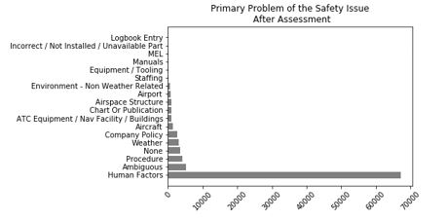
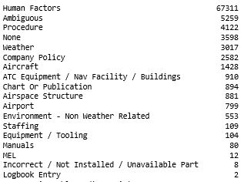

Slide 6
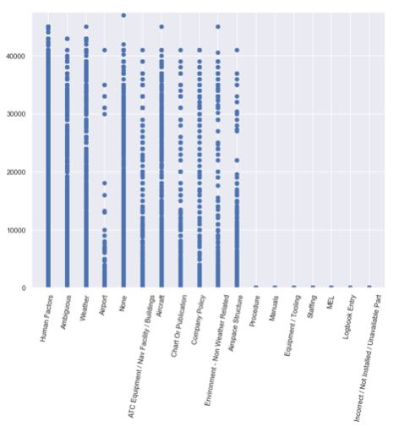

Slide 7
