Slide 1
CIS 641 · MIDTERM STATUS UPDATE
AI Study Assistant
One place for a student’s courses, deadlines and study plan, with AI advice on what to study next
Ali Belhrak · Team AIStudyAssistant · October 28, 2026
Notes:
[About 30 seconds]
Hi everyone, my name is Ali Belhrak. I'm a master's student in Applied Computer Science here at Grand Valley. My project for this class is called the AI Study Assistant. Today I'll give a quick update on where the project is: who is on the team, what the project is about, and the diagrams I made so far.

Slide 2
Team AIStudyAssistant
TEAM MEMBER
ROLES
Ali Belhrak
Project manager
Systems analyst
Designer
Developer
M.S. Applied Computer Science, Grand Valley State University
Solo project: I present every part today
github.com/alibelhrak/GVSU-CIS641-AIStudyAssistant
Notes:
[About 30 seconds]
My team is called AIStudyAssistant, and it's a team of one: I'm working on this project by myself. So I take all the roles. I'm the project manager, the systems analyst, the designer, and the developer. All my work, the proposal, the requirements and the diagrams, is in my team repository on GitHub, GVSU-CIS641-AIStudyAssistant.

Slide 3




The problem: school work is spread across many tools
Due dates
Study time
Materials
Hours studied
in the learning management system
in a calendar or a paper planner
in a notes app or cloud folder
usually not tracked at all
A student can see that an exam is coming, but not that they have barely studied for it, until a day or two before.
Notes:
[About 45 seconds]
So what problem am I trying to solve? As students, our school work is spread across many different tools. Due dates are in Blackboard. Study time is in a calendar or a paper planner. Notes and files are in a notes app or a cloud folder. And the hours we actually study for each course? Most of us don't track them at all.
The problem is that these tools don't talk to each other. A student can see that an exam is coming, but they can't see that they have barely studied for it. Usually they only notice a day or two before the exam, and by then it's too late to catch up.

Slide 4







The AI Study Assistant puts it all in one web app
Courses
Tasks
Deadlines
Schedule
with a weekly study goal
assignments, exams, quizzes
priorities and reminders
weekly study sessions
Materials
Progress
AI recommendations
files and links per course
hours studied vs. goal
what to study next, with a plan the student can accept or dismiss
Notes:
[About 45 seconds]
My solution is one web app that puts all of this in one place. The student adds their courses, and each course has a weekly study goal. They add their tasks, like assignments, exams and quizzes, with a due date and a priority. They can plan study sessions in a weekly schedule, upload materials for each course, and log the hours they studied so they can see their progress against the goal.
And the main feature is the AI recommendations. The system tells the student which course they should focus on next and gives them a plan of study sessions, and the student can accept it or dismiss it.

Slide 5
How the AI recommendation works
STEP 1 · RULES
STEP 2 · RULES
STEP 3 · LLM
STEP 4 · STUDENT
Find the study gap
Rank and plan
Explain it
Accept or dismiss
gap = hours needed − hours studied − hours planned
top 3 by deadline, priority and task type; sessions of up to 2 hours
writes the message and reason; rule-based text if it fails
accepting adds the sessions to the schedule
Key design choice: the LLM never sets the hours or dates, so it can’t invent numbers in the student’s schedule.
Notes:
[About 1 minute, 5 clicks]
Now let me explain how the recommendation works, because this is the most important part.
[click] First, simple rules find the study gap for every task coming up in the next 14 days. The gap is the hours the task needs, minus the hours the student already studied, minus the hours they already planned.
[click] Second, the rules rank these gaps by deadline, priority and task type, keep the top three, and build a plan of study sessions, each one up to two hours.
[click] Third, and only at this point, the language model writes a short message explaining the advice. If the model is not available, the system just uses a simple rule-based message, so it still works.
[click] Fourth, the student decides: accept the plan, and the sessions go into their schedule, or dismiss it.
[click] The key design choice here is that the LLM never decides the hours or the dates. The numbers always come from the rules, so the AI can't make up anything in the student's schedule.

Slide 6
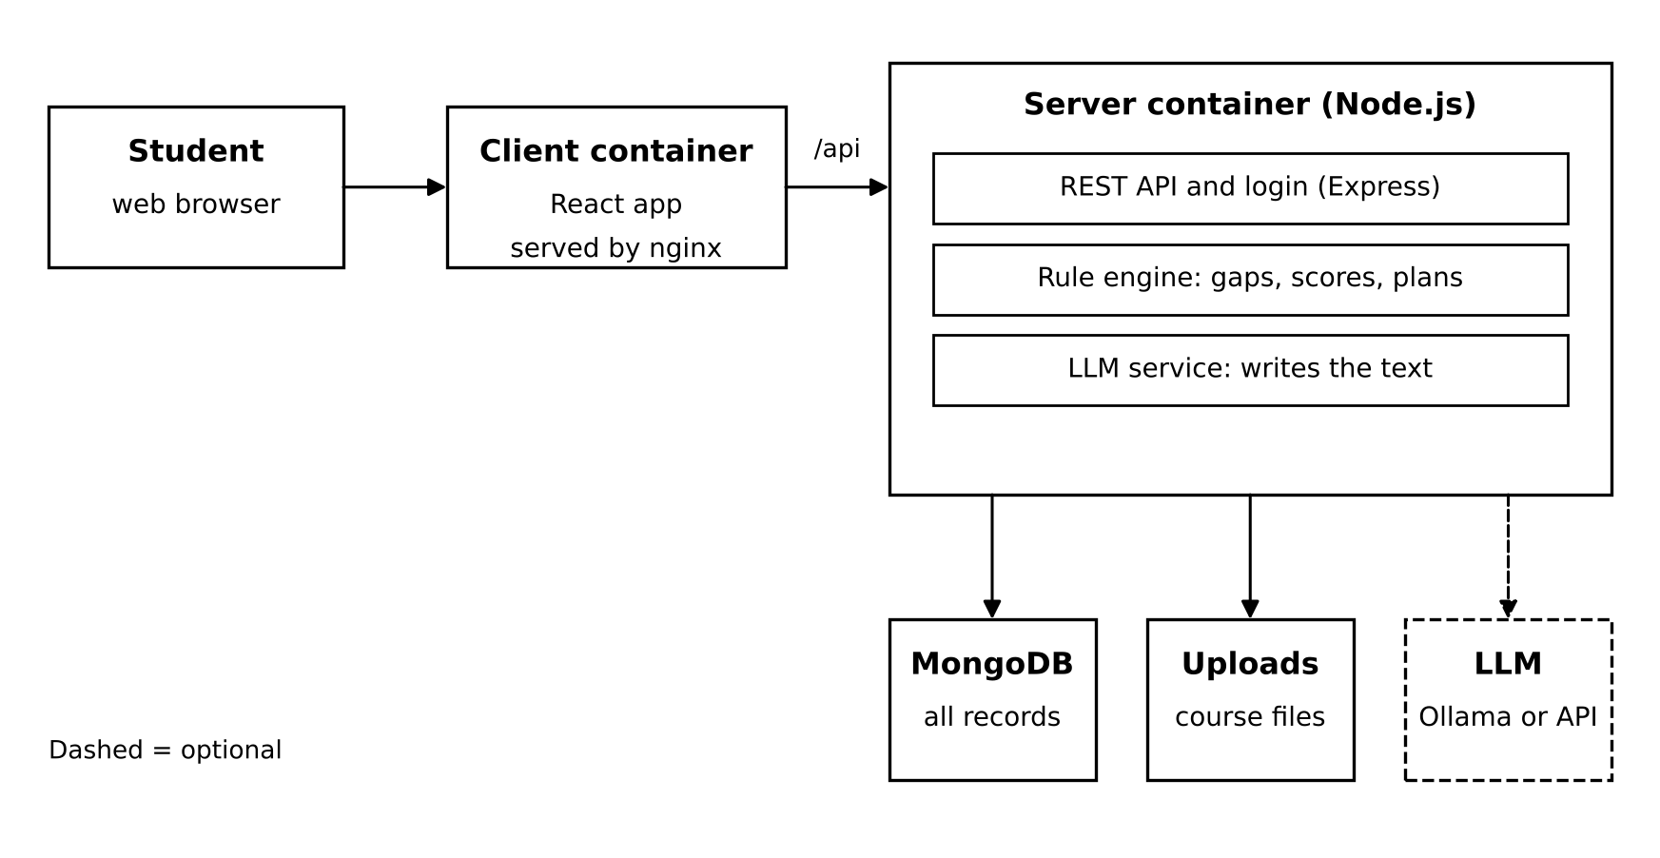
Architecture: a MERN web app in Docker
React front end
Express + Node.js API
MongoDB database
Llama 3.2 via Ollama (optional)
Docker Compose starts it all
Notes:
[About 45 seconds]
This is the architecture. It's a MERN web app. The student opens the React app in the browser. The React app talks to the Express server only through the /api route. Inside the server there are three parts: the REST API with login, the rule engine that does the calculations, and the LLM service that writes the text. The data is saved in MongoDB, and uploaded files go into an uploads folder.
The LLM is optional. I'm using Llama 3.2 running locally with Ollama, so it's free and the student data stays on the machine. And Docker Compose starts everything with one command.

Slide 7
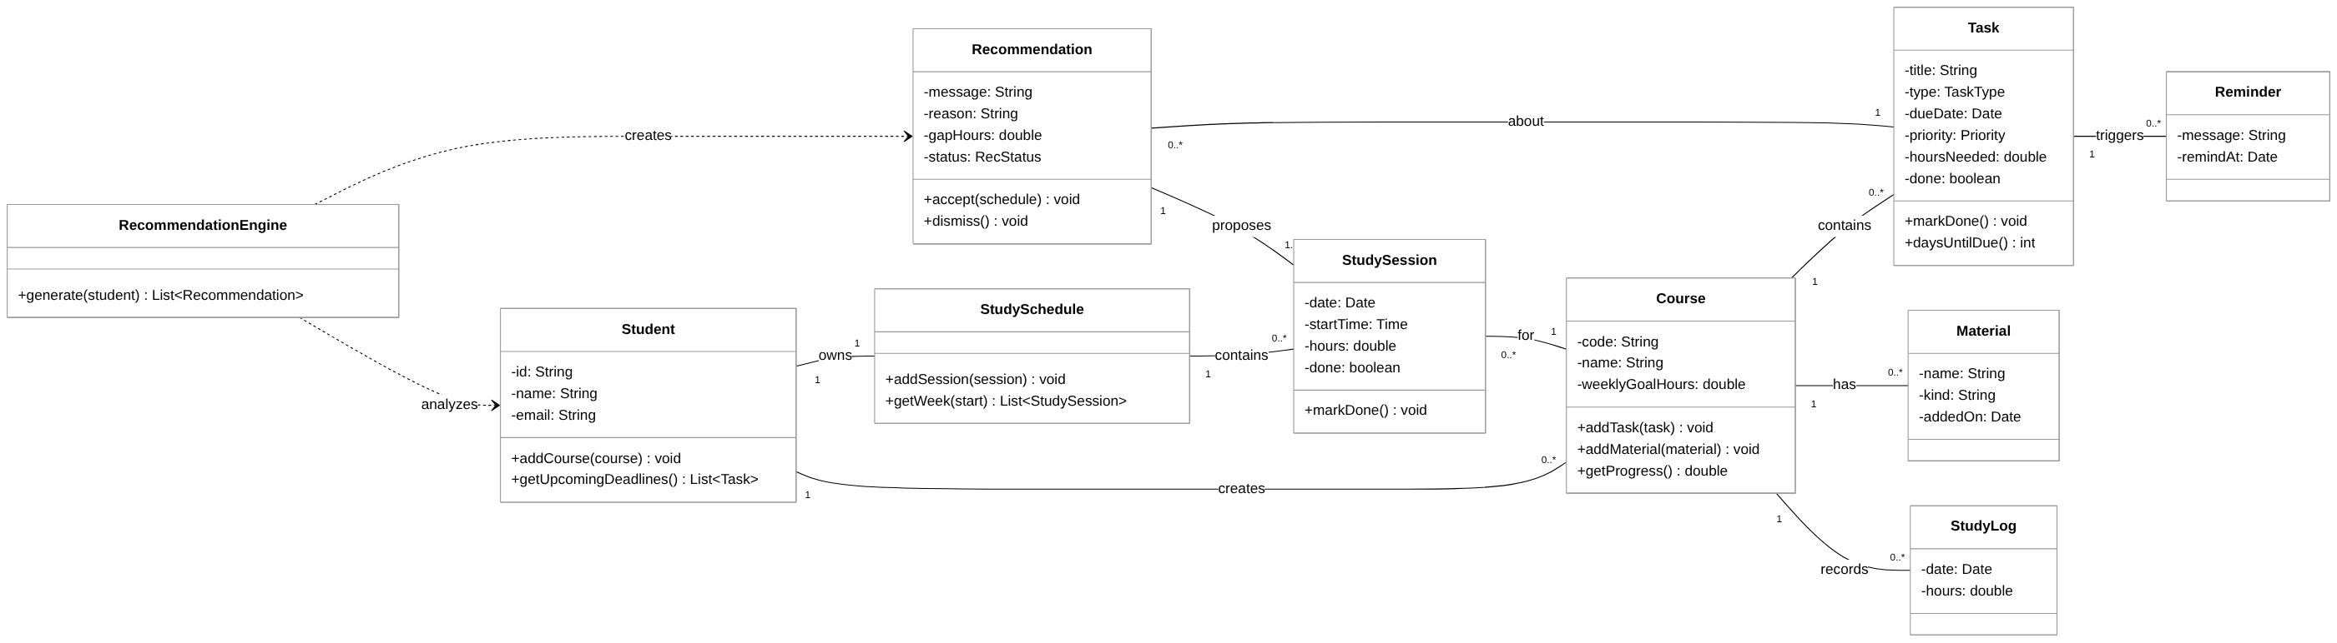
UML class diagram
A Student creates Courses, which hold Tasks, Materials and Study Logs. The RecommendationEngine reads the student’s data and creates Recommendations that propose Study Sessions.
Notes:
[About 45 seconds]
Here is my UML class diagram. The Student is the center of the system. A Student creates Courses, and each Course holds its Tasks, Materials and Study Logs. The Student also has one Study Schedule, which is made of Study Sessions. Tasks can trigger Reminders.
On the left you can see the RecommendationEngine. It reads the student's data and creates Recommendations. Each Recommendation is about one Task, and it proposes one or more Study Sessions.

Slide 8
CRC cards for the main classes
RecommendationEngine
Course
Recommendation
RESPONSIBILITIES
RESPONSIBILITIES
RESPONSIBILITIES
Find tasks due in 14 days
Calculate each study gap
Rank the gaps
Build a session plan
Create recommendations
Know its code, name and goal
Keep its tasks
Keep its files and links
Record study time
Report weekly progress
Know its message and reason
Know which task it is about
Hold the proposed sessions
Add sessions when accepted
Hide itself when dismissed
COLLABORATORS
COLLABORATORS
COLLABORATORS
Student, Task, Course, StudySchedule, StudySession, Recommendation
Task, Material, StudyLog, StudySession
Task, StudySession, StudySchedule
Notes:
[About 45 seconds]
These are CRC cards for the three most important classes.
The RecommendationEngine finds the tasks due in the next 14 days, calculates each study gap, ranks the gaps, builds the session plan and creates the recommendations. It works with almost every other class.
The Course knows its code, name and weekly goal, keeps its tasks and files, records study time and reports the weekly progress.
And the Recommendation knows its message and reason and which task it's about. It holds the proposed sessions, adds them to the schedule when the student accepts, and hides itself when the student dismisses it.

Slide 9
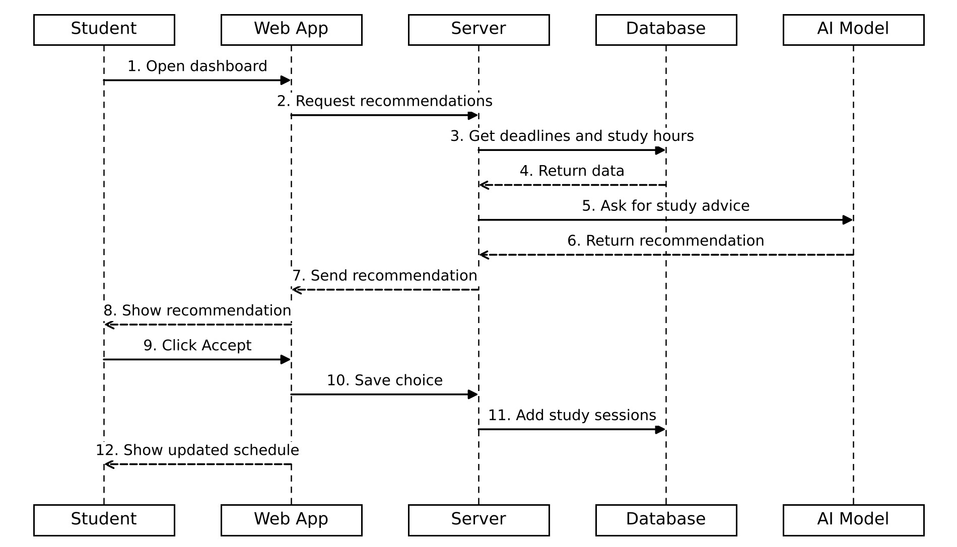
Sequence diagram: getting and accepting a recommendation
Steps 1–4: the server gets deadlines and study hours
Steps 5–8: the AI model writes the advice
Steps 9–12: the student accepts and the schedule updates
Notes:
[About 1 minute, 3 clicks]
This sequence diagram shows the main use case: getting and accepting a recommendation. Solid arrows are messages and dashed arrows are replies.
[click] In steps 1 to 4, the student opens the dashboard, the web app asks the server for recommendations, and the server gets the deadlines and study hours from the database.
[click] In steps 5 to 8, the server sends the calculated plan to the AI model, the model sends back the advice, and the recommendation is shown to the student.
[click] In steps 9 to 12, the student clicks Accept, the server saves the new study sessions in the database, and the web app shows the updated schedule.

Slide 10
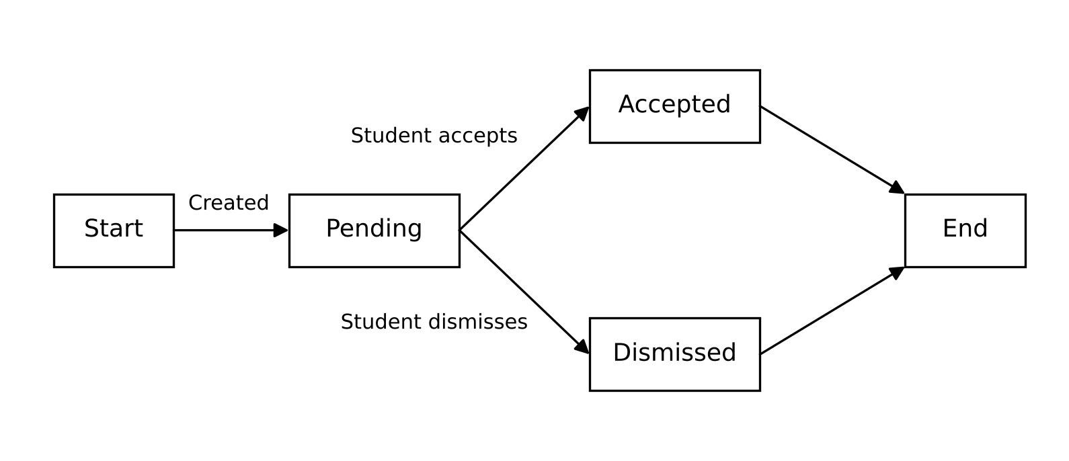
State machine diagram: a recommendation’s life
Pending: shown, waiting for the student
Accepted: sessions added to the schedule
Dismissed: hidden from the dashboard
Notes:
[About 30 seconds]
This state machine diagram shows the life of one recommendation. It is created when the student has a deadline coming and hasn't studied enough, and it starts in the Pending state, waiting for the student. If the student accepts it, it moves to Accepted and the sessions are added to the schedule. If the student dismisses it, it moves to Dismissed and is hidden from the dashboard. Either way, that's the end of its life.

Slide 11


Where the project stands
DONE
NEXT
Project proposal
Software requirements specification
Class diagram and CRC cards
Sequence and state machine diagrams
Early prototype of the main screens and the recommendation rules
Connect the screens to the Express and MongoDB back end
Add student accounts
Plug in Llama 3.2 through Ollama
Test every objective
Final report and demo
Notes:
[About 45 seconds]
So where does the project stand? So far I finished the project proposal, the software requirements specification, the class diagram and CRC cards, the sequence and state machine diagrams, and an early prototype of the main screens and the recommendation rules.
Next, I will connect the screens to the real Express and MongoDB back end, add student accounts, plug in Llama 3.2 through Ollama, and test every objective. For example, one test is that a student with an exam in three days and no study time gets that course recommended first. And then the final report and the demo.

Slide 12
Thank you. Questions?
Repository: github.com/alibelhrak/GVSU-CIS641-AIStudyAssistant
Portfolio: alibelhrak.github.io
Ali Belhrak · CIS 641 · Midterm Status Update
Notes:
[About 15 seconds]
That's my update. You can find everything in my repository, and my portfolio is at alibelhrak.github.io. Thank you for listening, and I'm happy to answer any questions.

