Slide 1
Social Isolation Inc.
Berkay UZUN - 2263812
Ali BELLİ - 2231421
Ahmet Halis SABIRLI – 2305225

Slide 2
TABLE OF CONTENTS
Topology and Controller Selection
Transformer Design
Component Selection and Simulation Results
Cost Analysis

Slide 3
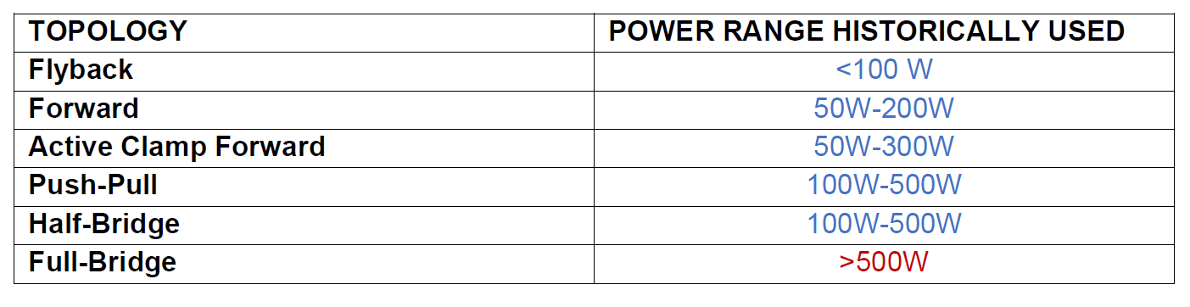
Topology Selection

Slide 4
Topology Selection

Slide 5
Controller Selection
LT3752 LT8316

Slide 6
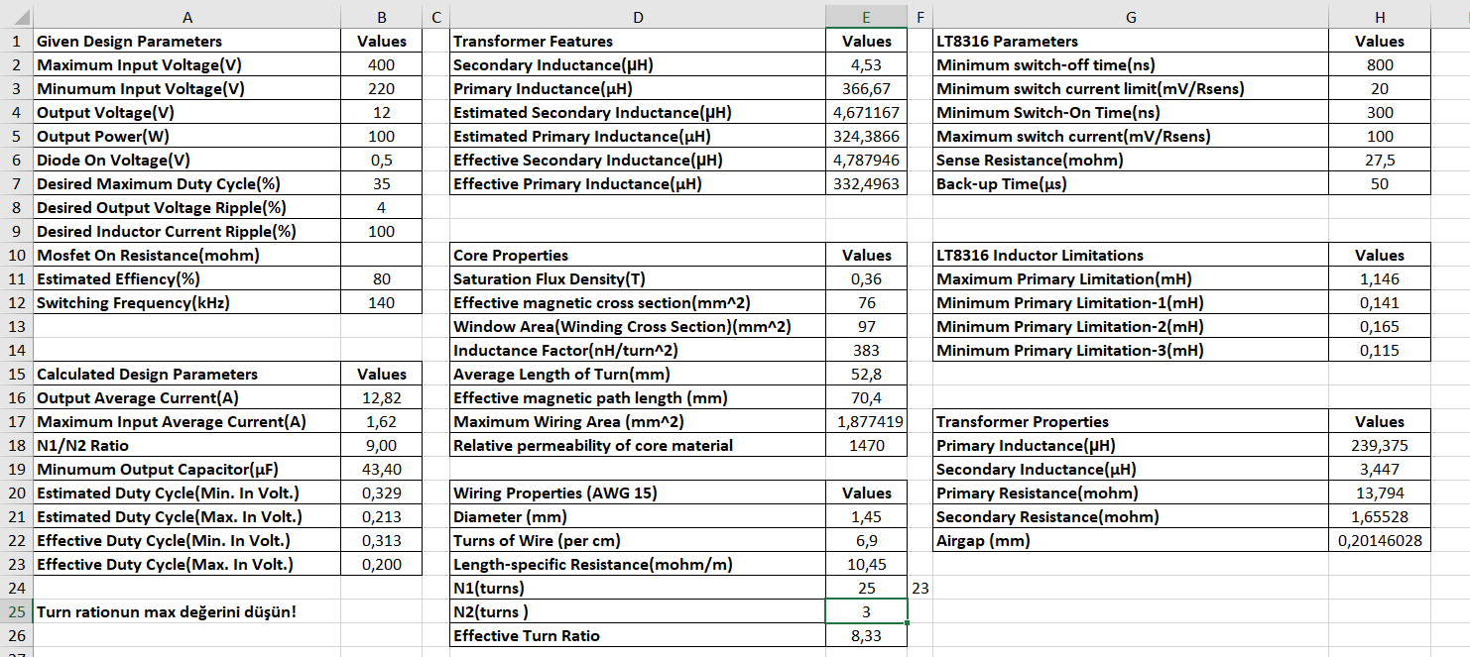
Transformer Design

Slide 7
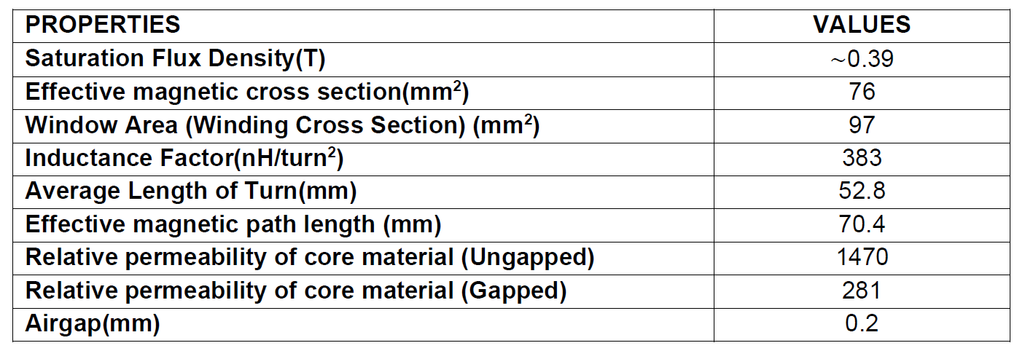
Transformer Design
Selected Core

Slide 8
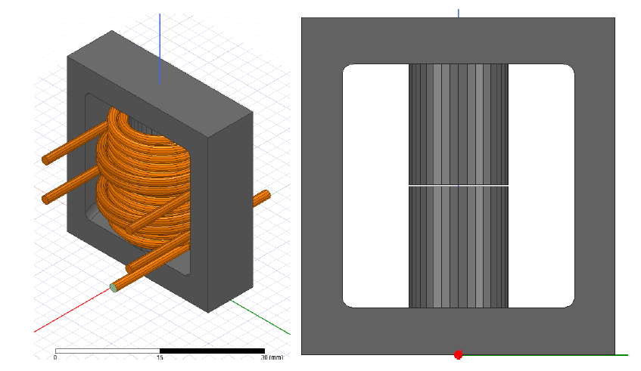
Finite Element Analysis

Slide 9
Finite Element Analysis

Slide 10
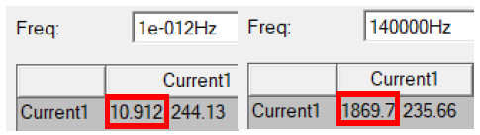
Finite Element Analysis

Slide 11
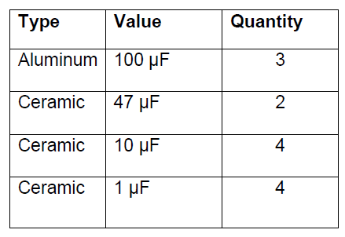
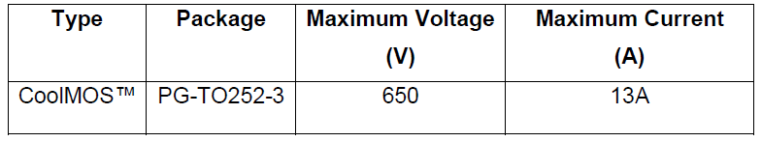
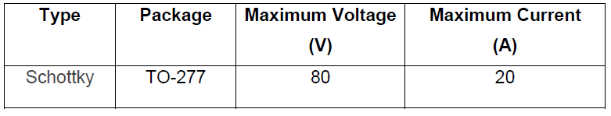
Component Selection

Slide 12
MOSFET Voltage and Current

Slide 13
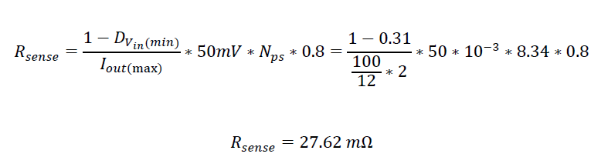
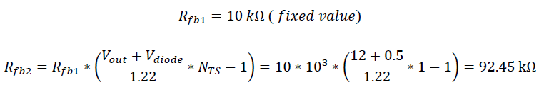
Sense and Feedback Resistor Selection

Slide 14
Project Design Schematic

Slide 15
Simulation Results
400V input

Slide 16
Simulation Results
220V input

Slide 17
Load Regulation

Slide 18
Load Regulation

Slide 19
Line Regulation

Slide 20
Line Regulation

Slide 21
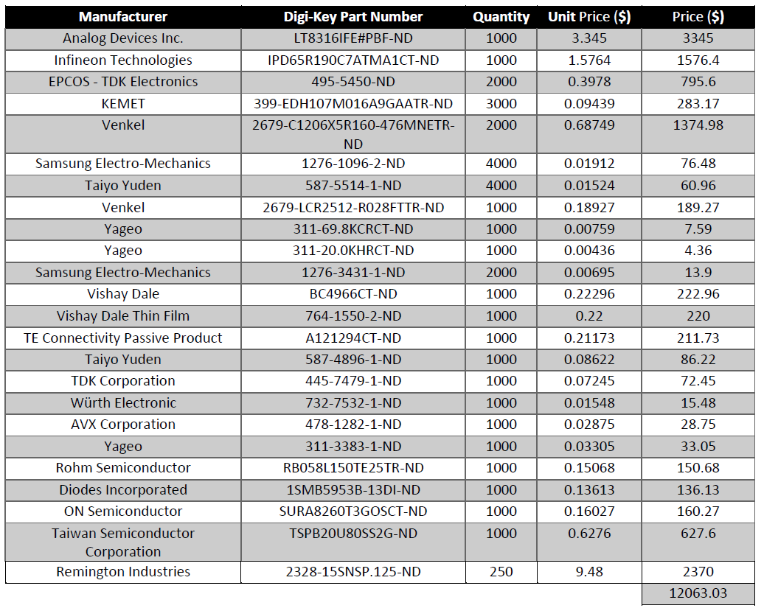
Cost Analysis

Slide 22
Thank You

