Slide 1
Pet Sign In Web App
by Ali B. Kaba

Slide 2

The old process
Pros
Pen and paper process.
Say hi to the receptionist.
Cons
Work in other side of building
Forget or don’t sign in at all
No auditing = problems = lawsuits
Pen and paper process
HR filing pet paper process
Inconsistent
Notes:
background

Slide 3

The new process
Create account.
Account approved by admin (HR).
Add pet & upload pet document.
Pet approved by admin (HR).
Sign in.
Sign in pet.
Fast and simple
More consistent

Slide 4
Context Dataflow Diagram

Slide 5
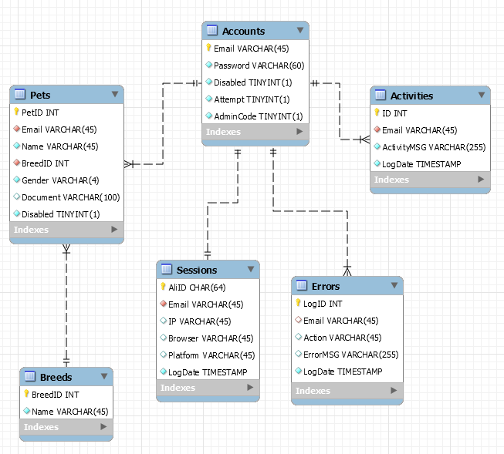
Entity Relationship Diagram
Primary Key
Not Null Foreign Key
Nullable Foreign Key
Not Null
Nullable

Slide 6
Security - OWASP
Open Web Application Security Project (OWASP)
Various attack preventions were added
Testing Checklist

Slide 7
Test Role Definitions (OTG-IDENT-001)

Slide 8
Testing for Bypassing Authentication Schema (OTG-AUTHN-004)
Session Management
Stored procedures with parameterized queries

Slide 12
function AddSession($Action,$Email){ StartSession(); $BrowserData = GetBrowserData(); $AliID = hash('sha256', uniqid(rand(), true)); $_SESSION["AliID"] = $AliID; $SessionIP = $BrowserData['IP']; $SessionBrowser = $BrowserData['Browser']; $SessionPlatform = $BrowserData['Platform']; global $PDOconn; $Query = 'CALL AddSession (?, ?, ?, ?, ?)'; $Statement = $PDOconn->prepare($Query); $Statement->bindParam(1, $AliID, PDO::PARAM_STR, 64); $Statement->bindParam(2, $Email, PDO::PARAM_STR, 45); $Statement->bindParam(3, $SessionIP, PDO::PARAM_STR, 45); $Statement->bindParam(4, $SessionBrowser, PDO::PARAM_STR, 45); $Statement->bindParam(5, $SessionPlatform, PDO::PARAM_STR, 45); Execute($Action,$Statement); }
INSERT INTO djkabau1_petsignin.Sessions (AliID, Email, IP, Browser, Platform) VALUES (xAliID, xEmail, xSessionIP, xSessionBrowser, xSessionPlatform);

Slide 13
Testing for Error Code (OTG-ERR-001)
function AddActivity($Action,$Email,$ActivityMSG){ global $PDOconn; $Query = 'CALL AddActivity (?, ?)'; $Statement = $PDOconn->prepare($Query); $Statement->bindParam(1, $Email, PDO::PARAM_STR, 45); $Statement->bindParam(2, $ActivityMSG, PDO::PARAM_STR, 255); Execute($Action,$Statement); }
function AddError($Action,$ErrorMSG,$PHP){ $Email = ValidateSession($Action); if (!isset($Email)) { $Email = NULL; } if (!isset($PHP)) { $FailedAction = stripslashes($_POST["FailedAction"]); $ErrorMSG = stripslashes($_POST["ErrorMSG"]); }else{ $FailedAction = $Action; } global $PDOconn; $Query = 'CALL AddError (?, ?, ?)'; $Statement = $PDOconn->prepare($Query); $Statement->bindParam(1, $Email, PDO::PARAM_STR, 45); $Statement->bindParam(2, $FailedAction, PDO::PARAM_STR, 45); $Statement->bindParam(3, $ErrorMSG, PDO::PARAM_STR, 255); $Statement->execute(); $PDOconn = null; }
function Execute($Action,$Statement){ try { $Statement->execute(); } catch (PDOException $e) { $ErrorMSG = 'Error 0: ' . $e->getMessage() . "\n"; $PHP = 1; AddError($Action,$ErrorMSG,$PHP); } }

Slide 14
function AddActivity($Action,$Email,$ActivityMSG){ global $PDOconn; $Query = 'CALL AddActivity (?, ?)'; $Statement = $PDOconn->prepare($Query); $Statement->bindParam(1, $Email, PDO::PARAM_STR, 45); $Statement->bindParam(2, $ActivityMSG, PDO::PARAM_STR, 255); Execute($Action,$Statement); }
function Execute($Action,$Statement){ try { $Statement->execute(); } catch (PDOException $e) { $ErrorMSG = 'Error 0: ' . $e->getMessage() . "\n"; $PHP = 1; AddError($Action,$ErrorMSG,$PHP); } }
function AddError($Action,$ErrorMSG,$PHP){ $Email = ValidateSession($Action); if (!isset($Email)) { $Email = NULL; } if (!isset($PHP)) { $FailedAction = stripslashes($_POST["FailedAction"]); $ErrorMSG = stripslashes($_POST["ErrorMSG"]); }else{ $FailedAction = $Action; } global $PDOconn; $Query = 'CALL AddError (?, ?, ?)'; $Statement = $PDOconn->prepare($Query); $Statement->bindParam(1, $Email, PDO::PARAM_STR, 45); $Statement->bindParam(2, $FailedAction, PDO::PARAM_STR, 45); $Statement->bindParam(3, $ErrorMSG, PDO::PARAM_STR, 255); $Statement->execute(); $PDOconn = null; }

Slide 16
Demonstration
http://petsignin.alibkaba.com/petsignin/

Slide 17
Q/A

