Slide 1
Pet Sign In Web App
by Ali B. Kaba

Slide 2
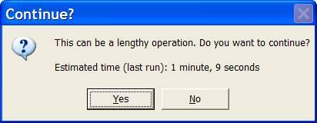
The old process
Pros
Pen and paper process.
Say hi to the receptionist.
Cons
Work in other side of building.
Long walking distance to
Forget or don’t sign in at all.
No auditing = problems = lawsuits.
Pen and paper process.
HR filing pet paper process.

Slide 3
The new process
Create account.
Account approved by admin (HR).
Add pet & upload pet document.
Pet approved by admin (HR).
Sign in.
Sign in pet.

Slide 4
Integrity – Session management
Integrity – Error Handling
Notes:
Security Foundation Concepts. CIA triad AIC triad
Session How to Create Bulletproof Sessions
http://blog.teamtreehouse.com/how-to-create-bulletproof-sessions
http://hueniverse.com/2015/07/08/on-securing-web-session-ids/
https://solutionfactor.net/blog/2014/02/08/implementing-session-timeout-with-php/

