Slide 1
School Information Dashboard RAP Project
Laura Stott (Education Analytical Services)
Alice Byers (RAP Support)
Notes:
Alice
Laura Stott – Assistant Statistician in Education Analytical Services and Co-chair of Disabled Staff Network
Alice Byers – Software Developer providing RAP support and expertise

Slide 2
Outline
What is and isn’t RAP
Why we conducted a Reproducible Analytical Pipeline (RAP) project
Aims of the School Information Dashboard (SID) project
Outline what we did and key principles
New dashboard
Feedback and Questions
Notes:
Alice
RAP = Reproducible Analytical Pipelines
SID = School Information Dashboard

Slide 3
What RAP isn't
R code
A dashboard
Automated SAS / SPSS code
Notes:
Alice
Not just personal opinion – RAP is defined by UK Civil Service Analytical Function
R code on its own isn’t RAP
A dashboard on its own isn’t RAP
Automated code written in proprietary software isn’t RAP

Slide 4
What is RAP? Reproducible Analytical Pipelines (RAP)
End to end process
Reproducible
Transparent
Automated
Notes:
Alice
End to end process inclusive of data extraction (if relevant), data cleaning, analysis, reporting and presentation of results

Slide 5
Features of RAP Levels of RAP
At minimum, a RAP must:
Minimise manual steps
Be built using open-source software; e.g. R, python
Be peer reviewed
Be version controlled; e.g. git
Be open to anyone; e.g. code published on GitHub
Follow good practice for quality assurance
Contain well-commented code and have documentation embedded
Notes:
Alice

Slide 6
RAP Strategy Government Analysis Function RAP Strategy
Tools - ensure that analysts have the tools they need to implement RAP principles.
Capability - give analysts the guidance, support and learning to be confident implementing the Reproducible Analytical Pipelines (RAP).
Culture - create a culture of robust analysis where the RAP principles are the default for analysis, leaders engage with managing analysis as software, and users of analysis understand why this is important.
Data Innovation team provide RAP support in Scottish Government. If interested, contact Gerry Scullion or Tom Wilson.
Notes:
Alice
Published by UK wide civil service Government Analysis Function
Three goals
Commitments for staff at three levels; Analysis Function, Analyst Leaders, Analysts
Highly recommend reading – easy to read, clear calls to action, engaging and empowering!

Slide 7


School Information Dashboard
The School Information Dashboards (SIDs) take roughly 3 weeks with a team of 3 people to create and QA. However, this could take longer if errors are found.
Involves a lot of manual data moving in excel with a lot of data. Open to error.
Updated twice a year with diverse data formats
Current platform used: Tableau
Notes:
Laura

Slide 8
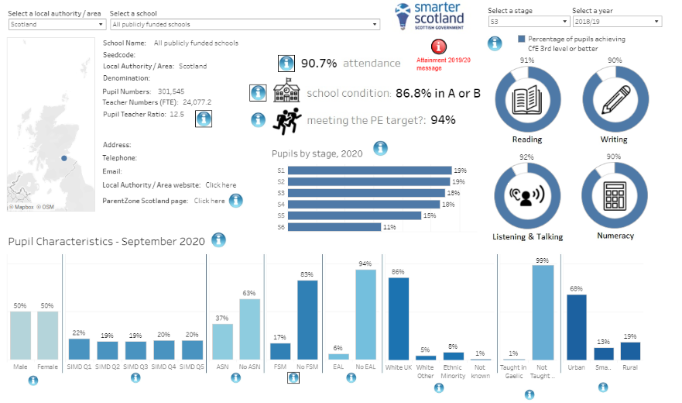
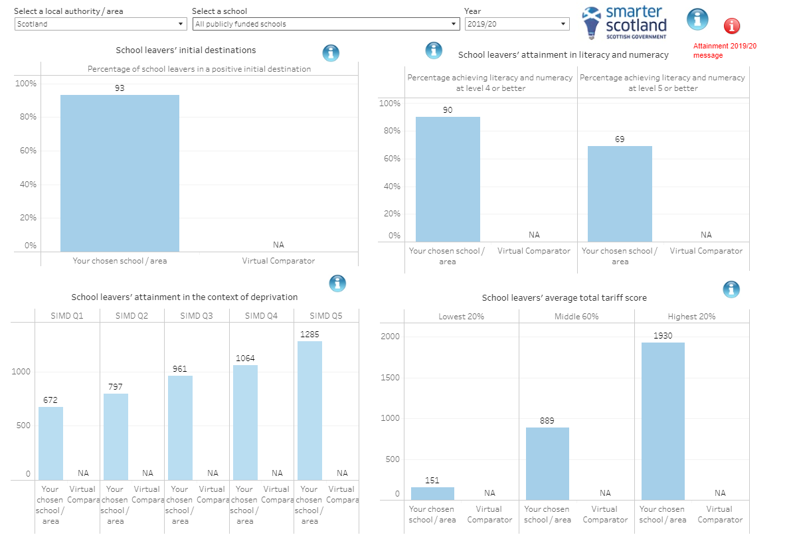
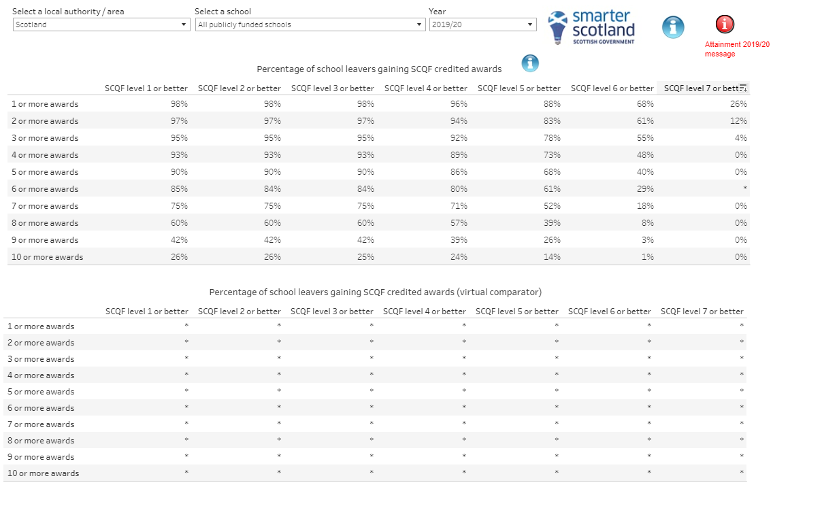
Existing dashboards
Secondary School Information Dashboard - Tableau Public
Tabs – not considered accessible, unable to read titles of tabs
Hover over – not accessible for screen readers, overload of information on the page
Interactive graphs – not accessible for screen readers
Headings – not in correct order for screen readers
Information overload – not accessible for usable for those with disabilities and other users
Language level - not usable, needs to be at a level at which the target audience can understand it
Notes:
Laura
Three dashboards; primary, secondary and special
Tableau – difficult to use, automate, and make accessible – poor user experience
Difficult to keep common elements the same across all three dashboards as production process so manual

Slide 9
Why RAP for School Information Dashboard?
This project aimed to:
Speed up the production of the dashboards
Reduce risk (time & error)
Increase replicability
Examine existing processes
Meet accessibility standards ensuring we meet our legal requirements as a minimum
Develop skills and share knowledge
Notes:
Laura
RAP projects mean that the same thing is done every time so makes you look at processes and solidify the plans.

Slide 10
Planning Process
Recognise accessibility and usability requirements and consider throughout – legal obligations (WCAG 2.1)
Identify risk and improvements
RAP team
Identify platform and process
Project plan/outline (time organisation)
Review data and processes
Discuss with data providers
Clean data and organise
Data protection – storage of data and code
Notes:
Laura
Using disability frameworks to look at the dashboard and how it can be improved - Understanding WCAG 2.1 - Service Manual - GOV.UK (www.gov.uk)
Meet with the RAP team and discus the aims and process to see if our project was applicable
Using the disability guidelines and tools to determine which platform would work best for replicability and accessibility. Open source is considered best practice and R shiny has accessibility packages.
Time constrains/team members being moved to other projects e.g. Emma going to work on the Ukraine data
Organise the data and discussed with providers a way in which the data can be provided the say way year on year. This helped strengthen communication and relationships between teams.
Ensure that data is held safely.
Use git hub to store code and track versions.

Slide 11



Accessibility Key Resources
Standards and Best Practice for Statistical Products
GitHub - Front-End-Checklist
Hemingway Editor (hemingwayapp.com)
Colour Brewer: Colour Advice for Maps
Tota11y – an accessibility visualization toolkit
Estimate how many people using your website might be disabled (how-many.herokuapp.com)
Colleagues
Pathways
Notes:
Laura

Slide 12
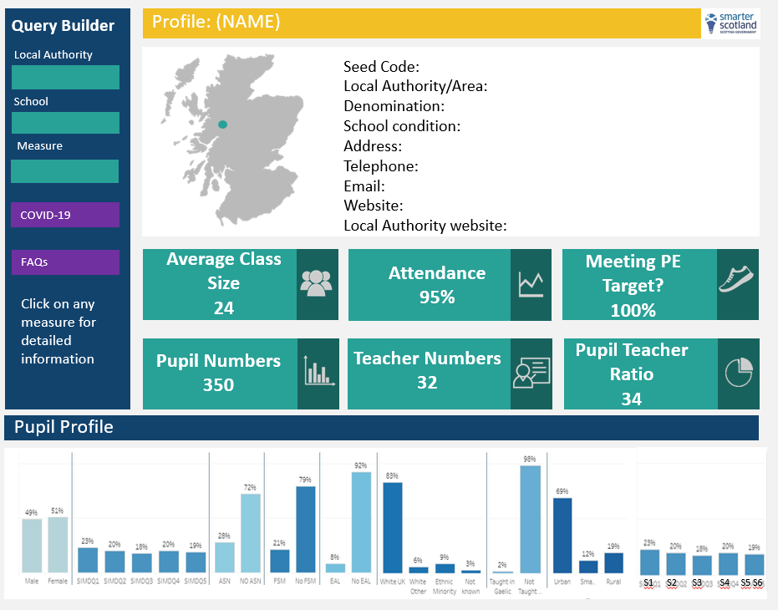
New dashboards - planning
Clickable for more information
Select the LA/school you want to see
Downloadable
Notes:
Alice
Laura also planned what new dashboard would look like – final product of RAP won’t always look different but in this case we used different software to present the dashboards
Excel spreadsheets of what data was required for each dashboard and which source data this came from
Ensured that we weren’t just trying to replicate existing processes in new software
Step back and come up with most sensible and logical process to achieve output required

Slide 13

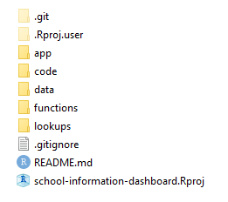
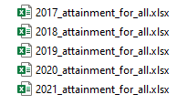
RAP Principles
Organised folder structure
Standardised naming conventions
Relative file paths
Writing manual processes as code
Functions
Version control
Open code DataScienceScotland/school-information-dashboard
Notes:
Alice
There are many more RAP principles we would have liked to have applied, such as:
R package
Unit tests
Data quality assurance
But we had a tight deadline and so decided to focus on the principles that would add the most value.

Slide 14
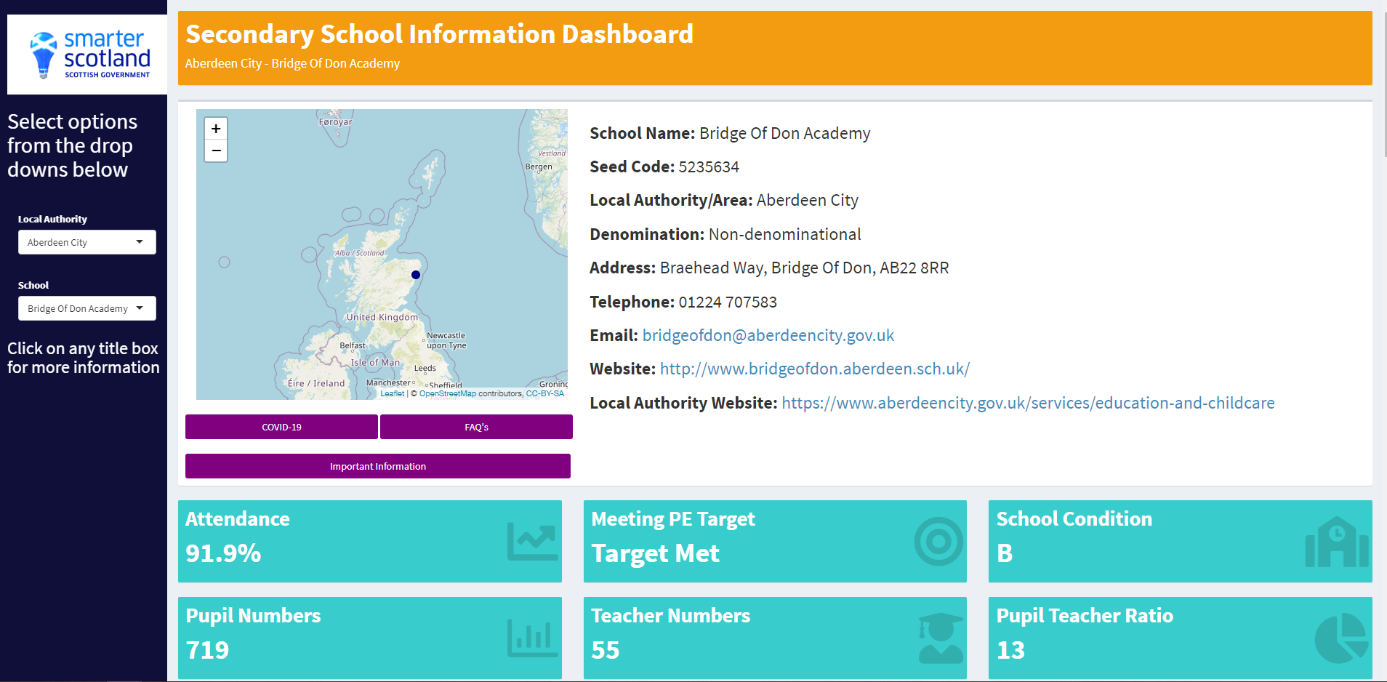
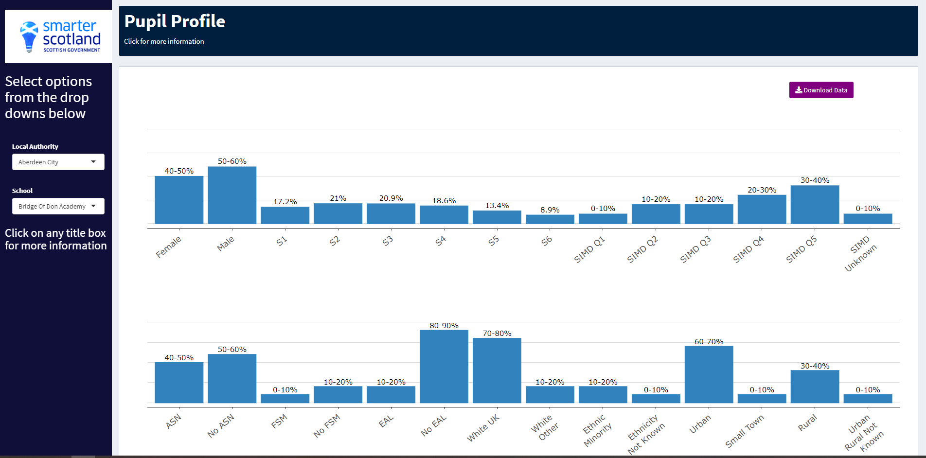
New dashboard
Clickable for more information
Fixed scrolling panel
Downloadable
Notes:
Laura

Slide 15
Contact Us
Laura Stott – Education Analytical Services
Email: laura.stott@gov.scot
Alice Byers – RAP Developer
Email: alice.byers@gov.scot
GitHub: alicebyers5
Notes:
Laura

Slide 16
Resources
RAP
RAP Strategy
Gov Analysis Function RAP Resources
OSR Paper – RAP: Overcoming Barriers to Adoption
RAP Blog
Levels of RAP
SG RAP Yammer Group
SG RAP Support Offer
SID
SID GitHub Repository
Existing Tableau dashboard
New R Shiny apps not yet published – links will be shared on RAP Yammer when available

Slide 17
Accessibility Resources
Checklists:
GitHub - Front-End-Checklist
The Front-End Checklist
Government guidance:
Standards and Best Practice for Statistical Products
Accessibility - an introduction
GSS training: Introduction to data visualisation
Testing for accessibility - Service Manual - GOV.UK
Wording:
Plain English... Write less, say more
Writing content for everyone - Government Digital Service
How Users Read on the Web
Wording:
Writing for GOV.UK - Content design: planning, writing and managing content
Hemingway Editor (hemingwayapp.com)
Creating accessible communications
Microsoft Word - how to write in plain English.doc
Government Design Principles - GOV.UK (www.gov.uk)
Vision:
Colour Brewer: Colour Advice for Maps
R Colour Brewer pdf document
Sa11y - accessibility quality assurance bookmark app-
Use of colour and Colour Contrast Analyser
The WCAG accessibility requirements
The gov.uk design system for gov style & components

