Slide 1
DDD, BDD & TDD
Santosh KC

Slide 2
DDD (Domain Driven Design)
The term was invented by Eric Evans, the author of book Domain-Driven design, published this famous book in 2004.
Approach to software development that primarily focuses on:
Core domain and its logic,
Establishing the model
Forces a collaboration between technical developers and domain experts

Slide 3
Concepts
Ubiquitous Language
Layered Architecture
Domain Elements (Building blocks)
Entities, Value, Services, Modules
Solution to maintain domain objects
Aggregates, Factories, Repositories

Slide 4
Ubiquitous Language
Common language structured around the domain model and shared by both domain experts and technical developers.
The domain model is used as the core of ubiquitous language.
No translation between developers and domain experts is usually needed.
Code is the durable expression of UL, try to abandon drawings, glossaries, and other documentations that are hard to make upto date.
Defined within bounded context.

Slide 5
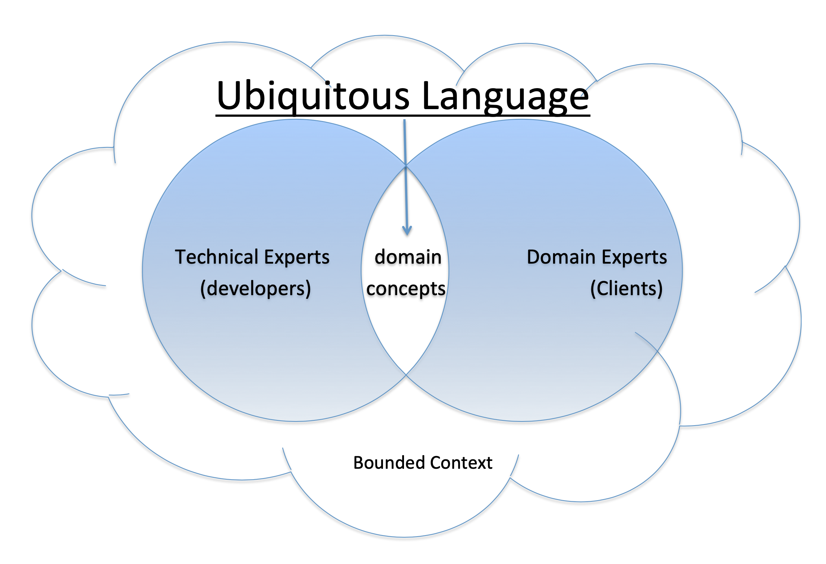

Slide 6
How to develop Ubiquitous Language?
Draw your domain in expressive way to whiteboard.
Create glossary. Example:
Event storming
Glossary
Tenant admin | A person who rented space in the building.
Rentspace | A meeting room that can be booked by tenant admin.

Slide 7
Event Storming
Lightweight method to model a domain.
Within workshop we work in iterations to add layer by layer to sharpen the picture of domain
Typical elements:
domain events, commands, aggregations, external systems, policies, timers, loops

Slide 8
Domain Events
Domain events (normally in past tense)
Product added to cart

Slide 9
Command-Event Pairs
Commands are added with events. (present tense)
Product add to cart

Slide 10
Aggregates / Entities
Data that is interacted with.
Product

Slide 11
Borders and Flow
Find border that defines bounded context.
Domain events flow between models.
Sales
Billing
Shipping

Slide 12
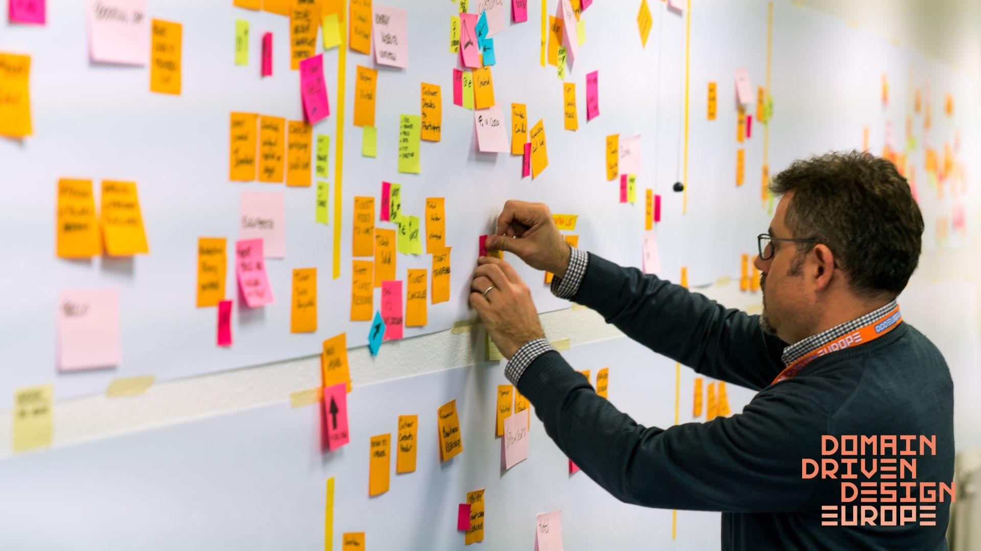
Image source: https://training.dddeurope.com/event-storming-master-class/

Slide 13
Clean Architecture
Software build with DDD takes advantages of layered architecture.
Infrastructure
Infrastructure Layer | Database, Network, Eventstore
Application Layer | Translates commands that comes from UI layer to use case invocation in domain layer.
Domain Layer | Contains real business logic. Should be designed as CQS principle. Platform independent.
Application
Domain

Slide 14
Domain Elements
Entities: Business objects that are defined by its identity, rather than its attributes.
Example to establish entities:
- customerId
- name
- averageSales
- productCategory
Customer
Customer
-customerId
-Name
-contactPhone
Business Line
-productCategory
-averageSales
- averageSales and product category are not used to identify customer.
-phoneNumber can be used to find customer.
-salesRepresentativ
-contactPhone
Contact
Contact
-salesRepresentative

Slide 15
Value object:
Object that contains descriptive attributes but has no conceptual identity.
Should be immutable. Must be created with constructor.
Example: In airlines system, if airlines distinguish each seat uniquely on every flight. Each seat is an entity in this context. However if they do not distinguish between every seats, in this context every seat is value object.

Slide 16
Aggregates:
Group of individual but related objects that work or can be treated as a unit.
Root aggregate is the only accessible entity.
Steering
Hight
setHeight()
Bicycle
Id
ride();
Aggregate
Root
Seating
setPostion()
Position
Tire

Slide 17
TDD (Test Driven Development)
Repetition of a very short development cycle.
TDD Cycle:
Add test
Run all tests and see if the new test fails.
Write the code
Run tests
Refactor the code
Repeat
Developer’s tool that help to write unit of code that works correctly

Slide 18
BDD (Behaviour Driven Development)
Encourages collaboration between developers, QA and business persons.
Combines principles of TDD with ideas of DDD and OOAD.
Rethinking the approach to unit testing and acceptance testing.
Suggests unit test name be whole sentence starting with “should” word.
Acceptance test should be written using standard agile framework of user story.
Acceptance criteria should be written in terms of scenario: Given ,When, Then

Slide 19
Example
Title: Explicit title
As a person or role who will benefit from the feature,
I want feature
so that I benefit or value from the feature.
Scenario 1: Items returned for refund should be added to inventory.
Given Initial context
When event that triggers the scenario
then expected outcome

Slide 20
Sample project
IT Body leasing company
Whenever timesheet has been added client need to be billed.
Client can not be deleted if they have currently some projects.

Slide 21
AUTH SERVER
Client
management
Client
Common
id
id
UserId Id
ProjectId
Freelancer
management
Project management
Project
Freelancer
Year
Month
hoursWorked
name
FrelancerId
Timesheet
Timesheet Id
id

Slide 22
INFRA LAYER
HTTP
Message Broker
Database
APPLICATION LAYER
DOMAIN LAYER
Domain Service
Rest Adapter
Domain Events Resolver
Aggregates
Repository

Slide 23
Communications
No reference between bounded context.
Communication types:
Synchronous( example: HTTP): Waits for response.
Asynchronous (example: AMPQ): Does not wait for response.

Slide 24
Why Event Bus?
Service 1
Service 3
Service 2
HBase
Redis
MySQL

Slide 25
Why Event Bus?
Service 1
Service 3
Service 2
HBase
Redis
MySQL

Slide 26
Why Event Bus?
Service 1
Service 3
Service 2
HBase
Redis
MySQL

Slide 27
Why Event Bus?
Source
Source
Source
EVENT BUS
Destination
Destination
Destination

Slide 28
RabbitMQ
Consumer
Queue
Source
Exchange
Queue
Consumer
Consumer
Queue

Slide 29
Demo

Slide 30
Thank You

