Slide 1




Trash Classification Model
A neural network for classifying images of trash
The Minh Nguyen, Jessika Noenchen, Jacob Trombley, Alice Zhang
MIE 1517F, Group 1
December 2025
Notes:
We are group 1 and our project is a trash classification model used to classify images of trash into 6 different classes.
time : 7 seconds

Slide 2
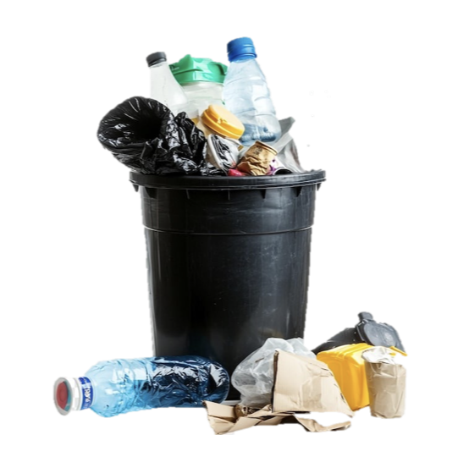
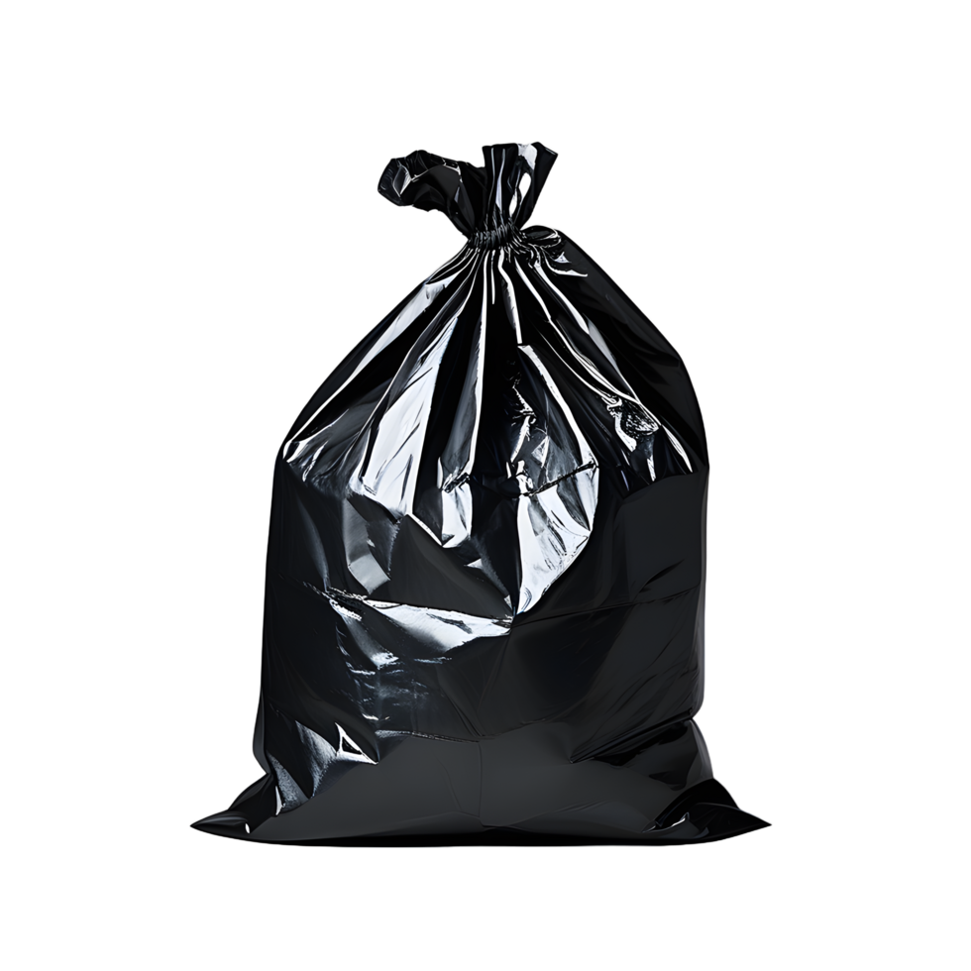
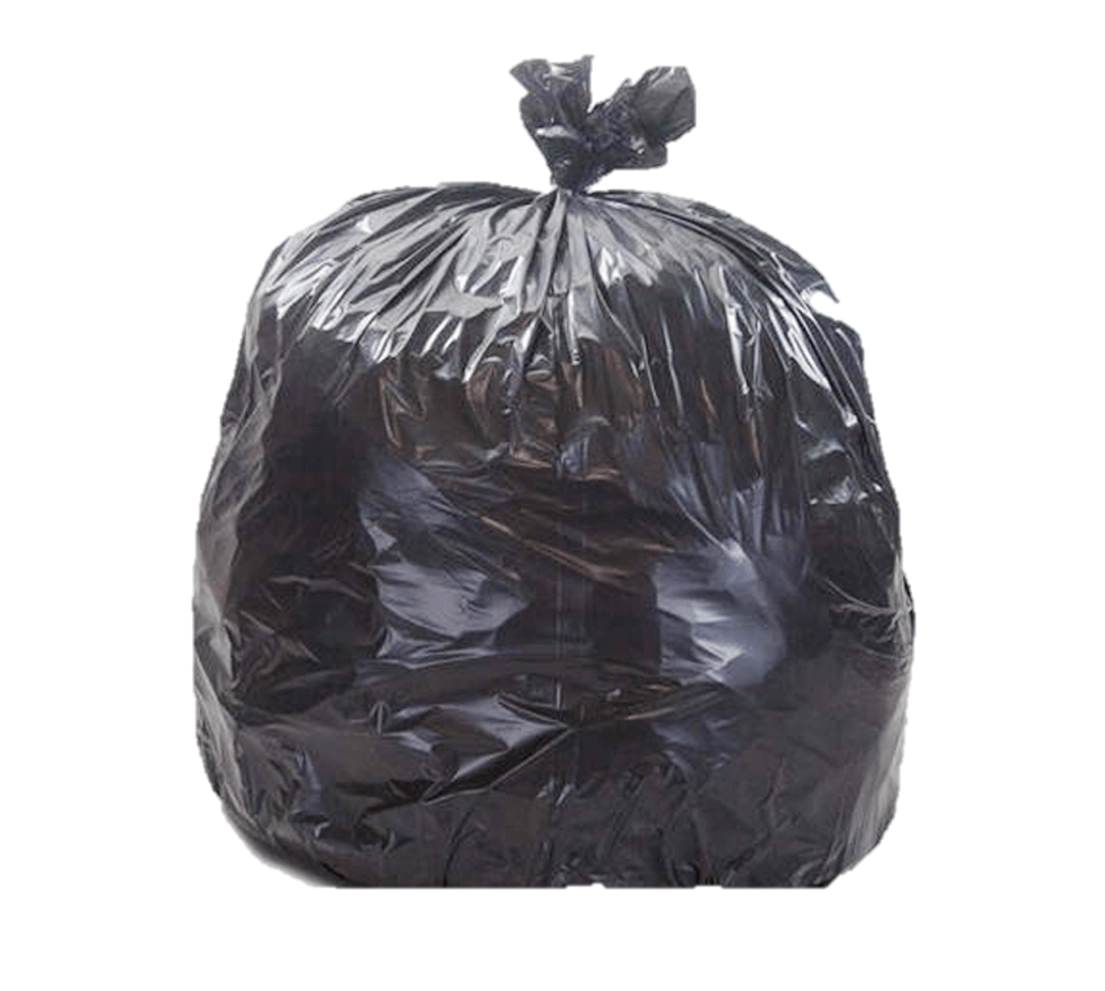
Problem
2
BILLION
TONNES
Notes:
The problem that we are trying to solve is that over 2 billion tonnes of municipal solid waste is produced globally each year.
Time: 5 seconds

Slide 3




Problem
ISSUE 4
Water, soil, and air pollution.
ISSUE 3
Waste that could have been recycled ends up in landfills.
ISSUE 2
Too much waste to sort.
ISSUE 1
Waste generation is increasing each year.
Notes:
With this number continuously increasing each year, we end up with too much waste to sort, meaning waste which could have been recycled ends up in landfills causing water, soil and, air pollution.
time : 9 seconds

Slide 4
Solution
Build a Trash Classification Model
Rapid Automated Sorting
Efficient and Proper Trash Sorting
Less Waste Pollution
Properly classify trash into recycling categories
Automate the sorting model to integrate with machinery
Trash sorting is more efficient and done accurately
Accurate sorting reduces contamination, improves recycling rates, and cuts environmental impact.
Notes:
Our proposed solution is to build a trash classification model that can properly sort trash into recycling categories. This could then be integrated with live video feed and machinery to efficiently sort trash, ultimately improving recycling rates and reducing environmental impact. This is an interesting problem to solve as it is at the intersection of deep learning and real-world sustainability.
*can remove last line if too long
time : 16 seconds

Slide 5



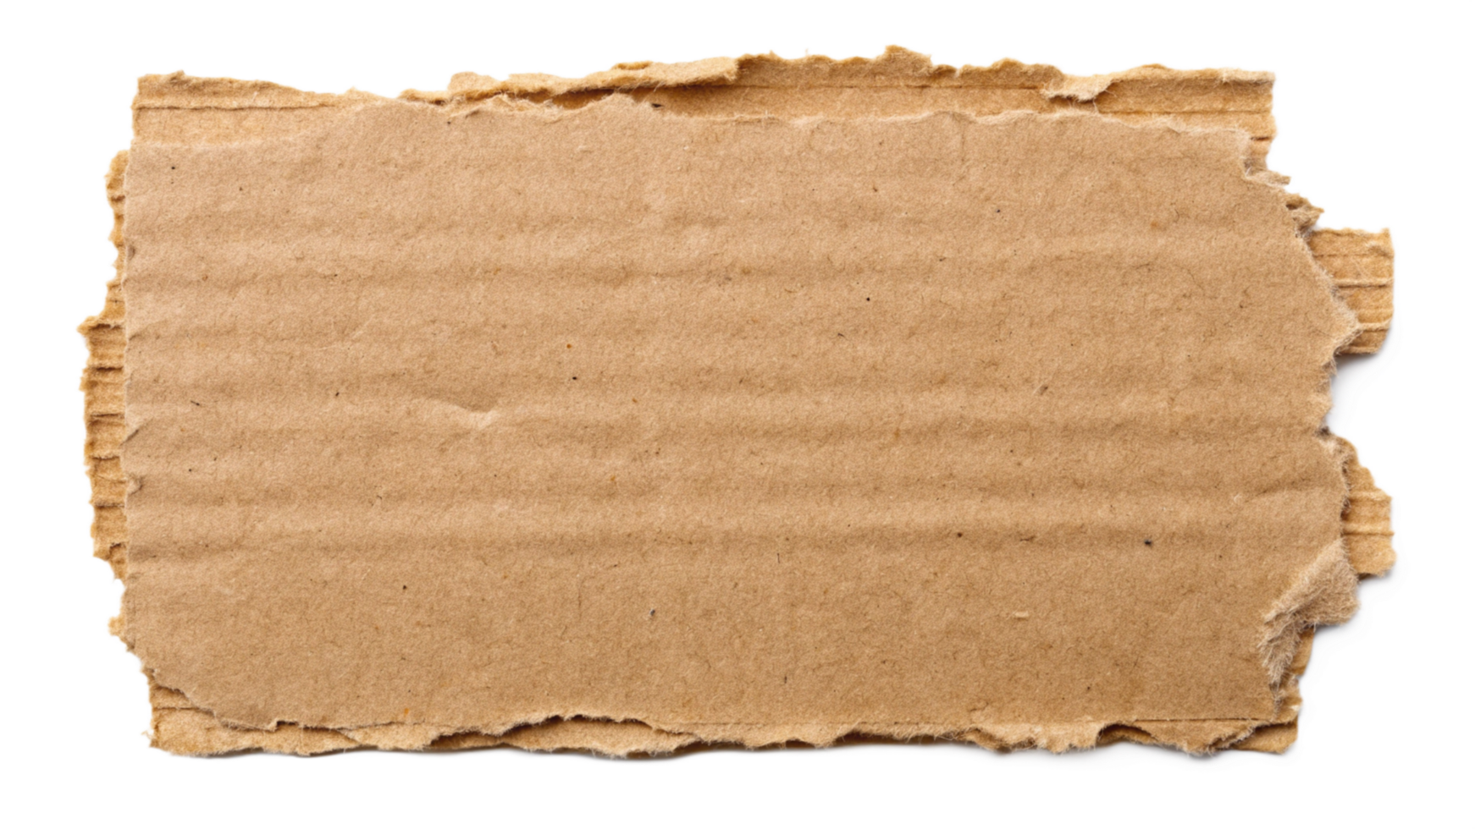
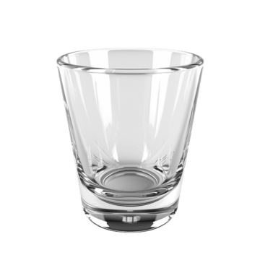
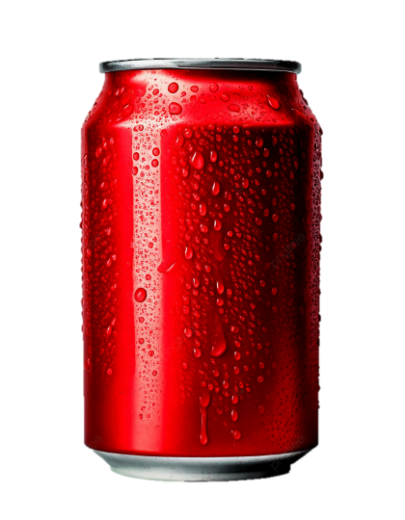
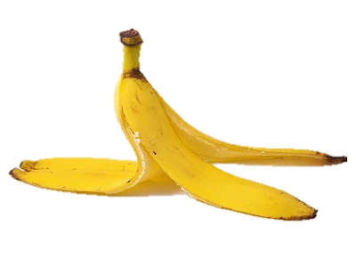

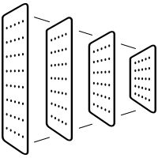

End-to-End Pipeline
1
6
TrashNet & TrashBox
Plastic
Paper
YOLO Object Detection/Crop
4
Preprocessing
Glass
Metal
2
Split Train/Val/Test
Cardboard
Other
5
Tuned CNN model
3
Initial CNN model
7
Live Video Feed
Notes:
Our modelling process began by combining the TrashNet and TrashBox datasets into a unified set of labeled trash images consolidated into 6 classes. We applied a 70/15/15 train–validation–test split, and augmented the training data to better capture real-world variation.
We first trained MobileNetV3-Large a CNN classifier using transfer learning. Next, we used a YOLO object detector to crop all images, and retrained the CNN on these cropped regions while tuning key hyperparameters such as learning rate, weight decay, and dropout. The resulting model predicts six classes of waste and was integrated with a live video stream to demonstrate its ability to perform real-time classification.
Time: 34 seconds
**put train images and cropped images
flips, color jitter, rotations, scaling, translations, and shearing

Slide 6
Demonstration
Demonstration (at least 1.0 min): You will need to show a demonstration of
your project evaluated on new, never before seen data. Try to be creative and
engaging with the demonstration. For example, if you are doing an image
classification task, you could record a video (or find one on YouTube) and feed
the frames of the video to your model to make predictions. Process the result and
play the video back as your demonstration.
Notes:
~60 seconds

Slide 7
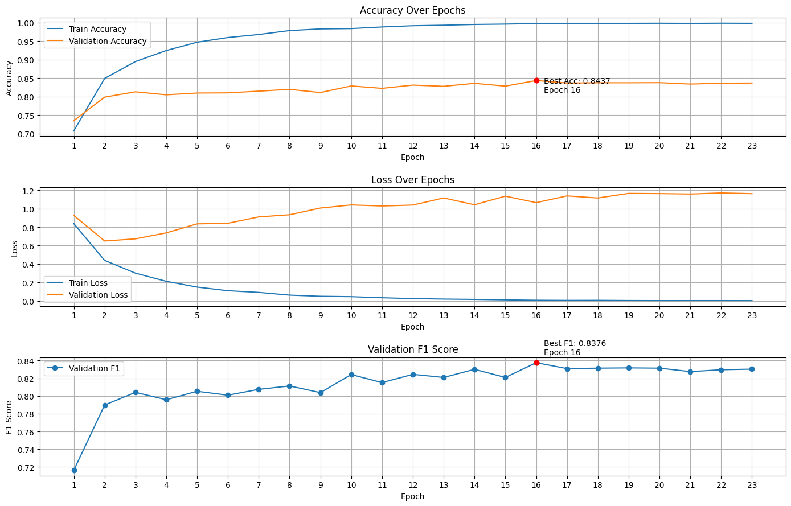

Quantitative Results: Train & Validation Curves
Notes:
We (quantitatively) tracked training and validation accuracy and loss across epochs. While accuracy continued to improve, the validation loss eventually increased, as cross-entropy penalizes highly confident wrong predictions (more heavily, even if accuracy rises). The validation F1 score confirmed that the model was generally making correct predictions without many false classifications. We selected the model at epoch 16, which achieved the best (combination of) validation accuracy and F1 score.
time : 23 seconds

Slide 8
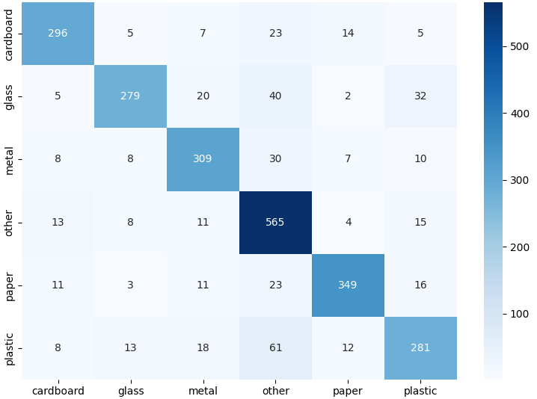
Quantitative Results: Test Metrics
82
%
Accuracy
True
0.82
F1
Predicted
Notes:
On our test set, the model achieved 82% accuracy and an F1 score of 0.82, indicating strong recall and precision—meaning it identifies items correctly fairly often and doesn’t mislabel many incorrect items.
Upon examining the confusion matrix, classes are occasionally predicted as ‘other’, since it functions as a catch-all category. We observed that glass, metal, and plastic are often confused with one another due to their similar shininess, while paper is commonly mistaken for cardboard or plastic because of similarities in color, texture, and reflectiveness.
Overall, the model’s errors tend to arise from similarities in shine, color, and shape between object types.
Time: 32 seconds

Slide 9
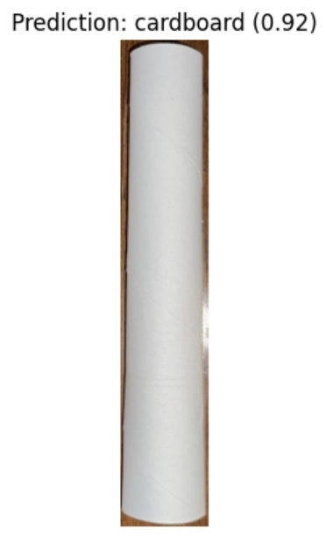
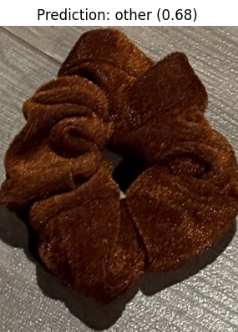
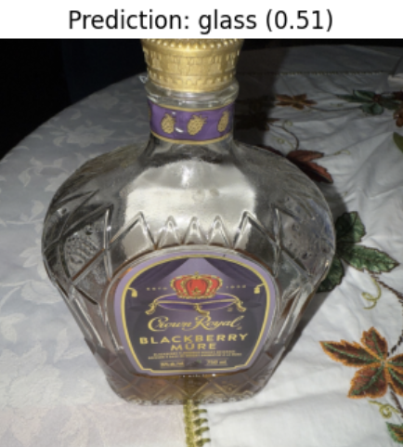
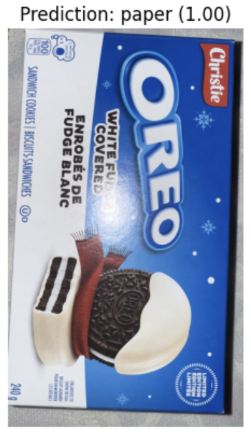
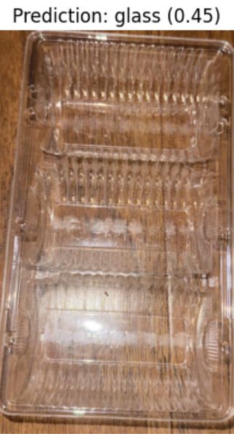
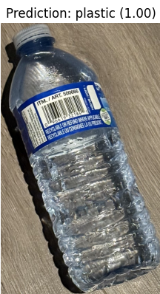
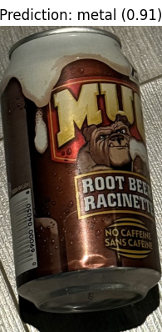
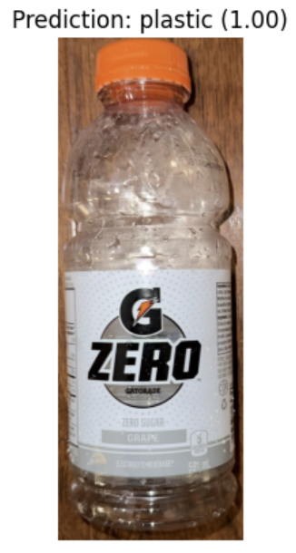
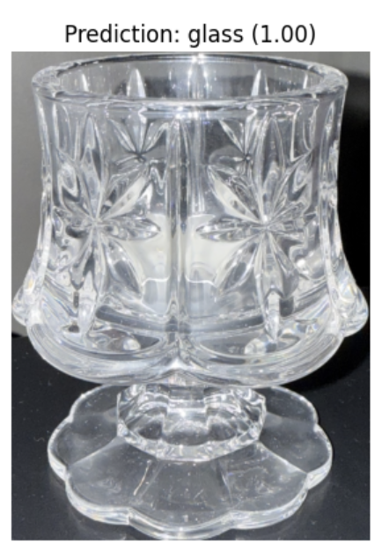
Qualitative Results
Correct Classifications
Incorrect Classifications
Notes:
Here, we are qualitatively testing a few new examples,
Generally, it does pretty well at classifying but…
On the right, we have some incorrect classifications. The oreo box is misclassified as paper likely because of its colors and the direct angle. The other is plastic but predicted as glass due to the lighting (even to the human eye).
time : 15 seconds

Slide 10






What we Learned
Load files into collab
Abundance of quality data
Different lighting changes the classification
YOLO object detection not cropping well for training data images
Do not need to process every frame
GPU resources help speed up training but still takes long
Notes:
Throughout this project, we learned a number of lessons that would have been extremely helpful to know at the start—and that we think would benefit anyone attempting a similar waste-classification system.
First, loading files directly into Colab is dramatically faster than reading them from Google Drive. Colab uses fast local SSD storage, while Drive is a slow, network-mounted filesystem, so using Drive quickly becomes a bottleneck.
We also learned that data quality matters more than model complexity. Having diverse images—different lighting conditions, angles, and variations of each trash type—improves performance far more than tweaking architectures or hyperparameters.
Lighting turned out to be one of the biggest challenges. The same object can be classified differently under bright lights, shadows, or uneven illumination. Strong augmentation is essential if the model is expected to work in the real world.
We also saw that YOLO doesn’t always detect only the trash. It can sometimes pick up hands, backgrounds, or other objects in the scene, which showed us how important clean annotations and consistent bounding boxes are.
For real-time video, we discovered that processing every single frame is unnecessary and actually causes lag. Techniques like frame-skipping, cooldown windows, and prediction smoothing made our live demo much more stable.
Another takeaway was the importance of compute resources. Colab’s limited GPU time directly shaped what we could train. More consistent access to GPU compute led to better-trained models and more reliable results.
Finally, reproducing results from research papers is harder than it looks. Many papers assume huge datasets, heavy compute, or preprocessing steps that aren’t fully explained. Matching their performance required a lot of experimentation and, in some cases, wasn’t feasible with our resources.
Time:
Hard negative examples are essential. Through our analysis, we realized that hard negative examples would be essential for improving performance. Many of our misclassifications occurred between visually similar objects (for example, shiny plastic being confused with glass or brown paper resembling cardboard). Incorporating deliberately confusing, look-alike samples into the dataset is a technique we now recognize as important for helping the model learn finer distinctions.

Slide 11
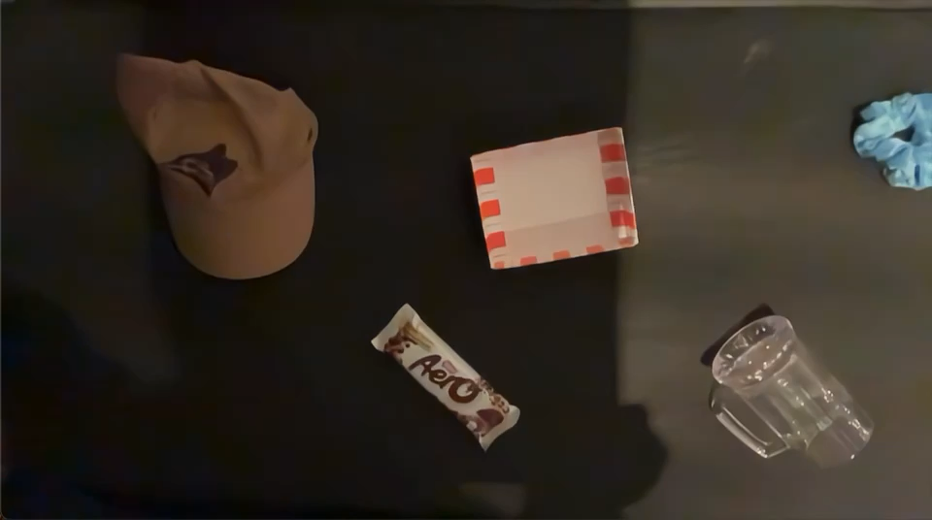

What we Learned
Laggy Live-Video Feed
Notes:
We also noticed that the live video stream became laggy because our model was running on the CPU instead of the GPU, which really slows down frame-by-frame predictions. Even though MobileNetV3 is a lightweight model, CPU is still slow in real-time use cases.
On top of that, our input resolution was fairly high, so each frame needed to be resized and preprocessed before the model could run, which added extra overhead. We were also processing every single frame, which isn’t necessary for real-time classification and only increases the workload.
In a real deployment, we’d improve performance by running MobileNetV3 on the GPU, lowering the input resolution, and skipping frames or using smoothing techniques to keep the video stream responsive.

Slide 12
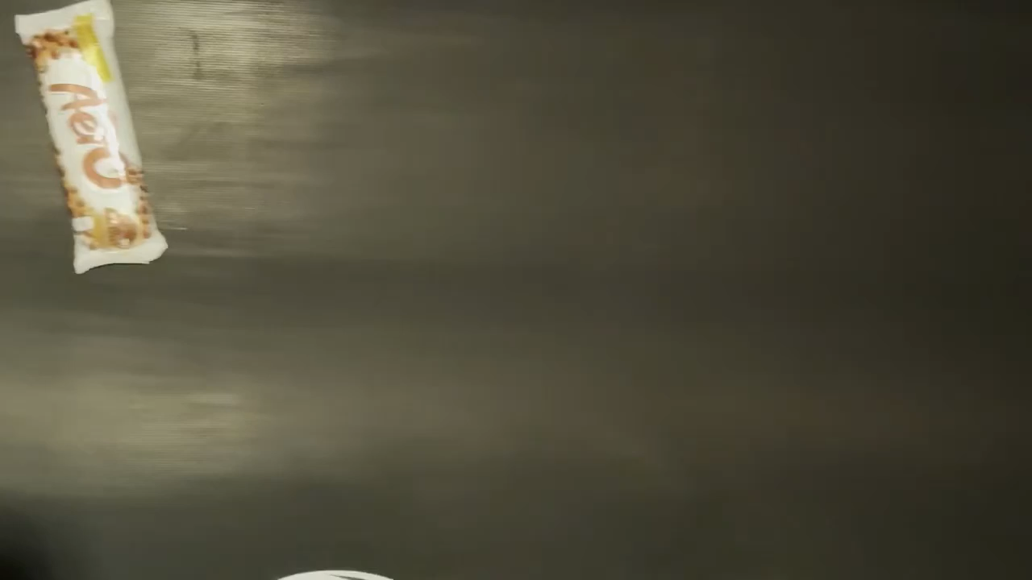

What we Learned
Reflections lead to no YOLO detection
Notes:
Lastly, we learned that reflections can impact YOLOs ability to detect the objects and was able to detect them better on non-reflective materials.

Slide 13
What we Learned
Load files into Google collab notebook session (faster) rather than developing the code in a way that pulls the files from Google Drive (slower)
Even on GPU and transfer learning, the model takes a long time to train, so having access to more GPU compute resources was extremely helpful
YOLO has a difficult time tracking images and is quite laggy
For each object when classified, before modifications we found that the live video detection flickers between different classifications, so need to modify it
The classification of the same image tends to change depending on the angle that the object is held and how light hits it
Objects that are reflective are not working for YOLO to detect the object properly
Processing every frame is overkill - leading to slower processing
Notes:
What did you learn from doing this project?
Focus on things that you would have liked to know before taking on this project, or things that your classmates may benefit from knowing before they take on a similar project. This could include computational challenges, training techniques, challenges with reproducing published results, or any tricks you learned by working on this project.

