Slide 1
Document Classifier
Dehong Yuan
21.04.2022

Slide 2
Agenda
App overview
Model insights
Data preprocessing
Models
Project structure
Future work

Slide 3
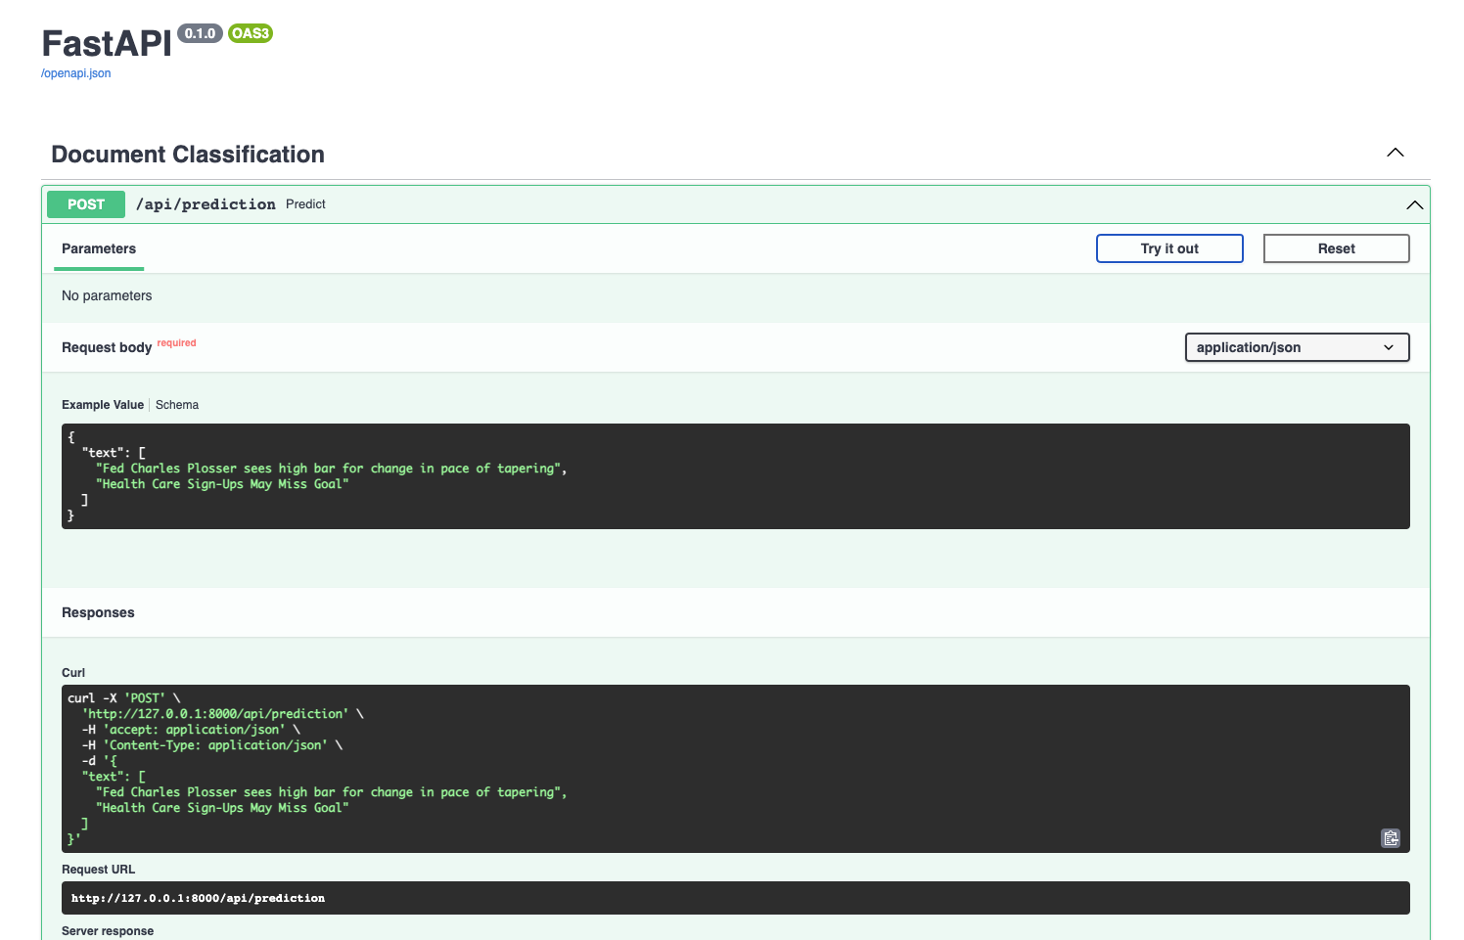
App Overview
Build a predictive model to classify news headlines into 4 categories
Categories of news:
Business (b)
Science and technology (t)
Entertainment (e)
Health (m)
Web API

Slide 4
Model Insights - Data preprocessing
Data validation
Clean text
Remove stop words
Convert text to a matrix of TF-IDF features
Encode labels into numbers
Split the dataset into train and test sets

Slide 5
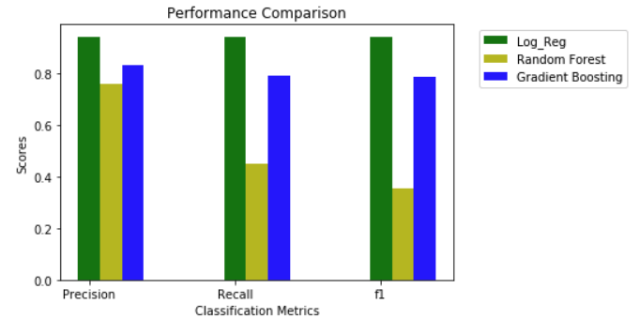
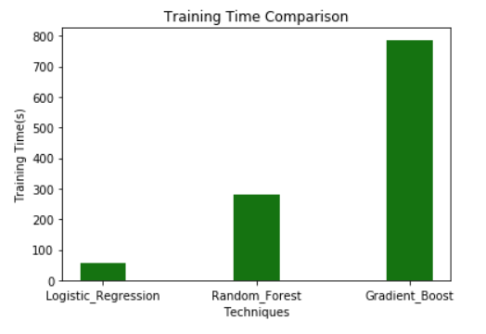
Model Insights - Models
Models are trained for document classification
Logistic Regression Model
Random Forest Model
Gradient Boosting Model

Slide 6
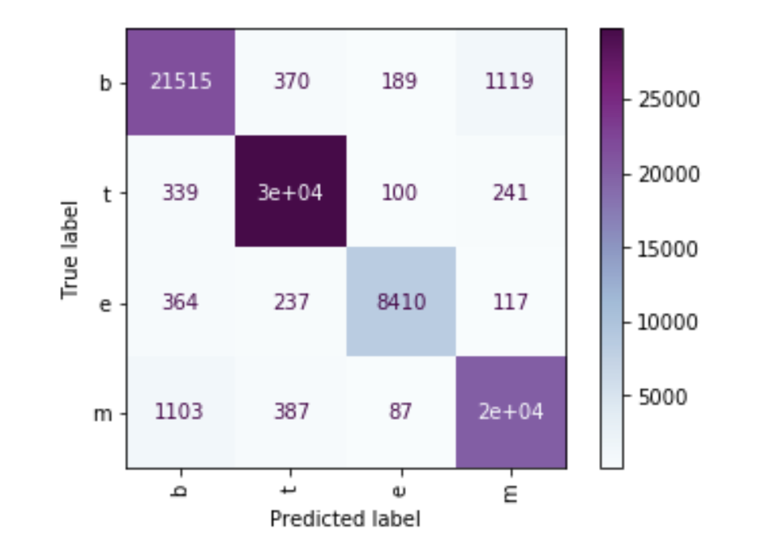
Model Insights - Evaluation
Confusion Matrix
Accuracy
Recall
Precision
F1 score

Slide 7
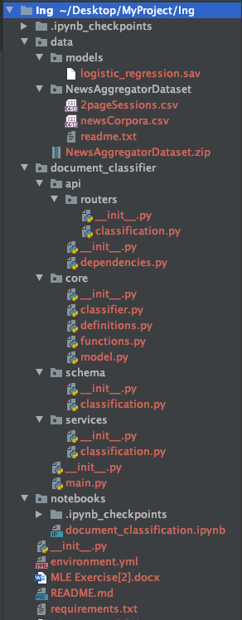
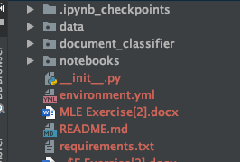
Project Structure

Slide 8
Future work
Data Imbalance
Undersampling/ Oversampling
Class weights
MLflow Experiments
Database development

Slide 9
Thank you!

