Slide 1
10810EECS204001 Data Structures HW4: Graph
11/22 12:00
~
12/6 23:59

Slide 2
Problem Situation
You are a student studying in a university with several campuses.
Between some campuses, you can take the shuttle bus.
Between some campuses, students could exchange their credits.

Slide 3
Example
Campus 0
Campus 1
Campus 4
Campus 5
Campus 2
Campus 3

Slide 4
Edge property
W: the moving time of the shuttle bus.
R: the rate for credits exchange.

Slide 5
Example
Campus 0
W: 20
R: 0.9
W: 20
R: 0.8
Campus 1
Campus 4
W: 15
R: 0.9
W: 30
R: 0.8
Campus 5
Campus 2
Campus 3
W: 10
R: 1

Slide 6
Operations
1. Add
2. Delete
3. Shortest
4. Map
5. ImportantBus
6. CreditExchange
7. CreditExchange2

Slide 7
Add
Add v1 v2 w r
Add an edge between campus v1 and v2. The edge property is w and r. W is moving time and r is exchange rate.
Ex: Add 1 2 20 0.9
Campus 1
Campus 2
W: 20
R: 0.9

Slide 8
Delete
Delete v1 v2
Delete the edge between v1 and v2.
Ex: Delete 1 2
Campus 1
Campus 2
W: 20
R: 0.9

Slide 9
Shortest
Shortest v1 v2
Calculate the minimum moving time between campus v1 and v2.
Print the answer. If there is no answer, print ”Error”.
Shortest 1 2 -> output: 15.
Shortest 1 4 -> output: Error.
W: 20
R: 0.9
Campus 1
Campus 2
W: 10
R: 0.9
W: 5
R: 0.9
Campus 3
Campus 4

Slide 10
Map
Map
Calculate the minimum total moving time for those buses connect every campus.
Print the answer. If there is no answer, print ”Error”.
Map -> output: 15
W: 20
R: 0.9
Campus 1
Campus 2
W: 10
R: 0.9
W: 5
R: 0.9
Campus 3

Slide 11
ImportantBus
ImportantBus
Determine if there is an important bus that without it, students can’t go certain campus.
Print “Yes” if it exists. Otherwise, print ”No”.
ImportantBus -> output: Yes
W: 20
R: 0.9
Campus 1
Campus 2
W: 5
R: 0.9
W: 10
R: 0.9
W: 5
R: 0.9
Campus 3
Campus 4

Slide 12
CreditExchange
CreditExchage v1 v2 c
Start with credit c, you need to maximize the final credits from campus v1 to v2. With this operation, the rate is between 0 and 1.
Print the maximized credits you can get. If you cannot, print “0”.
CreditExchange 1 2 100 -> output: 81
W: 20
R: 0.8
Campus 1
Campus 2
W: 5
R: 0.9
W: 10
R: 0.9
W: 5
R: 0.9
Campus 3
Campus 4

Slide 13
CreditExchange2
CreditExchage2 v1 v2 c limit
Sometimes the rate could more than 1, you need to maximize the final credits under some rules.
The rules are (1) you can only exchange under limit times. (can be less than limit) (2) you cannot exchange credits more than once on the same edge.

Slide 14
CreditExchange2: continue
CreditExchange2 3 4 100 2 -> output: 99
CreditExchange2 3 4 100 3 -> output: 108
W: 20
R: 1.1
Campus 1
Campus 2
W: 5
R: 1.1
W: 10
R: 0.9
W: 5
R: 0.9
Campus 3
Campus 4

Slide 15
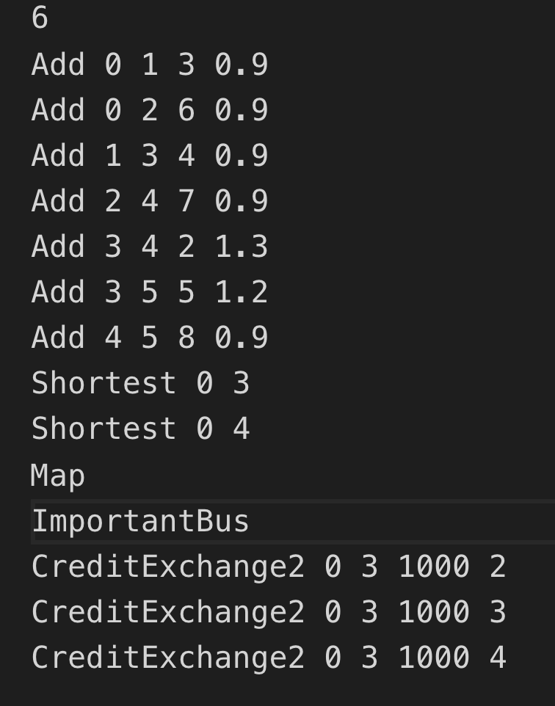
Input / Ouput
First line is the total number of campuses. (n<1000)
After first line, there are several operations that you should implement.

Slide 16
Notice
CreditExchange and CreditExchange2 will not show in same testcase.
In every exchange, credits should always be an integer. The method is to round down to its floor. (Ex: 19.9 -> 19)
You are allowed to use stl except for those direct functions and libraries.

Slide 17
Q&A
If you have any question, please post it on iLMS.

