Slide 1
10810EECS204001 Data Structures Homework 5
2019/12/9 10:10
~
2019/12/23 23:59

Slide 2
HW5
In this homework, you have to implement 2 functions
1. Inversion pairs count
2. Radix sort(LSD) process

Slide 3
Inversion Pair
Let A be a sequence of numbers.
(i , j) is an inversion pair if i < j but A[i] > A[j].
Example: A = [1, 2, 3, 4],
then A has no inversion pair.
Example: B = [4, 3, 2 ,1], B has 6 inversion pairs:
(1, 2), (1, 3), (1, 4), (2, 3), (2, 4), (3, 4).

Slide 4
Inversion Pairs Count
Input: a sequence of numbers
Output: the number of inversion pairs
For example: A = [9, 4, 5, 3],
the output is 5.
Because A has inversion pairs: (1, 2), (1, 3), (1, 4), (2, 4), (3, 4).

Slide 5
Radix Sort (LSD) Process
Input: a sequence of numbers
and r(radix)
Output: first element and last element of results
in every pass of the radix sort(LSD)

Slide 6
Radix Sort (LSD) Process (r=10)
For example: A = [179, 208, 306, 93, 859, 984, 55, 9, 271, 33]
r = 10
You should output: 271 9
306 93
9 984

Slide 7
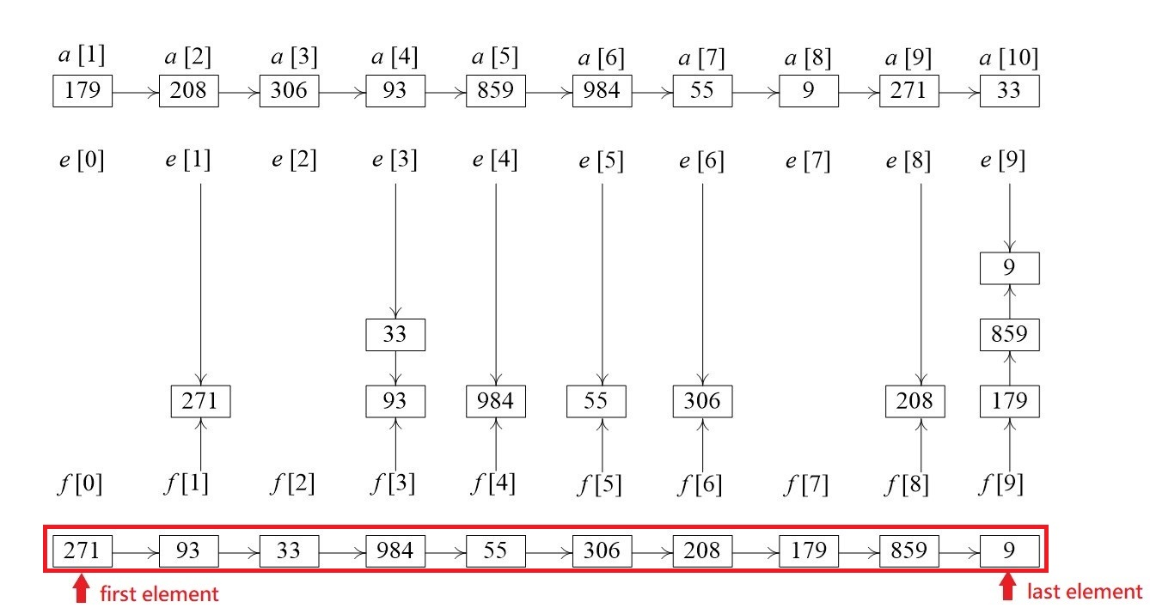
Radix Sort (LSD) Pass 1

Slide 8
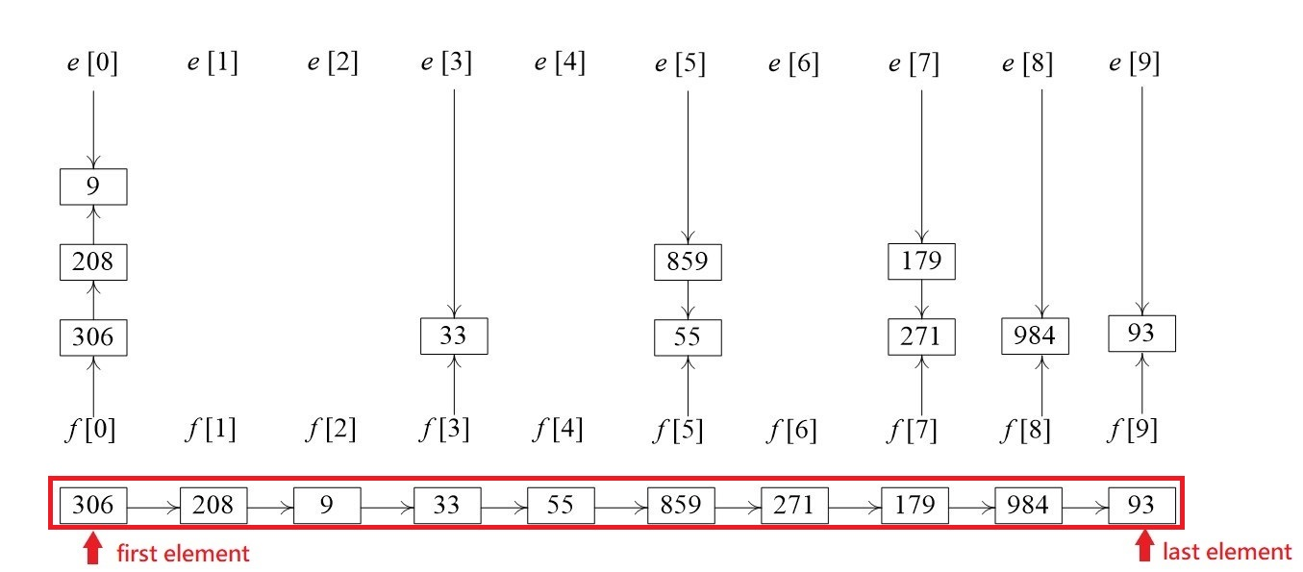
Radix Sort (LSD) Pass 2

Slide 9
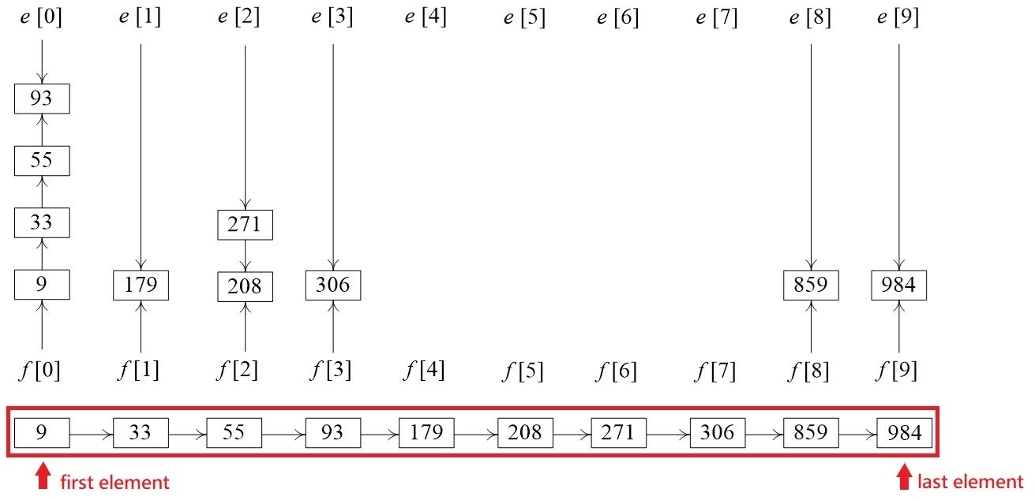
Radix Sort (LSD) Pass 3

Slide 10
Radix Sort (LSD) Process (r=4)
For example: A = [57, 67, 59, 7, 82]
r = 4
You should output: 57 7
82 59
67 59
7 82

Slide 11
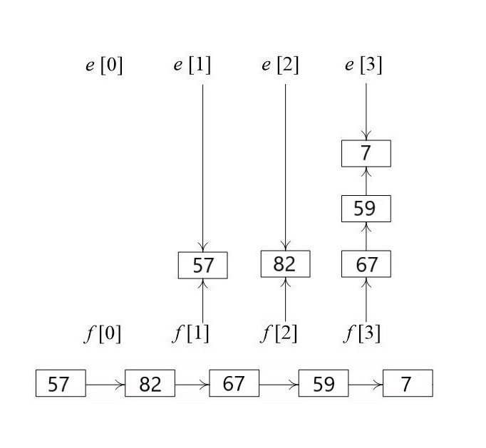
Radix Sort (LSD) Pass 1
57 = 0321
67 = 1003
59 = 0323
7 = 0013
82 = 1102

Slide 12
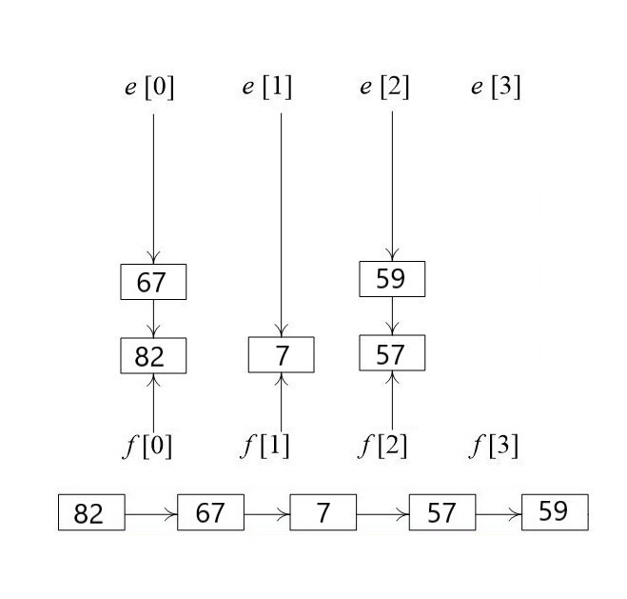
Radix Sort (LSD) Pass 2
57 = 0321
82 = 1102
67 = 1003
59 = 0323
7 = 0013

Slide 13
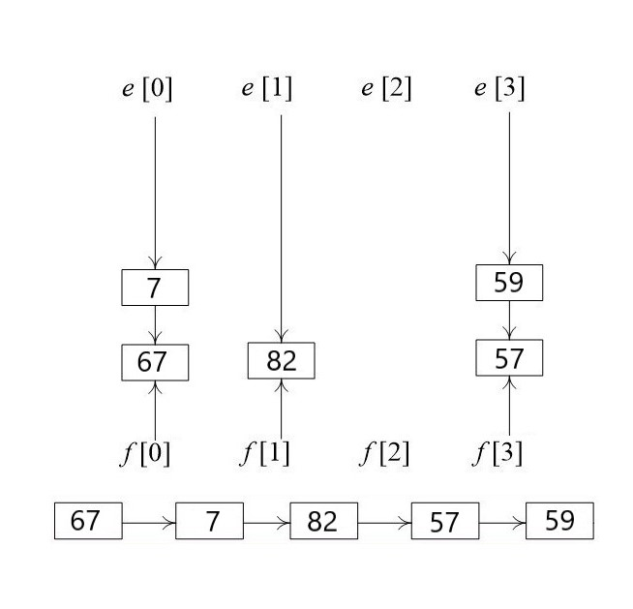
Radix Sort (LSD) Pass 3
82 = 1102
67 = 1003
7 = 0013
57 = 0321
59 = 0323

Slide 14
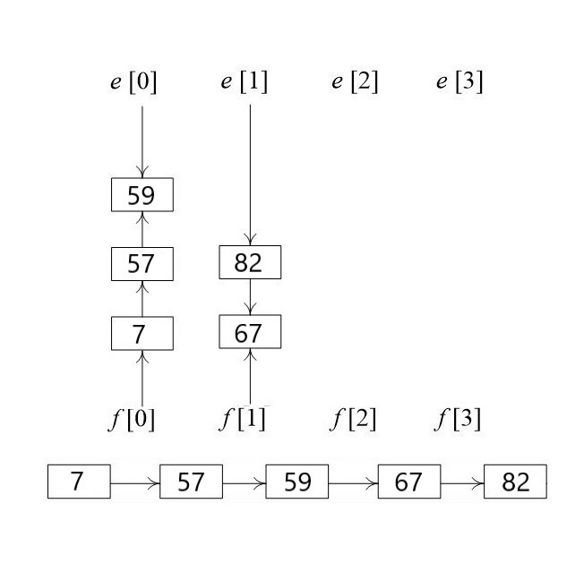
Radix Sort (LSD) Pass 4
67 = 1003
7 = 0013
82 = 1102
57 = 0321
59 = 0323

Slide 15
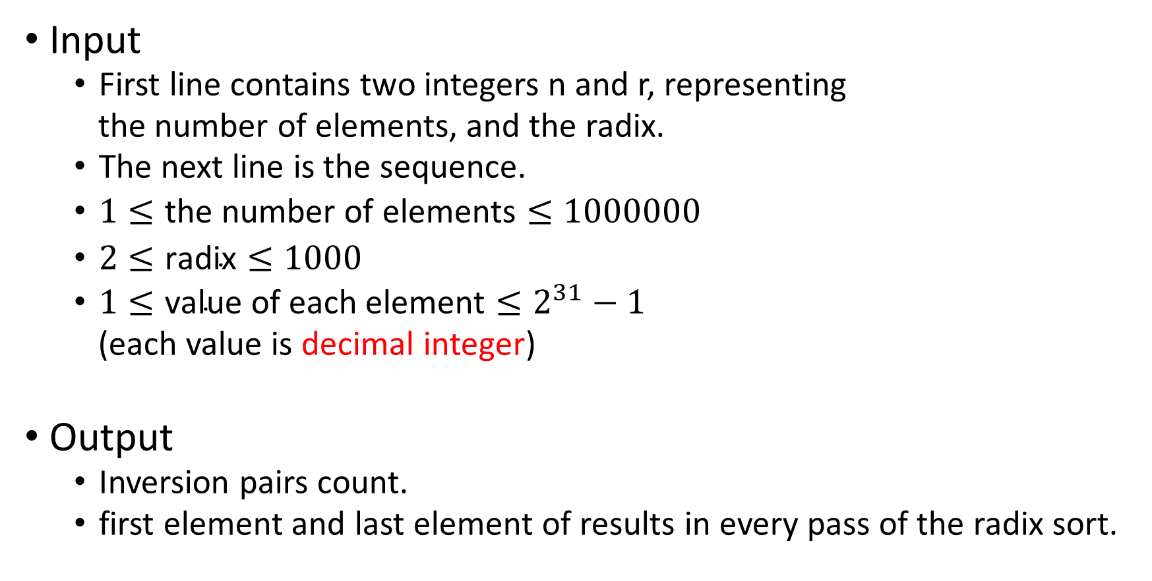
Input & Output
Input
First line contains two integers n and r, representing
the number of elements, and the radix.
The next line is the sequence.
$1≤\text{the} \text{number} \text{of} \text{elements}≤1000000$
$2≤\text{radix}≤1000$
$1≤\text{value} \text{of} \text{each} \text{element}≤2^{31}−1$
(each value is decimal integer)
Output
Inversion pairs count.
first element and last element of results in every pass of the radix sort.

Slide 16


Sample Input & Sample Output
Input
Output

Slide 17
STL
You are allowed to use STL.
But don’t use any STL related to sort.

Slide 18
The End

