Slide 1
CS4101 嵌入式系統概論 General Purpose IO
Prof. Chung-Ta King
Department of Computer Science
National Tsing Hua University, Taiwan
Materials from MSP430 Microcontroller Basics, John H. Davies, Newnes, 2008

Slide 2
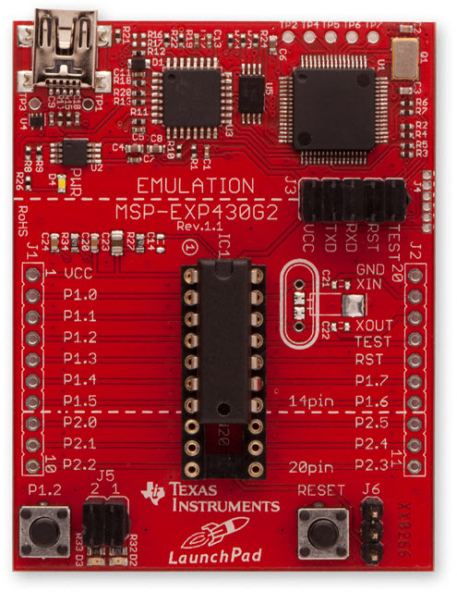
Recap: MSP430 LaunchPad
USB Emulator Connection
Embedded Emulation
Crystal Pads
Chip Pinouts
Part and Socket
P1.3 Button
LEDs P1.0 & P1.6
Reset Button

Slide 3
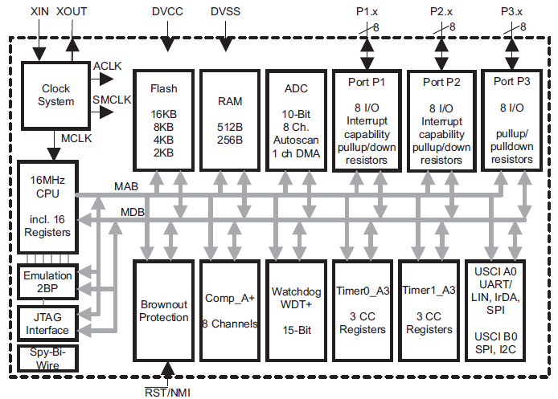
Recap: MSP430 Microcontroller
LED
0100..0
X
No P3 for 20-pin MCU
P1OUT
P1IN
…
MOV.B #0x40,P1OUT
P1REN
0x21
0x40
Notes:
Go through all the components once and explain their meanings

Slide 4
Recap: MSP430 Program for Output
// Blinking both LEDs #include <msp430.h> void main(void) { WDTCTL = WDTPW + WDTHOLD; // Stop watchdog P1DIR |= 0x41; // set P1.0 & 6 to outputs for(;;) { volatile unsigned int i; P1OUT ^= 0x41; // Toggle P1.0 & P1.6 i = 50000; // Delay do (i--); while (i != 0); } }

Slide 5
Outline
MSP430 GPIO
Configuring GPIO
GPIO output
GPIO input
Problems with input from buttons
Sample code for GPIO input

Slide 6
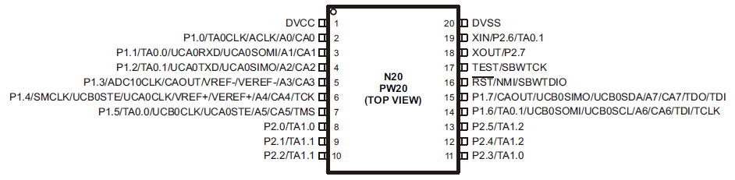
MSP430 GPIO
GPIO = General Purpose Input/Output
Digital I/O
8-bit I/O ports
Each pin is individually controllable
by memory-mapped registers R1IN, R1OUT, …
 | P1.7 | P1.6 | P1.5 | P1.4 | P1.3 | P1.2 | P1.1 | P1.0
I/O Port 1 | Bit 7 | Bit 6 | Bit 5 | Bit 4 | Bit 3 | Bit 2 | Bit 1 | Bit 0

Slide 7
Configuring GPIO Ports
Registers (Mem Addr) | Functions | Descriptions
P1IN (0x0020) | Port 1 input | This is a read-only register that reflects the current state of the port's pins.
P1OUT (0x0021) | Port 1 output | The values written to this read/write register are driven out to corresponding pins when they are configured to output.
P1DIR (0x0022) | Port 1 data direction | Bits written as 1 (0) configure the corresponding pins for output (input).
P1SEL (0x0026) | Port 1 function select | Bits written as 1 (0) configure corresponding pins for use by the specialized peripheral (for general-purpose I/O).
P1REN (0x0027) | Port 1 resistor enable | Bits set in this register enable pull-up/down resistors on the corresponding I/O pins.

Slide 8
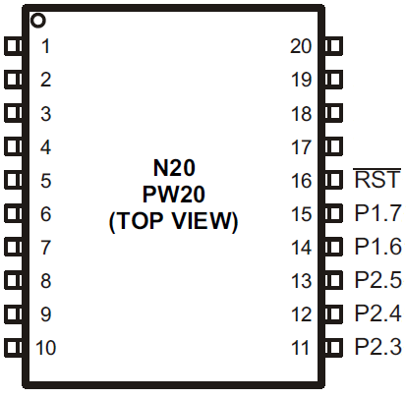
PxDIR (Pin Direction): Input or Output
PxDIR.y: 0 = input 1 = output
Register example: P1DIR &= 0x80;
P1IN.7
P1OUT.7
P1DIR.7
“1”
 | 7 | 6 | 5 | 4 | 3 | 2 | 1 | 0
P1IN
P1OUT
P1DIR | 1

Slide 9
GPIO Output
PxOUT.y: 0 = low 1 = high
Register example: P1OUT &= 0x80;
P1IN.7
P1OUT.7
P1DIR.7
“1”
“1”
“1”
 | 7 | 6 | 5 | 4 | 3 | 2 | 1 | 0
P1IN | X
P1OUT | 1
P1DIR | 1

Slide 10
GPIO Input
Problem occurs if P1.7 is connected to a button!
P1IN.7
P1OUT.7
P1DIR.7
“1”
“0”
“1”
 | 7 | 6 | 5 | 4 | 3 | 2 | 1 | 0
P1IN | 1
P1OUT | X
P1DIR | 0

Slide 11
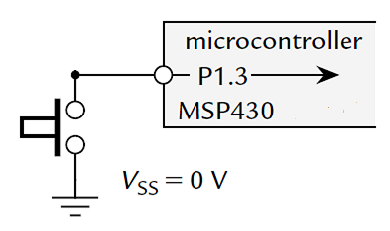
Problem with Input from a Button
When the button is pressed down (closed), MSP430 will detect a 0 from the pin
When the button is up (open), what will MSP430 detect?
Ans.: random value
→ Floating

Slide 12
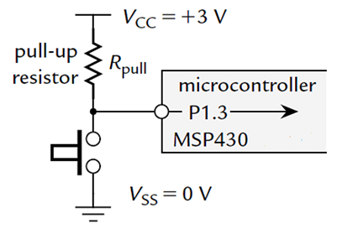
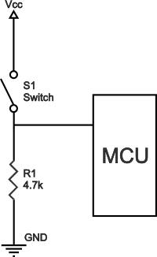
Typical Way of Connecting a Button
A pull-up resistor R_{pull} holds input at logic 1 (voltage V_{CC}) while button is up and logic 0 (V_{SS}) when button is down → active low
But a wasted current through R_{pull} to ground when button is down → reduced by making R_{pull} large enough, e.g. 33 kΩ
Also work with pull-down R:
http://www.resistorguide.com/pull-up-resistor_pull-down-resistor/

Slide 13
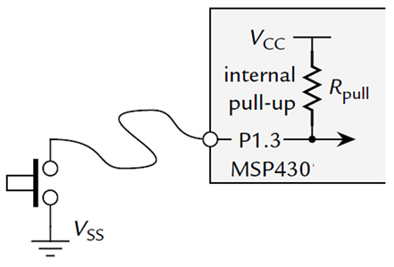
Typical Way of Connecting a Button
MSP430 offers internal pull-up/down resistor
PxREN register selects whether this resistor is used (1 to enable, 0 to disable)
When enabled, the corresponding bit of PxOUT register selects whether the resistor pulls up the input to V_{CC} (1) or down to V_{SS} (0) on button up
Another issue on button: bouncing
Need to do debouncing

Slide 14
GPIO Input
P1IN.7
P1OUT.7
P1DIR.7
P1REN.7
up/down
Enable resistor
 | 7 | 6 | 5 | 4 | 3 | 2 | 1 | 0
P1IN | x
P1OUT | 1
P1DIR | 0
P1REN | 1
PxREN enables pull-up/pull-down resistors
PxOUT selects pull-up (1) or -down (0)
Lower cost devices may not provide up/down resistors for all ports

Slide 15
Sample Code for Input
#include <msp430.h> #define LED1 BIT0 //P1.0 to red LED #define B1 BIT3 //P1.3 to button void main(void){ WDTCTL = WDTPW + WDTHOLD; //Stop watchdog timer P1DIR = LED1; //Set P1.0 for output P1OUT = LED1; //Turn on red LED P1REN = B1; //Set P1.3 to use internal resistor P1OUT |= B1; //Set P1.3 to use pull-up resistor for(;;){ //Loop forever if((P1IN & B1) ==0){ //Is button down? P1OUT &= ~LED1; } // Yes, turn red LED off else{ P1OUT |= LED1; } // No, turn red LED on } }
Why not
P1OUT = 0;
P1OUT = 1;
Button is active low: 0→down; 1→up
Notes:
Whenever button is down, turn LED off. Whenever button is up, turn LED on.
P1OUT is not initialized and must be written before configuring the pin for output.
Assume button is active low (0 → pressed; 1 → depressed)
** Set P1OUT to 0 or 1 will destroy P1.3 setting

Slide 16
Sample Code for Input
What happen if we add a delay loop inside the for-loop?
What if we want to blink the LEDs at all time instead of just turning them on/off on button up/down?
i = 50000; // Delay do (i--); while (i != 0);

Slide 17
Summary
GPIO: general purpose input/output
Configuring GPIO
P1DIR, P1SEL, P1REN
GPIO output
GPIO input
Problems with input from buttons → pull-down/-up resistor
Sample code for GPIO input
Continuous looping to check button event → polling

