Slide 1
You should know: Homework 1
CS 3570 Introduction to Multimedia

Slide 2
Rules
Plagiarism
Copy from classmates or from who ever took this course
If you refer any code from public web, Google / Stackoverflow, you must cite and explain how it works in your report.
Not complete homework package
Readme [-10%], should mention how to execute the code, or you’ll get zero.
Image results [-5%]
Late hand-in will get 20% off every day

Slide 3
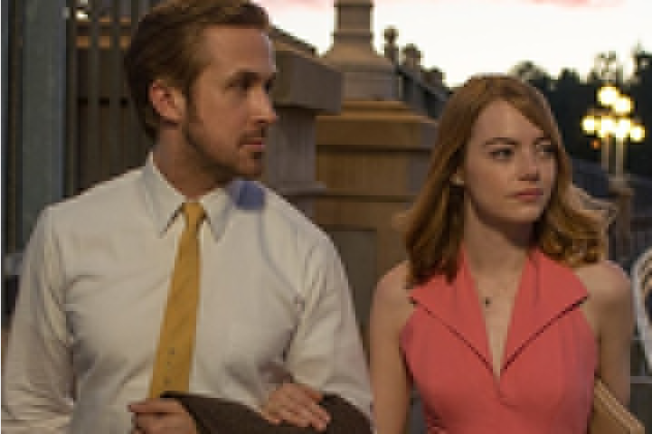

Prob1. Sample Result
Example of compressed image with $n=2$

Slide 4
Hints
Use `double` for calculation to preserve the numerical precision.
While computing the PSNR between original and processed images, you had better use `double` instead of `uint8`.
You might use the Matlab built-in functions not allowed in this homework to evaluate your implementations.

Slide 5
Notes
任何會直接得到我們作業要求結果的內建functions 一律都不能使用，除非特別補充。
In report, it should contains at least
how you implement the methods
and discussion to the output results

