Slide 1
The Study Abroad Project (SAP)
Sam, Winston, Chance, Ethan

Slide 2
Quick Refresher
- Developing a mobile app for the UWYO Abroad office.
- Set of 30+ schools that they want advertised.
- Targeted towards incoming students to the university, and outgoing students.
- Need to make it easy to update for the study abroad office, once we leave.

Slide 3
Scope of work from Fall 2019
- Create a navigable Android app that showcases the information provided to us from a brochure.
- Create a database of programs approved by the study abroad office to be displayed to users and allow the SAO to edit it.
- Research technologies like Google's Flutter UI Framework.
- Expand the app to provide information specific to incoming or outgoing students, send them notifications on relevant deadlines etc.

Slide 4







Tech Stack

Slide 5
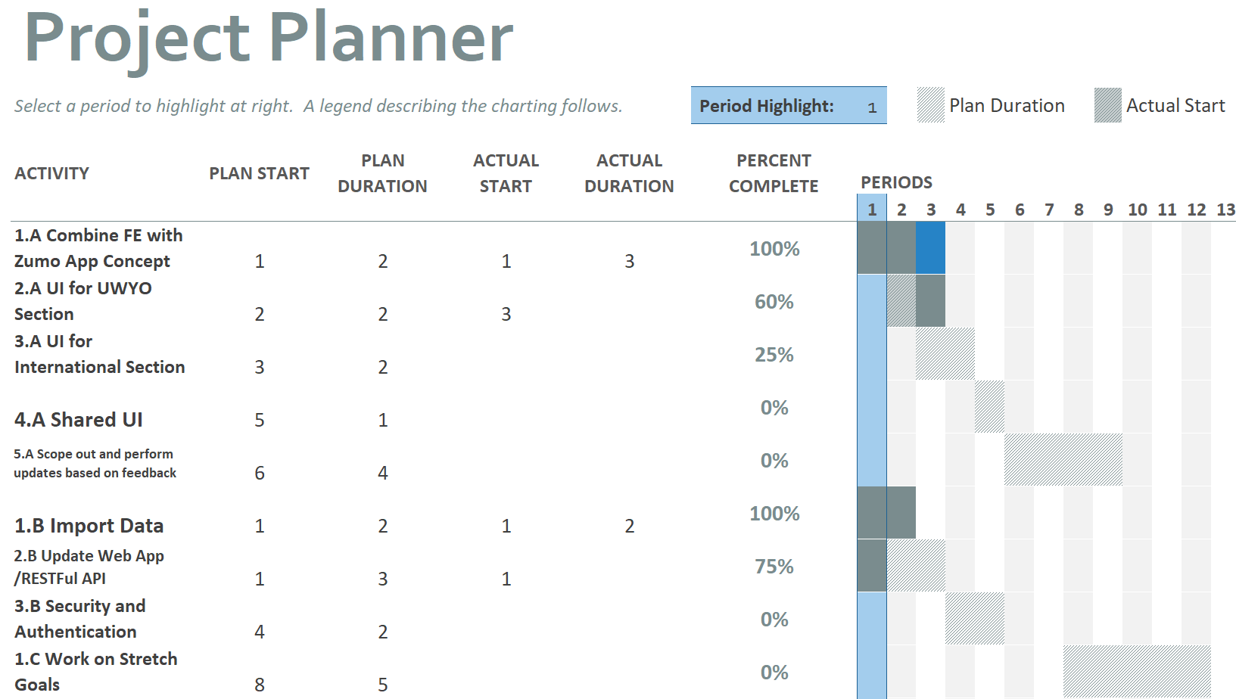
Current Status
We are on-track!

Slide 6

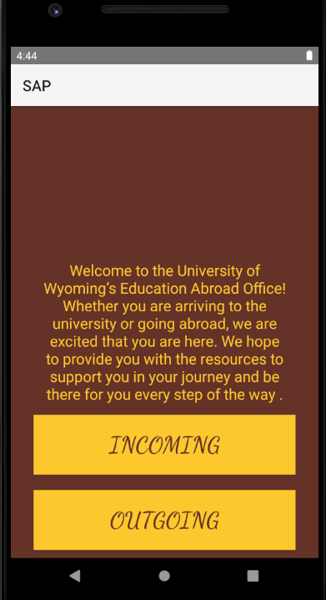
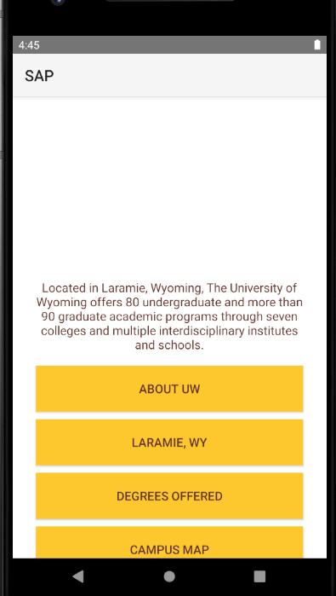
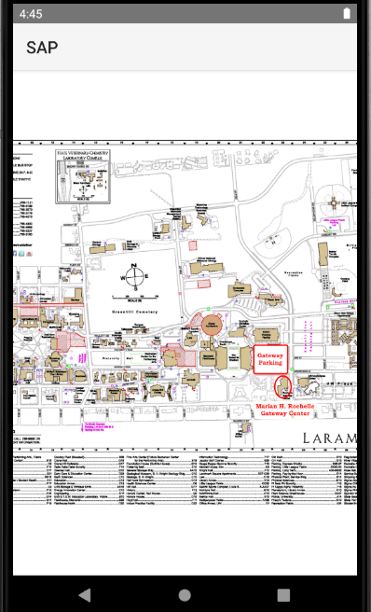
Demo

Slide 7
Successes, Roadblocks, & Changes
Successes: Front-end: successfully integrated the database Back-end: Web app deployment w/ Codefirst Roadblocks: Front-end: integrating the database Back-end: integrating the database Changes: Front-end: Scrapping the idea of using Flutter Back-end: Simplified Database Schema

Slide 8
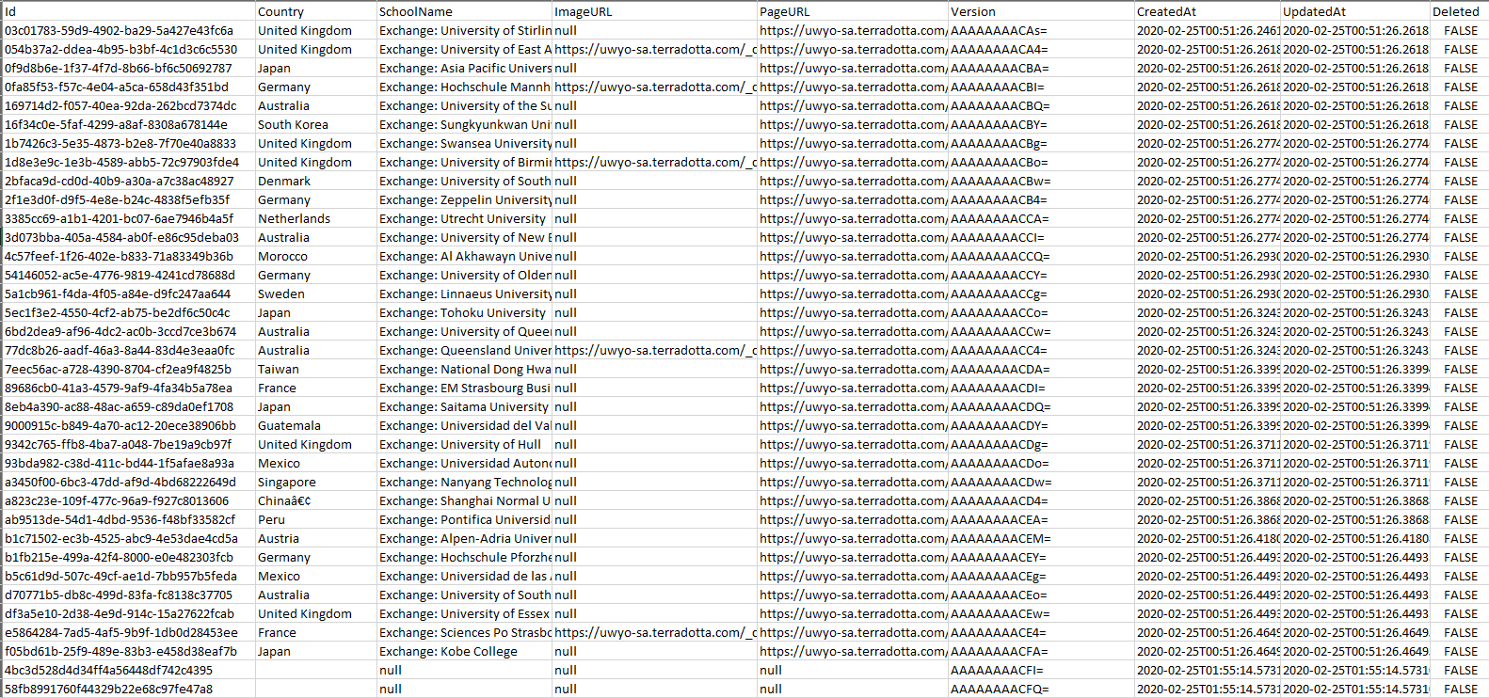
State of Our Database

Slide 9

Lessons Learned
- Easy to fall behind.
- Don’t be afraid to use free, open-source software
- Make sure you read all the documentation
- Make sure to keep backups of build artifacts and deployments

Slide 10

Confidence in Success
90%

Slide 11
