Slide 1

Data Analysis for the Development of
Companion Robots for Older Adults
Interaction experience, continued use and the Guardian proposal
Class: CT2985013
Student Name: Wong Chei Oi (Alice)
AI-generated concept illustration. Proposed product only.
Notes:
Data Analysis for the Development of Companion Robots for Older Adults
Interaction experience, continued use and the Guardian proposal
Interaction experience, continued use and the Guardian proposal
AI-generated concept illustration. Proposed product only.

Slide 2
Why study support for older adults?
Purpose: Explain Hong Kong’s projected population share aged 65 and over.
Method: 2026–2046 projections published in 2023, excluding foreign domestic helpers.
Finding: A rise of 10 percentage points. Local demand still needs separate research.
Population context motivates the study. Product suitability needs separate evidence.
Source: Census and Statistics Department (2023), Appendix B, Table B1.
Figure 7 Report p. 3
02
Notes:
Why study support for older adults?
Purpose: Explain the population context for this research.
Finding: A rise of 10 percentage points. Local demand still needs separate research.
Source: Census and Statistics Department (2023), Appendix B, Table B1.
Method: Compare five years in the 2023 projection. Unit: population percentage.
Population context motivates the study. Product suitability needs separate evidence.

Slide 3
Research question and evidence
What do interaction records reveal, and which improvements should the team test next?
Main dataset: HRI CUES
Nine supplementary CSVs: 61 aggregate rows
590 dialogue turns
1 file
Population projection
Research context
25 participants and 25 survey rows
6 files
ElliQ, PIO, PARO and Hyodol
Interaction process and individual experience
Use, outcomes and continued use
2 files
Hobbit and IC3 fraud data
Turn duration, user feedback, observer ratings
Function availability and safety scenarios
Synthesis: interaction controls, support scenarios and a four-week pilot
Analyse each source separately. Supplementary CSVs do not add HRI CUES participants.
The meaning of each row determines how we interpret a comparison.
Report p. 4
03
Notes:
Research question and evidence
Which interaction and support functions should the team test first?
Main dataset: HRI CUES
590 dialogue turns
25 participants and 25 survey rows
Interaction process and individual experience
Turn duration, user feedback, observer ratings
Nine supplementary CSVs: 61 aggregate rows
1 file
Population projection
Research context
6 files
ElliQ, PIO, PARO and Hyodol
Use, outcomes and continued use
2 files
Hobbit and IC3 fraud data
Function availability and safety scenarios
Synthesis: interaction controls, support scenarios and a four-week pilot
Analyse each source separately. Supplementary CSVs do not add HRI CUES participants.
The meaning of each row determines how we interpret a comparison.

Slide 4
590 turns come from 25 people
HRI CUES main dataset
Dataset | Rows | One row represents
HRI CUES turns | 590 | One dialogue turn
HRI CUES survey | 25 | One participant
Nine supplementary CSVs | 61 | A published category or group-time point
HRI CUES in full
Human-Robot Interaction Conversational User Enjoyment Scale
Observer assessment of enjoyment during robot conversations
590 turns come from 25 participants. Summaries must account for repeated observations.
After defining each row, check and prepare the data.
Report p. 4
04
Notes:
590 turns come from 25 people
590 turns come from 25 participants. Summaries must account for repeated observations.
After defining each row, check and prepare the data.
HRI CUES in full
Observer assessment of enjoyment during robot conversations
HRI CUES main dataset
Sources:
https://doi.org/10.5281/zenodo.12588810
Scale definition: Irfan et al. (2026), IEEE Transactions on Affective Computing, 17(2), 1438–1453. https://doi.org/10.1109/TAFFC.2025.3590359

Slide 5
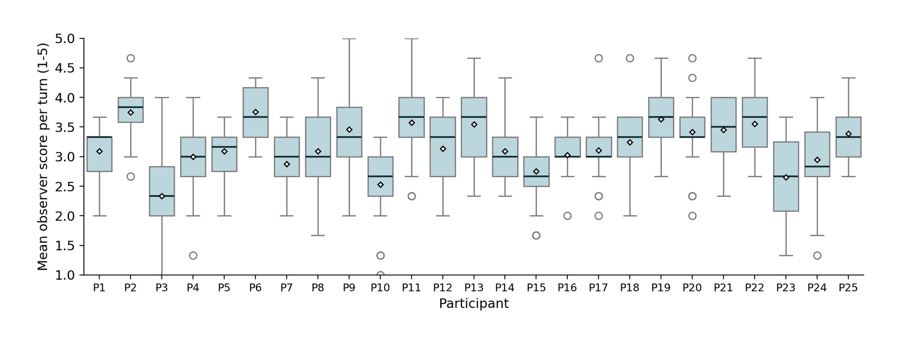
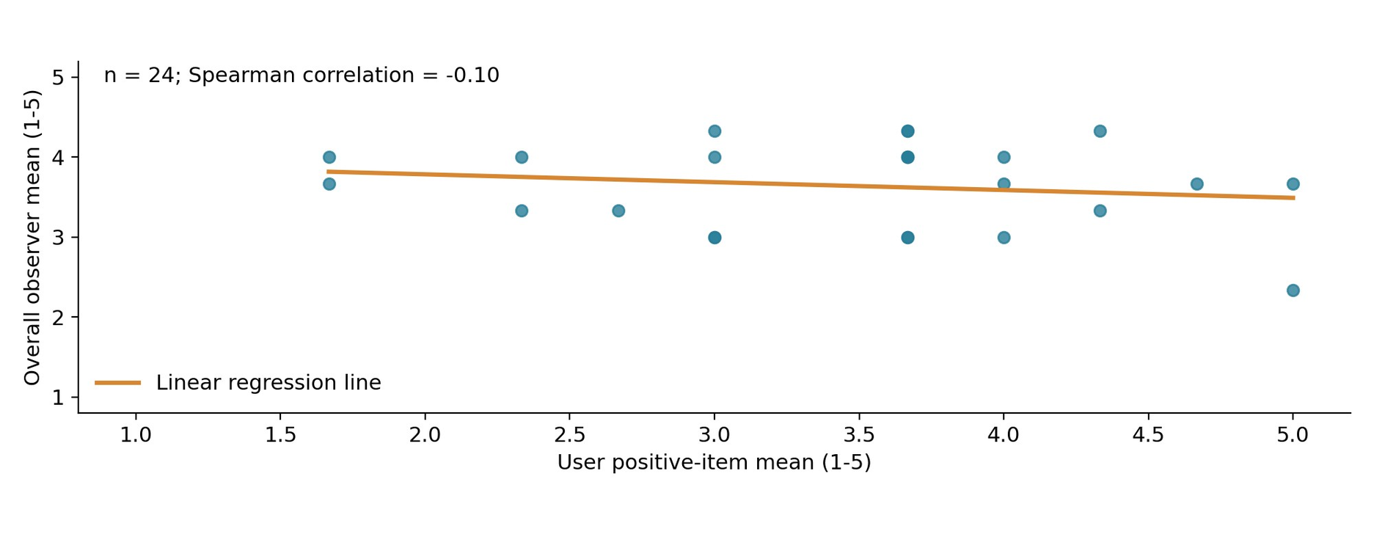
Preparing the data for analysis
HRI CUES main dataset
1 Read and check
2 Prepare and calculate
3 Answer with charts
Dataset
Turns
Survey
Example: first dialogue turn
Experience varies: boxplot
Rows
590
25
End 00:00:09,270
Start 00:00:00,000
Missing cells
0
1
Turn duration = 9.27 seconds
Keep P21 satisfaction missing
Ratings relate: scatterplot
24 complete pairs for comparison
Group by participant and average
Mean: 23.6 turns per person
Mean: 17.73 seconds per turn
read_csv, head, shape
info, describe
isna().sum().sum()
Time conversion, groupby, mean
merge, pivot
Matplotlib, Seaborn, Plotly
First, check the number of turns recorded for each person.
Report p. 4
05
Notes:
Preparing the data for analysis
1 Read and check
2 Prepare and calculate
3 Answer with charts
Dataset
Turns
Survey
Rows
Missing cells
Keep P21 satisfaction missing
24 complete pairs for comparison
Example: first dialogue turn
End 00:00:09,270
Start 00:00:00,000
Turn duration = 9.27 seconds
Group by participant and average
Mean: 23.6 turns per person
Mean: 17.73 seconds per turn
Time conversion, groupby, mean
merge, pivot
Experience varies: boxplot
Ratings relate: scatterplot
First, check the number of turns recorded for each person.
HRI CUES main dataset

Slide 6
Dialogue turns per participant
HRI CUES main dataset
Purpose: Check how interaction records are distributed across 25 participants.
Method: Count dialogue turns by participant and compare using a bar chart.
Finding: 590 turns from 25 people. More turns do not establish preference or continued use.
Turn counts describe data volume. Duration describes the interaction process.
Source: Irfan et al. (2024), Exchanges.
Figure 1 Report p. 5
06
Notes:
Dialogue turns per participant
Purpose: Check how interaction records are distributed across 25 participants.
Finding: 590 turns from 25 people. More turns do not establish preference or continued use.
Source: Irfan et al. (2024), Exchanges.
Method: Count dialogue turns by participant and compare using a bar chart.
Turn counts describe data volume. Duration describes the interaction process.
HRI CUES main dataset

Slide 7
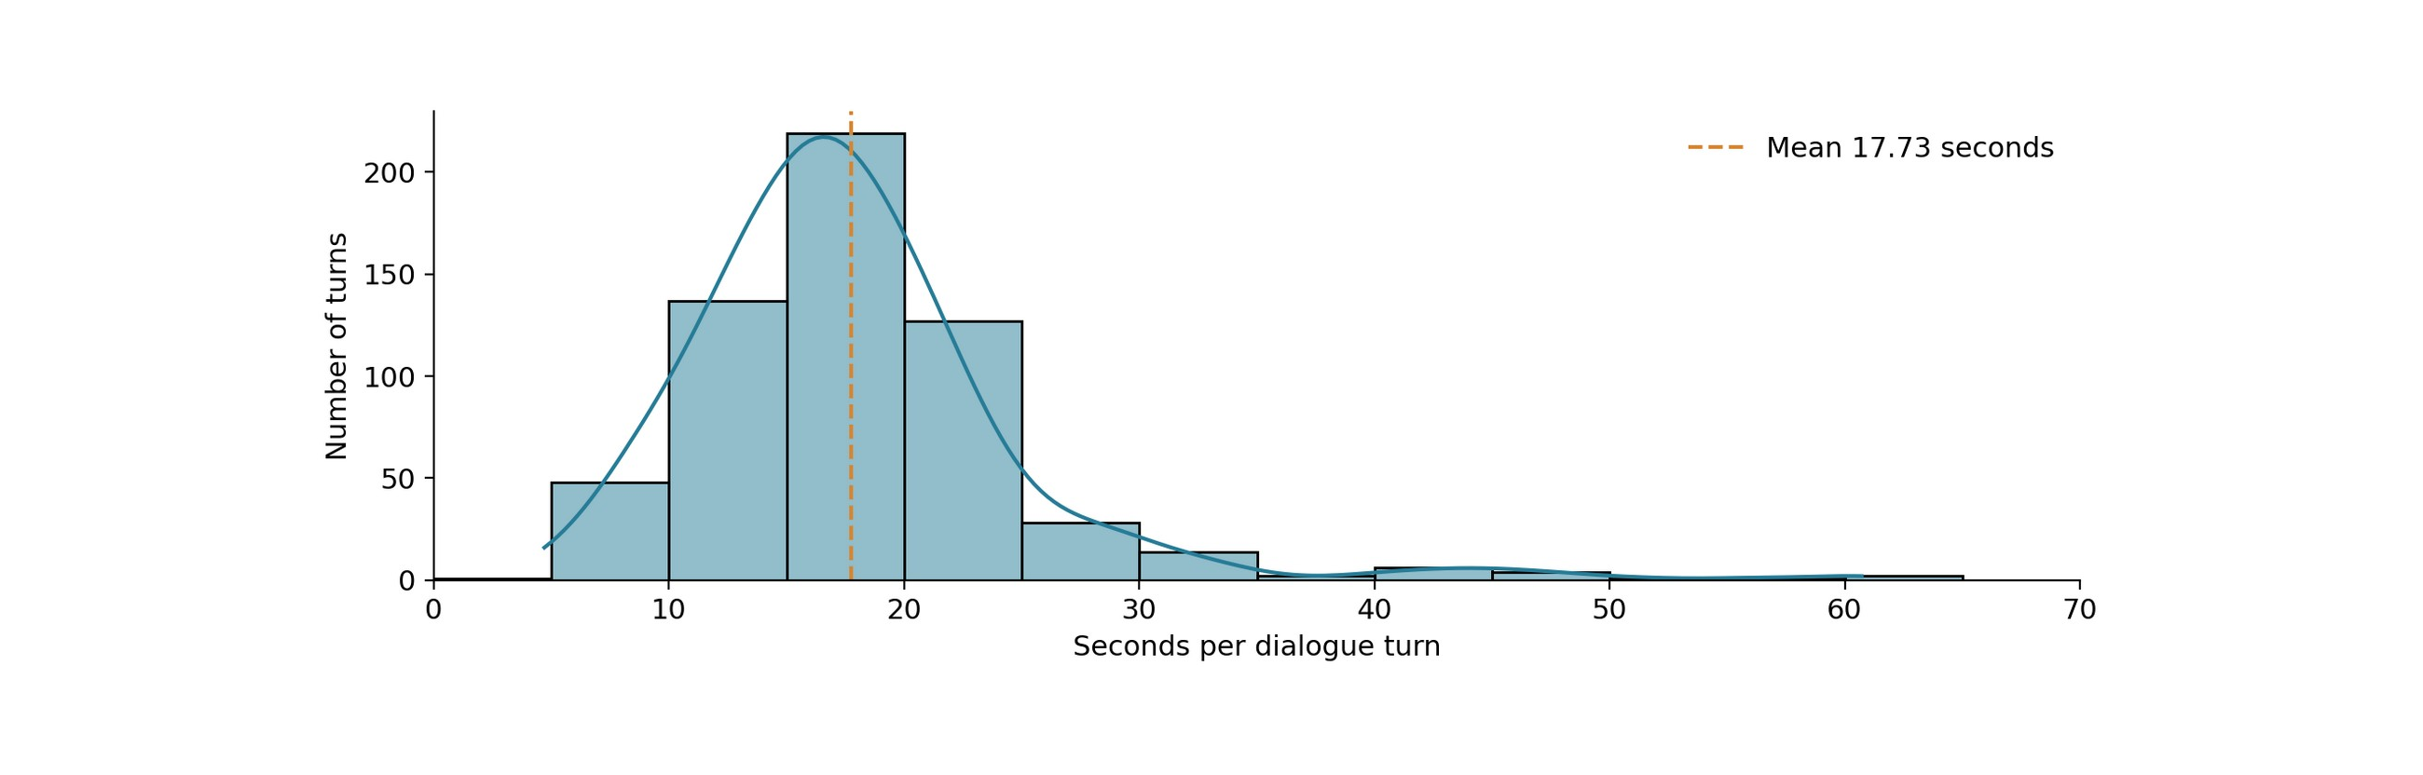
Dialogue turn duration
HRI CUES main dataset
Purpose: Describe the distribution of dialogue turn duration.
Method: Subtract start from end time. Use a histogram and KDE to describe the sample.
Finding: Mean duration is 17.73 seconds. Turns include both speakers and do not measure system latency.
Duration describes the process. Ratings provide a view of experience.
Source: Irfan et al. (2024), Exchanges. Author calculations.
Figure 2 Report p. 5
07
Notes:
Dialogue turn duration
Purpose: Describe the distribution of dialogue turn duration.
Finding: Mean duration is 17.73 seconds. Turns include both speakers and do not measure system latency.
Source: Irfan et al. (2024), Exchanges. Author calculations.
Method: Subtract start from end time. Use a histogram and KDE to describe the sample.
Duration describes the process. Ratings provide a view of experience.
HRI CUES main dataset

Slide 8
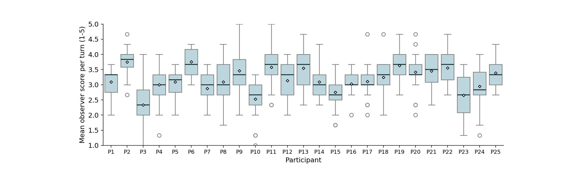
Observed enjoyment varies across turns
HRI CUES main dataset
Purpose: Examine variation within and between participants.
Method: Average the three observer scores for each turn, then plot by participant.
Finding: Scores vary. Line: median. White diamond: mean. Box: middle 50% of turns.
Do observers and users describe the same experience?
Source: Irfan et al. (2024), Exchanges. Author calculations.
Figure 3 Report p. 6
08
Notes:
Observed enjoyment varies across turns
Purpose: Examine variation within and between participants.
Finding: Scores vary. Line: median. White diamond: mean. Box: middle 50% of turns.
Source: Irfan et al. (2024), Exchanges. Author calculations.
Method: Average the three observer scores for each turn, then plot by participant.
Do observers and users describe the same experience?
HRI CUES main dataset

Slide 9
How users rated the interaction
HRI CUES main dataset
Purpose: Summarise user feedback and show the overall observer rating separately.
Method: Average four questionnaire items separately, plus the overall observer mean.
User reports: four survey items
Observers: overall rating
Finding: Fun averages 4.00. Higher strangeness means feeling more strange. The fifth measure is from observers.
The next comparison examines the relationship between these perspectives.
Source: Irfan et al. (2024), Overall. Author calculations.
Figure 4 Report p. 6
09
Notes:
How users rated the interaction
Purpose: Summarise user feedback and show the overall observer rating separately.
Finding: Fun averages 4.00. Higher strangeness means feeling more strange. The fifth measure is from observers.
Source: Irfan et al. (2024), Overall. Author calculations.
Method: Average four questionnaire items separately, plus the overall observer mean.
The next comparison examines the relationship between these perspectives.
User reports: four survey items
Observers: overall rating
HRI CUES main dataset

Slide 10
User and observer ratings
HRI CUES main dataset
Purpose: Compare user reports with overall observer ratings.
Method: Pair 24 complete three-positive-item averages with overall observer means.
24 complete respondents Spearman = -0.10
Finding: Spearman is about -0.10, a weak association. The orange fit does not establish causation or prediction.
User and observer ratings differ. How much do observers differ from each other?
Source: Irfan et al. (2024), Overall. Author calculations.
Figure 5 Report p. 7
10
Notes:
User and observer ratings
Purpose: Compare user reports with overall observer ratings.
Finding: Spearman is about -0.10, a weak association. The orange fit does not establish causation or prediction.
Source: Irfan et al. (2024), Overall. Author calculations.
Method: Pair 24 complete three-positive-item averages with overall observer means.
User and observer ratings differ. How much do observers differ from each other?
24 complete respondents Spearman = -0.10
HRI CUES main dataset

Slide 11
Score differences between observers
HRI CUES main dataset
Purpose: Describe differences between the three ratings of each turn.
Method: Subtract the lowest from the highest score per turn, then count each gap.
Finding: Blue: 478 turns (81.0%). Orange: 112 (19.0%). Score spread is descriptive only.
The workshop does not measure continued use. Product studies provide further context.
Source: Irfan et al. (2024), Exchanges. Author calculations.
Figure 6 Report p. 7
11
Notes:
Score differences between observers
Purpose: Describe differences between the three ratings of each turn.
Finding: Blue: 478 turns (81.0%). Orange: 112 (19.0%). Score spread is descriptive only.
Source: Irfan et al. (2024), Exchanges. Author calculations.
Method: Subtract the lowest from the highest score per turn, then count each gap.
The workshop does not measure continued use. Product studies provide further context.
HRI CUES main dataset

Slide 12
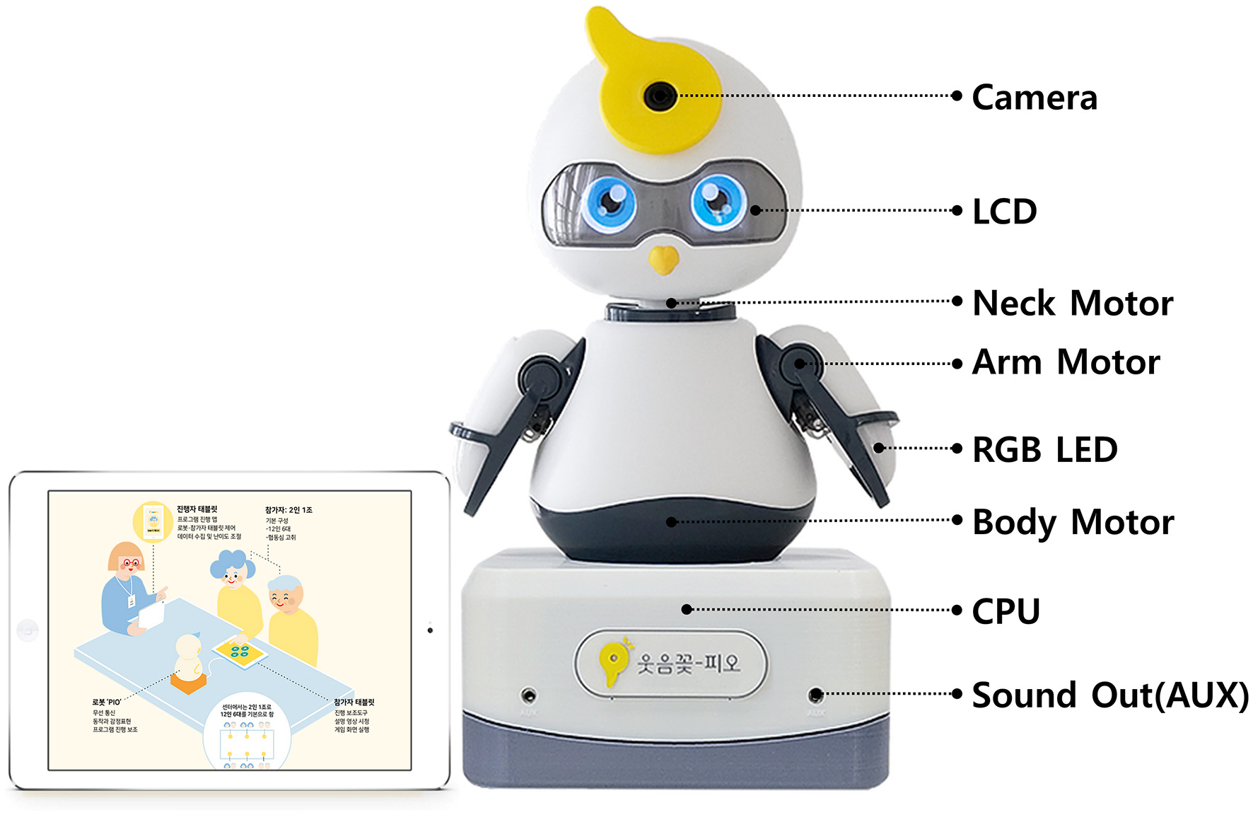
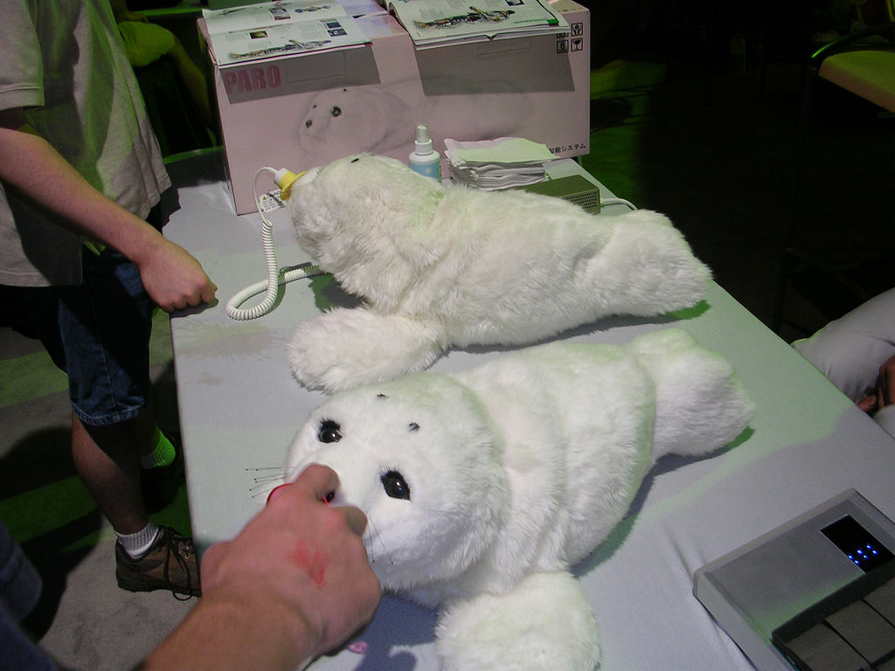
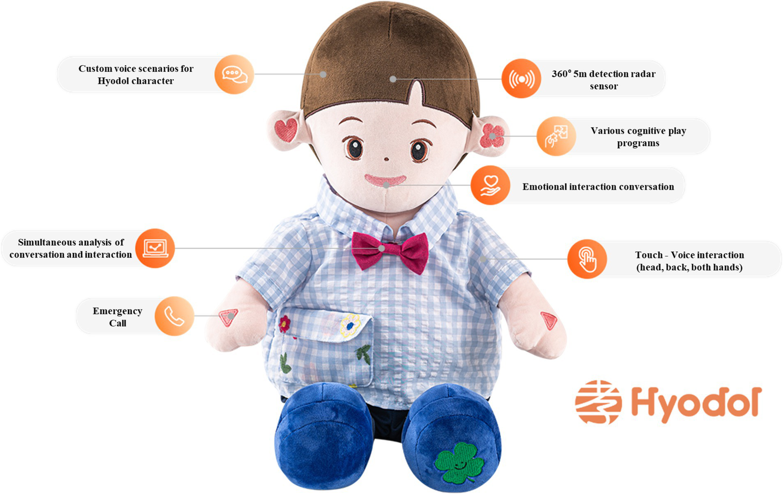
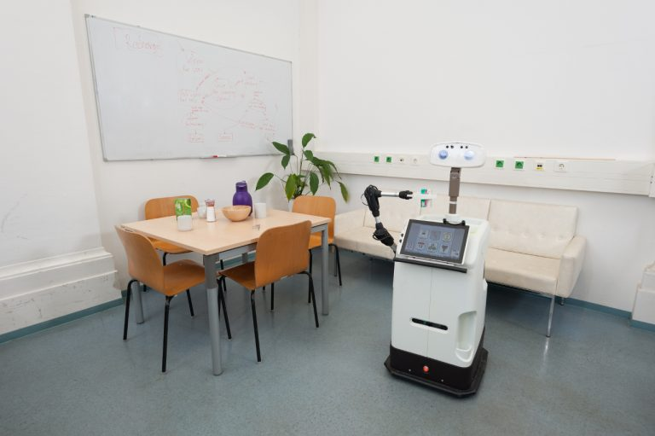
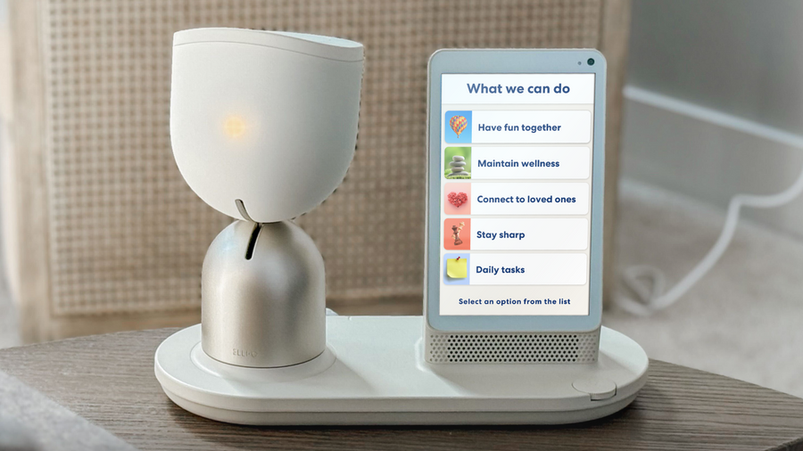
Continued use after a short interaction
ElliQ
PIO
PARO
Hyodol
Hobbit
Desktop conversation and activities
Parrot shaped activity robot
Seal shaped interaction robot
Doll retention and return
Mobile home support prototype
Different participants, periods and measures. These studies supplement the workshop evidence.
First, examine ElliQ activity shares and user feedback.
Product appendix: Report pp. 19-21
12
Notes:
Continued use after a short interaction
Product appendix: Report pp. 19-21
Desktop conversation and activities
Parrot shaped activity robot
Seal shaped interaction robot
Doll retention and return
Mobile home support prototype
Different participants, periods and measures. These studies supplement the workshop evidence.
First, examine ElliQ activity shares and user feedback.
Sources:
https://elliq.com/
https://doi.org/10.3389/fpubh.2023.1097485
https://commons.wikimedia.org/wiki/File:Paro_robot.jpg
https://doi.org/10.3389/fpubh.2024.1424123
https://www.acin.tuwien.ac.at/en/vision-for-robotics/roboter/hobbit/

Slide 13
ElliQ activity categories
Purpose: Understand the reported uses of a companion product.
ElliQ
Method: Sort reported activity shares and compare them in a horizontal bar chart.
Finding: Companionship accounts for 40.1% of activities. This is not a treatment effect or a share of users.
Activity shares describe use. User feedback describes reported experience.
Source: Intuition Robotics (2026), p. 6.
Figure 8 Report p. 8
13
Notes:
ElliQ activity categories
Purpose: Understand the reported uses of a companion product.
Finding: Companionship accounts for 40.1% of activities. This is not a treatment effect or a share of users.
Source: Intuition Robotics (2026), p. 6.
Method: Sort reported activity shares and compare them in a horizontal bar chart.
Activity shares describe use. User feedback describes reported experience.
Sources:
https://elliq.com/

Slide 14
ElliQ self-reported feedback
Purpose: Examine users' reported experience with ElliQ.
ElliQ
Method: Compare four published positive-response percentages.
Finding: 94% reported feeling less lonely. Item sample sizes are unspecified. Scores did not fall by 94%.
Self-reports offer a clue. PIO provides a separate before-and-after comparison.
Source: Intuition Robotics (2026), p. 3.
Figure 9 Report p. 8
14
Notes:
ElliQ self-reported feedback
Purpose: Examine users' reported experience with ElliQ.
Finding: 94% reported feeling less lonely. Item sample sizes are unspecified. Scores did not fall by 94%.
Source: Intuition Robotics (2026), p. 3.
Method: Compare four published positive-response percentages.
Self-reports offer a clue. PIO provides a separate before-and-after comparison.
Sources:
https://elliq.com/

Slide 15
PIO loneliness scores over six weeks
Purpose: Compare mean loneliness scores before and after six weeks.
PIO
Method: Compare baseline and Week 6 means for 31 activity-group and 33 control participants.
Finding: PIO group: 42.45 to 31.19. Groups were not randomised and activities included staff. Lower is better.
The next chart expresses these results as observed decreases.
Source: Lim (2023), Table 4.
Figure 10 Report p. 9
15
Notes:
PIO loneliness scores over six weeks
Purpose: Compare mean loneliness scores before and after six weeks.
Finding: PIO group: 42.45 to 31.19. Groups were not randomised and activities included staff. Lower is better.
Source: Lim (2023), Table 4.
Method: Compare baseline and Week 6 means for 31 activity-group and 33 control participants.
The next chart expresses these results as observed decreases.
Sources:
https://doi.org/10.3389/fpubh.2023.1097485

Slide 16
PIO observed decrease by group
Purpose: Express the before-and-after scores as decreases for comparison.
PIO
Method: Subtract Week 6 from baseline in each group, then compare decreases.
Finding: The observed decrease differs by 10.71 points. Staff-led activities prevent isolating the robot's contribution.
Does improvement persist? PARO provides separate follow-up evidence.
Source: Lim (2023), Table 4. Author calculations.
Figure 11 Report p. 9
16
Notes:
PIO observed decrease by group
Purpose: Express the before-and-after scores as decreases for comparison.
Finding: The observed decrease differs by 10.71 points. Staff-led activities prevent isolating the robot's contribution.
Source: Lim (2023), Table 4. Author calculations.
Method: Subtract Week 6 from baseline in each group, then compare decreases.
Does improvement persist? PARO provides separate follow-up evidence.
Sources:
https://doi.org/10.3389/fpubh.2023.1097485

Slide 17
PARO change at Weeks 6 and 10
Purpose: Examine whether observed changes persist at follow-up.
PARO
Method: Compare change from baseline in both groups at Weeks 6 and 10.
Finding: PARO decreased 5.36 points at Week 6 and 1.52 at Week 10. Week 10 difference: p=.07, inconclusive.
Beyond score changes, do users keep the product?
Source: Chen et al. (2024), Table 4.
Figure 12 Report p. 10
17
Notes:
PARO change at Weeks 6 and 10
Purpose: Examine whether observed changes persist at follow-up.
Finding: PARO decreased 5.36 points at Week 6 and 1.52 at Week 10. Week 10 difference: p=.07, inconclusive.
Source: Chen et al. (2024), Table 4.
Method: Compare change from baseline in both groups at Weeks 6 and 10.
Beyond score changes, do users keep the product?
Sources:
https://commons.wikimedia.org/wiki/File:Paro_robot.jpg

Slide 18
Hyodol retention after four months
Purpose: Describe retention and return in the original cohort.
Hyodol
Method: Use all 41 original participants as the denominator for each percentage.
Finding: Kept 58.5%, returned at four months 26.8%, returned within one week 14.6%. Free use is not purchase.
Retention describes the outcome. Return reasons suggest possible improvements.
Source: Lee et al. (2024), Methods 2.2 and Results 3.4.
Figure 13 Report p. 10
18
Notes:
Hyodol retention after four months
Finding: Kept 58.5%, returned at four months 26.8%, returned within one week 14.6%. Free use is not purchase.
Source: Lee et al. (2024), Methods 2.2 and Results 3.4.
Purpose: Describe retention and return in the original cohort.
Method: Use all 41 original participants as the denominator for each percentage.
Retention describes the outcome. Return reasons suggest possible improvements.
Original cohort
41 people
Kept
24 (58.5%)
Returned at 4 months
11 (26.8%)
Returned within 1 week
6 (14.6%)
Sources:
https://doi.org/10.3389/fpubh.2024.1424123

Slide 19
Why users returned Hyodol
Purpose: Identify barriers that could inform design tests.
Hyodol
Method: Count reasons from 11 four-month returners. Multiple responses are allowed.
Finding: Sound disturbance: 5 people. Prerecorded content: 4. Test volume, quiet times and topic choices.
Interaction settings suggest a starting point. Support functions need separate testing.
Source: Lee et al. (2024), Table 4.
Figure 14 Report p. 11
19
Notes:
Why users returned Hyodol
Purpose: Identify barriers that could inform design tests.
Finding: Sound disturbance: 5 people. Prerecorded content: 4. Test volume, quiet times and topic choices.
Source: Lee et al. (2024), Table 4.
Method: Count reasons from 11 four-month returners. Multiple responses are allowed.
Interaction settings suggest a starting point. Support functions need separate testing.
Sources:
https://doi.org/10.3389/fpubh.2024.1424123

Slide 20
Fraud scenarios for Guardian testing
Purpose: Design scenarios involving suspicious calls and software installation requests.
Method: Compare six selected US complaint categories for people over 60 in 2023.
Finding: Tech Support has 17,696 complaints. US counts do not measure Hong Kong risk or prevention.
Complaint counts help choose scenarios. Workflow reliability still needs testing.
Source: FBI (2024), 2023 Elder Fraud Report, p. 7.
Figure 16 Report p. 12
20
Notes:
Fraud scenarios for Guardian testing
Purpose: Design scenarios involving suspicious calls and software installation requests.
Finding: Tech Support has 17,696 complaints. US counts do not measure Hong Kong risk or prevention.
Source: FBI (2024), 2023 Elder Fraud Report, p. 7.
Method: Compare six selected US complaint categories for people over 60 in 2023.
Complaint counts help choose scenarios. Workflow reliability still needs testing.

Slide 21
Hobbit prototype feature availability
Purpose: Identify prototype functions and workflows that require testing.
Hobbit
Method: Compare availability (%). Users tried Device first, then Companion mode.
Feature | Companion mode | Device mode
Stop command | 87.11 | 82.86
Call robot | 79.30 | 81.79
Learn new object | 49.61 | 50.00
Pick up object | 19.53 | 23.21
Bring object | 16.80 | 21.43
Calendar reminder | 32.81 | 35.36
Go to location | 81.64 | 77.86
Emergency function | 75.78 | 70.71
Follow user | 21.09 | 20.36
Approach user | 85.94 | 83.57
Finding: Working over days in use is an availability indicator, not detection accuracy or rescue success.
Use reported experience and function limitations to propose improvements.
Source: Bajones et al. (2018), Table 2.
Figure 15 Report p. 12
21
Notes:
Hobbit prototype feature availability
Purpose: Identify prototype functions and workflows that require testing.
Finding: Working over days in use is an availability indicator, not detection accuracy or rescue success.
Source: Bajones et al. (2018), Table 2.
Method: Compare reported availability in Companion and Device modes using colour and values.
Use reported experience and function limitations to propose improvements.
Sources:
https://www.acin.tuwien.ac.at/en/vision-for-robotics/roboter/hobbit/
Device mode came first, followed by Companion mode. The study used sequential conditions. Working over days in use includes partial working days. It does not estimate detection accuracy, per-task success or rescue rates.

Slide 22
Improvements suggested by the evidence
Evidence | Improvement to test
Individual experience varies | Topic choices and brief user feedback
Sound and content can disturb users | Volume, quiet times and a clear stop option
Suspicious technical requests | Pause and verify with a trusted person
Prototype function availability varies | Notification confirmation and human fallback
Evidence supports design tests. Long-term outcomes still need local validation.
The Guardian proposal puts these ideas into everyday scenarios.
Report p. 13
22
Notes:
Improvements suggested by the evidence
Evidence supports design tests. Long-term outcomes still need local validation.
The Guardian proposal puts these ideas into everyday scenarios.

Slide 23

Guardian proposal: companionship and support
Everyday companionship
Verification and authorised help
Choose topics, adjust volume and stop the interaction
Pause, verify and contact a trusted person with consent
Proposed scenarios. AI-generated illustration, not a real product or validated function.
The next step is a four-week pilot to find usability and workflow problems.
Report p. 14
23
Notes:
Guardian proposal: companionship and support
Everyday companionship
Share photos and let users choose topics
Verification and authorised help
Prompt verification and contact family with consent
Proposed scenarios. AI-generated illustration, not a real product or validated function.
The next step is a four-week pilot to find usability and workflow problems.
The Guardian functions and trial are proposals. No new participant data or validated safety outcomes are reported.

Slide 24
Proposed four-week pilot
Week | Main procedure | Records
1 | Agree topics, volume and consent | Stopping and withdrawal
2 | Staff test 20 scripted cases and failures | False alarms, missed prompts, delivery, delay and acknowledgement
3 | Five volunteers try fictional scenarios with staff present | Understanding, stopping and willingness to use again
4 | Fix problems and retest | Review further supervised use
Proposed scale only. No new participants or completed tests are reported.
Which records would support a decision after testing?
Report p. 15
24
Notes:
Proposed four-week pilot
Proposed scale only. No new participants or completed tests are reported.
Which records would support a decision after testing?
The Guardian functions and trial are proposals. No new participant data or validated safety outcomes are reported.
Before testing, define the expected response for each of the 20 scripted cases. Five volunteers would take part with staff present. The proposed tests have not been conducted.

Slide 25
Records needed before a larger trial
Can users understand prompts and stop independently?
Are simulated messages and notifications fully recorded?
Have known notification failures been fixed and retested?
The team and centre review the records before deciding on a larger supervised trial.
Review user actions and notification records before expanding.
Report p. 15
25
Notes:
Records needed before a larger trial
Can users understand prompts and stop independently?
Are simulated messages and notifications fully recorded?
Have known notification failures been fixed and retested?
The team and centre review the records before deciding on a larger supervised trial.
Review user actions and notification records before expanding.
The Guardian functions and trial are proposals. No new participant data or validated safety outcomes are reported.
A false alarm is a warning in a scripted case predefined as requiring no warning. A missed prompt is no warning in a case predefined as requiring one. Missed acknowledgement and delivery failure are separate workflow problems. The team must confirm stopping, withdrawal and retesting of known failures before considering further supervised use.

Slide 26
Recommendations for development
User suitability determines development priorities
Main data show individual experience varies
Product studies add continued-use evidence
Support functions require independent testing
Recommendation: run the four-week pilot, then review whether to expand
Report pp. 14-15
26
Notes:
Recommendations for development
User suitability determines development priorities
Main data show individual experience varies
Product studies add continued-use evidence
Support functions require independent testing
Recommendation: run the four-week pilot, then review whether to expand
The Guardian functions and trial are proposals. No new participant data or validated safety outcomes are reported.

Slide 27
Research data and references
Main dataset: Irfan et al. (2024), anonymised HRI CUES dataset
https://doi.org/10.5281/zenodo.12588810
Scale paper: Irfan et al. (2026), HRI CUES
https://doi.org/10.1109/TAFFC.2025.3590359
Supplementary sources
Census and Statistics Department (2023), population projections
Intuition Robotics (2026), ElliQ programme report
Lim (2023), PIO; Chen et al. (2024), PARO
Lee et al. (2024), Hyodol; Bajones et al. (2018), Hobbit
FBI (2024), 2023 Elder Fraud Report
Full references: Report pp. 16-17 and the source documentation.
Report pp. 16-17
27
Notes:
Research data and references
Main dataset
Irfan et al. (2024), anonymised HRI CUES dataset
https://doi.org/10.5281/zenodo.12588810
Supplementary sources
Census and Statistics Department (2023), population projections
Intuition Robotics (2026), ElliQ programme report
Lim (2023), PIO; Chen et al. (2024), PARO
Lee et al. (2024), Hyodol; Bajones et al. (2018), Hobbit
FBI (2024), 2023 Elder Fraud Report
Full references: Report pp. 16-17 and the source documentation.

Slide 28
Product illustrations and price context
Product forms and uses provide context for the analysis
ElliQ
PIO
PARO
Desktop device and tablet
Parrot shaped robot
Seal shaped robot
Conversation and everyday activities.
Staff-led cognitive and social activities.
Group interaction and companionship.
Recorded US annual fee: USD 588
Plus USD 249 rental initiation fee
Current retail price unverified
Supplier quotation required
Historical reference: USD 6,000
US launch price in 2009
Related analysis: Figures 8 and 9
Related analysis: Figures 10 and 11
Related analysis: Figure 12
Price context recorded on 15 October 2026. Original currencies. Rental fees, historical prices and targets differ.
28
Notes:
Product illustrations and price context
Product forms and uses provide context for the analysis
Desktop device and tablet
Conversation and everyday activities.
Recorded US annual fee: USD 588
Plus USD 249 rental initiation fee
Related analysis: Figures 8 and 9
Parrot shaped robot
Staff-led cognitive and social activities.
Current retail price unverified
Supplier quotation required
Related analysis: Figures 10 and 11
Seal shaped robot
Group interaction and companionship.
Historical reference: USD 6,000
US launch price in 2009
Related analysis: Figure 12
Price context recorded on 15 October 2026. Original currencies. Rental fees, historical prices and targets differ.
Sources:
https://elliq.com/products/membership
https://elliq.com/
https://doi.org/10.3389/fpubh.2023.1097485
https://www.parorobots.com/pdf/pressreleases/PARO%20Robots%20US-Press%20Release%202009-11-04.pdf
https://commons.wikimedia.org/wiki/File:Paro_robot.jpg

Slide 29
Retention and home support products
Continued-use experience and home functions supplement the interaction analysis
Hyodol
Hobbit
Doll shaped companion robot
Mobile home support prototype
Home companionship, studied through retention and return.
A wheeled research prototype with a screen and robotic arm.
Current retail price unverified
Supplier quotation required
Historical target: below EUR 14,000
Research target, not current retail price
Related analysis: Figures 13 and 14
Related analysis: Figure 15
Price context recorded on 15 October 2026. Original currencies. Rental fees, historical prices and targets differ.
29
Notes:
Retention and home support products
Continued-use experience and home functions supplement the interaction analysis
Doll shaped companion robot
Home companionship, studied through retention and return.
Current retail price unverified
Supplier quotation required
Related analysis: Figures 13 and 14
Mobile home support prototype
A wheeled research prototype with a screen and robotic arm.
Historical target: below EUR 14,000
Research target, not current retail price
Related analysis: Figure 15
Price context recorded on 15 October 2026. Original currencies. Rental fees, historical prices and targets differ.
Sources:
https://doi.org/10.3389/fpubh.2024.1424123
https://www.acin.tuwien.ac.at/en/project/hobbit/
https://www.acin.tuwien.ac.at/en/vision-for-robotics/roboter/hobbit/

