Slide 1
Security checklist for Web Developers
Lidiia ‘Alice’ Skalytska
OWASP Kyiv 2017

Slide 2
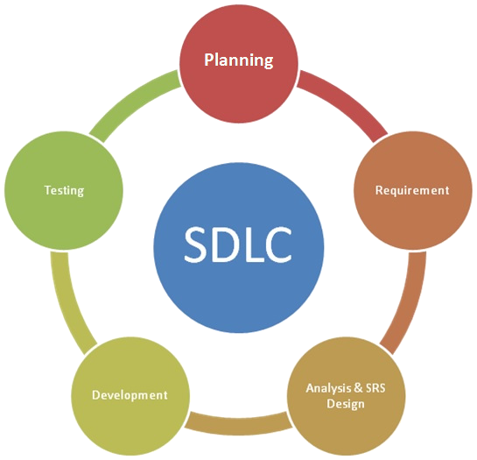
Software development lifecycle

Slide 3
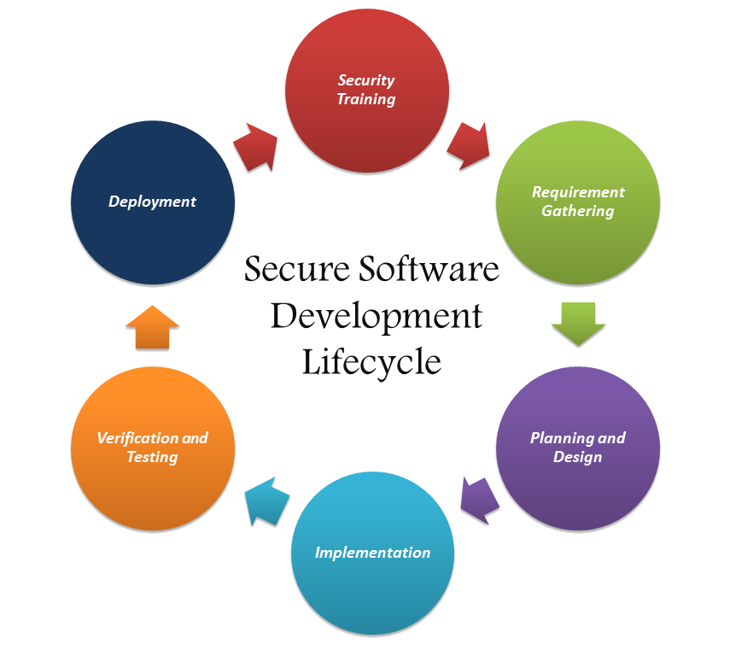
Secure Software development lifecycle

Slide 4
Planning
Analyze your application
threat modeling
user interface flaws
data presentation flaws
Usability
create applications that users understand and like to use
Security incident plan
build security incident plan. One day, you will need it.

Slide 5
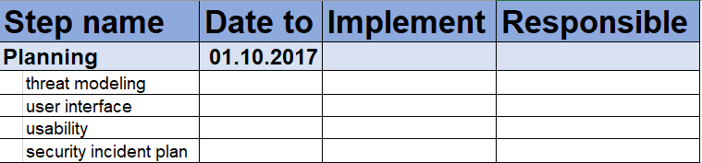

Slide 6
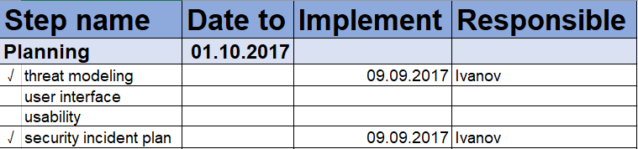

Slide 7
Development / Implementation
Authentication
Database
Input / output / validate
Web Traffic
Logs
The 3rd party components

Slide 8
Authentication
Use Facebook / Google / etc. Login
Use multi-factor authentication
Implement Proper Password Strength Controls
Ensure all passwords are hashed
Implement Secure Password Recovery Mechanism
Never write your own crypto
Prevent Brute-Force Attacks

Slide 9
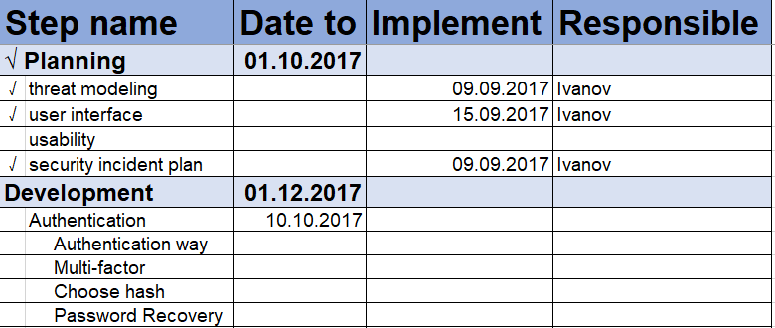

Slide 10
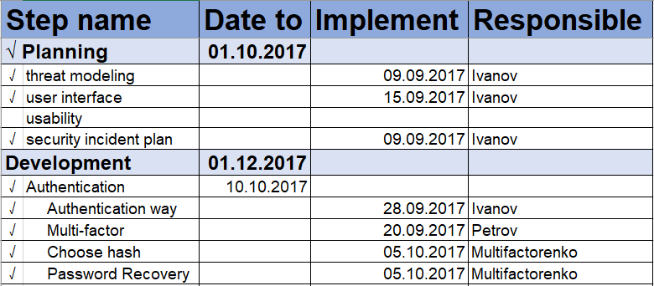

Slide 11
Database
Access control
Use minimal privilege user account
If you can use crypto, use it!
Store backups in other place(s)
Encrypt backups

Slide 12
Input / Output / Validate
Client-side and server-side input validation
Always validate and encode user input before displaying
Never use untrusted user input
Input data is always suspect

Slide 13
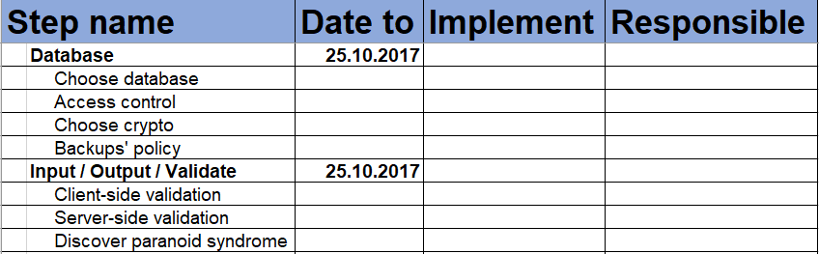

Slide 14
Web Traffic
TLS
Use TLS for the entire site
Cookies
Cookies must be httpOnly and secure
HSTS
Use HSTS responses

Slide 15
Logs
All user account management activity
Every access control related events
Application errors and system events
Changes to application configuration settings
You need readable logs (who? when? where?)

Slide 16
The 3rd party components
Libraries
internally or externally
keep them small
check vendor reputation
APIs
use a special key to access
testing inputs and outputs
check vendor reputation
Microservices
each microservice is separate
use JSON
use TLS

Slide 17
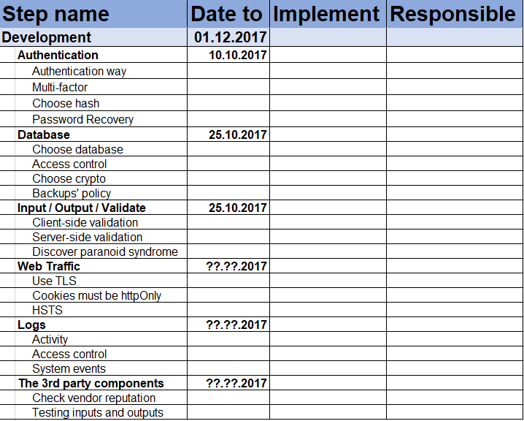

Slide 18
Testing
Create a testing plan
1
Audit your design and implementation
2
Do penetration testing
3
Think like a hacker
4

Slide 19
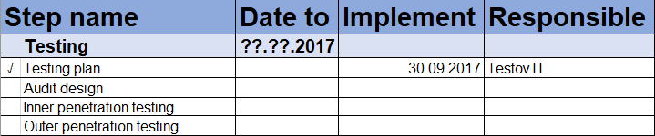

Slide 20
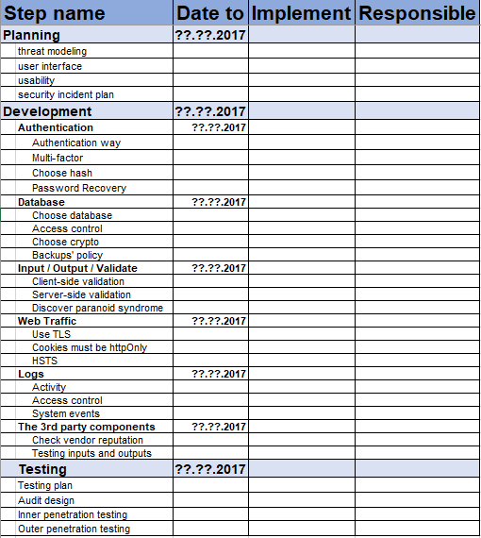
Resume
Planning
Development
Testing

Slide 21
Questions?
Security checklist
for Web Developers
alice.bizarius@gmail.com
securit13podcast@gmail.com
http://securit13.libsyn.com/
@alice_kaifat

