Slide 2
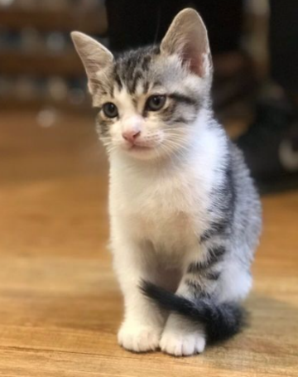
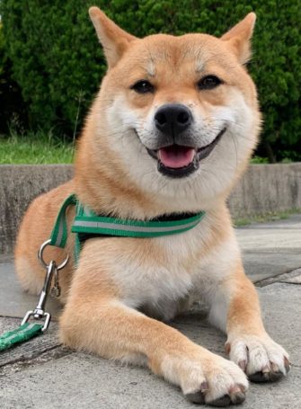
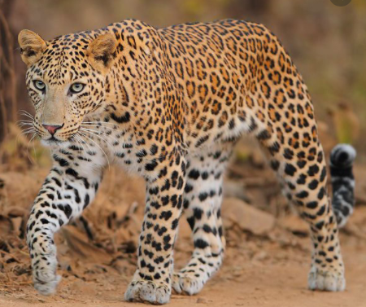
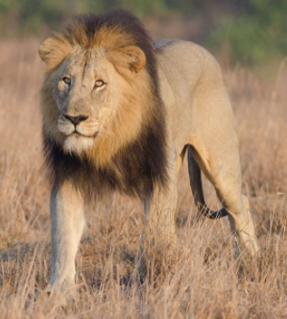
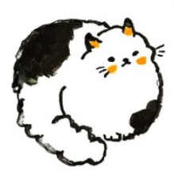
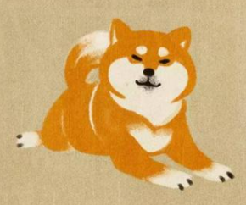
Transfer Learning
Target data
Task:
貓狗分類
Source data
Domain相似 Task不同
Domain不同 Task相同

Slide 3
Domain Adaptation
Task 是 Target domain，但 Target data 沒有或是部分標註，Source data皆有標註
資料是相同性質(都是影像或都是語音)
D^{s}
D^{t}
D^{s} ≠ D^{t}
T^{s} = T^{t}
Domain不同
Task相同
Source
皆有標註
Target
沒有或是部分標註

Slide 4
Features
Target
Domain Adaptation
Target
Source
Source
不同特徵空間
Classifier Bad
相同特徵空間
Classifier Good

Slide 5
Methods
1.Discrepancy
2.Adversarial
3.Reconstruction

Slide 6
Discrepancy
feature extractor
Target
透過一些統計手法，
例如：loss function，
使兩個domain之間的距離
更加接近
Distance close
feature extractor
Source

Slide 7
Discrepancy Methods
Deep Domain Confusion (MMD)
Deep Adaptation Networks
CORAL, CMD

Slide 8
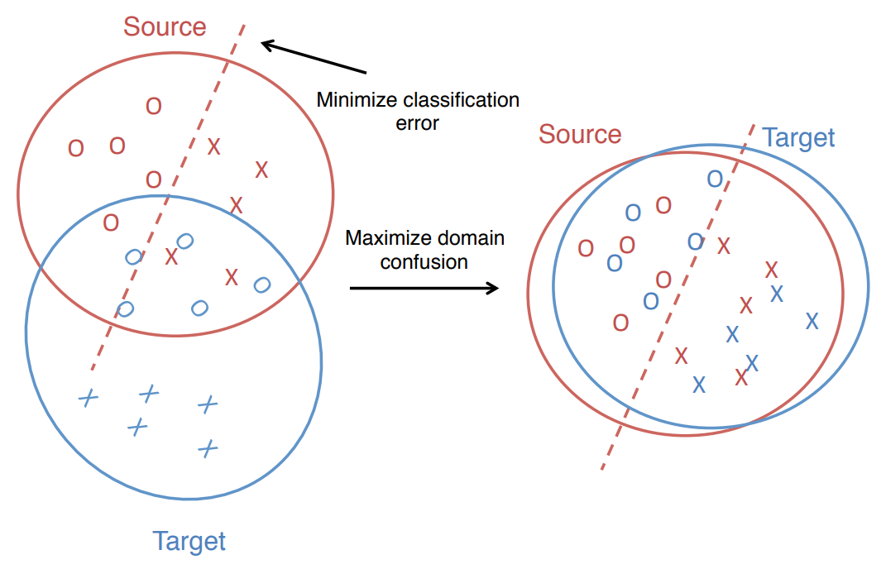
Deep Domain Confusion
Deep Domain Confusion: Maximizing for Domain Invariance
Arxiv: https://arxiv.org/abs/1412.3474/

Slide 9
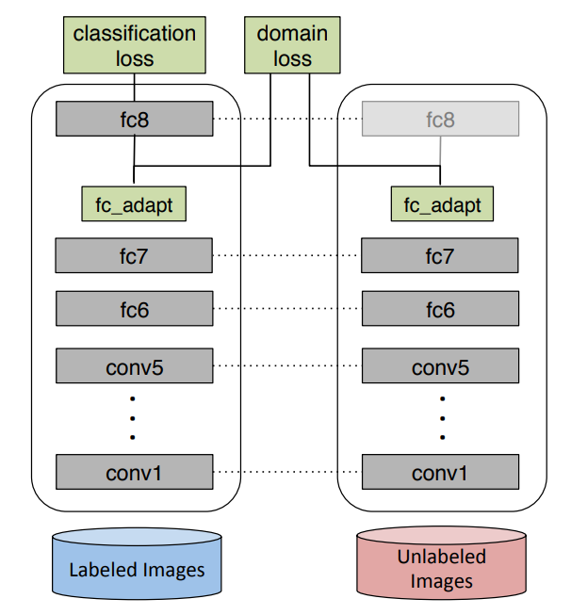
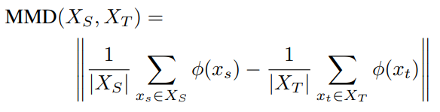

Deep Domain Confusion
Maximum Mean Discrepancy (MMD)
測量特徵分布之間的距離
Objective Function
Classification + MMD
Source
Target

Slide 10
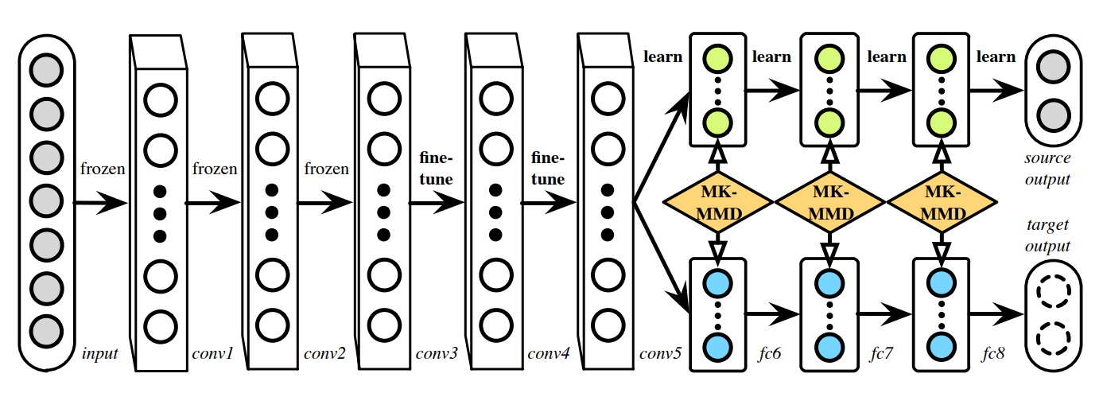
Deep Adaptation Networks
Learning Transferable Features with Deep Adaptation Networks
Arxiv: https://arxiv.org/abs/1502.02791/
Multiple Kernel MMD
Single adaption layer → Multiple adaption layers

Slide 11
Adversarial
Feature extractor
Target
Domain
Classifier
混淆
Feature extractor
Source
透過 Domain Classifier 分辨特徵來自 Target domain 還是 Source domain，若分辨不出，表示在相同特徵空間內

Slide 12
Adversarial Methods
Simultaneous Deep Transfer Across Domains and Tasks
Domain Adversarial Training of Neural Networks (DANN)
PixelDA

Slide 13
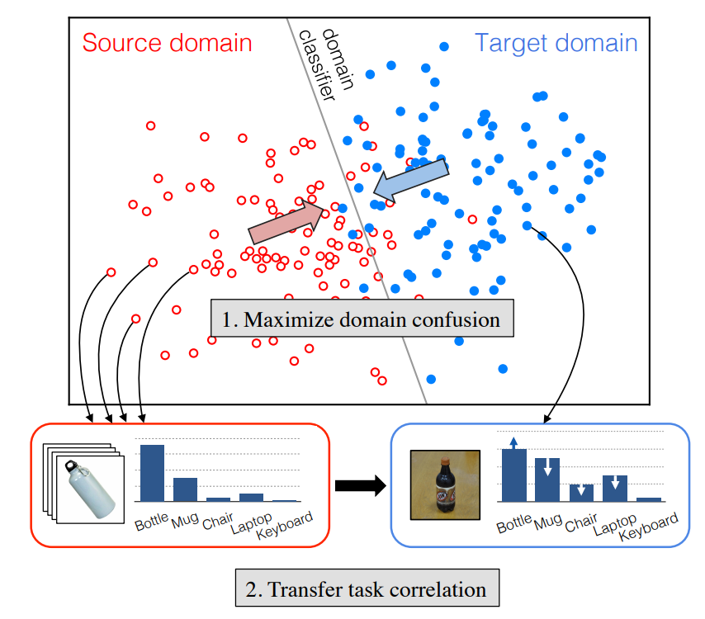
Simultaneous Deep Transfer Across Domains and Tasks
Arxiv: https://arxiv.org/abs/1510.02192/
提出 Domain Classifier 概念
Simultaneous
1.Maximum Domain Confusion:
加入 domain classifier
2.Transfer task correlation:
Soft-label loss

Slide 14
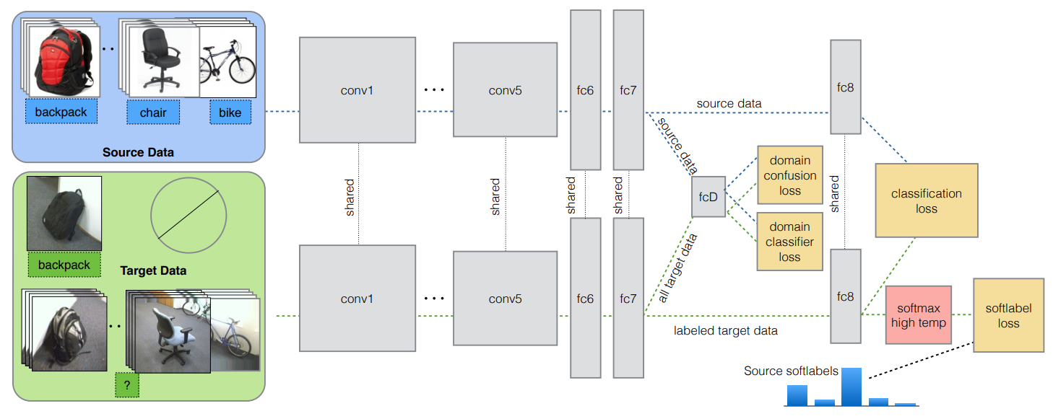
Domain Confusion

Slide 15
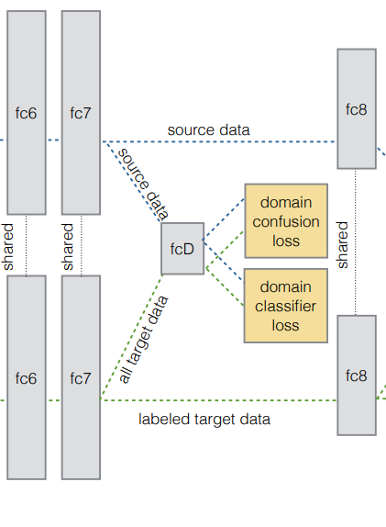
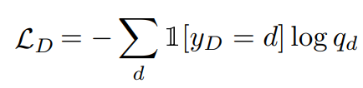
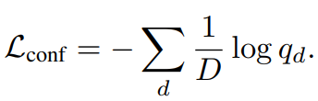
Domain Confusion
Source
Domain classifier loss:
判斷特徵來自哪個 Domain
Target
Domain confusion loss:
讓 Domain classifier 混淆

Slide 16
Domain Confusion
Domain
Distribution
0.6
Domain classifier loss:
Learn a good domain classifier
0.4
Feature extractor
Source
(label:1)
Domain
Classifier
0
1
Feature
Freeze weights
1
- ( 1 * log(0.6) + 0 * log(0.4) ) 0.2218
~
0
0
1

Slide 17
Domain Confusion
Domain
Distribution
0.6
Domain confusion loss:
Learn a representation that confuses the classifier
0.4
Feature extractor
Source
(label:1)
Domain
Classifier
0
1
Feature
Freeze weights
0.5
0.5
- ( 0.4 * log(0.5) + 0.6 * log(0.5) ) 0.3
~
0
1

Slide 18
Label Correlation

Slide 19
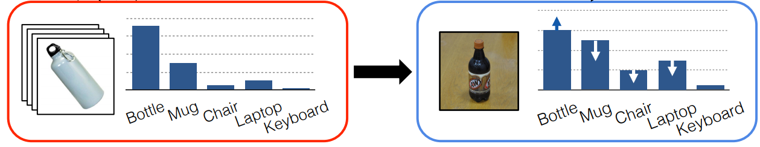
Label Correlation
Source
Target
0.7
0.5 -> 0.7
0.3 -> 0.2
0.2
Class distributions of source and target should be similar

Slide 20
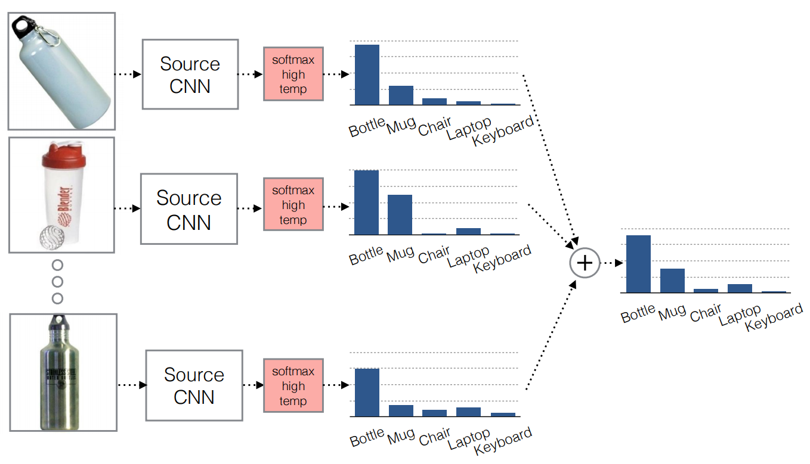
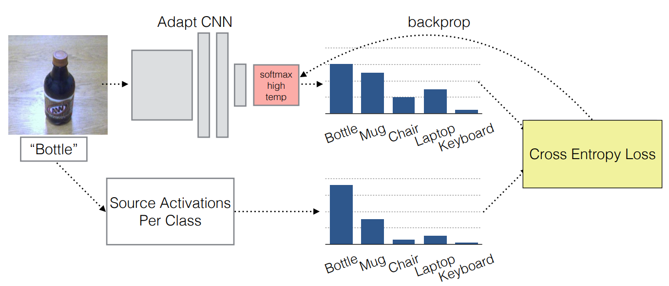
Label Correlation
Source
Target
Class 分布越接近越好

Slide 21

Simultaneous Deep Transfer Across Domains and Tasks
= + +

Slide 22
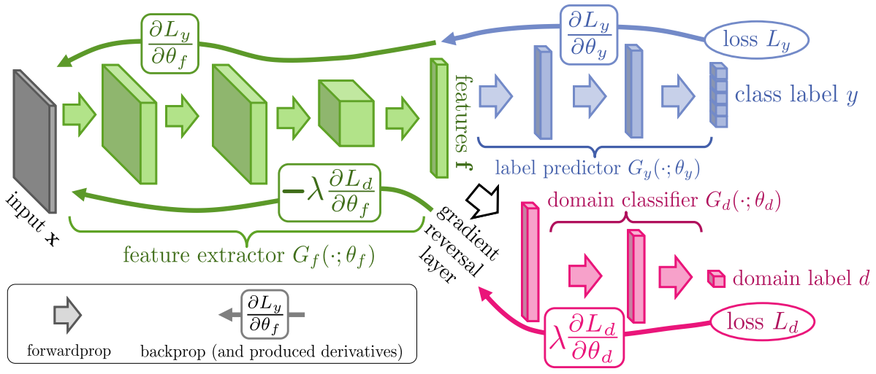
Domain Adversarial Training of Neural Networks(DANN)
Arxiv: https://arxiv.org/abs/1505.07818/
Domain Classifier + Gradient Reversal
Feature Extractor:
增加Label Classifier準確率
降低Domain Classifier準確率
Label Classifier: 判斷 Feature 是哪個 Class
Domain Classifier:
判斷 Feature 是哪個 Domain (Source or Target)
Binary classification

Slide 23

Domain Adversarial Training of Neural Networks(DANN)
Label classifier 判斷類別
Cross Entropy Loss
CNN提取特徵
0.8
0.2
1
0

Slide 24

Domain Adversarial Training of Neural Networks(DANN)
Binary Cross Entropy:
Source
(label:1)
Domain classifier 判斷圖片是從 Source 還是 Target 來的
Binary Cross Entropy Loss:
y * log(p) + (1-y) * log(1-p)

Slide 25
Domain Adversarial Training of Neural Networks(DANN)
目的：消除 Domain 特性
作法：在 domain classifier 和 feature extractor 中間加一層 gradient reversal layer，
讓 feature extractor update 的⽅方向和 loss gradient 反向
Source
(label:1)

Slide 26
Domain Adversarial Training of Neural Networks(DANN)

