Slide 1
PSNR
Closed-loop Matters: Dual Regression Networks for Single Image Super-Resolution
Deep unfolding network for image super-resolution
Image Super-Resolution with Cross-Scale Non-Local Attention and Exhaustive Self-Exemplars Mining
Method | Scale factor | Set5 | Set14 | BSD100 | Urban100 | Parameters
DRN-L | x4 | 32.74 | 28.98 | 27.83 | 27.03 | 9.8M
USRGAN | x4 | 32.45 | 28.83 | 27.69 | 26.44 | 17.02M
CSNLN | x4 | 32.68 | 28.95 | 27.80 | 27.22 | 3M

Slide 2
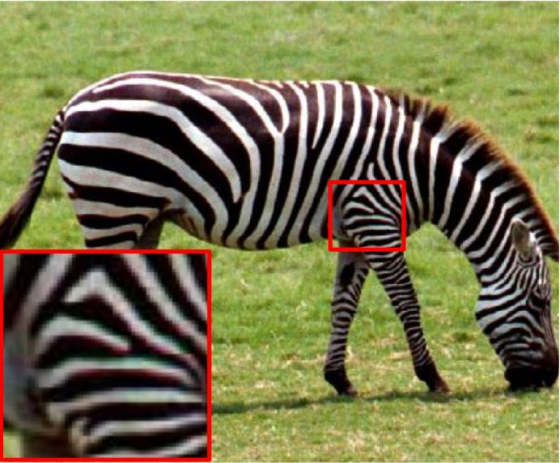
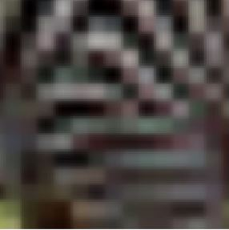
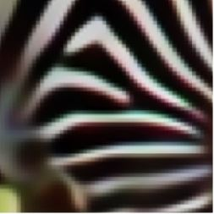

Visual Result
LR
DRN-L
CSNLN
HR

Slide 3
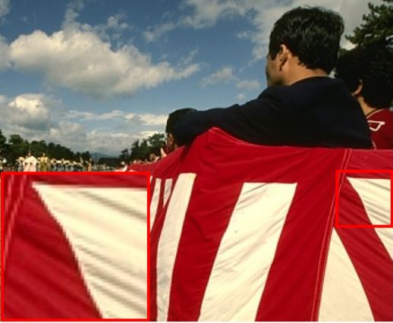



Visual Result
LR
DRN-L
CSNLN
HR

Slide 4
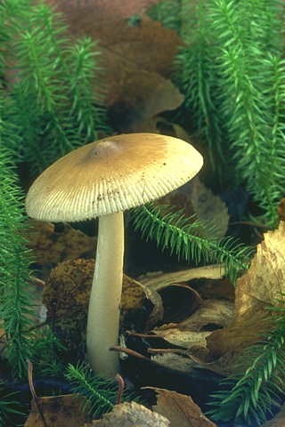


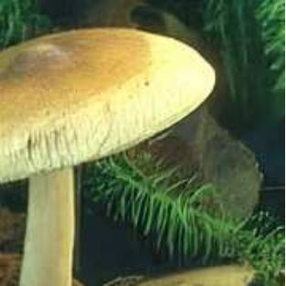
Visual Result
CSNLN
USRGAN
HR
LR

Slide 5
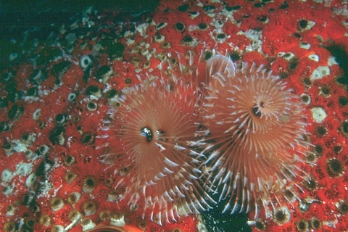

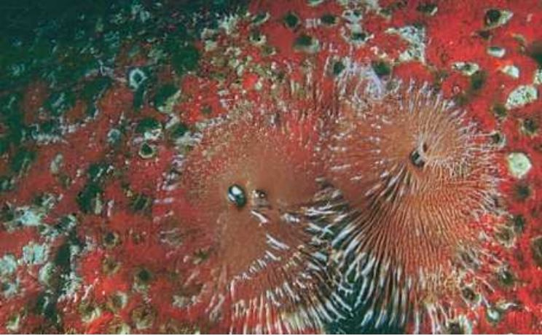

Visual Result
HR
CSNLN
USRGAN
LR

