Slide 1
Mushroom Classification
Chau Yuen Ying-12330225

Slide 2
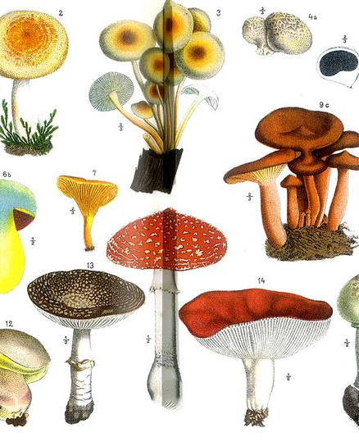
Introduction
Mushrooms classification:
Edible (Living)
Poisonous (Died)
Features:
23 features

Slide 3
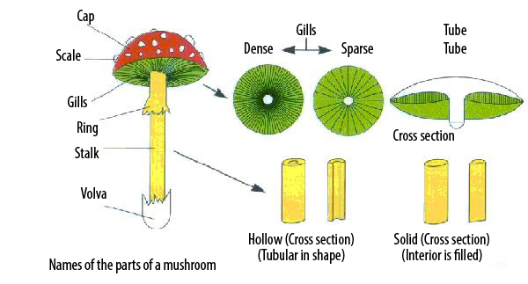
Introduction
Feature
cap-shape | cap-surface | cap-color | bruises | odor | gill-attachment
gill-spacing | gill-size | gill-color | stalk-shape | stalk-root | stalk-surface-above-ring
stalk-surface-below-ring | stalk-color-above-ring | stalk-color-below-ring | veil-type | veil-color | ring-number
ring-type | spore-print-color | population | habitat | ring-number

Slide 4
Problem
Which features are most indicative of a poisonous / edible mushroom?
What the model is the best?

Slide 5
Aims and Objectives
Finding which is(are) feature(s) estimated the most accuracy
Compare LDA, MSV and logistic regression model

Slide 6
Data description
All categorical variables
Class: e, p
## class cap.shape cap.surface cap.color bruises odor gill.attachment ## 1 p x s n t p f ## 2 e x s y t a f ## 3 e b s w t l f ## 4 p x y w t p f ## 5 e x s g f n f ## 6 e x y y t a f
## gill.spacing gill.size gill.color stalk.shape stalk.root ## 1 c n k e e ## 2 c b k e c ## 3 c b n e c ## 4 c n n e e ## 5 w b k t e ## 6 c b n e c

Slide 7
## stalk.color.below.ring veil.type veil.color ring.number ring.type ## 1 w p w o p ## 2 w p w o p ## 3 w p w o p ## 4 w p w o p ## 5 w p w o e ## 6 w p w o p
## stalk.color.below.ring veil.type veil.color ring.number ring.type ## 1 w p w o p ## 2 w p w o p ## 3 w p w o p ## 4 w p w o p ## 5 w p w o e ## 6 w p w o p
## spore.print.color population habitat ## 1 k s u ## 2 n n g ## 3 n n m ## 4 k s u ## 5 n a g ## 6 k n g

Slide 8
Data description
Variable: 23
Total Data: 8124
Missing Data: 2480
After removed missing data:
5644

Slide 9
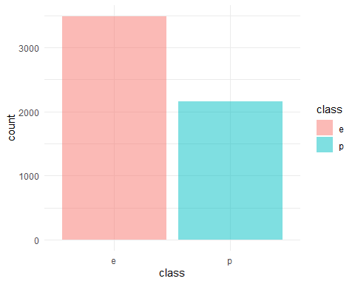
Data description - Class
E = ‘edible’
P = ‘poisonous’

Slide 10
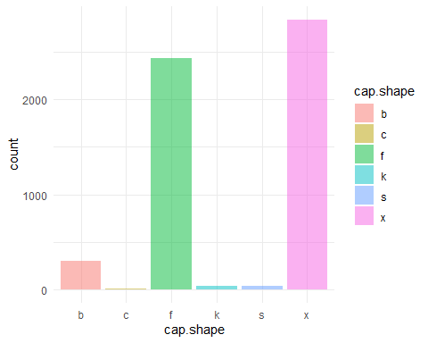
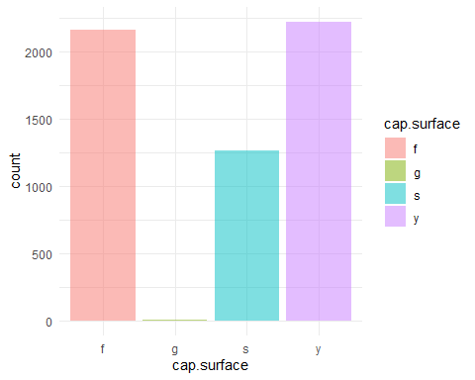
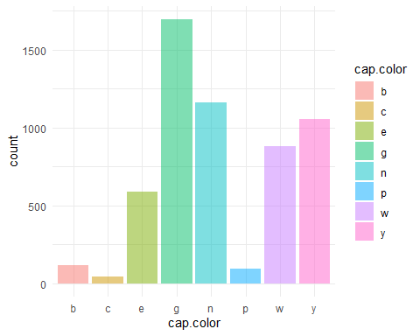
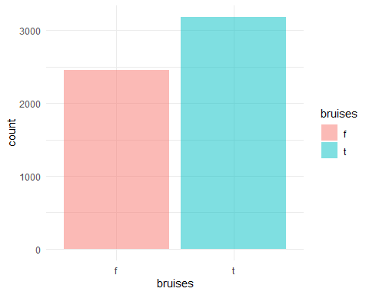
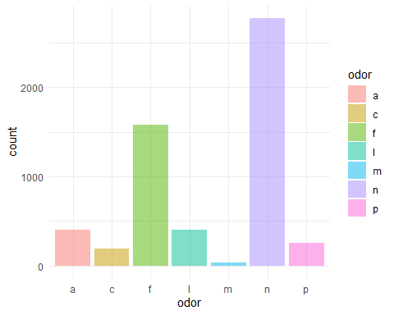
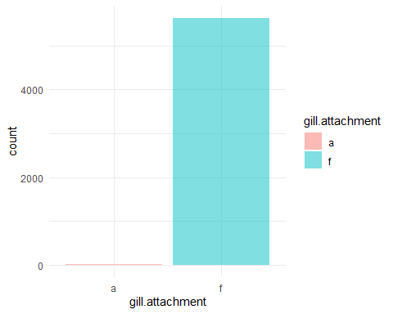
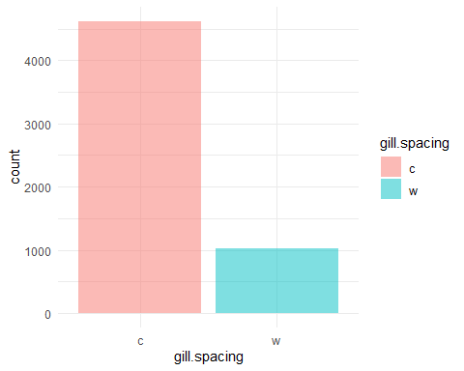
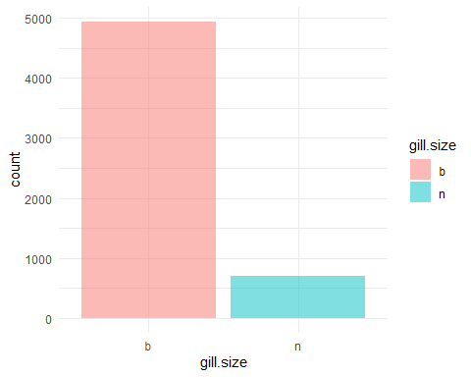
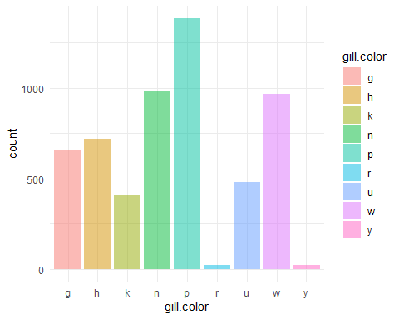

Slide 11
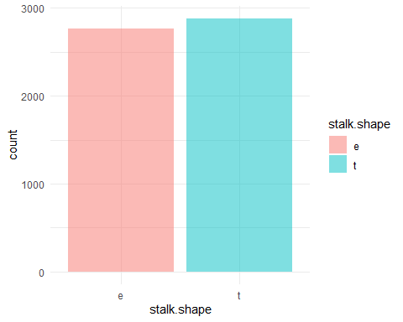
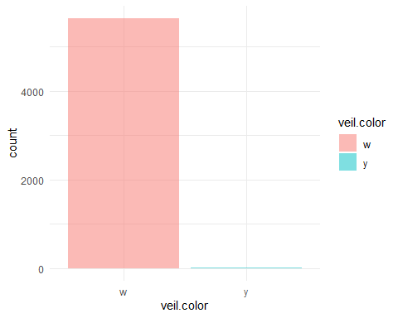
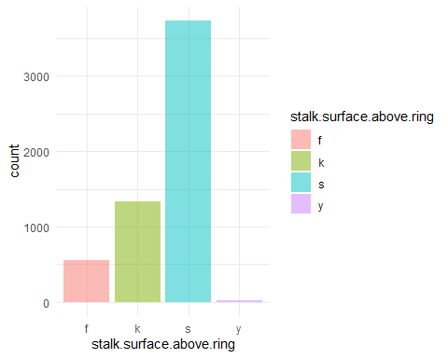
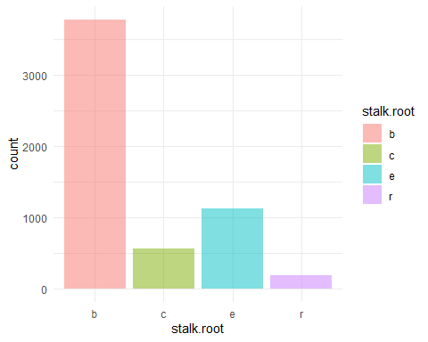
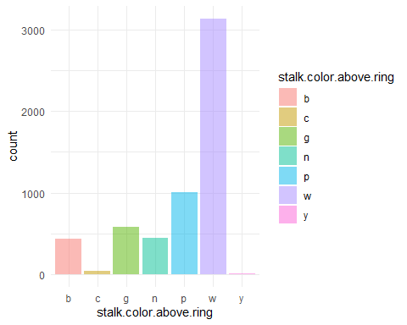
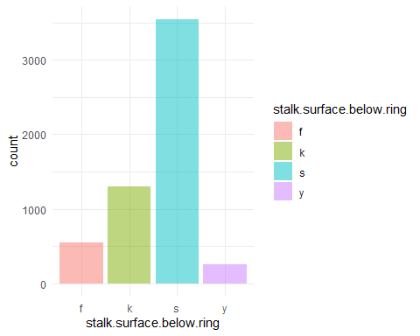
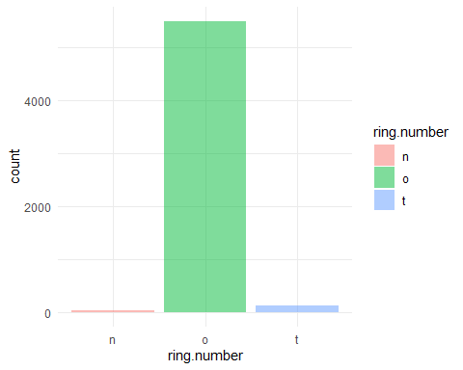

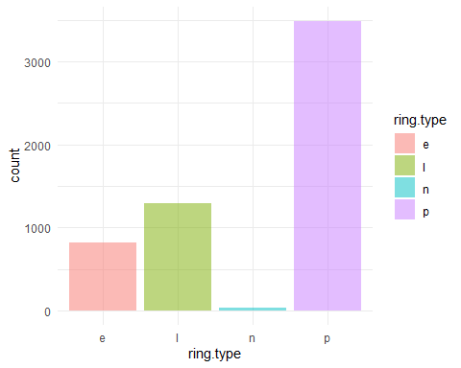

Slide 12
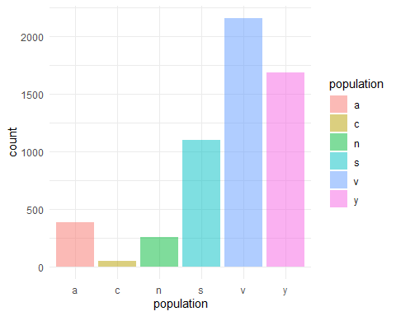
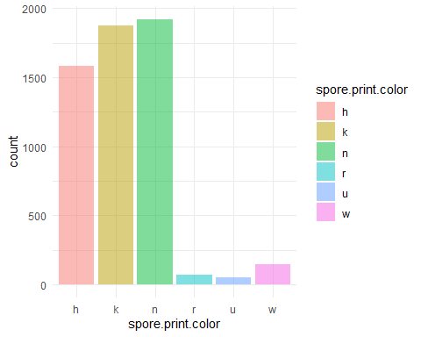
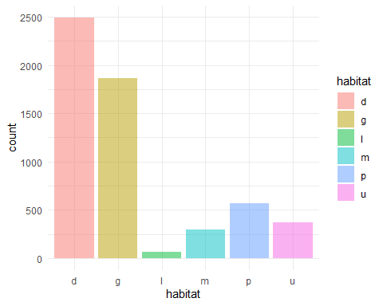

Slide 13
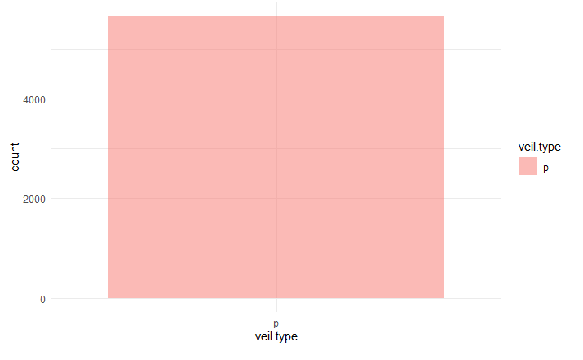
Remove veil.type

Slide 14
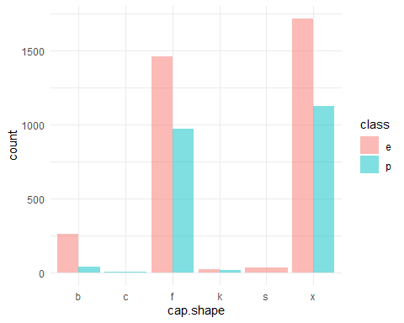
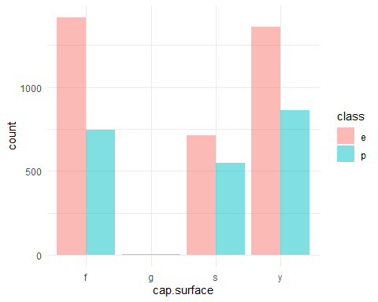
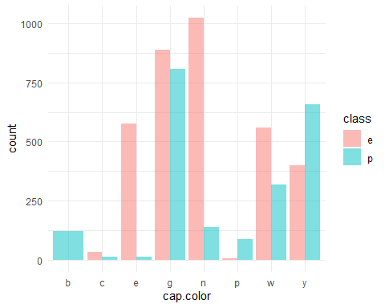
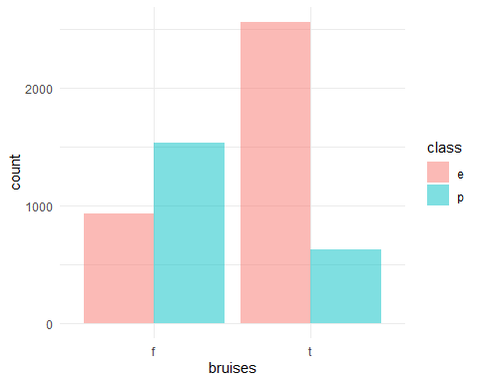
Variable with class

Slide 15
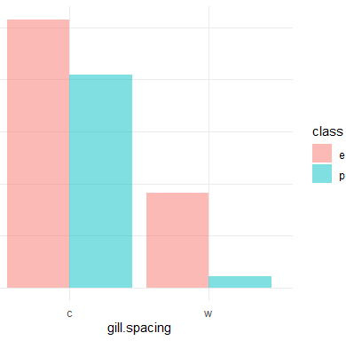
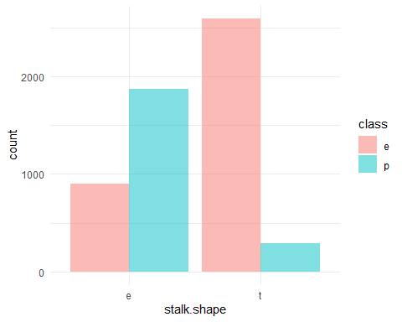
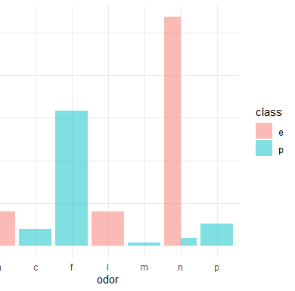
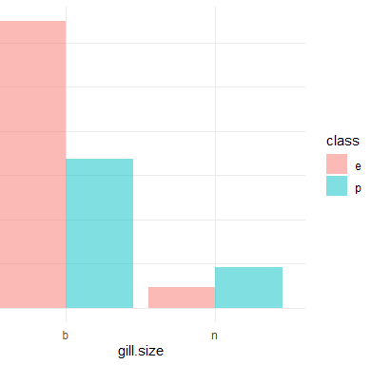
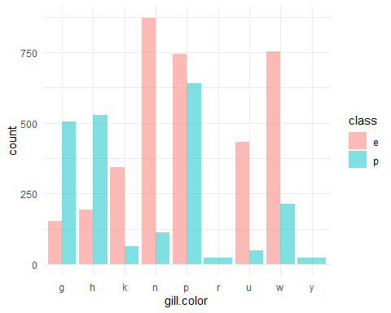
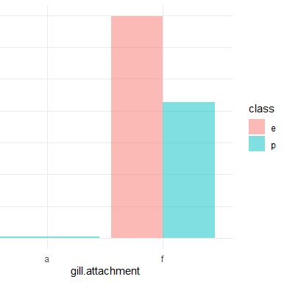

Slide 16
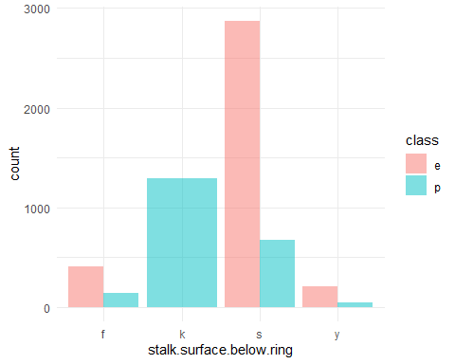
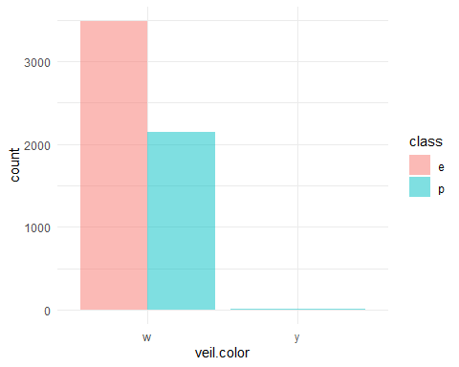
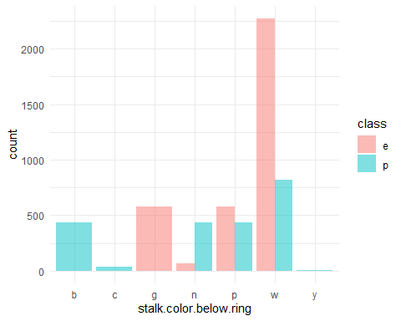

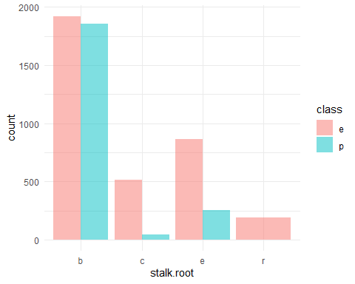
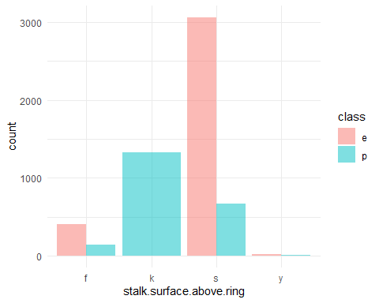

Slide 17
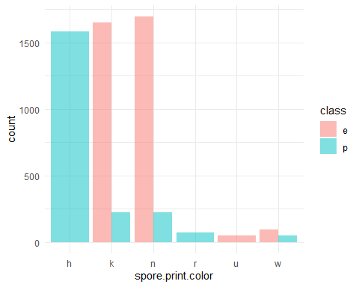
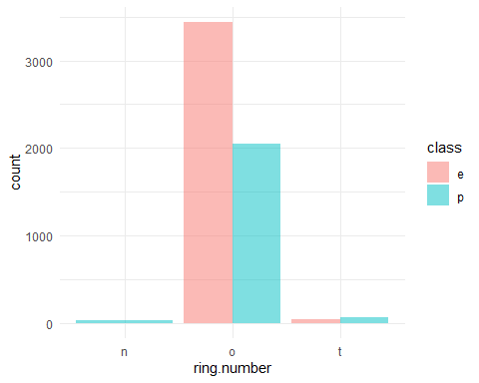
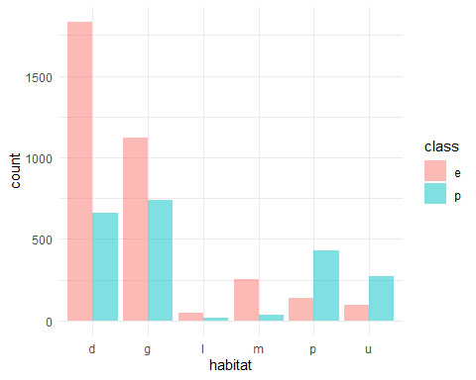
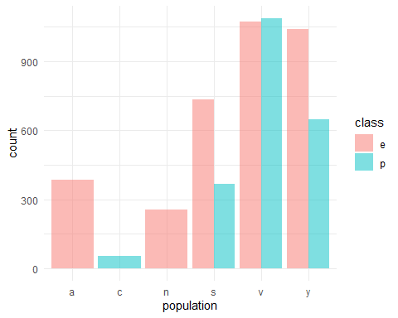
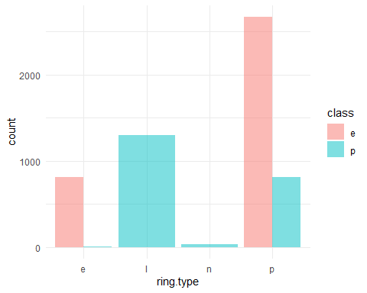

Slide 18
So, which features are the most feature with class?

Slide 19
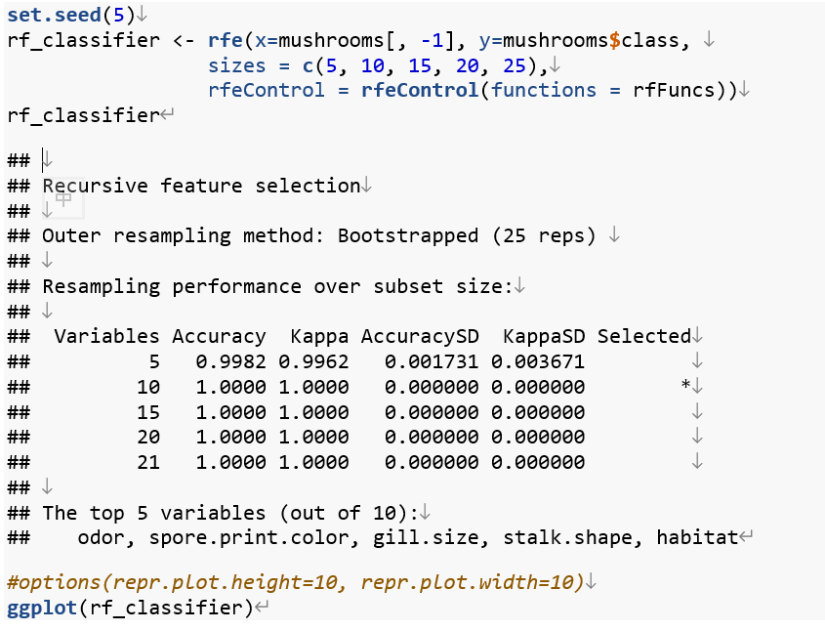
Feature Selection: Recursive feature elimination

Slide 20
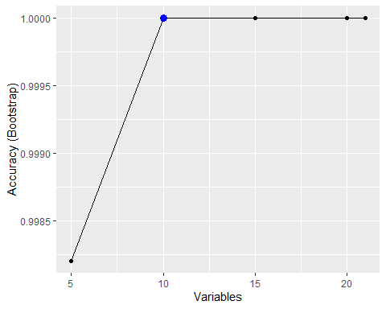
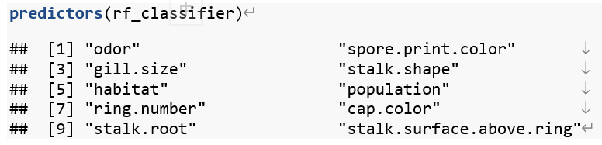

Slide 21
Model Selection
Linear discriminant analysis (LDA)
Support Vector Machine (SVM)
Logistic Regression

Slide 22
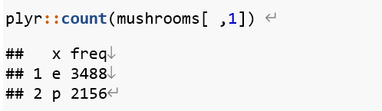
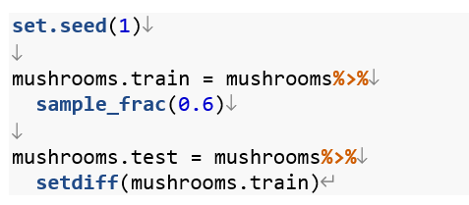
Split Data

Slide 23
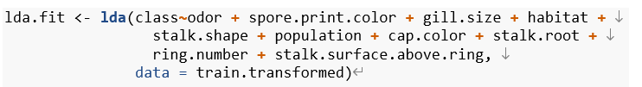
Linear discriminant analysis - LDA

Slide 24



Slide 25


Slide 26

LDA – Prediction

Slide 27


LDA - ROC

Slide 28

SVM – Support Vector Machine

Slide 29

The cost of best performance is 10

Slide 30


Slide 31


Slide 32


ROC - SVM

Slide 33

Logistic Regression

Slide 34


Slide 35


Slide 36


ROC - Logistic Regression

Slide 37

Conclusions

Slide 38


Slide 39


Slide 40
Conclusion
Feature Selection
Model Compare
 | Accuracy | Pos Pred Value | Neg Pred Value
SVM | 95.7% | 97.04% | 93.94%
LDA | 93.38% | 93.08% | 93.92%
Logistic Regression | 95.85% | 94.89% | 93.16%

Slide 41
Recommendations
The best model is SVM

Slide 42
Limitations
Positive responses, edible, are more than poisonous (Negative responses)
The result focus on positive responses
SVM is using normalize the data.
The result maybe effected
All models' variables are filtered
The accuracy rate decrease

