Slide 1
Controlled Spear-Phishing Simulation & Risk Assessment
Practical Implementation Using GoPhish for Organizational Defense Analysis
Axia Hub Cybersecurity Internship Project

Slide 2
Project Objectives & Scope
Demonstrate open-source phishing simulation workflows (GoPhish v0.12.1).
Deploy 100% offline within a local sandbox environment (127.0.0.1:3333).
Evaluate human risk vectors and establish telemetry for security awareness training.
Map OSINT findings to institutional portal structures safely.

Slide 3
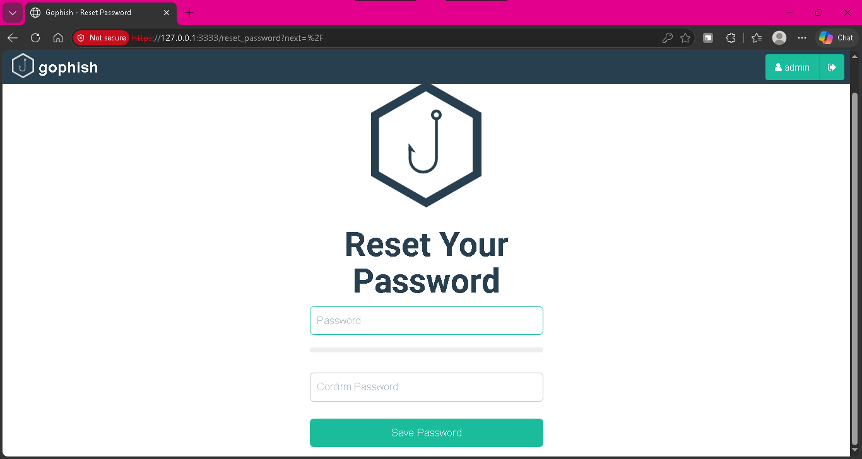
Environment Setup & Administration
Initialized GoPhish binary locally on Windows workstation.
Bound admin interface to https://127.0.0.1:3333 securely.
Updated temporary credentials to establish isolated administrative control.

Slide 4
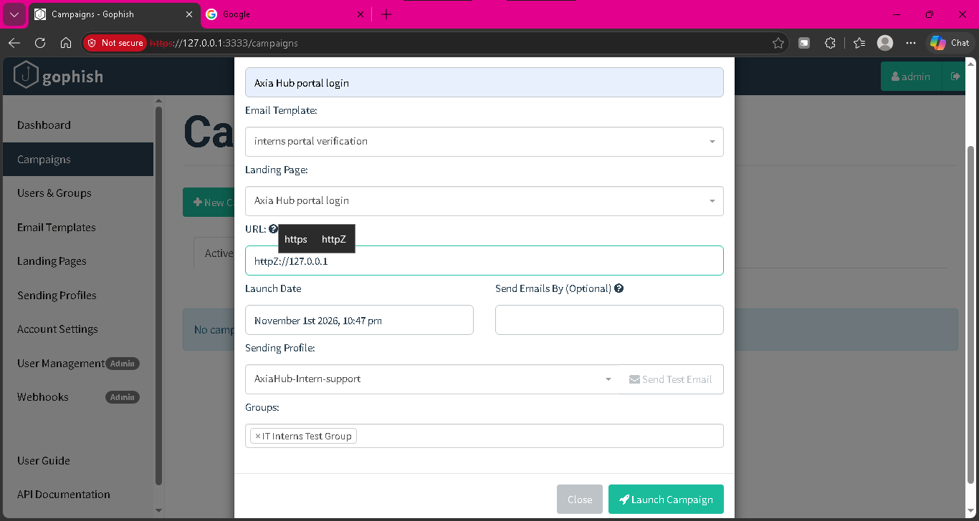
Sending Profile & Templates
Created 'AxiaHub-Intern-Support' profile with mock sender address (internsupport@axiahub.ng).
Drafted spear-phishing email template ('verify your acceptance into axia hub') with tracking tag {{.URL}}.

Slide 5
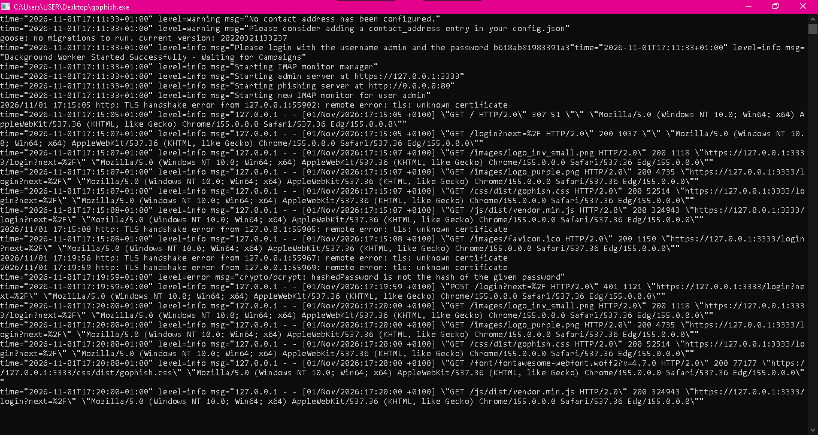
Landing Page & Campaign Launch
Configured credential-harvesting landing page mirroring organizational portal login.
Linked template, landing page, and test user groups into active campaign workflow.

Slide 6
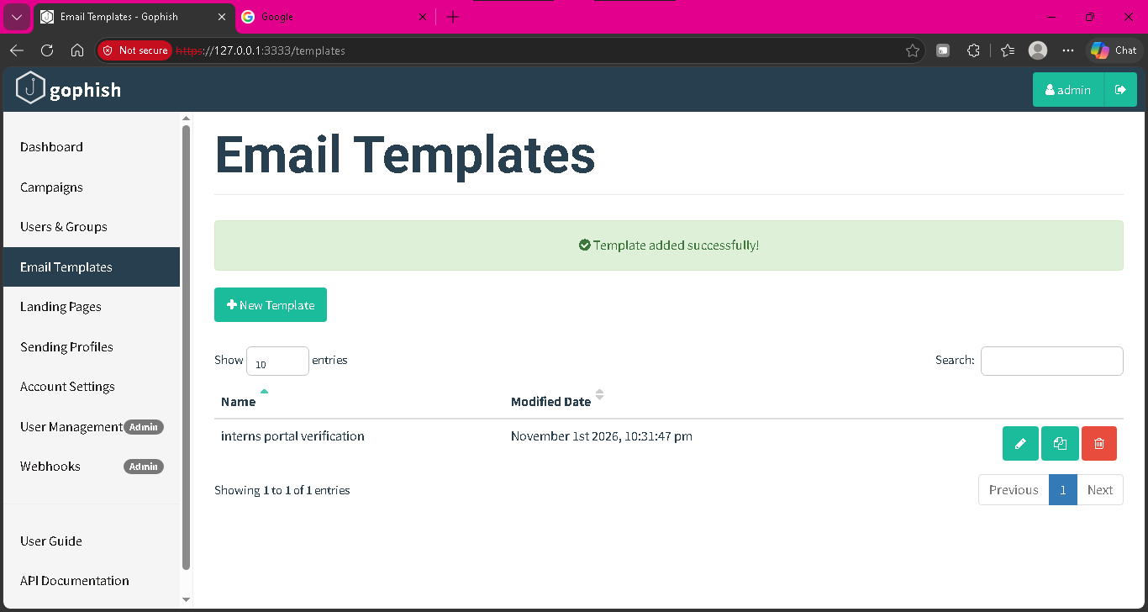
Dashboard Telemetry & Results
Monitored interaction metrics: Emails sent, links clicked, and credentials submitted in real-time.
Achieved zero outbound external risk through localized sandbox isolation.

Slide 7
Conclusion & Defensive Controls
Key Takeaway: Human vulnerability remains a primary attack surface requiring proactive testing.
Defensive Recommendations:
• Enforce Multi-Factor Authentication (MFA).
• Conduct routine employee awareness training.
• Implement strict SPF, DKIM, and DMARC policies.

