Slide 1
Ethics of Ai
Alice Hua, Ajit Barhate, Tim Chen
Capstone - Fall 2021

Slide 2
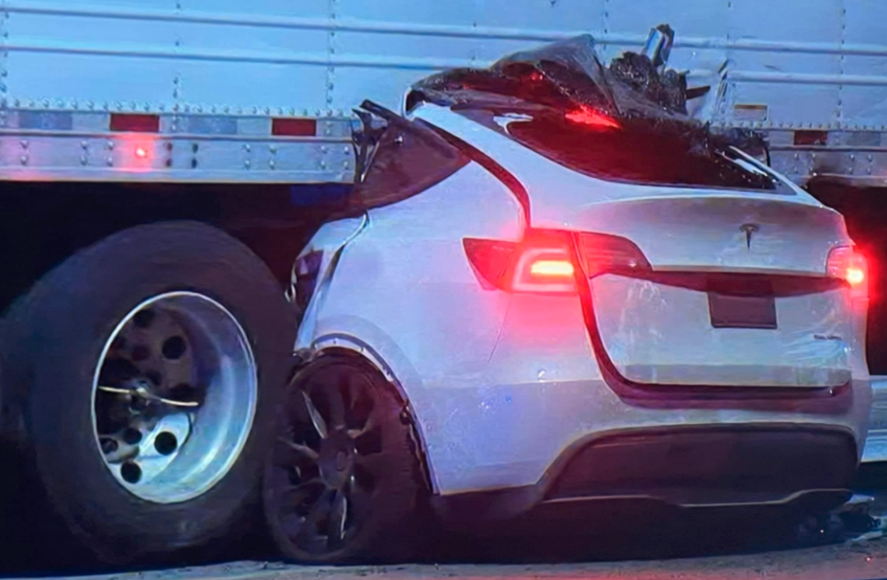
Whose Fault?
Notes:
Problem: Reliability & Safety
First question asked: Whose fault is it? The driver, or the autopilot?
If it is the autopilot, who is responsible for the accident? The driver? The engineer?

Slide 3
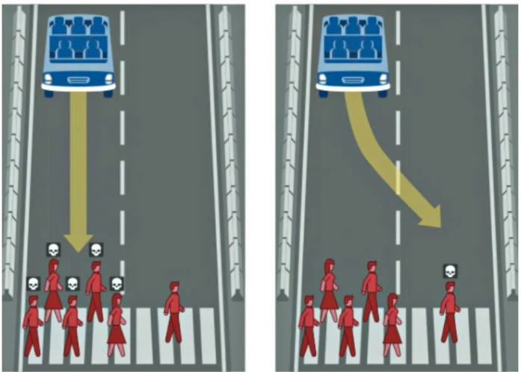
The Trolley Dilemma
Hey Tesla , please make a decision for me...
Option A: Kill 5
Option B: Kill 1
Notes:
The trolley dilemma: would you kill one person to save five?would you kill one person to save five?
Deontology

Slide 4
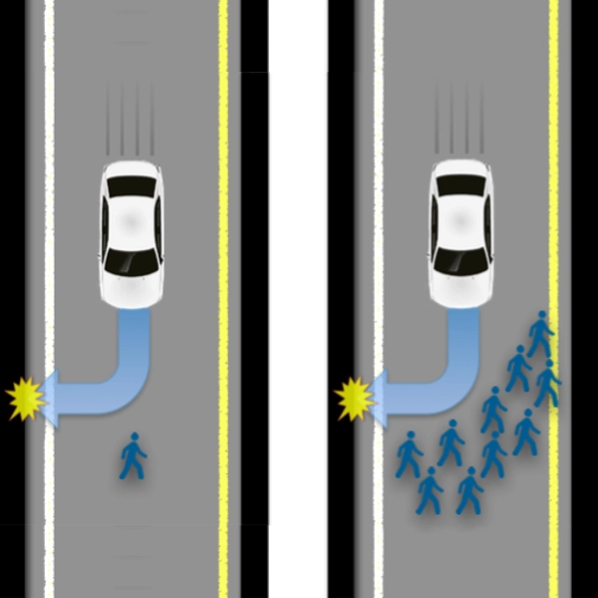
The “Tesla” Dilemma
Hey Tesla , please make a decision for me...
Option A: Kill 5
Option B: Kill 1
Option C: Kill… Yourself?

Slide 5
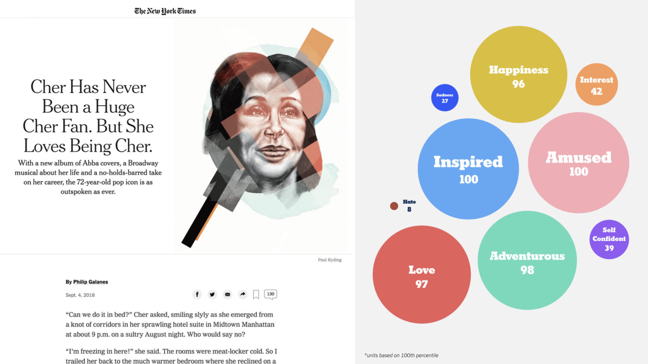
NYT’s Emotional Targeting
Source: https://www.nytimes.com/2018/09/04/arts/music/cher-abba-broadway-interview.html
Notes:
Issue: Data Subject Right.
Emotion is data. Can advertisers has the right to use to data about your emotion without your consent?
NLP is used to predict possible states of emotions after you finish reading the article, premium ads are served based on these possible emotions that the article caused you to feel.
https://www.poynter.org/business-work/2019/the-new-york-times-sells-premium-ads-based-on-how-an-article-makes-you-feel/

Slide 6
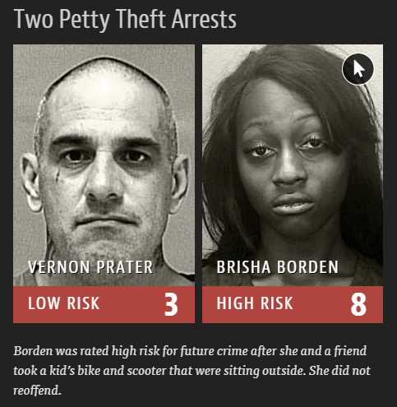
COMPAS: An AI-Assisted Justice… Or Injustice?
Source: https://www.nytimes.com/2017/10/26/opinion/algorithm-compas-sentencing-bias.html
Notes:
Issue: Bias
Ai is increasingly being used to influence life-changing decisions. In case of predictive policing, not unsimilar to Minority Report,
COMPAS (Correctional Offender Management Profiling for Alternative Sanctions), a risk assessment algorithm used by the state of Wisconsin
Used historical recidivism data which reflects our world also reflects our biases, particularly in discrimination against black defendants.
Broden committed a petty theft crime. She took a kid’s bike.
Prater, on the other hand, is a seasoned criminal. He is an armed robbery.

Slide 7
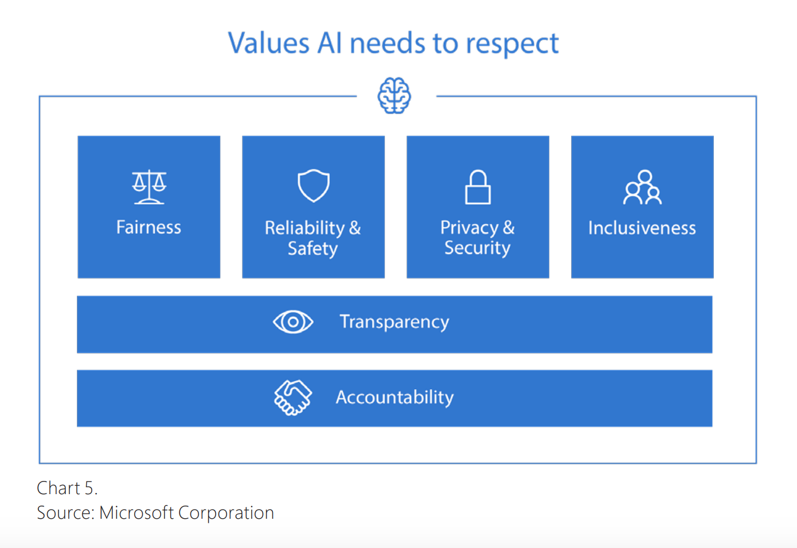
Responsible AI Framework
Notes:
Here is a framework of ethics for AI proposed by Microsoft.
The foundation of the framework is accountability. Data scientists must be accountable for considering the possible consequences of the models they build. On top of accountability is transparency. Customers deserve the transparency, not just into the data being used, but also what the model is capable of or NOT capable of achieving.
Then, building on transparency and accountability, we have fairness, reliability, privacy, and inclusiveness. The 3 examples Alice has discussed have touched all aspects of this framework.
Class Project Examples:
What if a pet daycare model fails to detect a deadly seizure?
What if an economic classification model uses the density of a certain race such as black or Asian people to classify the wealth of an area?
What if a financial prediction model is unable to provide enough transparency into the decision making process behind the scene?

Slide 8
Think Fast Think Slow
 | System I: Think Fast | System II: Think Slow
HUMAN | Intuition Built by “experience” | Logic Enabled by expert knowledge
AI | AI Today Data-Driven Training Data -> Inference E.g. Neural Net | AI in the Past Symbolic & Logical If... else... E.g. Expert System
Source: Francesca Rossi, Andrea Loreggia. 2019. Preferences and Ethical Priorities: Thinking Fast and Slow in AI
Notes:
Another way to examine AI ethics is the Think Fast Think Slow framework introduced by the famous psychologist, Daniel Kahneman.
Kahneman believes that we human have two systems. System I is our intuition, built on top of our experience from the past. System II, on the other hand, is about deliberation and logic. It is enabled by the ability to reason and domain expert knowledge.
So, the machine learning models we build today are mostly System I. The model is trained on data. Then it generalizes and builds the intuition for inference. The Expert System from the 70s is System II. It is based on knowledge from the domain experts and a lot of if else logics.
Now, one direction of the research on the ethics of AI is that: Yes, System I models are efficient. But we also need System II to overwrite some of the ethical issues produced by System I.

Slide 9
What Is MemorAi?
Our Mission Preserve our customers as a person and enrich their memories, so friends and family can remember and relive life moments they have shared long after they are gone. Product AI-assisted web/app product that will:
Allow people to preserve who they are from their perspective through guided interviews (text + media)
Allow their family to enrich memories through media contribution (photos/videos)

Slide 10
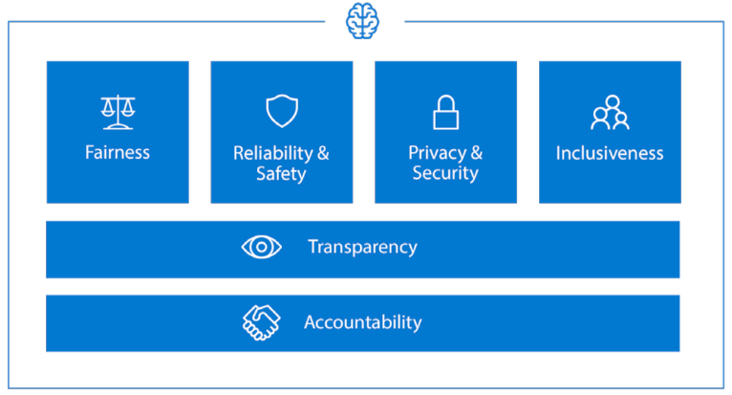
Ethical Challenges With MemorAi
Reliability & Safety
Can customers trust us to preserve their data for 100+ years?
E.g. Data lost due to server failure...
E.g. What if the company is dissolved?
Privacy & Security
How do we protect the privacy for a deceased person?
E.g. Should we allow ads using the deceased person’s data?
E.g. Can friends & family invite more people to see the contents?
Inclusiveness
Bias in the search engine?
E.g. Racial bias in keyword extraction model.
E.g. “I love playing sports.” => Basketball
Transparency & Accountability
Should the AI engineers have access to the customer’s personal life stories and media files?
What sort of agreements should we have in place to avoid misuse of the personal information?
E.g. The AI engineer may require to look at the personal data during the EDA or error analysis.

Slide 11
APPENDIX

Slide 12
References
Francesca Rossi, Andrea Loreggia. 2019. Preferences and Ethical Priorities: Thinking Fast and Slow in AI https://www.ifaamas.org/Proceedings/aamas2019/pdfs/p3.pdf
The Rise and Fall and Re-Rise of Symbolic AI https://medium.com/deepcode-ai/the-rise-and-fall-and-re-rise-of-symbolic-ai-14faec102821
The New York Times Sells Premium Ads Based on How an Article Makes You Feel https://tinyurl.com/yxphqkvq
Bias Detectives: The Researchers Striving To Make Algorithms Fair https://medium.com/mlearning-ai/machine-learning-ai-bias-eb2b854a0f9d
How Global Tech Companies Can Champion Ethical AI https://www.weforum.org/agenda/2020/01/tech-companies-ethics-responsible-ai-microsoft/
Ethical Principles in Machine Learning and Artificial Intelligence: Cases From the Field and Possible Ways Forward https://www.nature.com/articles/s41599-020-0501-9

Slide 13
References
Here's How Tesla Solves A Self-Driving Crash Dilemma https://tinyurl.com/yjwyzpc7
The Future of Autonomous cars https://www.digit.in/features/tech/digit-mag-the-future-of-autonomous-cars-53726.html
Autonomous Accidents: The Ethics of Self-Driving Car Crashes https://vce.usc.edu/volume-4-issue-2/autonomous-accidents-the-ethics-of-self-driving-car-crashes/

