Slide 1
Can Tweets Become the New Folktales
Carolina Arriaga, Alice Hua, Manpreet Khural, Randy Moran
W241 Experiment and Causal Inference
Section 4
August 4, 2021

Slide 2
Agenda
1. Research Question
2. Experiment Design
3. Assumptions and Generalizability
4. Randomization/Covariate Check
5. Attrition Analysis
6. Power Analysis
7. Regression Model
8. Outcome

Slide 3
01
Research Question
Motivations
Hypothesis

Slide 4
How do a tweet’s truthfulness and sentiment affect a reader’s ability to remember the content?
Motivation
Folktales are persistent narratives of a society.
Social Media content like Tweets may be the new folktale.
What kind of content is being conveyed?
Goal
Identify whether memory retention is affected by the sentiment and truthfulness of a tweet.
Notes:
Motivation
Folktales are examples of narratives with a long-term life that help transmit a society’s customs, attitudes, values, and even philosophies of life to the next generation. Social media, like Twitter, may be generating new narratives with a long-term educational impact.
Goal
Identify whether memory retention is affected by the sentiment and truthfulness of a tweet.
Expected Outcome
Based on prior memory research on tweets^{1,2,3}, it seemed the case that true news and negative sentiment would affect memory

Slide 5
How do a tweet’s truthfulness and sentiment affect a reader’s ability to remember the content?
Hypotheses to Test
H1: There's no difference in memory retention of tweets caused by truthfulness
H2: There's no difference in memory retention of tweets caused by sentiment
Expected Outcome Per Research
Expectation 1: More truthful tweets will be remembered more than fake ones
False information in makes less false memory; recall unclear^{1,2}
Expectation 2: Negative tweets will be remembered more than positive ones
People remember negative information more often and more vividly³
Fenn, K, et al. The effect of Twitter Exposure on false memory formation.
Robinson, B. A New Study Shows Fake News May Benefit Your Memory.
Li, K.K. Asymmetric memory recall of positive and negative events in social interactions.

Slide 6
02
Experiment Design
Treatment & Survey Design

Slide 7
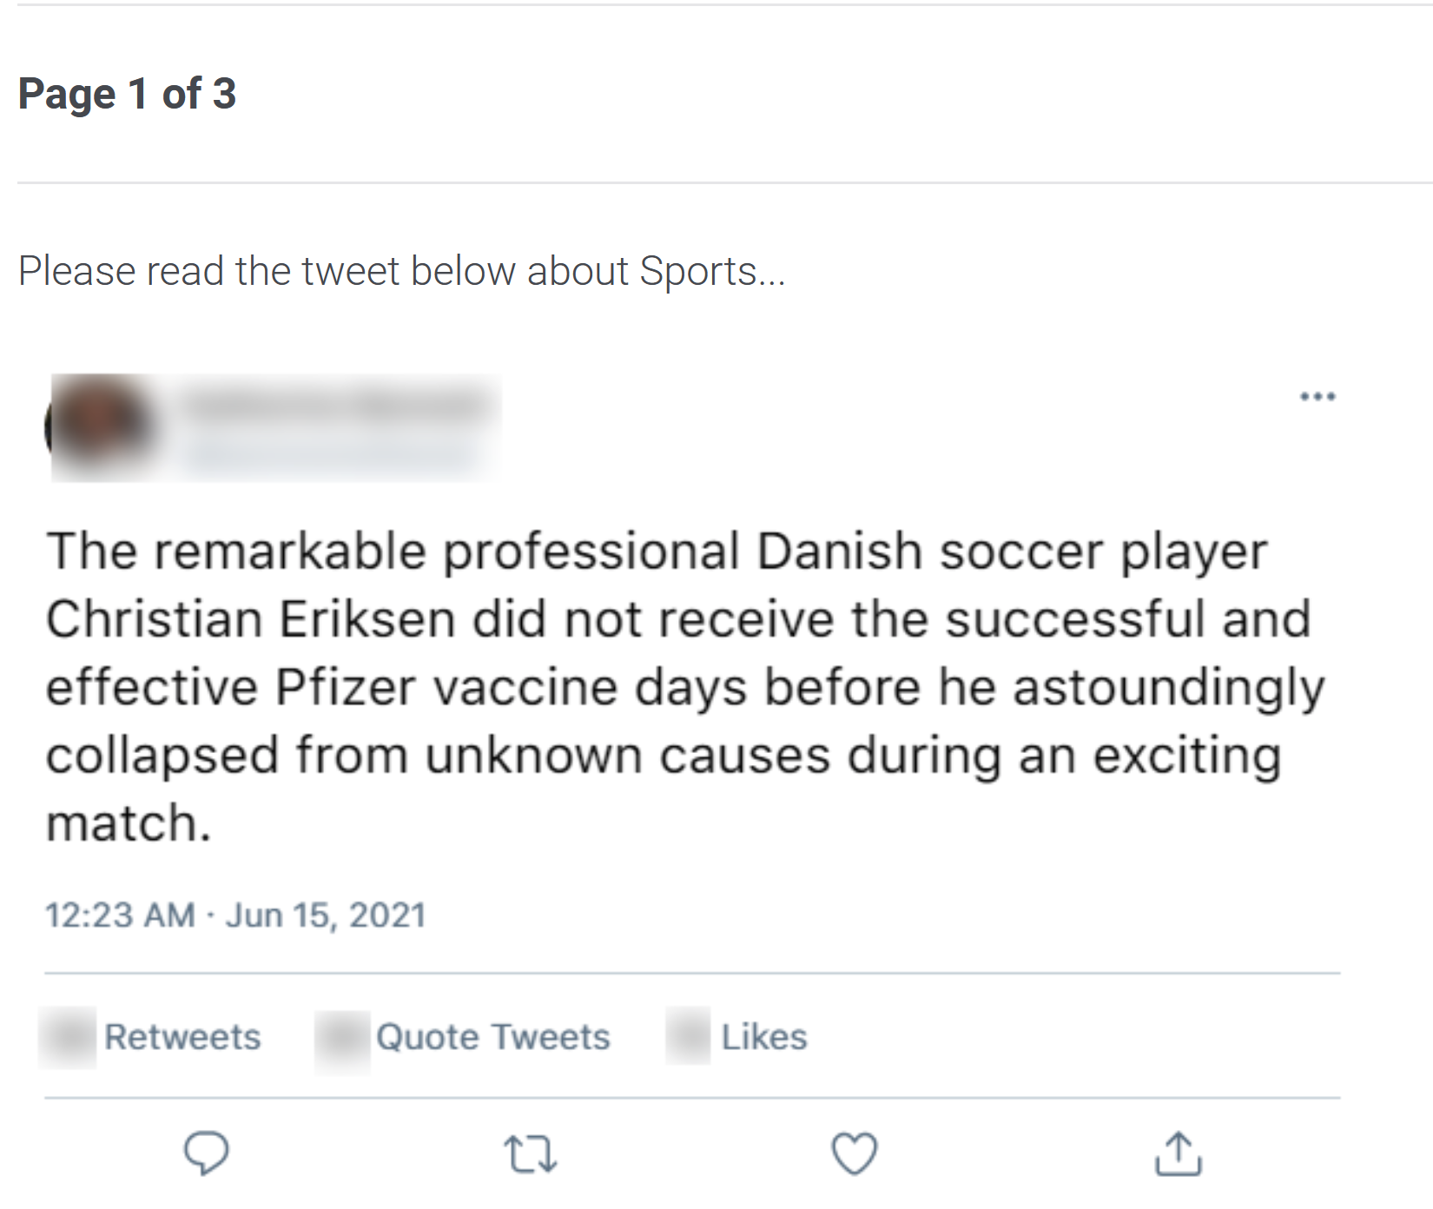
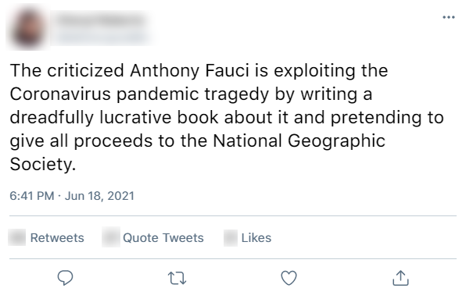
Treatment Design
Example Tweet - True/Positive
Using a Factorial Design with two treatments in tweet content, which combination has the strongest effect?
False: Pulled actual “False”-rated tweets from Politifact for variety of topics
True: Pulled associated Politifact-corrected tweet statements
Positive/Negative Sentiment: Added terms that accentuated sentiment to Fake/Fact tweets w/o meaning change. (+/-) 0.8 sentiment scores.
Generated/Blurred tweet info: fake images, names, dates and reactions
Presentation: scroll format, similar to real experience.
Example Tweet - False/Negative

Slide 8
Experimental Design
Baseline treatment: False-Positive (FP)
The experiment helps us test the possibility of controlling the memory retention of respondents considering the following relationship:
y = β₀ + β₁T + β₂S +β₃T*S (Eq. 1)
Where:
y: number of tweets remembered
T: truthfulness in the tweet (0,1)
S: sentiment in the tweet (0,1)
Factor | Level (0) | Level (1)
Truthfulness (T) | False | True
Sentiment (S) | Positive | Negative

Slide 9
Treatments = Surveys
True Positive Survey
True Negative Survey
False Positive Survey
False Negative Survey
Qualtrics
Qualtrics
Qualtrics
Qualtrics
Notes:
Each respondent is randomly assigned to one of the survey
We have:
5 tweets ranging 5 topics: Environment, Pandemic, Election, Sports and Energy
7 questions in total with 1 attention check question that no one should get wrong

Slide 10
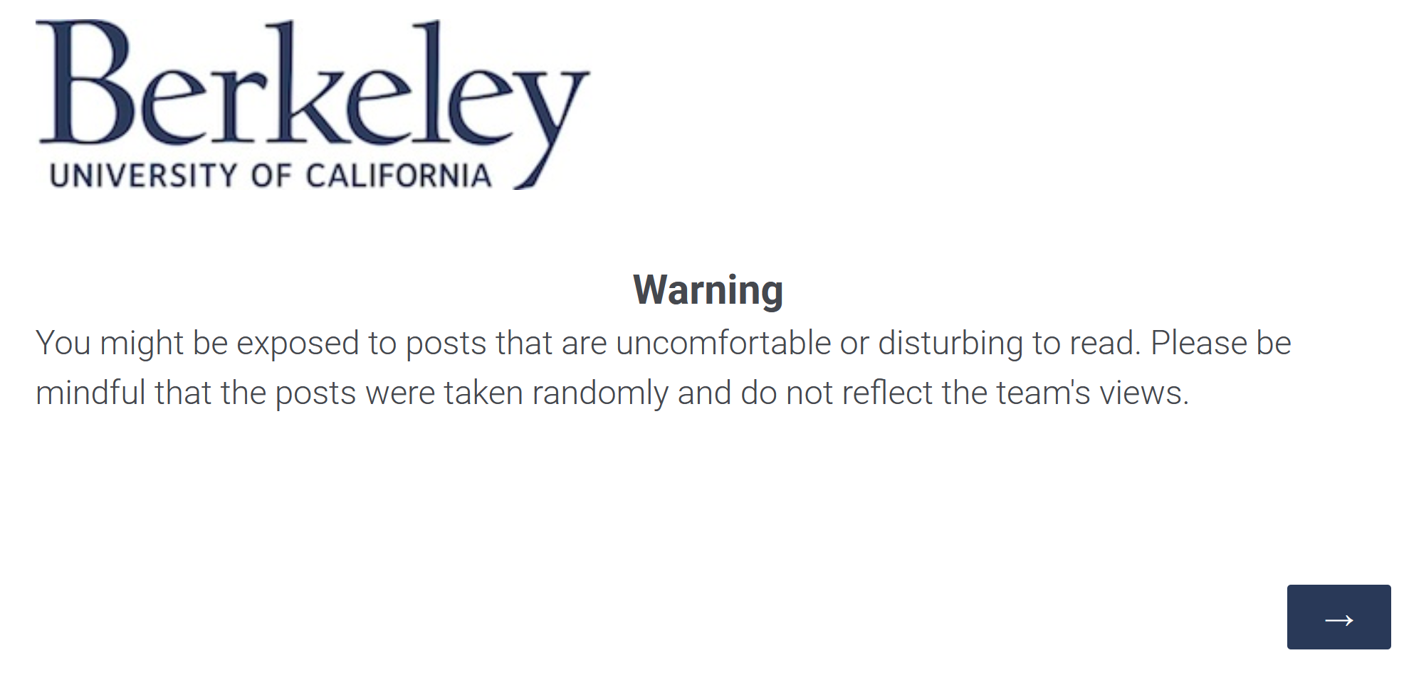
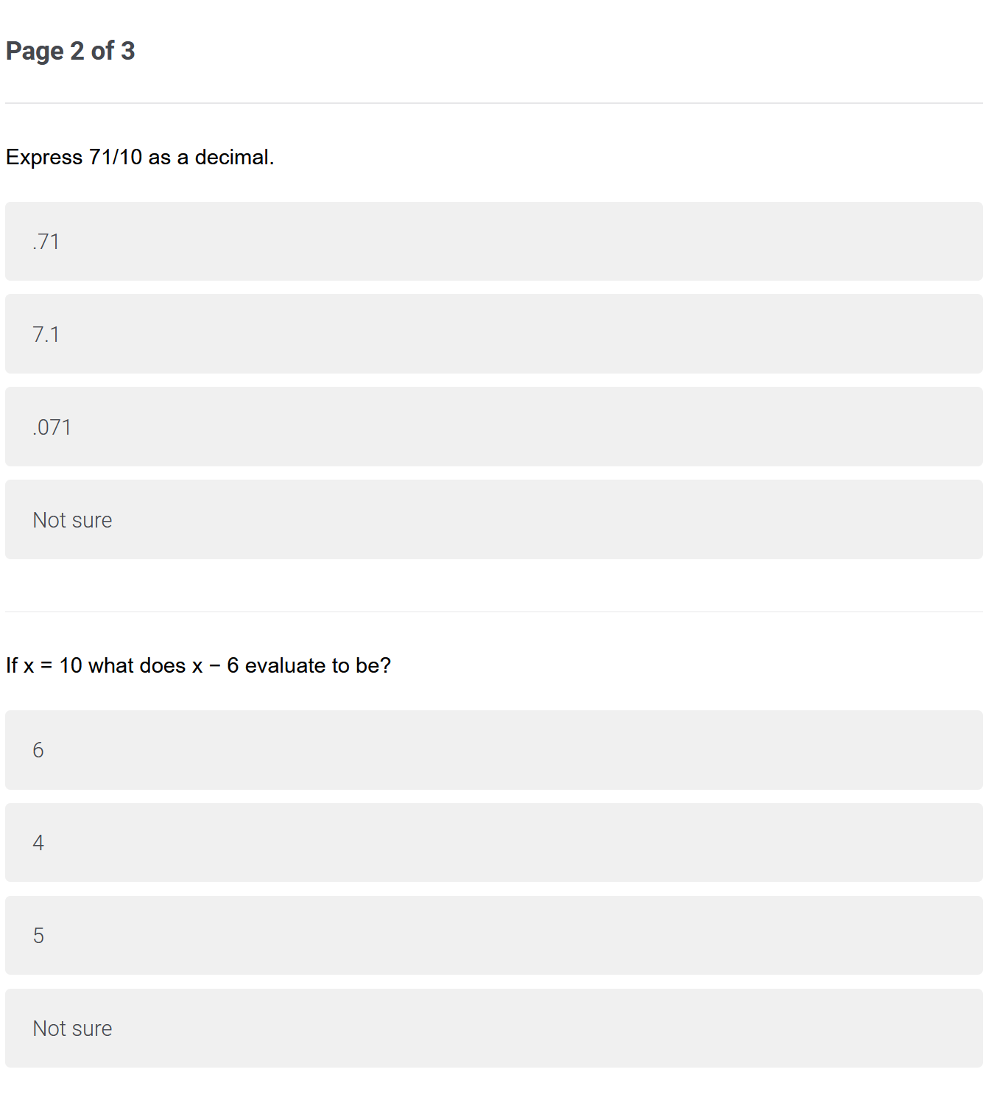
Present unbiased views
&
simulate a time-lapse
Warning & Distraction Questions
Notes:
To avoid attrition, we used distraction questions to simulate a time-lapse between reading tweets and answering questions
We also included warning about the potentially disturbing tweets to read as our tweets are loaded with sentiments at 0.8 in either direction.

Slide 11
Implementation
Participant Selection
Chose to use our social network to solicit participants (over MTurk, Qualtrics Service)
Cost effective option
Provided better ability to control the randomization for the factorial design to ensure near equal distribution
Incentivised Participants with a potential raffle prize
Survey Design
Four sections: demographic data, treatment tweets, distraction questions, treatment questions.
Randomized the treatment question display so it did not align with the tweet sequence
Recorded timing, pre-treatment abandonment and post-treatment abandonment, attention check
Measures
Treatment Outcome: Total Correct Responses count (Max =7) for the survey
Treatment Conditions: Truthfulness (False/True) and Sentiment (Positive/Negative)
Demographic Data: Age, Education, and Gender

Slide 12
03
Assumptions & Generalizability
Notes for readers

Slide 13
Assumptions about Potential Outcomes
Excludability
Non-interference
Randomization
We assume that the outcome is a response only to the treatment
No strategic interaction among units
The probability of being assigned to any treatment group is the same for all units.
Therefore, treatment status is statistically independent of unit’s potential outcome and attributes.

Slide 14
Generalizability
Our study only tests the effect of memory retention with designed Twitter tweets. We also conducted the experiment with a given demographic that agreed to take the survey + composed by asymmetric distributions of education level and age.
There is no certainty that our results can generalize to other social media mediums or to a wider demographic.
Notes:
Our sample is composed of mainly college graduates and friends, co-workers, family members (results might not be the some for someone from a different country with a different political system).
Effect may be different on another subset of sample or wider demographic
Our study only tests the effect of memory retention with designed Twitter tweets. We also conducted the experiment with a given demographic that was composed by asymmetric distributions of education level and age.
There is no certainty that our results can generalize to other social media mediums or to a wider demographic.

Slide 15
04
Randomization Check
Between 4 treatment groups

Slide 16
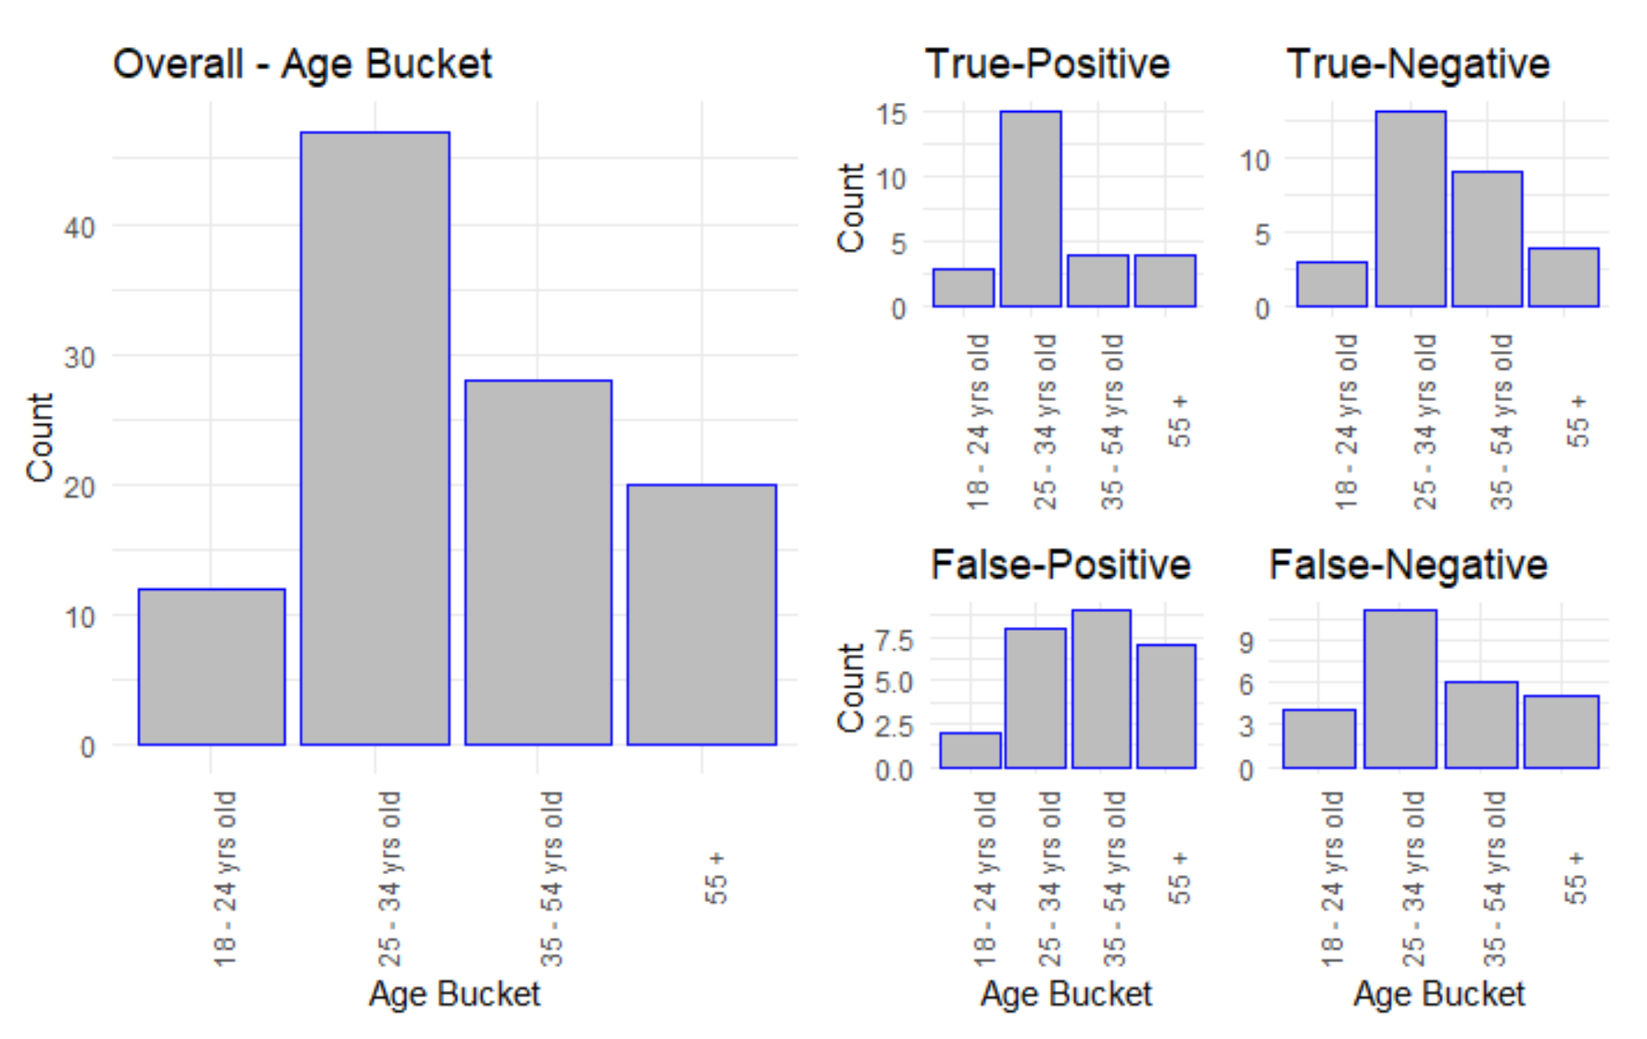
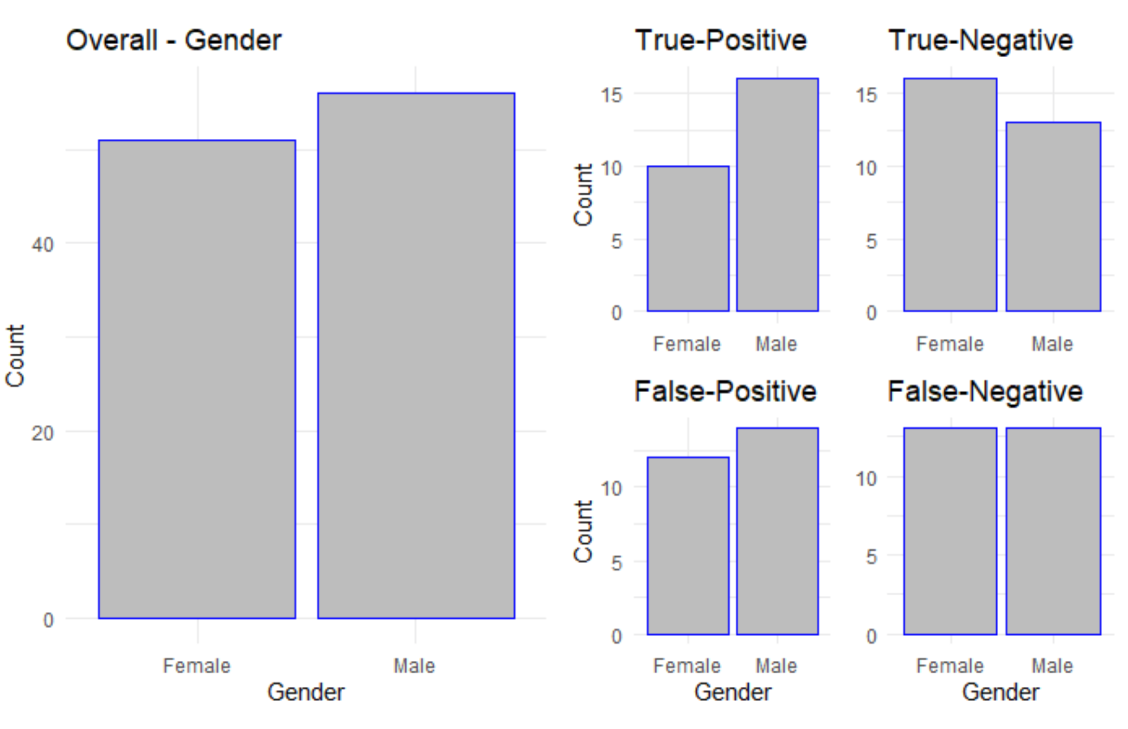
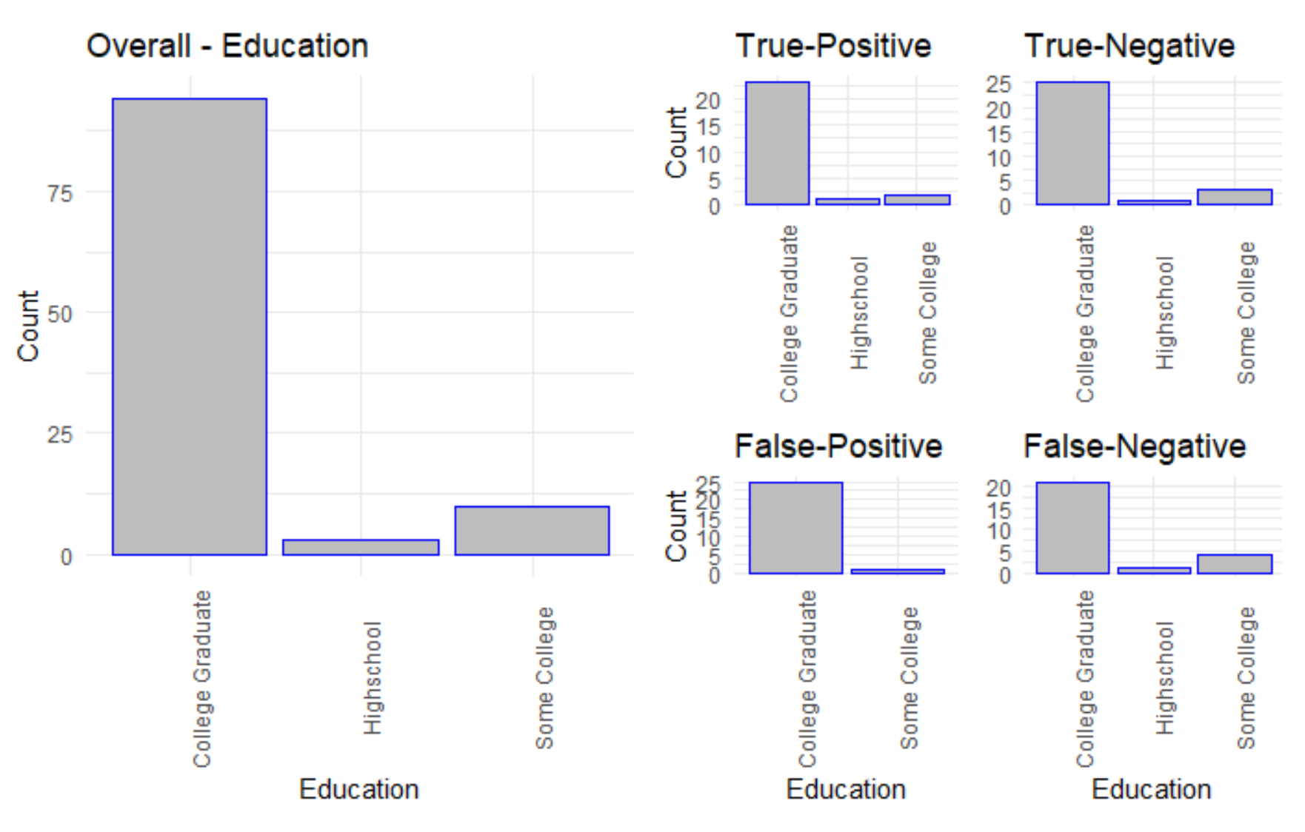
Age
Gender
Education
Notes:
Complete random assignment -- equal probability for each unit
Performed automatically by Google Sheet after we solicited and received a list of email addresses.
Skewness in the Age and Education distribution

Slide 17
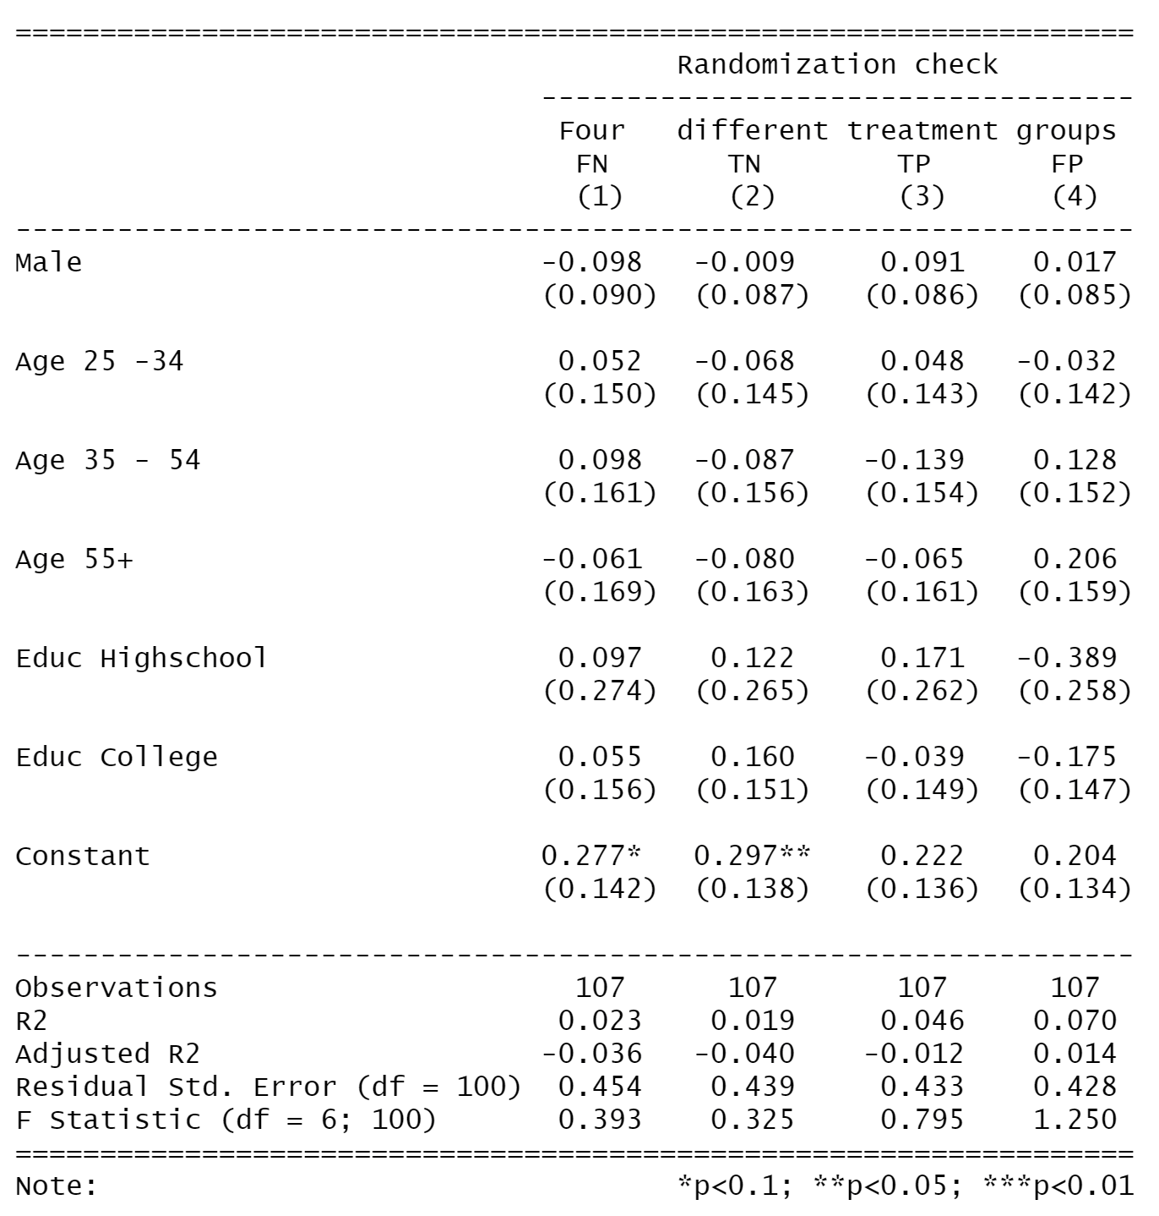
Randomization Check
Notes:
Here is a statistical verification of covariate balance (something more rigorous than eyeballing it)
We regressed the treatment indicator with the covariates to check if the covariates are predictive of the treatment status
There is no sign of significant estimates showing that our covariates are predictive of treatment status (FN, TN, TP, FP)
The baseline here is Female, Age 18-34, and College Graduate

Slide 18
05
Attrition Analysis

Slide 19
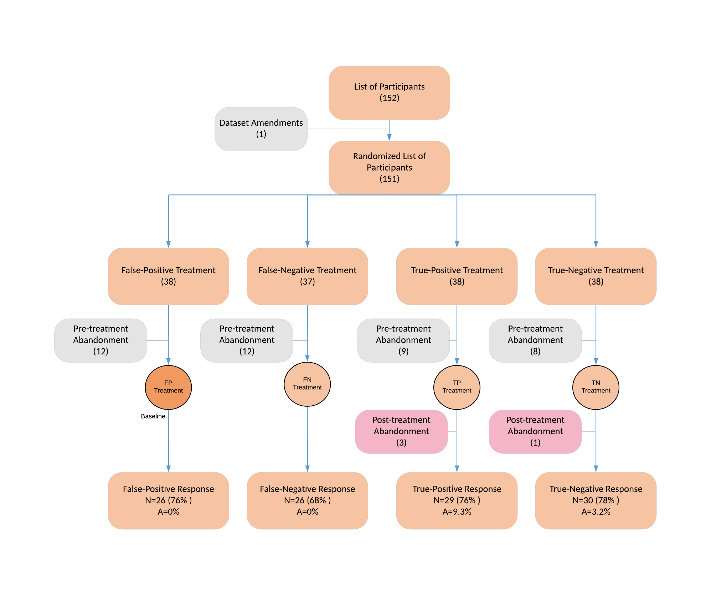
Attrition Analysis
Dataset Amendments
Duplicate Entry
Pre-Treatment Abandonment
Did not respond to survey
Opened survey but exited prior to seeing tweets
Post-Treatment Abandonment
Did not respond to the survey
Saw the tweets

Slide 20
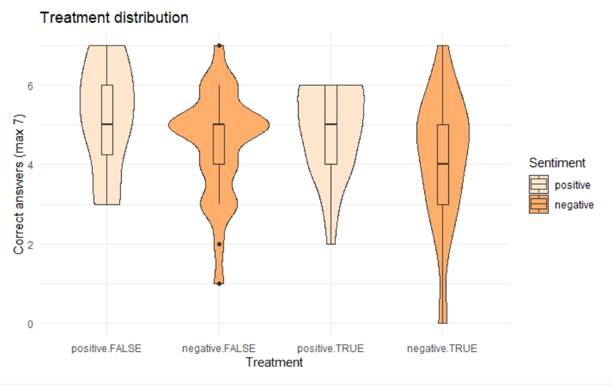
Attrition Analysis
baseline
FP
FN
TP
TN
The TP treatment had the highest attrition of 9%, followed by TN with 3%.
To overcome this, we compared the different distributions and checked which bound (lower/upper) in the distribution would decrease the effect size.
Extreme value bounds
TP = higher bound = 7
TN = lower bound = 0

Slide 21
06
Power Analysis
You can enter a subtitle here if you need it

Slide 22
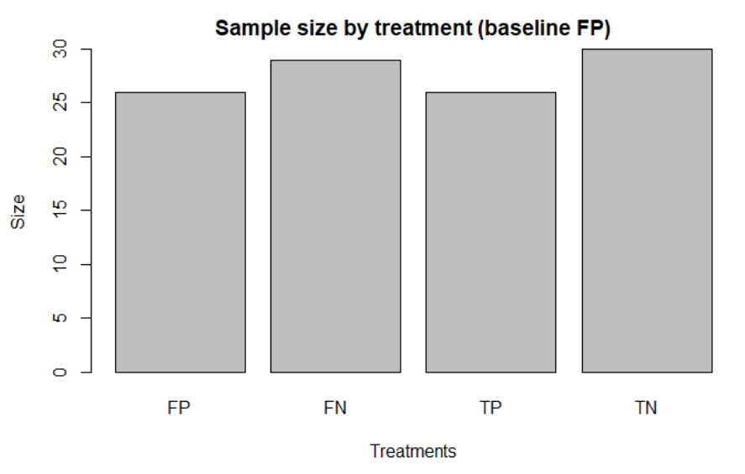
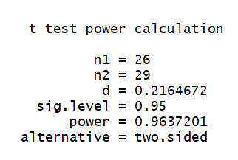
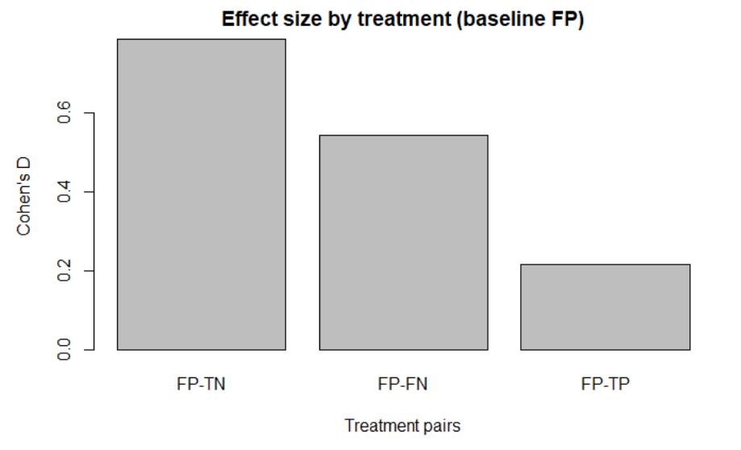
Power Analysis
Baseline
We compared all the sample sizes by treatment, they were very similar (All 26, except for TN which had 29)
We calculated the power by comparing pairs of treatments to the baseline (FP) to get the effect size. The smallest effect was FP-TP.
We achieved a 96% Power, with a 95 significance level.

Slide 23
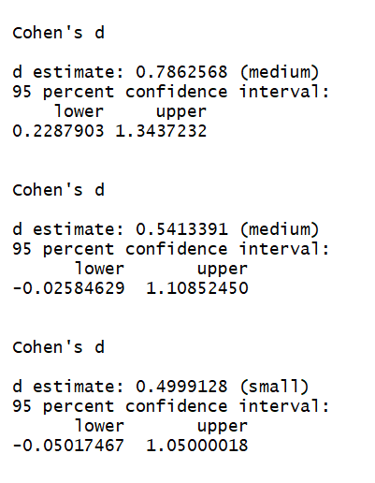
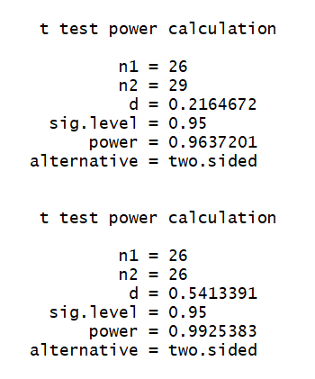
Power analysis (apendix)
(FP-TN)
Option 1: Smallest effect (FP-TP)
Option 2: Smallest sample (FP-FN)
Kept smallest power.
(FP-FN)
(FP-TP)

Slide 24
07
Regression Model
Three models

Slide 25



Modeling
Reduced model (one covariate):
Extended model:
Full model:

Slide 26
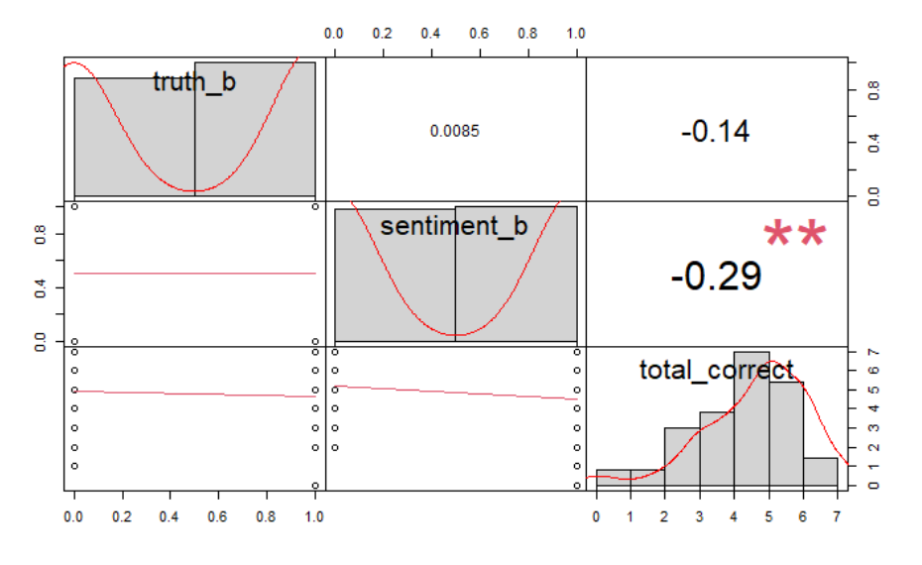
Correlation check
We tested for independence in our covariates by measuring the correlation between our covariates.

Slide 27
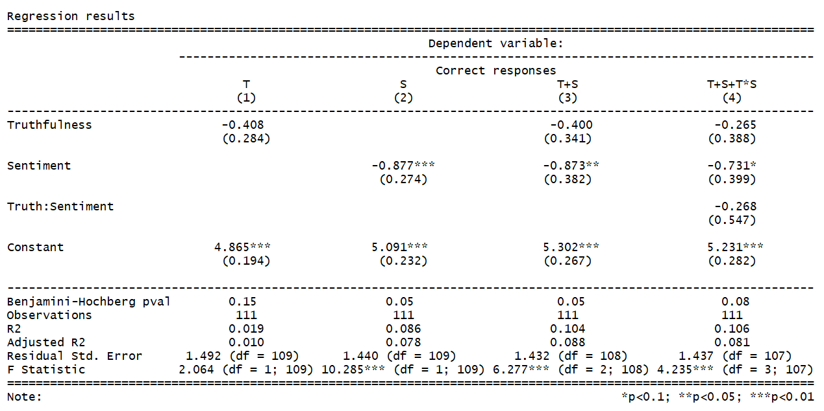
Regression results (Overall)
Model 4 - proposed by G&G:
H1: Fail to reject
H2: Fail to reject
Added Benjamini-Hochberg p-value for reference.
We believe there’s evidence that sentiment had an impact in short-term memory retention (model 2 and 3).
Factor | Level (0) | Level (1)
Truthfulness (T) | False | True
Sentiment (S) | Positive | Negative

Slide 28
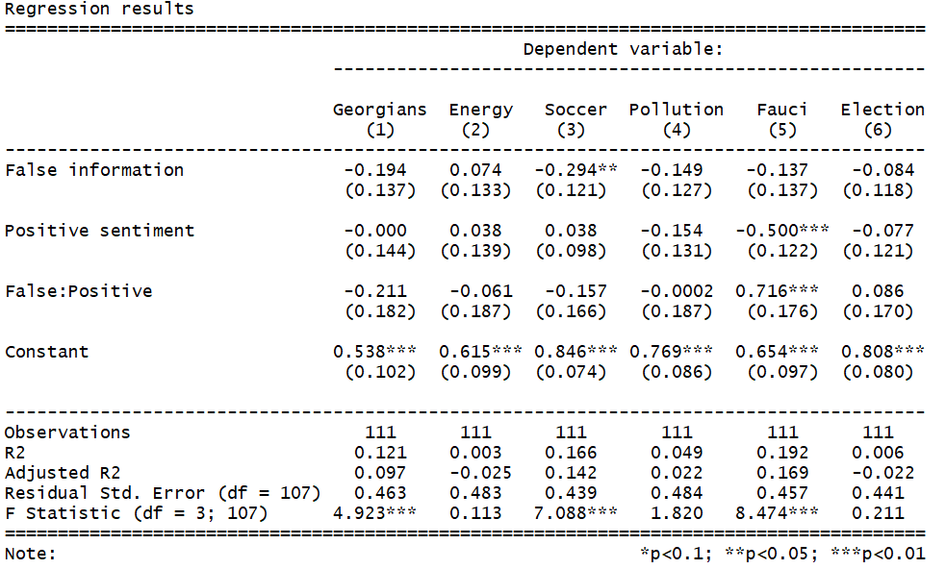
Regression results (Question level)
Sports tweet
True information had a negative impact in memory.
Pandemic tweet
Negative sentiment had a negative impact in memory, and a strong interaction negatively correlated to sentiment alone.
Factor | Level (0) | Level (1)
Truthfulness (T) | False | True
Sentiment (S) | Positive | Negative

Slide 29
08
Outcome
Hypothesis Validation

Slide 30
Conclusions
H1: There's no difference in memory retention of tweets caused by truthfulness
H2: There's no difference in memory retention of tweets caused by sentiment
We didn’t find evidence suggesting that short-term memory was caused by truthfulness in the tweet.
We found marginal evidence that negative sentiment cause a reduction in short-memory retention.
This is an interesting finding because the literature suggest the opposite (Li, K.K.). A larger study would help us understand the effect.

Slide 31
Threats to validity
Hard to replicate due to being dependent on text. We used third party verification to facilitate the process: Polifact and VADER sentiment package.
Selection of subjects can be questionable because it came from a relatively close network -a mix of colleagues, mids students, facebook groups (general) and close friends.
Attrition of 9% in one of the treatment can point out that something in the tweet affected the outcome.
Spill-over effect was mitigated by telling people to not share information after responding the survey. Depends on a system of honor.

Slide 32
Further discussion
Extreme sentiments seem to have somewhat an effect (marginal p-value) which could be further investigated.
Possibility to try different platforms and see if there’s consistency in the results from the tweets.
We tried as best to have a single standard test. All the questions were the same, but we had two answer sheets. A follow up experiment could seek to combine all into a single standard test and response sheet.
Both Sports and Pandemic tweets are related in terms of Covid-19 and mortality. This could create a special attention to the content.

Slide 33
Thanks!
Notes:
Thank you for listening!

Slide 34
Feedback
Did we achieve the treatment we meant in our tweet design?
We did not use all our budget, could increasing the prize amount or number have helped increase our participants?
Did our warning on the tweets increase our abandonment rate?
Did our choice to use the personal network limit the results?
Threats to validity:
Any additional analyses we could do to improve strength of conclusions?
Notes:
We would now like to collect your feedback and answer any questions you may have!
Specifically, we are concerned about: [maybe mention only the most important] and they can read it for the rest

Slide 35
Appendix
Fenn, K, et al. The effect of Twitter Exposure on false memory formation, Psychonomic Bulletin & Review, https://www.researchgate.net/publication/262301675_The_effect_of_Twitter_exposure_on_false_memory_formation
Robinson, B, A New Study Shows Fake News May Benefit Your Memory, Forbes, Oct 17, 2020 https://www.forbes.com/sites/bryanrobinson/2020/10/17/a-new-study-shows-fake-news-may--benefit-your-memory/?sh=bb9b55b2687b.
McGrath D, People remember fake news more if it aligns with their personal beliefs, TheJournal.ie Aug 22, 2019, https://www.thejournal.ie/fake-news-repeal-abortion-eighth-amendment-ucc-cork-4777533-Aug2019/

