Slide 1

A Linear Discriminant Analysis of Data from Archive of Our Own
Alice Hankin for STATS 767

Slide 2
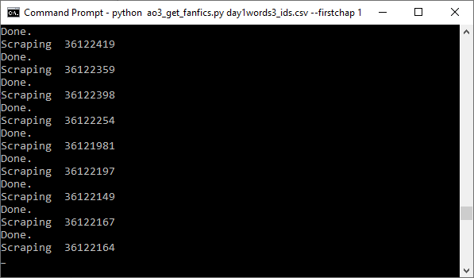
The Data
I used a Python web scraper to download metadata from every work that was:
Completed in the first week of 2022
Not locked (for registered users only)
Written in English

Slide 3
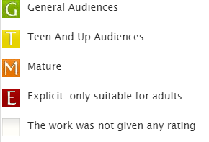
The Data
~29000 works
8 numeric variables plus 3 categorical variables
rating | num_tags | daystocomplete | words | chapters | comments | kudos | bookmarks | hits
General Audiences | 3 | 1 | 883 | 1/1 | 2 | 7 | 1 | 163
Mature | 4 | 12 | 17182 | 2/2 | 5 | 19 | 0 | 412
from these
Can we determine the
?
rating
numeric variables

Slide 4
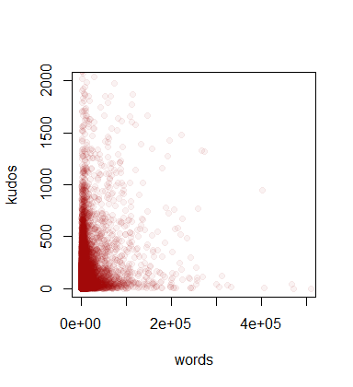
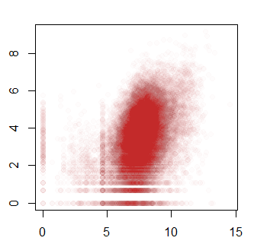
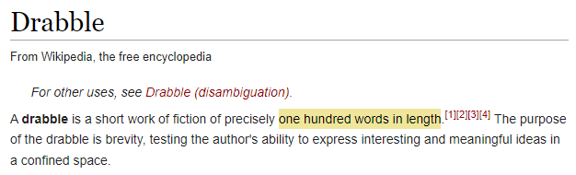
Why do we need to log the data?
What are these strange vertical lines?

Slide 5
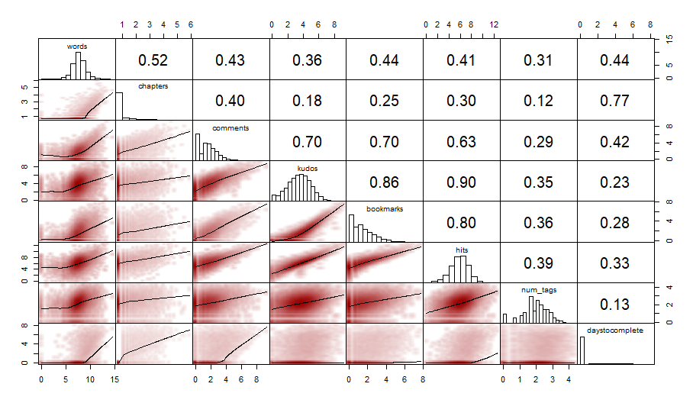

Slide 6
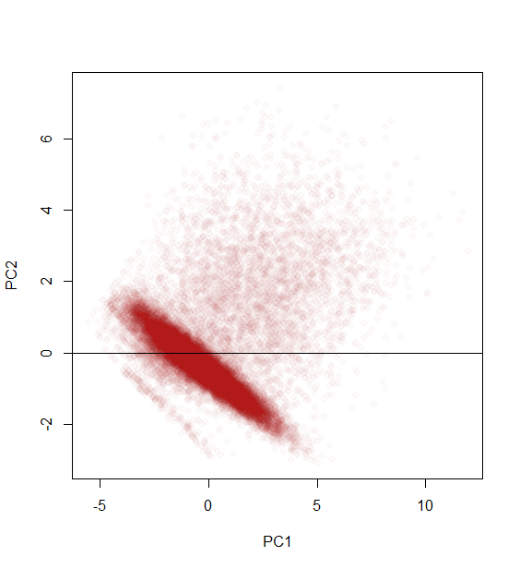
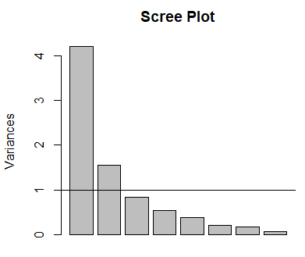
PCA - attempt #1

Slide 7
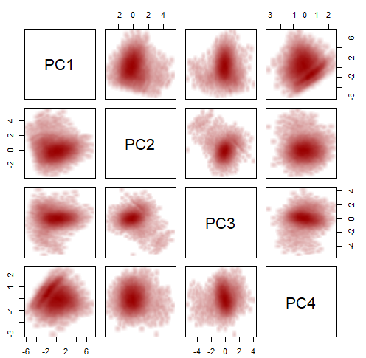
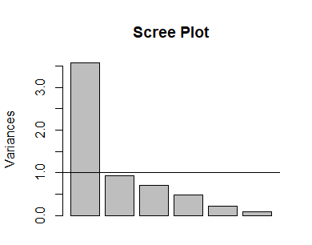
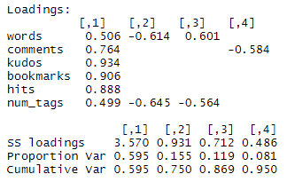
PCA - attempt #2

Slide 8
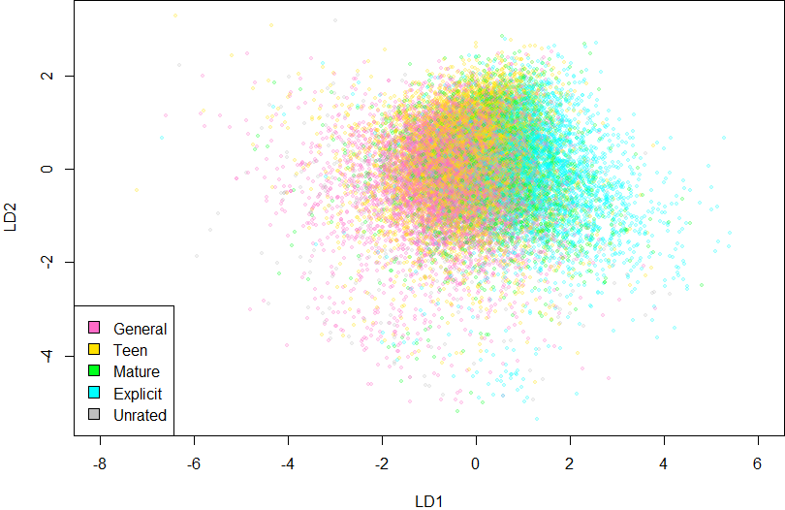

Slide 9
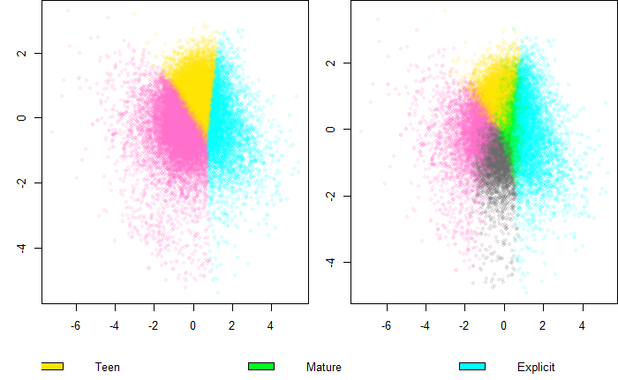
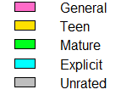

Slide 10
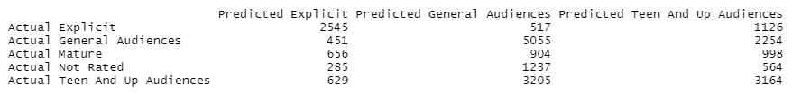
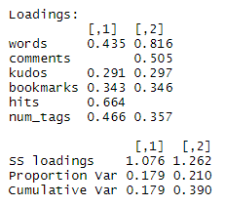
Misclassification rate of 55%
Hard to interpret the loadings!
First component - how appealing the work is?
Second component - how long the work is?

Slide 11
Limitations
Future Work
Data could not be taken all at once
Monthly/yearly effects
Locked works
Sentiment analysis of the tags or the content of the work
QDA / test of multivariate normality
Comparison of fandoms

Slide 12
Thank you!

