Slide 1


Smart Lighting Project
Nannini Alice
Internet of Things
A.Y. 2019-2020

Slide 2
Introduction
This project develops a smart lighting system, based on sensors and actuators installed in streetlights all over the city.
These devices are able to interface with a cloud application, that collects their data and offers to the user the possibility of changing their status.
Smart Lighting project 2

Slide 3
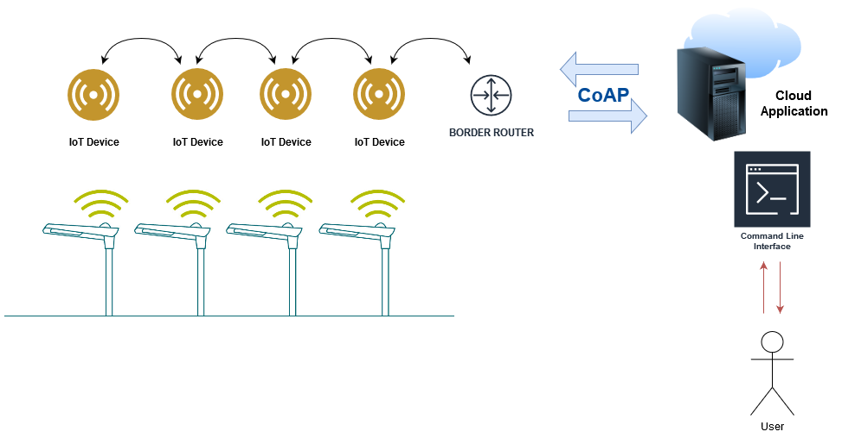
System scheme and structure
Smart Lighting project 3

Slide 4
LLN
Each streetlight is equipped with:
A light sensor that constantly collects data about the light intensity in its area.
The light is measured in percentage of luminosity (value from 0 to 100).
A light actuator that controls the bulb of the streetlights, turning it on or off.
The bulb can be controlled in a manual mode, from the application user, or in an automatic mode from the device.
Both these devices are controlled in a single smart node, installed on the streetlight.
All the nodes are managed by a border router.
Smart Lighting project 4

Slide 5
LLN
If the actuators are in automatic mode, then each node automatically turns on or off the bulb depending on the luminosity detected by the sensor.
On the other hand, if the actuators are in manual mode, then they switch the bulbs only after a request from the cloud application.
Each node has a button to switch between modes.
In addition, the user can change modes via an interface command.
Smart Lighting project 5

Slide 6
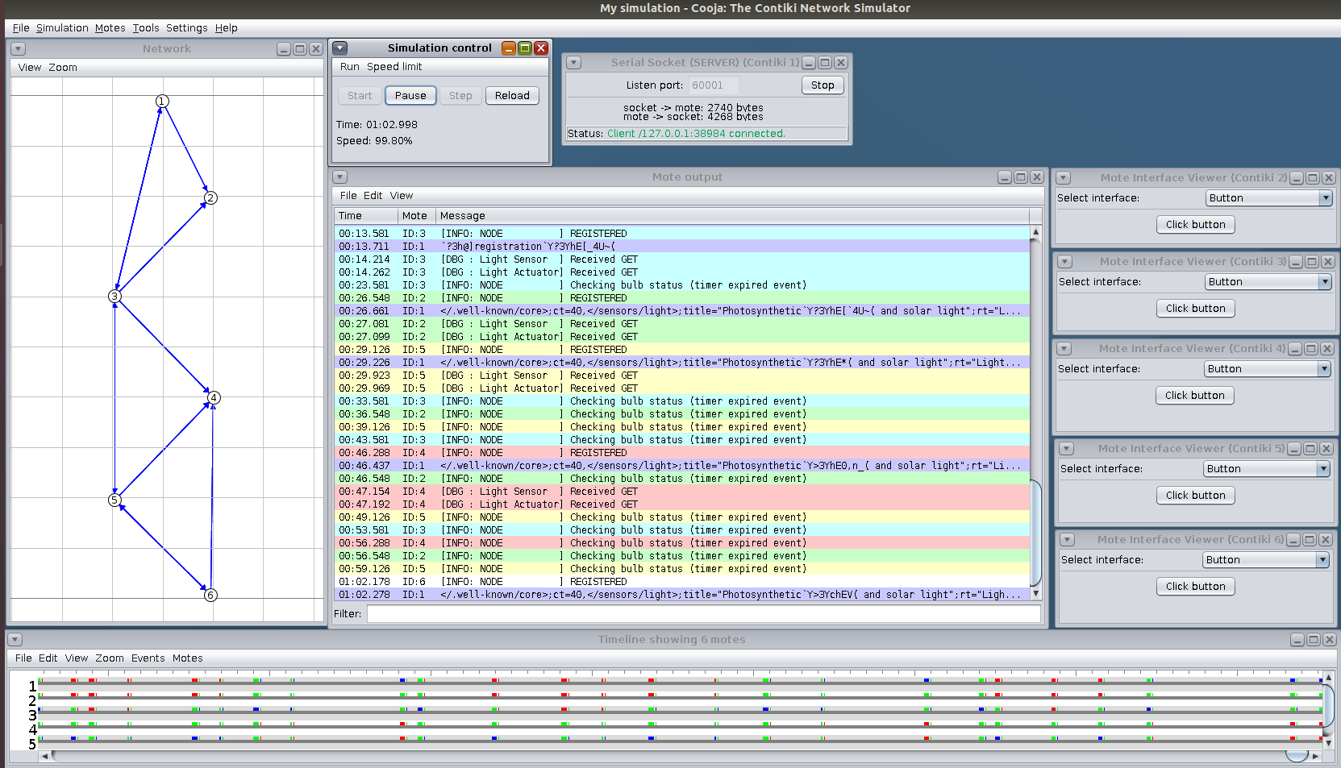
Cooja Simulation
Smart Lighting project 6

Slide 7
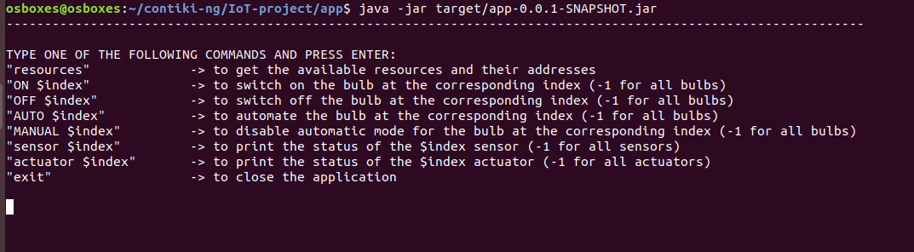
Cloud Application
The cloud application has:
A CoAP server that registers the smart nodes and starts monitoring them through the CoAP observing.
A command line interface that the user can exploit to send request to each node of the network:
Smart Lighting project 7

Slide 8
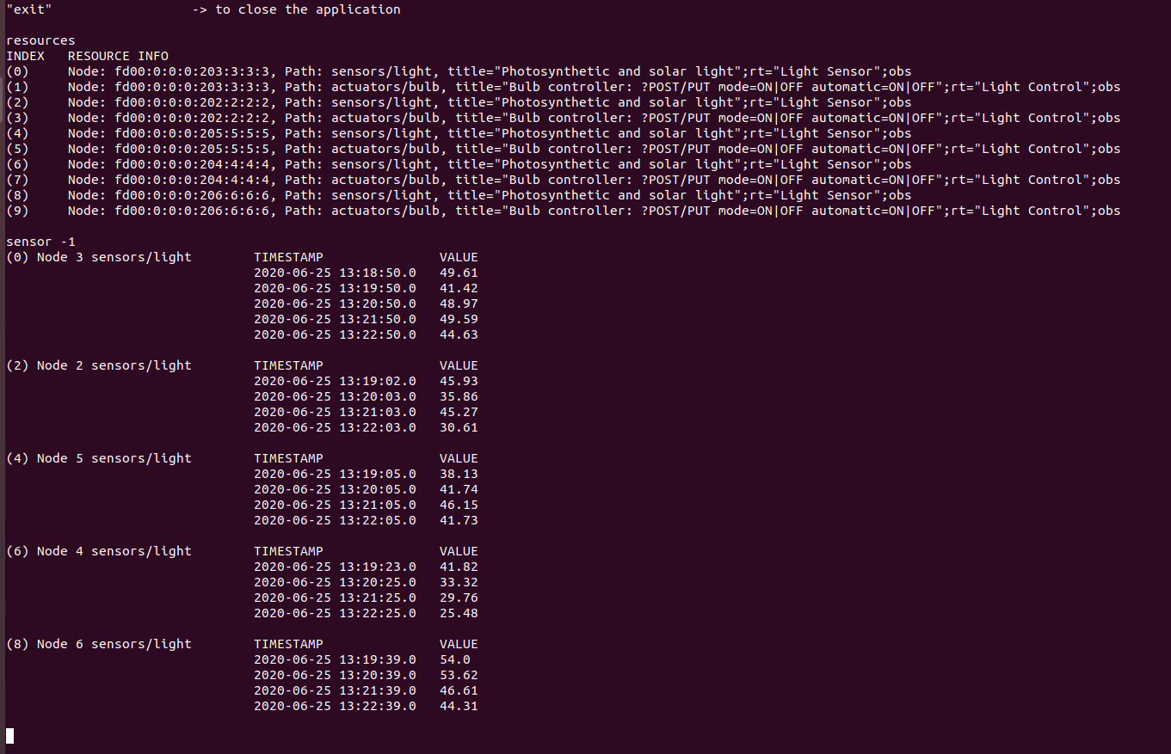
Command Line Interface
Smart Lighting project 8

