Slide 1
STAD: ”Scraping Twitter And Detect” on flooding
Data Mining and Machine Learning 2019/2020
Nannini Alice
Parola Marco

Slide 2
What is STAD
The goal of our application is to prevent and detect potentially dangerous situations, caused by strong weather conditions that involve rain and flooding.
It’s based on scraping twitter and analyzing each tweet, in order to discover some tweets that contain information related to these critical situations.
We analyze the data and develop the application using Python and Sklearn library.

Slide 3

Getting the data
The tweets are collected using twint:
an advanced opensource Twitter scraping tool, written in Python, thanks to which it's very easy to collect data, according to some criteria, and store them in csv files.
https://github.com/twintproject
Some search criteria are setted, e.g. geographic coordinates, to find the data related to the area that is to be monitored.

Slide 4
Pre-processing the data
We extract from the csv file, created by twint, the tweets' texts, discarding all the meta-information associated with them (id, user, etc.).
We filter only the tweets, written in Italian, by using the guess_language package.
We clean the text of each tweet removing eventual URLs: to do so, we use a Regular Expression filter.

Slide 5
Text elaboration
We follow the standard steps of text elaboration, in order to be able to represent each tweet as a numerical vector:
tokenization, stop-word filtering and stemming
stem filtering by relevant stems
feature representation
Then the classification model is applied on the vectorized tweets.

Slide 6

The training set
We’ve collected tweets from September 2019 to February 2020, filtering by some context-related keywords:
We've also scraped some posts randomly, not related to any weather phenomenons (without specifying any keywords).

Slide 7
The training set
We’ve selected and manually labelled 864 tweets, from the collected ones. We’ve decided to map them in 3 classes:
0 → the tweet is not related to a weather condition (348);
1 → the tweet is about rain or some weather condition not dangerous (214);
2 → the tweet is about some dangerous situation caused by the rain (302)

Slide 8
The training set
Class 0:
"Ma si certo. L'errore e la stupidaggine di questi ragazzi sono da condannare, anche perché c'erano delle direttive ferree vista la situazione. Su questo non ci piove. Spero di essermi chiarito."
Class 2:
"Ora piove a dirotto per la gioia di yuki che non può andare al parco"
Class 2:
"Maremma, il maltempo devasta la riserva della Feniglia, mille pini sradicati"
Class 0:
"Ma dai, ma piove sul bagnato! Povera Antonella!!!!! #GFVIP"
Class 1:
"Ma oggi piove pure e io sono a casa a non saper che fare"

Slide 9
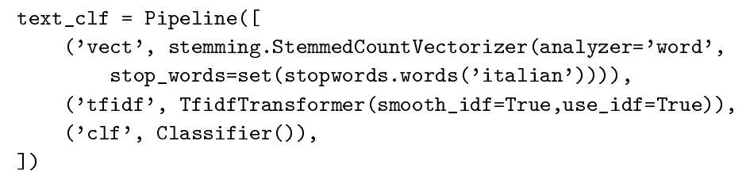
Supervised learning stage
In order to build our model, we’ve previously carried on a supervised learning phase, in which we’ve grouped all the elaboration actions into a single pipeline. The pipeline is executed on the training set multiple times, each time using a different classification algorithm.

Slide 10
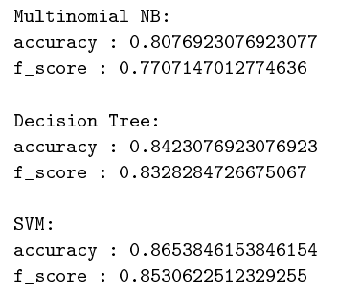
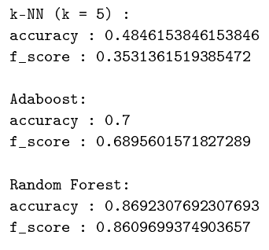
Classification and evaluation
After stratified splitting the dataset in training set (70%) and test set (30%), we’ve tried an holdout validation to compute for each classifier the accuracy, the f-measure and the confusion matrix.

Slide 11
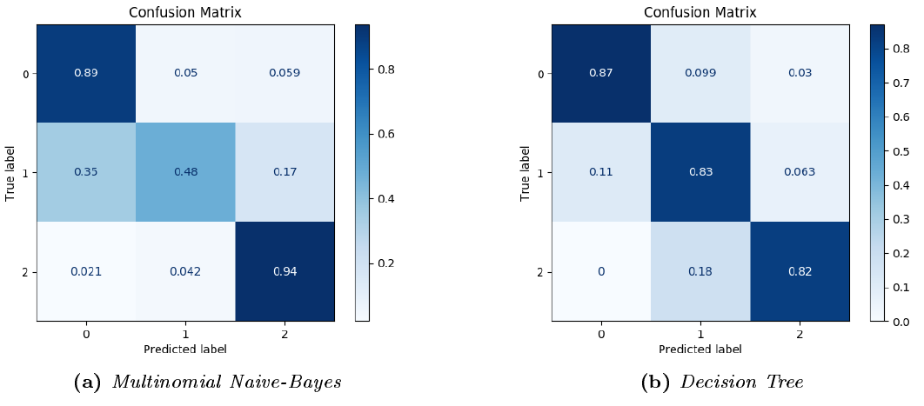
Classification and evaluation

Slide 12
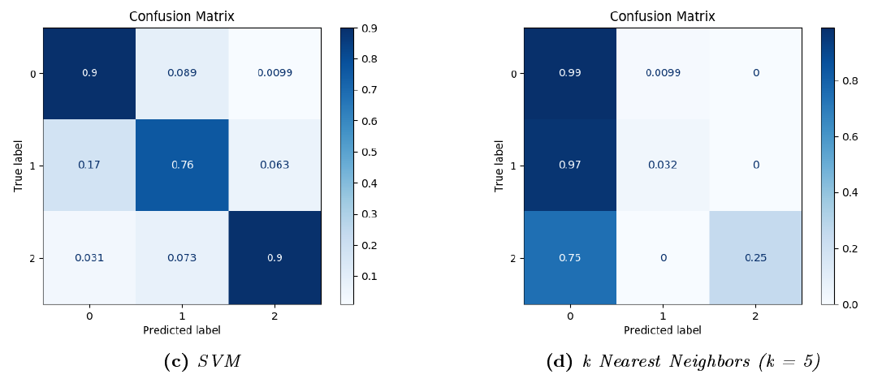
Classification and evaluation

Slide 13
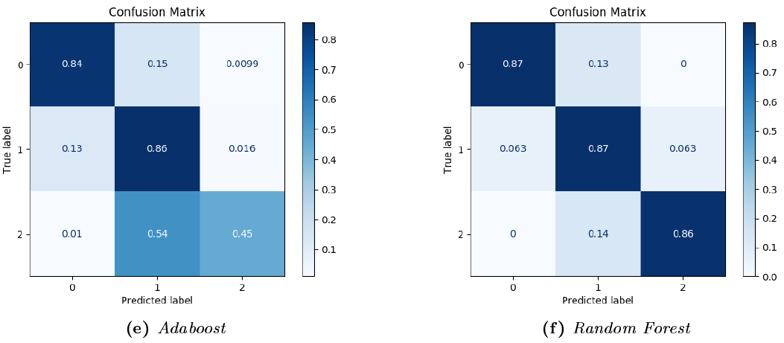
Classification and evaluation

Slide 14
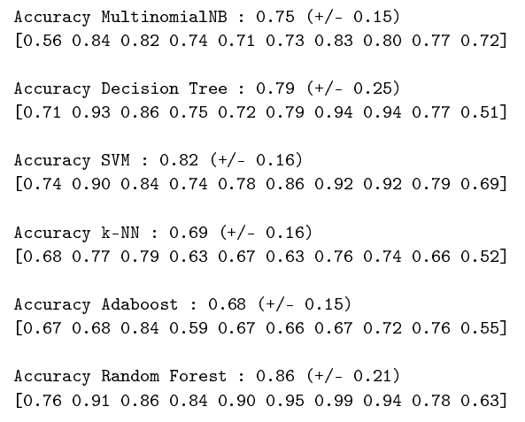
Classification and evaluation
We’ve also tried to evaluate all the previous phases of elaboration and supervised learning, based on our dataset, with the method of cross-validation (using 10 folds).

Slide 15
Classification and evaluation
Given the results obtained both in single evaluation and in cross-validation, we conclude that the SVM classifier is the best for our application. Indeed, it has the higher accuracy, second just to the Random Forest's one. Moreover, this last algorithm has larger confidence intervals (±2std) than the SVM, that is to prefer.

Slide 16
Classification and evaluation
We’ve applied the non-parametric Wilcoxon test (with α=0.1) between the accuracy distributions, taken from two cross-validation executions, of the SVM classifier and the accuracy distributions of the other classifiers.
All the tests rejected the null-hypothesis, so we’ve been positive in choosing the SVM as our classifier.

Slide 17
Testing the model
We’ve selected some significant events of strong weather conditions, involving rain and flooding, happened in Italy during the past years. We’ve collect the tweets posted on the social network during an interval of 5 days around each event, and then we’ve passed these data to our new constructed model.
Some examples:
2011-11-04 flood in Genova (6 deaths)
2017-12-12 flood in Lentigione, Reggio Emilia (1 death)

Slide 18
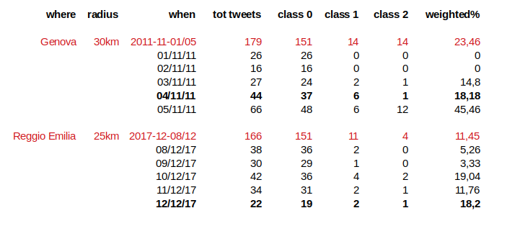
Testing the model

Slide 19
Testing the model
We’ve also selected some days with no significant weather conditions, and applied the model on the data retrieved.
Some examples:

Slide 20
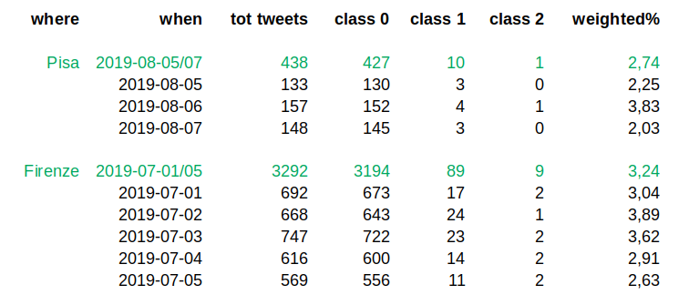
Testing the model

Slide 21

Testing the model
Given the various tests on the model, we’ve decided to set a threshold for launching the alert when the application detects more than 10% on the collected tweets classified as 1 or 2.
The percentage is calculated weighting the class 2 more than the class 1:

Slide 22
The GUI
After the analysis phase, we’ve trained an SVM classifier and exported it in a file.
We’ve implemented a simple demo, requiring 3 parameters: x coordinate, y coordinate, and radius of the area.
Every 10 minutes a scraping phase is scheduled, in order to retrieve the tweets published in the last 10 minutes. These tweets are elaborated and classified by the imported SMV classifier.
We plot the data related to the last 6 hours, and we check if in this interval the percentage of the tweets about rain is greater than 10%.

Slide 23
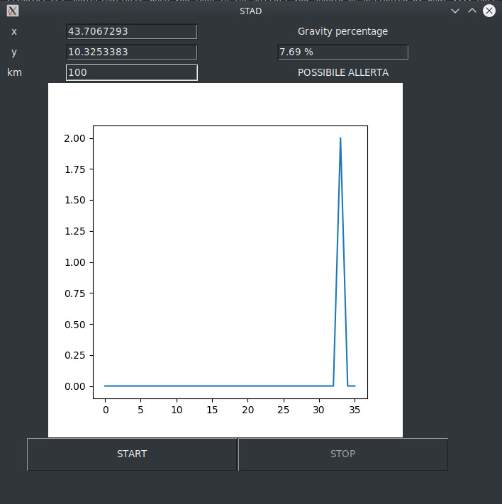
The GUI

