Slide 1

Dynamic Multipath Scheduling Protocol in SDN
Project Work of “Advanced Network
Architectures and Wireless Systems”
Nannini Alice
Poleggi Stefano
A.Y. 2020-2021
Notes:
<numero>

Slide 2
Used technologies
VirtualBox 6.1
Floodlight VM pre-configured with mininet, Open vSwitch, and Floodlight v1.1: for the tests, the VM has been executed with the maximum memory available (3562MB) and 4 processors. Two network adapters have been used: NAT and host-only adapter. https://floodlight.atlassian.net/wiki/spaces/floodlightcontroller/pages/8650780/Floodlight+VM
Mininet 2.2.1
Wireshark 2.6.6
Iperf 2.0.5
<numero>
Notes:
<numero>

Slide 3
Introduction
DMSP is based on a multipath enviroment and makes real-time changes to select least congested links for routing data packets. The path selection and monitoring is done by a central SDN controller.
We modified the java code of the project Floodlight to adapt it to the DMSP requirements.
S. A. Hussain, S. Akbar and I. Raza, "A dynamic multipath scheduling protocol (DMSP) for full performance isolation of links in software defined networking (SDN)," 2017 2nd Workshop on Recent Trends in Telecommunications Research (RTTR), Palmerston North, 2017, pp. 1-5, doi: 10.1109/RTTR.2017.7887866.
<numero>

Slide 4
Topology
We created the topology with redundant links for multipaths, using Mininet.
We wrote a python code (“fat-tree.py”) that implemented a “Fat Tree Topology” and we executed it from command line:
sudo mn --custom fat-tree.py
--controller=remote,ip=192.168.56.109
,port=6653 –topo=fat-tree
<numero>

Slide 5
Building Multipaths
We adapted the original module TopologyInstance in the package net.floodlightcontroller.topology: when calculting dijkstra shortest paths, we managed to store all the next-hops for each source-destination tuple that have minimum cost, instead of stopping at the first one found.
We used the found next-hops to build all the possible paths and then we stored them in a cache.
<numero>

Slide 6
Building Multipaths
The main funcions in the code that we modified for calculating the multhipaths are:
getRoute [l.753-816]: get the possible multi-paths from the cache to the TopologyManager
dijkstra [l.496-557]: calculate all the minimum cost next-hops
buildroute [l.655-727]: build all the possible paths from the next-hops of dijkstra
<numero>

Slide 7
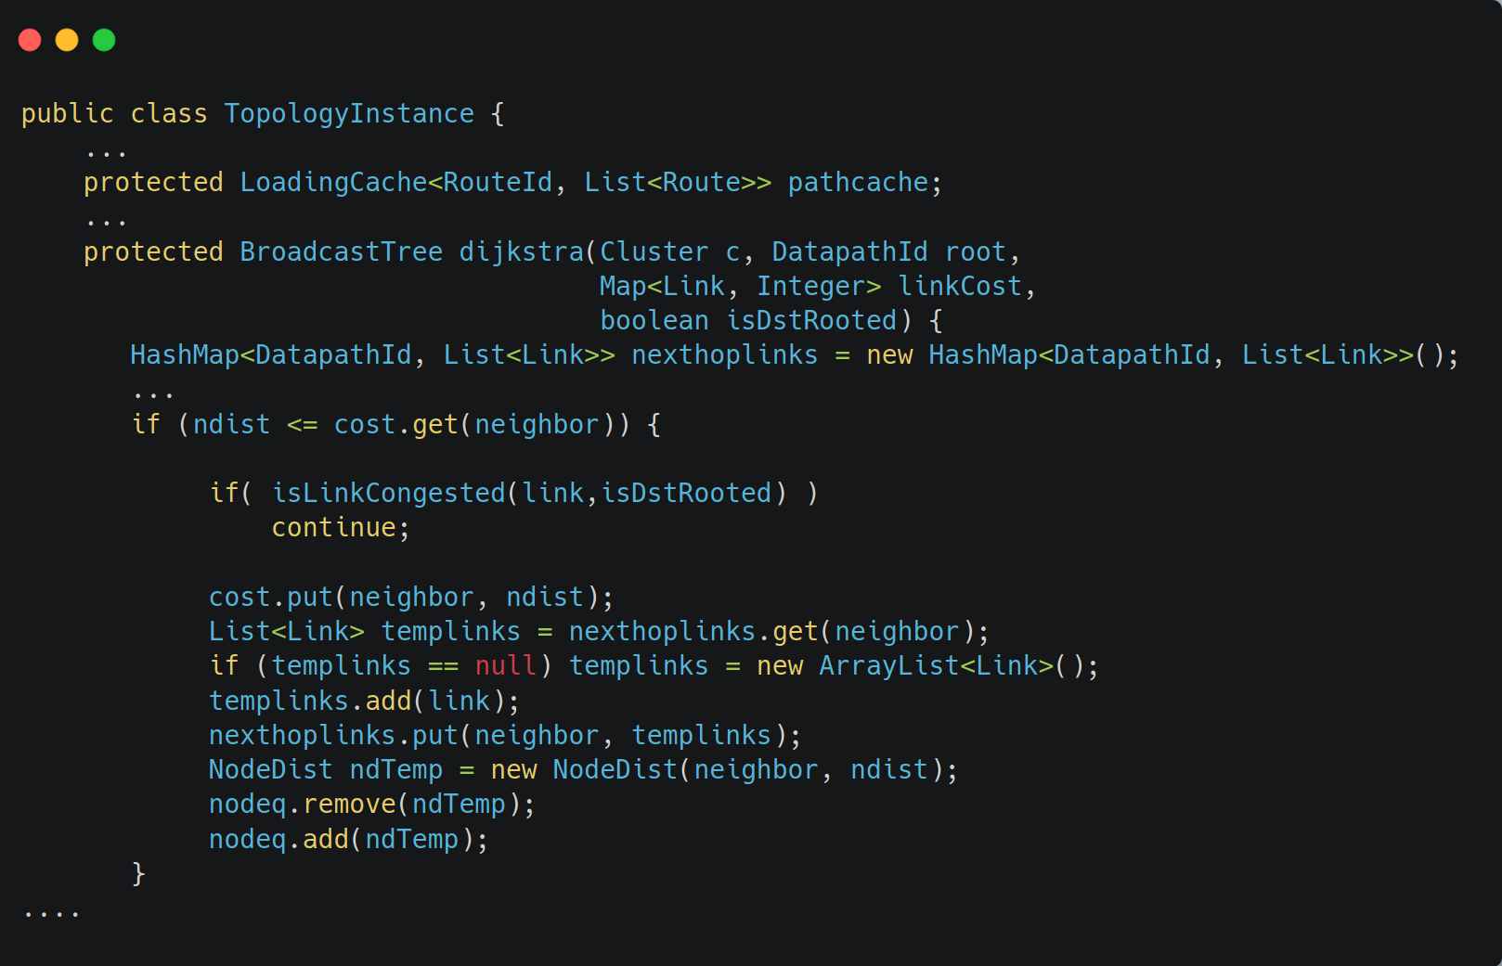
TopologyInstance
This is an extract of the code, in which we can see how the multiple next-hops are selected.
<numero>

Slide 8
Scheduling of multipaths
We have updated the TopologyManager module: after receiving the list of possible paths from the TopologyInstance, it schedules one for each source-destination host pair, using the Round Robin algorithm.
The interested functions are:
  class PathId [l.97-155]
  getRoute [l.780-802]
  scheduleNewRoute [l.805-821]
  checkStatistics [l.370-379]
<numero>

Slide 9
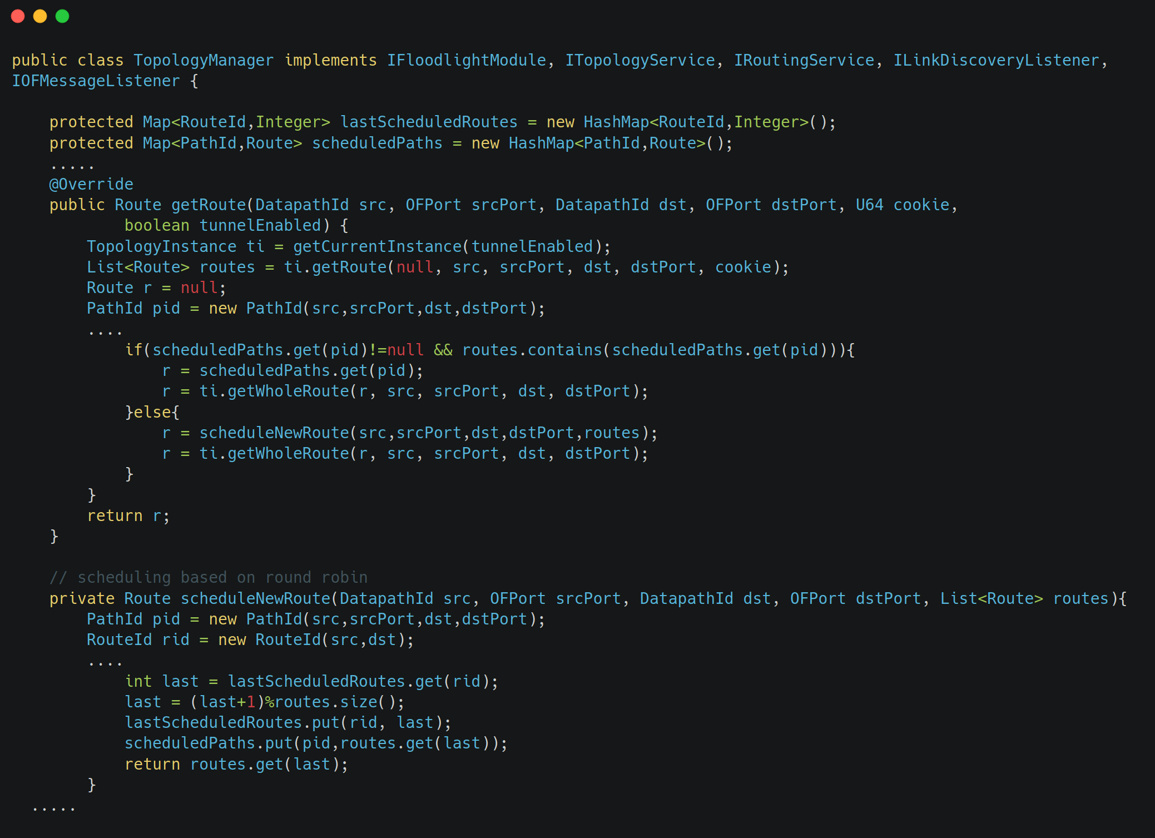
TopologyManager
<numero>

Slide 10
Statistics on bandwidth
Since the DMSP protocol requires congestion control, so that different paths can be scheduled according to link available bandwidth, we included this part.
We integrated the statistics module of a later version (present since 14 Dec 2015) of Floodlight to our system, which periodically collects statistics about link bandwidth.
This service is exploited by the TopologyInstance: congested links do not contribute to path building.
<numero>

Slide 11
Statistics on bandwidth
We added several classes in a new package net.floodlightcontroller.statistics:
IStatisticsService: interface of the service
StatisticsCollector: implements the interface and contains the threads that collect the bandwidth statistics
SwitchPortBandwidth: utility class to store statistics for each port
The other classes in the package are for the Rest API service
<numero>

Slide 12
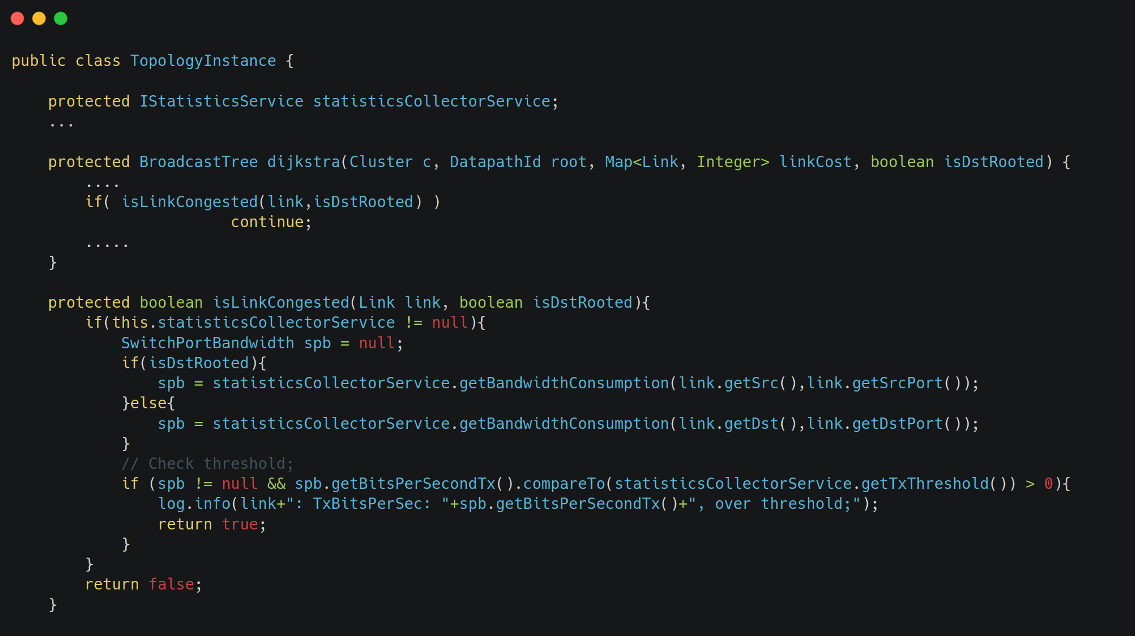
Use of StatisticsCollector
The congested links are not considered in the computing of the possible paths by TopologyInstance.
<numero>

Slide 13
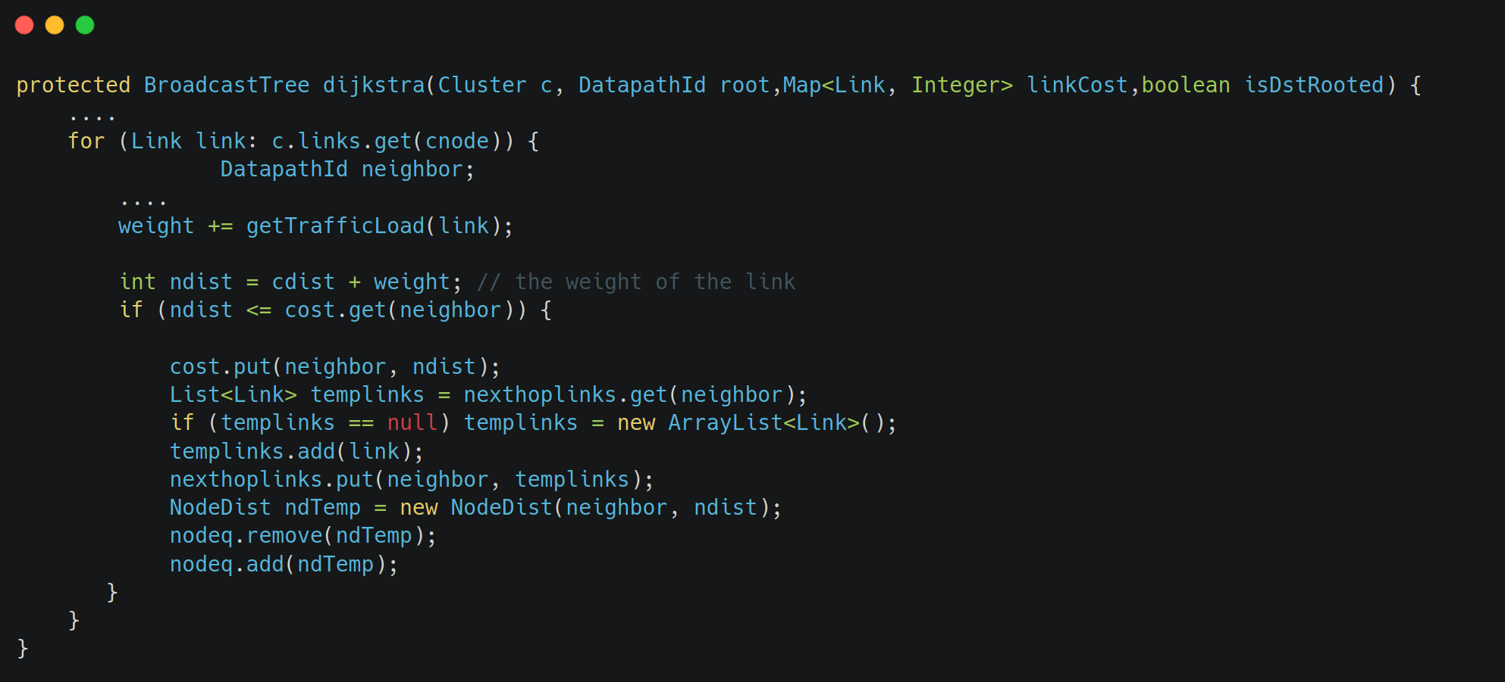
Alternative choice
We developed an alternative version to calculate the shortest paths, modifying the dijkstra code (class TopologyInstance): insteaod of setting the link weights all to 1, we use the traffic load on the link. So the computed paths will be the ones with less load on them.
To exploit this altervative, the code is:
<numero>

Slide 14
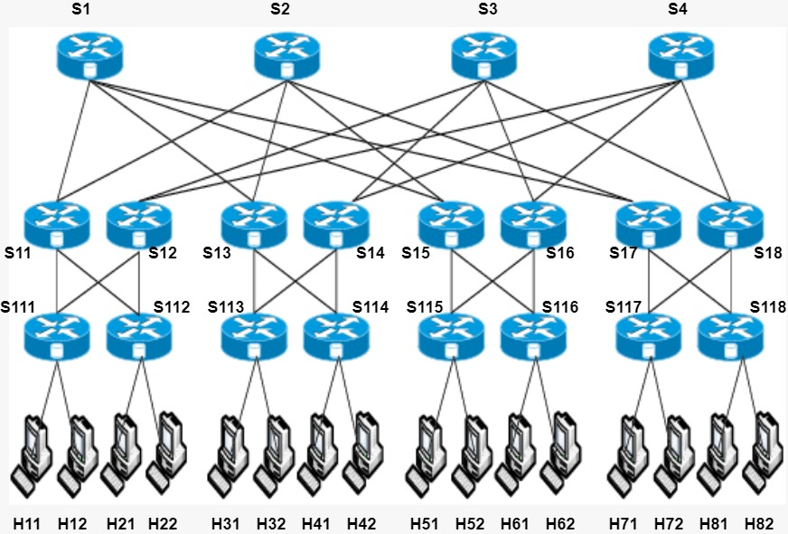
Topology
<numero>

Slide 15
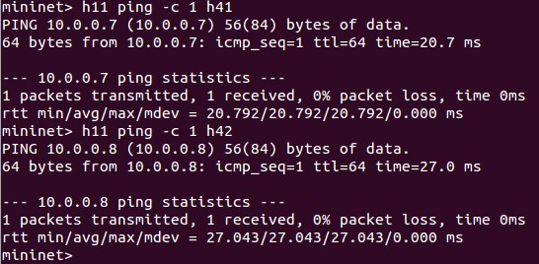
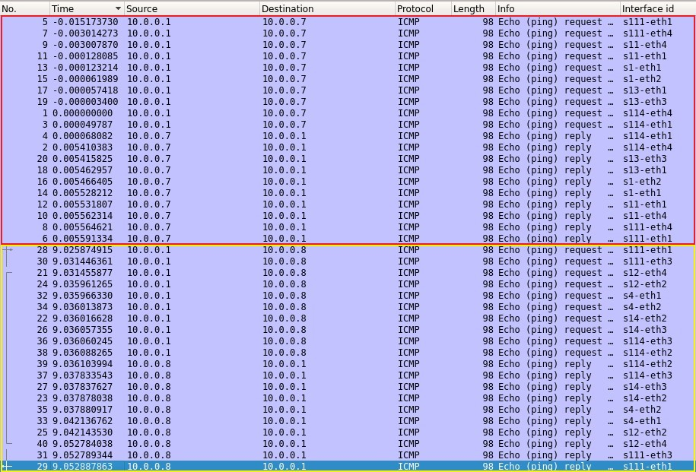
Test on multipath
Two consecutive pings between hosts connected to the same switches go on different paths.
<numero>

Slide 16
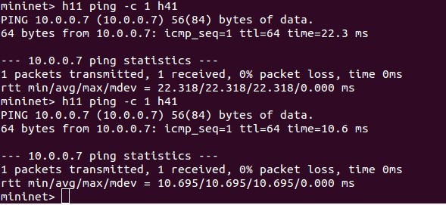
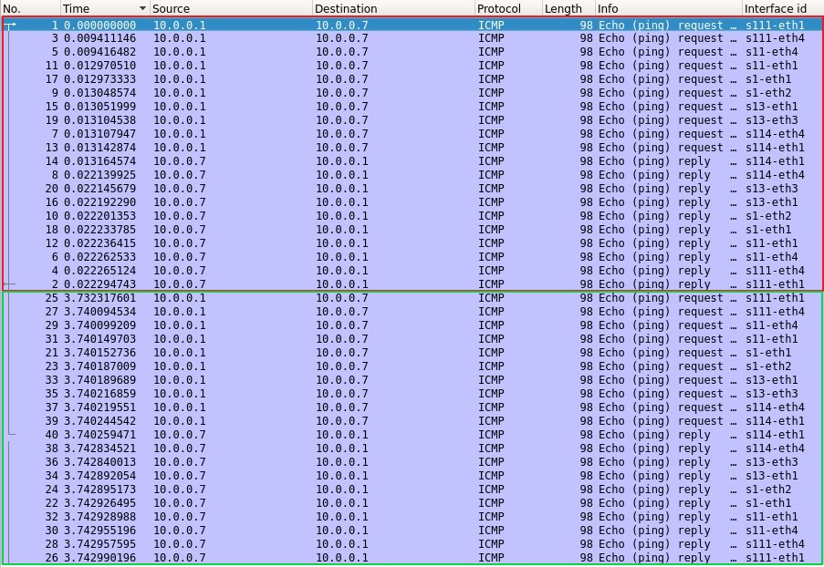
Test on congestion
Two consecutive pings between the same hosts go on the same path.
<numero>

Slide 17
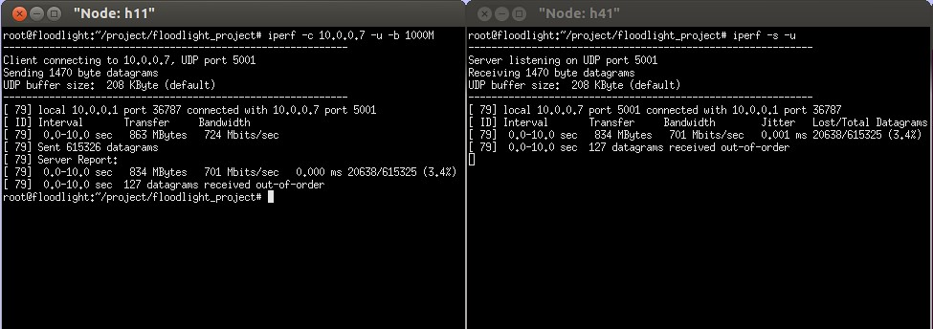
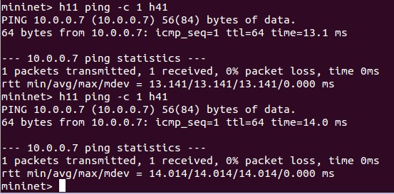
Test on congestion
We congest the path between h11 and h41 with the command iperf.
The controller will detect the congestion on the links and compute a different path for the hosts comunication.
<numero>

Slide 18
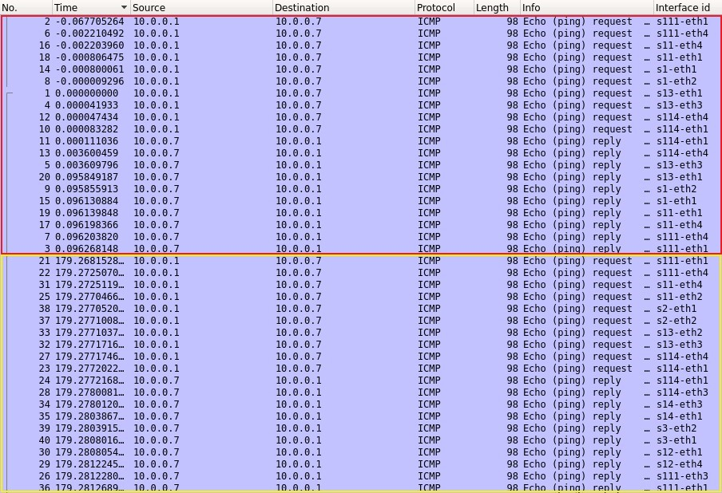
Test on congestion
Before the congestion
After the congestion
<numero>

Slide 19
Pingall comparision
We executed the pingall command for the three versions of the project:
Scheduling with dijkstra the first shortest path available
Scheduling multipaths with Round Robin, discarding congested links
Scheduling multhipaths with dijkstra, considering as cost measure the traffic load on each link
<numero>

Slide 20
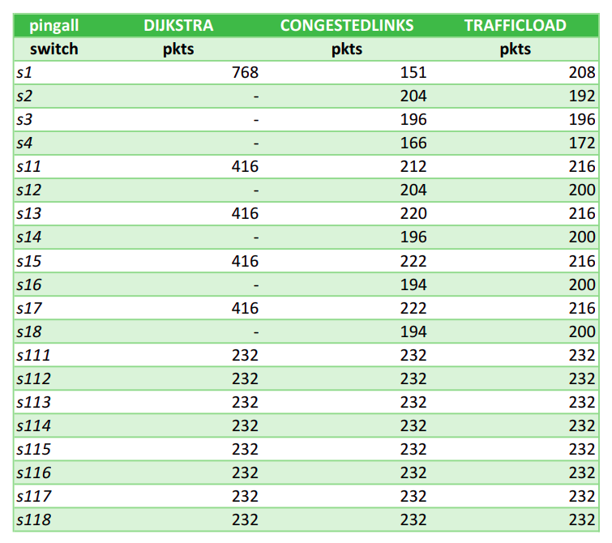
Pingall comparision
These are the results in term of number of packets captured at each switch’s interfaces.
<numero>

Slide 21
Parameters
To study better the network we could modify some parameters:
Add the option –link tc,bw=10 to the mininet command, to limit the bandwidth of the links
Change consequently the TX_THRESHOLD of the interface IstatisticsService
Change the FLOWMOD_DEFAULT_IDLE_TIMEOUT in the ForwardingBase class, to alterate the timeout of the flow table entries
Change the expireAfterWrite timeout of the PathCache in the TopologyInstance class.
<numero>

