Slide 1
Interpolating ship paths in the Port of Metro Vancouver
Supporting an emissions inventory
Cameron Wallace, B.Sc – Digital Solutions Coordinator
Notes:
Not my slides

Slide 2
Notes:
Generic who is SNC
- top 3 engineering companies in the world
- engineering, procurement, construction, management
- examples: 407 hwy in To, Evergreen line (build only) and Canada line

Slide 3
The Project
The Port Metro Vancouver leads “a suite of initiatives that reduce air emissions associated with key port activities: ships, trucks, cargo-handling equipment and terminal activities. Our approach is to collaboratively work with industry and stakeholders in each sector to develop programs that respond to their unique operating context and meet industry leading environmental objectives.” *
The final report, based in part on data delivered by SNC Lavalin; https://www.portvancouver.com/wp-content/uploads/2017/12/2015PortEmissionsInventory.pdf
* https://www.portvancouver.com/environment/air-energy-climate-action/
Notes:
Port emissions inventory – be as green as possible (Green Initiative, international initiative)
Collected data, wrote report
Emissions of everything: all things in motion, huge scope

Slide 4
The Project
Port Metro Vancouver collects ship position data using a couple different sources. The data-set in question here is the most complete and accurate, the AIS (Automatic Identification System). This is supplemented by radar and radio call ins.
The AIS is a global satellite supported system and is mandatory for all ships over 300 Gross Tonnes.
Ship Emissions can be calculated through engine load, a fuel factor, an age factor, engine type. Engine load can be determined by the speed of the vessel, while the rest of the information can be determined through cross-referencing to international vessel databases.
Notes:
Ship tracking data for port region – need engine load ie speed to estimate emissions

Slide 5
The Team
The project team consisted of;
Air and Emissions Specialists
Data Analyst/Programmer
GIS Analyst

Slide 6
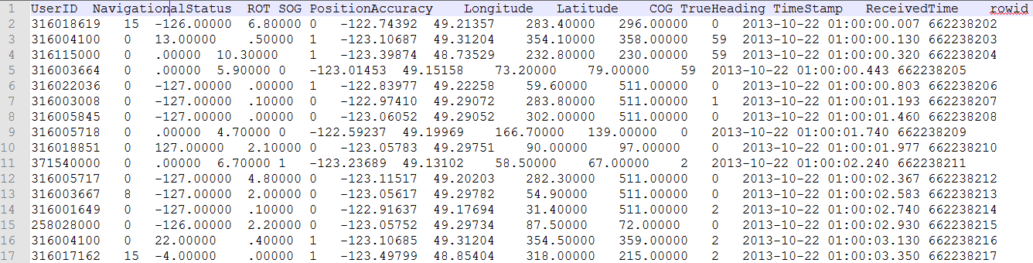
The problem
As part of the data that was provided, we received large text files (not atypical for legacy systems);
Notes:
Example data – this is the data students get – observe headings
How many rows?

Slide 7
How to Calculate Emissions
Equation to calculate marine emissions:
E = P x LF x T x EF (12)
Where:
E = Emissions (g)
P = Power Rating of Engine (Maximum Continuous Rating, kW)
LF = Load Factor (fraction of rated power for an engine)
T = Time in mode (h)
EF = Emission Factors in g/kWh (CACs) and g/tonne (GHGs)
Scope: OGVs, assist tugs, workboats, dredging
Sources: main engines, aux engines, boilers
Activity modes: maneuver, u-slow, u-half, u-full, anchor, berth
Notes:
You won’t be able to compute this without doing more research – but you can learn the speed of the ship at all times – speed combined with load as a function of speed is a proxy for LFxT
“mode” means activity modes (proxy for a speed bin)
P, EF are constant for all time for the ship (EF also depends on the fuel type)
LF depends on speed (operating mode)

Slide 8
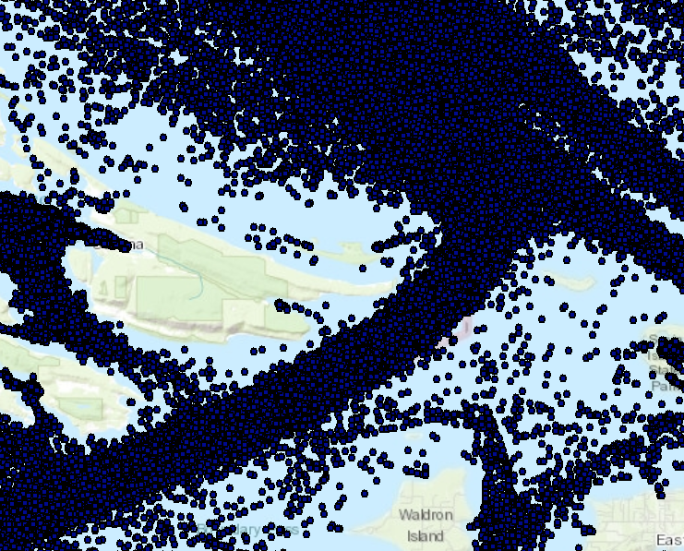
The Data
Notes:
Spatial view:
Point-by-point looks okay – few points are on land, for example

Slide 9
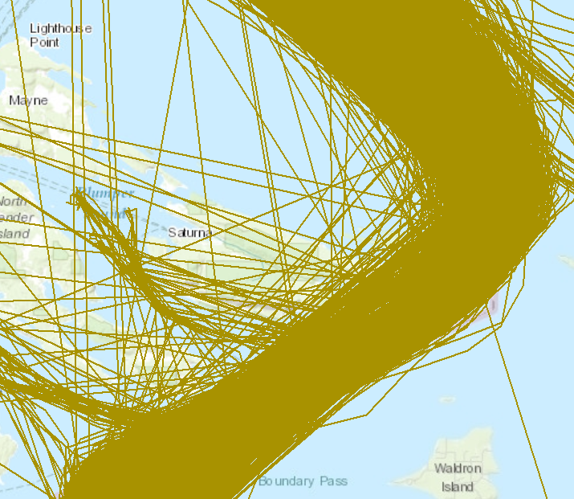
The Problem
While much of the data is of acceptable quality, a portion of it wasn’t.
Notes:
Spatio-temporal view – many tracks are over land
Some of the tracks are no good – most are, but some are not – missing or bad data are the most common problems
Real problem is to “fix” these data so that you don’t have to throw out routes
i.e. need to go around land, not over

Slide 10
Fields
https://sd.ic.gc.ca/pls/engdoc_anon/mmsi_search.ship
https://www.fleetmon.com/vessels/

Slide 11
Problem Formulation
Figure out Position of Ships to be able to pull granular location, speed, to enable emission calculation in more granular fashion (if given the actual Emission Factor and Power Rating).
Omit or fix erroneous data points (omit bad trips, not just points, or replace erroneous points in trips to avoid land etc.)
Notes:
Primary question: how to clean up the data, discard any bad points, correct any inaccurate point, provide realistic paths
Bonus question: actually determine speed over water

Slide 12
Questions?
Cameron.Wallace@snclavalin.com

