Slide 1
Node.js and Express
Written by: Alice Roherty-Carrier

Slide 2
What is node.js?
Node.js is a runtime built on Chrome’s V8 Engine.
Allows you to run JavaScript outside of a browser.
Can communicate with a database, serve web pages, and more.
Features a wide-variety of open-source packages through NPM.
We can run our Node.js apps from the command-line using the command “node <filename>”.

Slide 3
The V8 engine
The V8 Engine is the JavaScript engine used in Google Chrome.
Computers do not understand JavaScript.
A JavaScript engine takes JavaScript and converts it into machine code so that it can be run.

Slide 4
The V8 engine
The V8 engine can stand alone or be embedded into other C++ applications.
Node.js is written in C++ because it uses Chrome’s V8 engine which is also written in C++.
Node.js is a C++ program with the V8 engine embedded into it, which extends the features of JavaScript.

Slide 5
npm
NPM stands for Node Package Manager and it is the package manager used by Node.js. (NuGet is the package manager we use for C#.)
NPM offers many Node.js packages.
A Node.js package is code that was written by someone else to offer a specific functionality.

Slide 6
npm
Using NPM we can install node packages and create packages for other people to use.
NPM can be browsed for packages at www.npmjs.com
To install a package we use the console command “npm install <package name>” in the project directory.
When we install a package it is stored in the node_modules folder.
The node_modules folder will be created for you if it doesn’t exist already and you install a package.

Slide 7
Package.json
The package.json is a file that keeps track of our node packages.
We can create one ourselves or have NPM create one for us using the command “npm init”.
The package.json helps us to keep track of our projects dependencies. (Packages that our project needs to run.)

Slide 8
Package.json
Installed NPM packages will not be added to the package.json by default.
To tell NPM that a package we are installing is a dependency we must pass the save flag to the install command. “npm install <package name> -save”
When we use the save flag NPM will automatically add the installed package to our dependencies in the package.json
Once we have our dependencies listed in the package.json we can use the command “npm install” to install all of them at once.

Slide 9

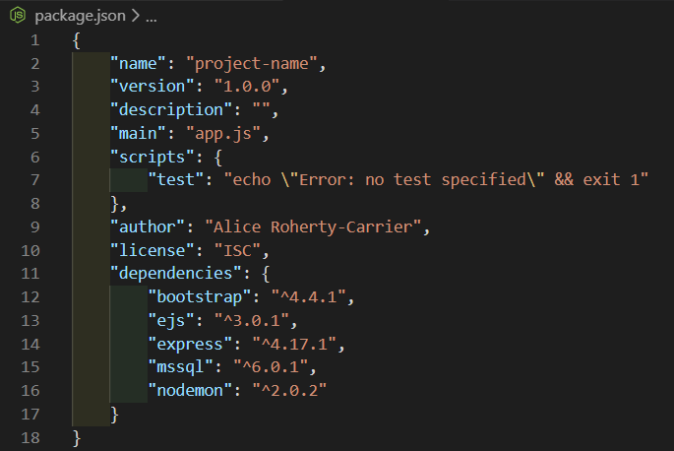
Package.json example

Slide 10
The Global Object
When writing client-side JavaScript the global object is the window object.
The global object in Node.js is called global.
This object contains methods such as console.log() that are normally on the window object.

Slide 11
The Global Object
In Node.js console.log() logs to the terminal rather than the debug console of a browser because Node.js runs on a computer and not in a browser.
Contains __dirname and __filename variables that contain an absolute path of the current directory and the name of the current file respectively.

Slide 12
Modules and require
Node Modules allow us to break up our code into different logical parts.
We can import our modules into different files. (Similar to C# using statements or import statements in Java.)
A module is contained within a regular .js file.

Slide 13
Modules and require
We import a module with the require() function which accepts a file path as a parameter.
In order to make values in a module available to files that import it, we need to specifically export the values we want to be made available.
We do this using the module.exports object.

Slide 14
Modules and require
We can set the module.exports object to whatever we want. (Number, function, object, etc.)
When we require a module we need to store whatever is being exported in a variable in order to be able to use it.
When requiring a module that we’ve created we must start the path a “.”. Example: “require(‘./module’)”
When requiring a package that we’ve installed into the node_modules folder we only need to use the module name.

Slide 15



Exporting and Requiring Pi

Slide 16
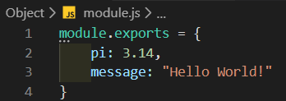

Exporting and requiring an Object
Notes:
Complete Steps 1-9 of the Demo

Slide 17
Core modules
Node.js comes with some built-in modules that we do not have to install, these are called core modules.
To require a core module you simply require the name of the module. (No path required.)
Some examples of core modules would be the http (for creating a web server), fs (for file system interaction), and events (for creating custom events) modules.

Slide 18

Requiring a core module

Slide 19
What is express?
Express is one of the most popular packages available for Node.js
Express is a node package that helps us with routing and templating (Creating Views).
We can install express using npm with the command “npm install express”.
To use express in our app we must require it.

Slide 20

Requiring Express

Slide 21
Creating an Express application
In order to use express in our app once we’ve required it, we must create a variable (traditionally called “app”) and set it to an instance of express.
To create an instance of express you will call the variable you stored the module in as a function.
We also need to tell the app to listen for connections and which port to listen on using the app.listen(port) method.

Slide 22
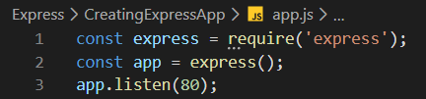
Creating an Express application

Slide 23
Routing in express
To create routes in express we call functions off of the “app” variable that correspond to the HTTP Methods. (GET, POST, PUT, DELETE)
To create a route for a GET request we would use the get() method which accepts the route path and a callback function as parameters.
The callback function is passed two parameters, these are our request and response objects.

Slide 24
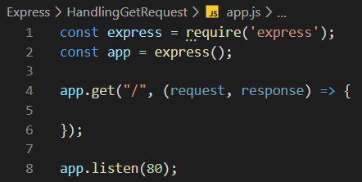
Routing for a get request in express

Slide 25
Request and response
The request object contains information about the request that was sent to us by the user.
The response object contains methods that allow us to send data back to the user who created the request.
For Example: If we wanted to send an html page to the user who makes a request we would use the response object. If we wanted to retrieve a query string or route parameter we would use the request object.

Slide 26
Response methods
sendFile(path) – Gets the file at the specified path and sends it as a response.
render(viewName, [data], [callback]) – Renders a specified view passing it the data object if there is one and then executing the callback if one is specified.
end() – Ends the response process.
sendStatus(statusCode) – Sets the http status code of the response and sends it. (404, 200, etc.)
json(jsonObject) – Returns JSON to the user as a response.
redirect(route) – Redirects the user to a specified route.
send(body) – Sends the response with specified body content.

Slide 27
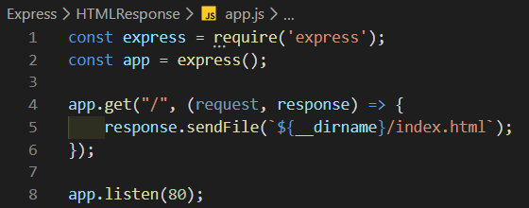
Sending an HTML page as a response
Notes:
Complete Steps 10 – 17 of the Demo.

Slide 28
Route Parameters
A route parameter is a variable that is passed in through the URL.
To create a route parameter in express we add a colon and our variables identifier into our path string.
Once our route has been updated to include the route parameter, it’s value can be accessed from the request object.
The request object contains a property called “params” which contains an object with the route parameters that have been defined as its properties.

Slide 29
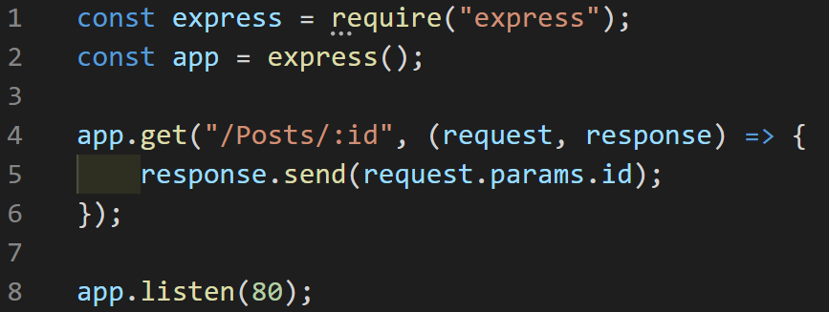
Using route parameters
Notes:
Complete Steps 18 and 19 of the Demo.

Slide 30
Serving Static Files
Static files are any files that do not require any processing before being sent to the user. (Example: Images and stylesheets)
When serving static files we don’t need to make a route for each file.
Instead we make a folders contents publicly accessible all at once.

Slide 31
Serving Static Files
We do this using the express.static() method which accepts our desired folder’s name as a parameter.
We pass the desired route to map the folder to and express.static() as arguments to the app.use() method.

Slide 32
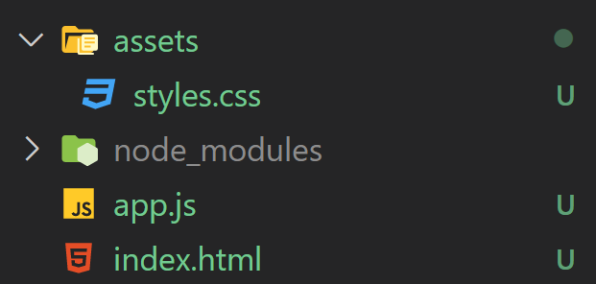
Serving Static Files

Slide 33
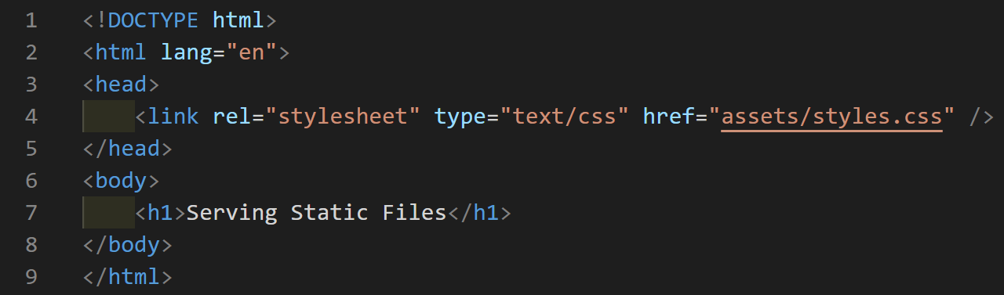
Serving Static Files

Slide 34
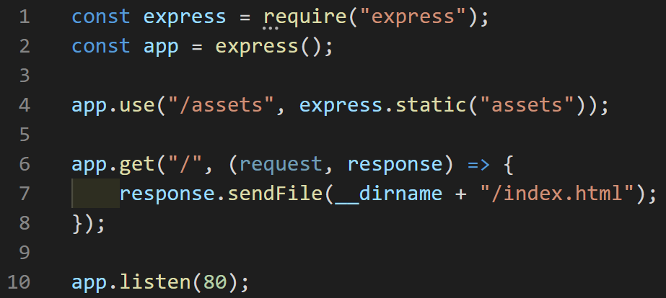
Serving Static Files
Notes:
Complete Steps 20-25 of the Demo.

Slide 35
Handling Post Requests
To create a route for a post request we use the app.post() method which accepts the route path and any number of callback functions as parameters.
When we send data in a post request the data is stored in the request’s body.
The request object in Express does not handle parsing of post requests for us.
In order to parse the body of post requests we need to use a node module called body-parser. (npm install body-parser)

Slide 36
Handling Post Requests
To use the body parser we must begin by requiring it.
For the average post request from an HTML form we use the URL Encoded Parser available from this module.
The URL Encoded Parser takes the form of a function that we will then pass into our app.post() method as a callback before passing in our usual callback.

Slide 37
Handling Post Requests
Once we have our route set up with the parser we can access our posted data through the request object’s body property.
The body parser will populate the request’s body property with an object with properties corresponding to the name attributes set on the form’s inputs.

Slide 38
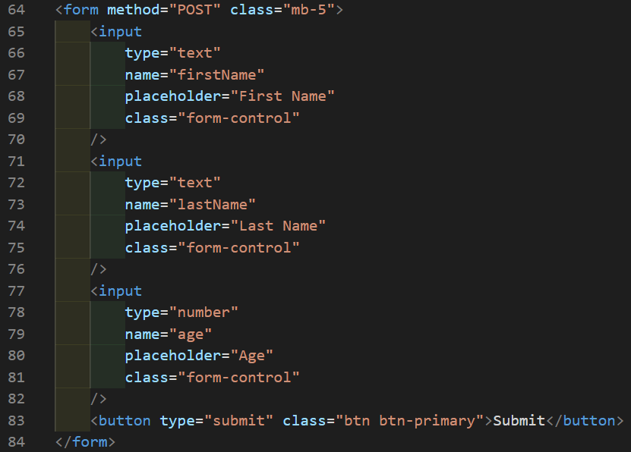
Handling Post Requests

Slide 39
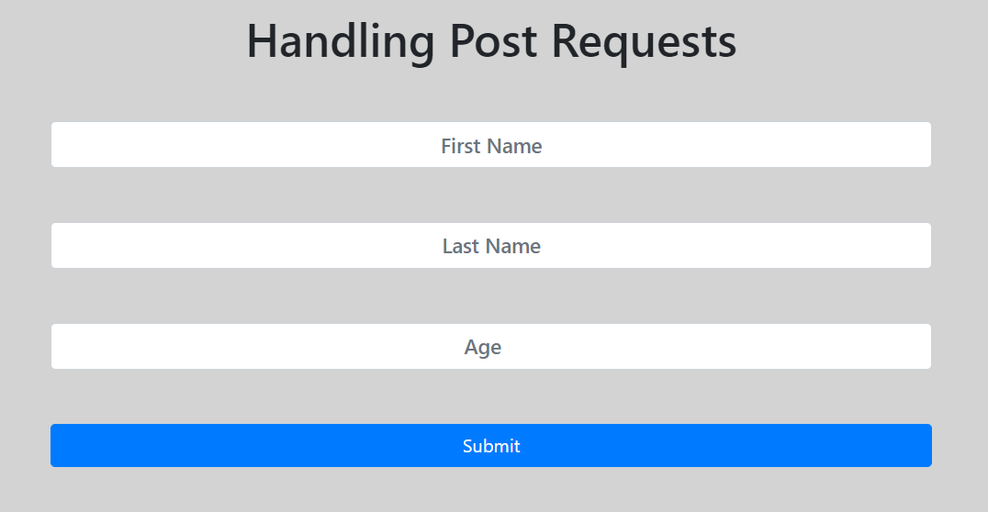
Handling Post Requests

Slide 40
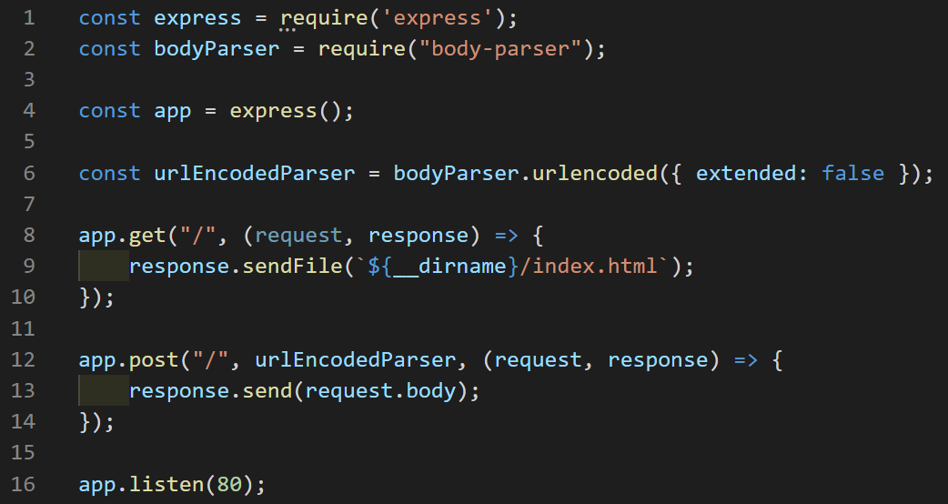
Handling Post Requests

Slide 41
Handling Post Requests
Notes:
Complete Steps 26 – 31 of the Demo.

Slide 42
Templating engines
Templating Engines allow us to dynamically inject data into our HTML pages.
Some templating engines that you have used would include Razor (C#) and JSP (Java).
There are many templating engines that are compatible with express.
We will be using a templating engine called EJS.

Slide 43
Setting up ejs
We need to install EJS before we can use it in our application.
We can install EJS using NPM. “npm install ejs”
We then need to change the “view engine” setting for our app to “ejs”.
To make changes to our apps settings we use the app.set(key, value) method.
In order to ger proper syntax highlighting and code snippets for EJS we must install an extension for VS Code called “EJS language support”.

Slide 44
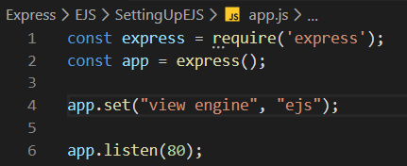
Setting up ejs
Notes:
Complete Steps 32 – 34 of the Demo.

Slide 45
Rendering Views
When we request a view express will automatically look for a folder called “views” so we should always create this folder for storing our views.
To create a view we create a file with an extension of .ejs
To render a view we use the response.render(viewName) method.
We do not need to include “.ejs” when specifying the view name.

Slide 46

Rendering a view
Notes:
Complete Steps 35 – 38 of the Demo.

Slide 47
Passing data to views
The response.render() method accepts a maximum of three parameters, the view name, an optional data object that will be passed to the view, and an optional callback.
In order to pass data to the view we must include the optional data object when rendering the view.
Once data has been passed to the view we can interact with it using EJS.

Slide 48

Passing data to a view

Slide 49
Working with ejs
EJS provides us with a variety of tags we can use.
EJS tags are syntactically similar to JSP tags.
To output a value use the <%= %> tag. (This tag HTML escapes the value before outputting it.)

Slide 50
Working with ejs
To output a raw / unescaped value use the <%- %> tag.
EJS also includes a scriptlet tag <% %> this tag is only for control flow and cannot output any value.
To create a comment use the <%# %> tag.
The scriptlet tag can be used to break up control statements such as if statements and loops using the same syntax as JSP.

Slide 51

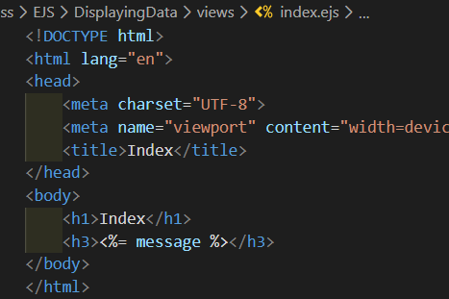
Displaying data with ejs
Notes:
Complete Step 39 of the Demo.

Slide 52
PARTIAL VIEWS
Partial Views allow us to eliminate redundancy in our layouts.
We should use partial views for anything that will be used in multiple views.
EJS offers us a function that allows us to render partial views. include(viewName, [data])

Slide 53
Partial views
The path to a partial view is still relative to the “views” folder.
When including a partial view we should use the raw output tag (<%- %>) to avoid double-escaping our HTML output.
For Example: If we had a called “views/partials/nav.ejs” we would include it as such “<%- include(“partials/nav”) %>

Slide 54
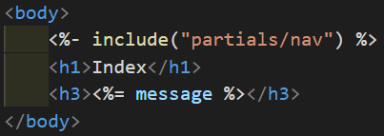
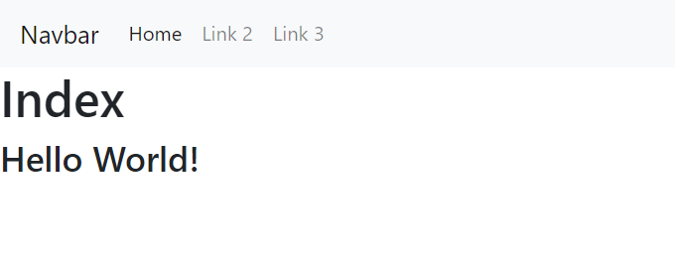
Including a partial view
Notes:
Complete Steps 40 – 42 of the Demo.

Slide 55
Node Modules To Try Out
onoff – Allows Programming for Raspberry Pi in Node.js (W3Schools Tutorial)
face-api.js – Allows for face detection, face recognition, landmark detection, mood detection, age detection, and gender detection. (FaceAPI.js YouTube Tutorial)
socket.io – Allows for real-time bidirectional event-based communication between the server and clients using web sockets. (Socket.io YouTube Tutorial)

Slide 56
Sources
The Net Ninja - Node.JS Tutorial for Beginners
Node.js Documentation
Express Documentation
EJS Documentation

