Slide 1
The Startup Investment World
Trends - Industries - Acquisitions - Regions

Slide 2
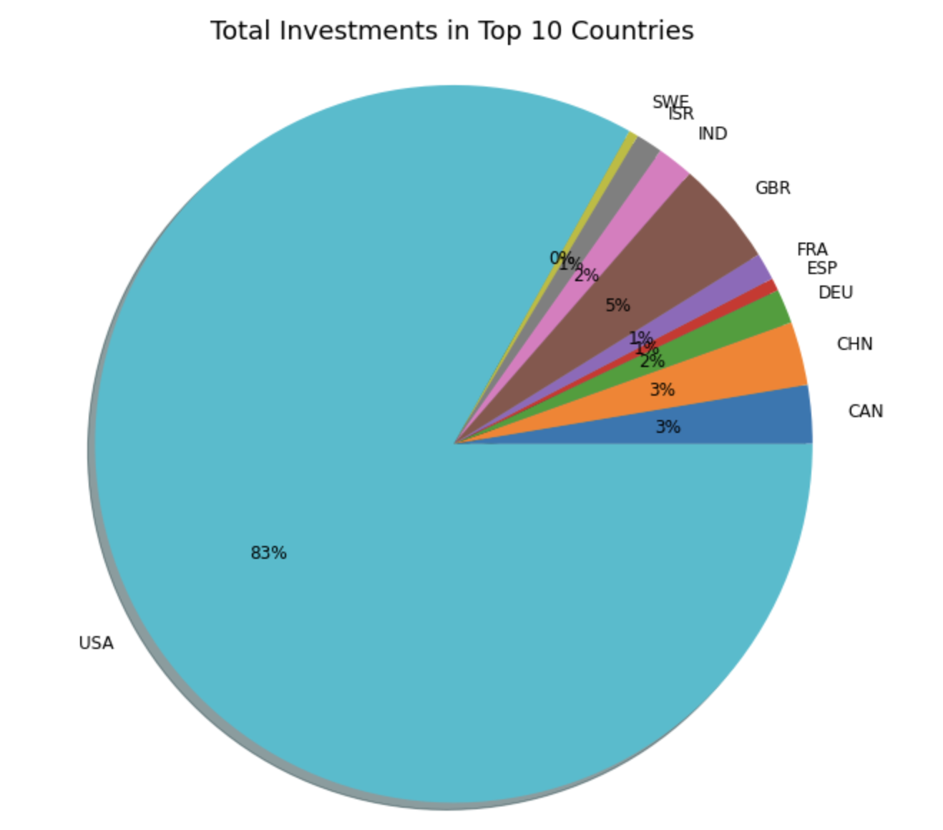
Dataset and Analysis Introduction
Dataset contains information about the startup investment ecosystem
Investment over time
Startup Industries
Acquired Startups
Startup Regions
Most of our investments are for Startups in the US

Slide 3
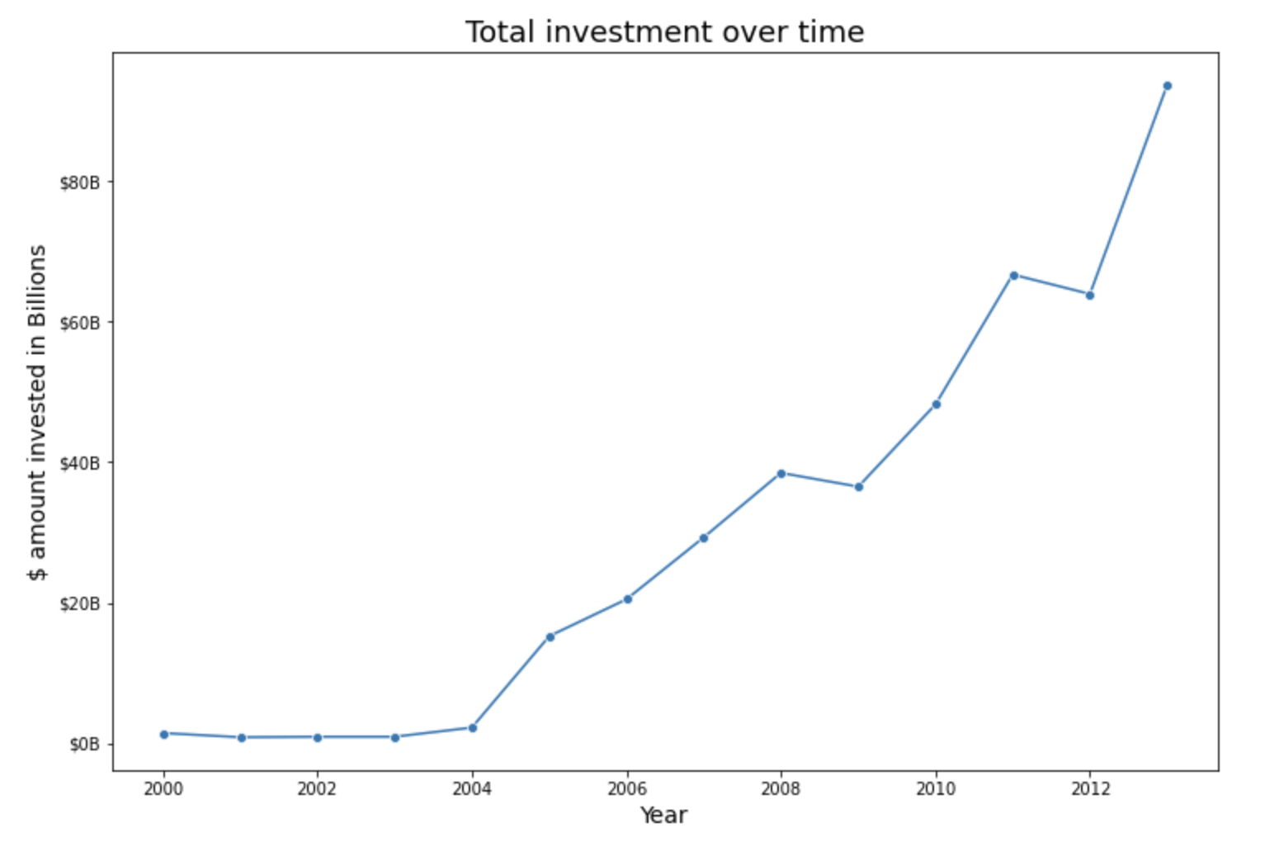
Investment trend over time

Slide 4
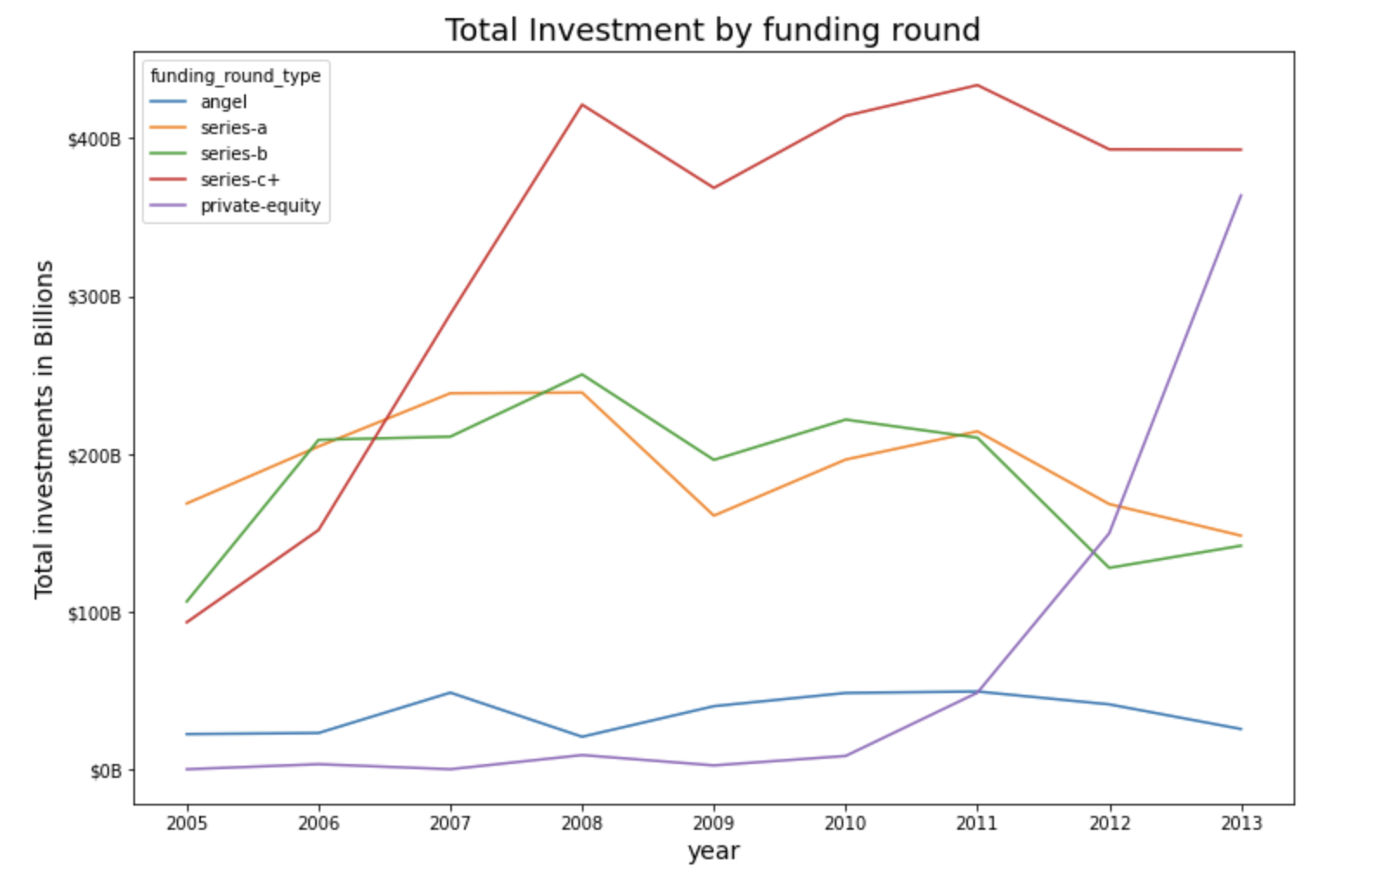
Investment trend by funding rounds
Seed rounds (angel rounds)
→ $500K to $1M
Series-a rounds
→ $3M to $8M
Series-b rounds
→ $8M to $20M
Series-c+ rounds
$30M to $50M
Private equity
→ Different from financing given to Startups

Slide 5
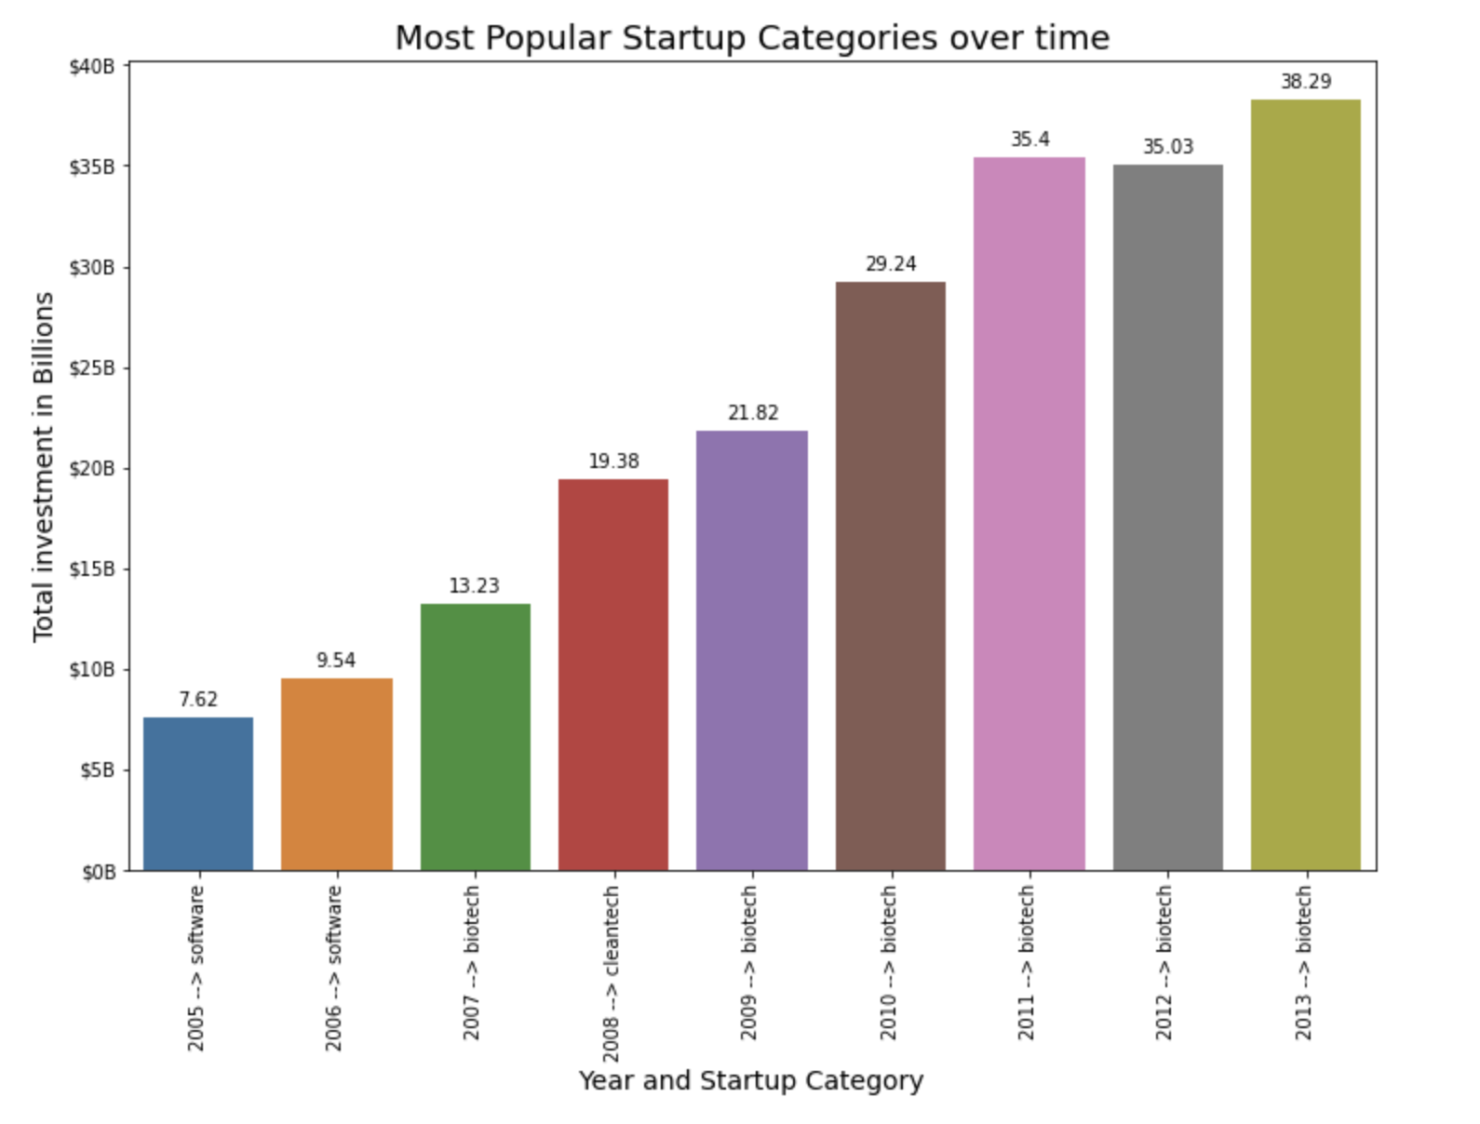
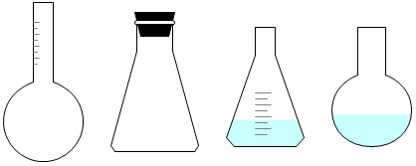
Most funded industries over time
→ Biotech leads the way being the top funded industry type for the last 5 most recent years

Slide 6
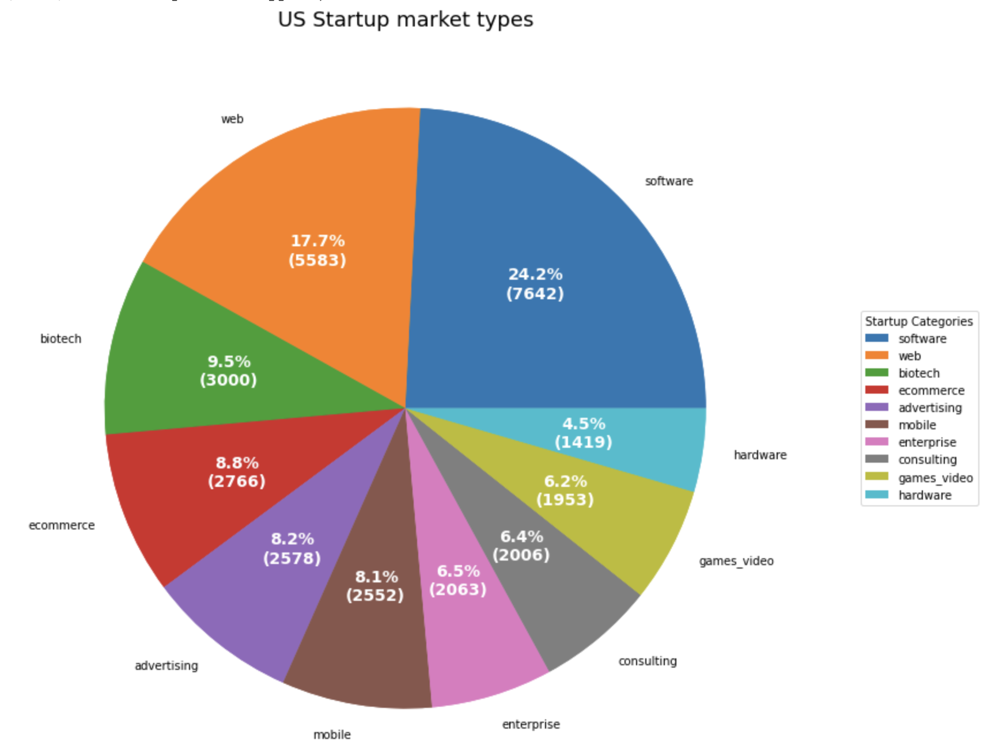
Analyzing Startup industries
Top industries
Software
Web
Biotech

Slide 7
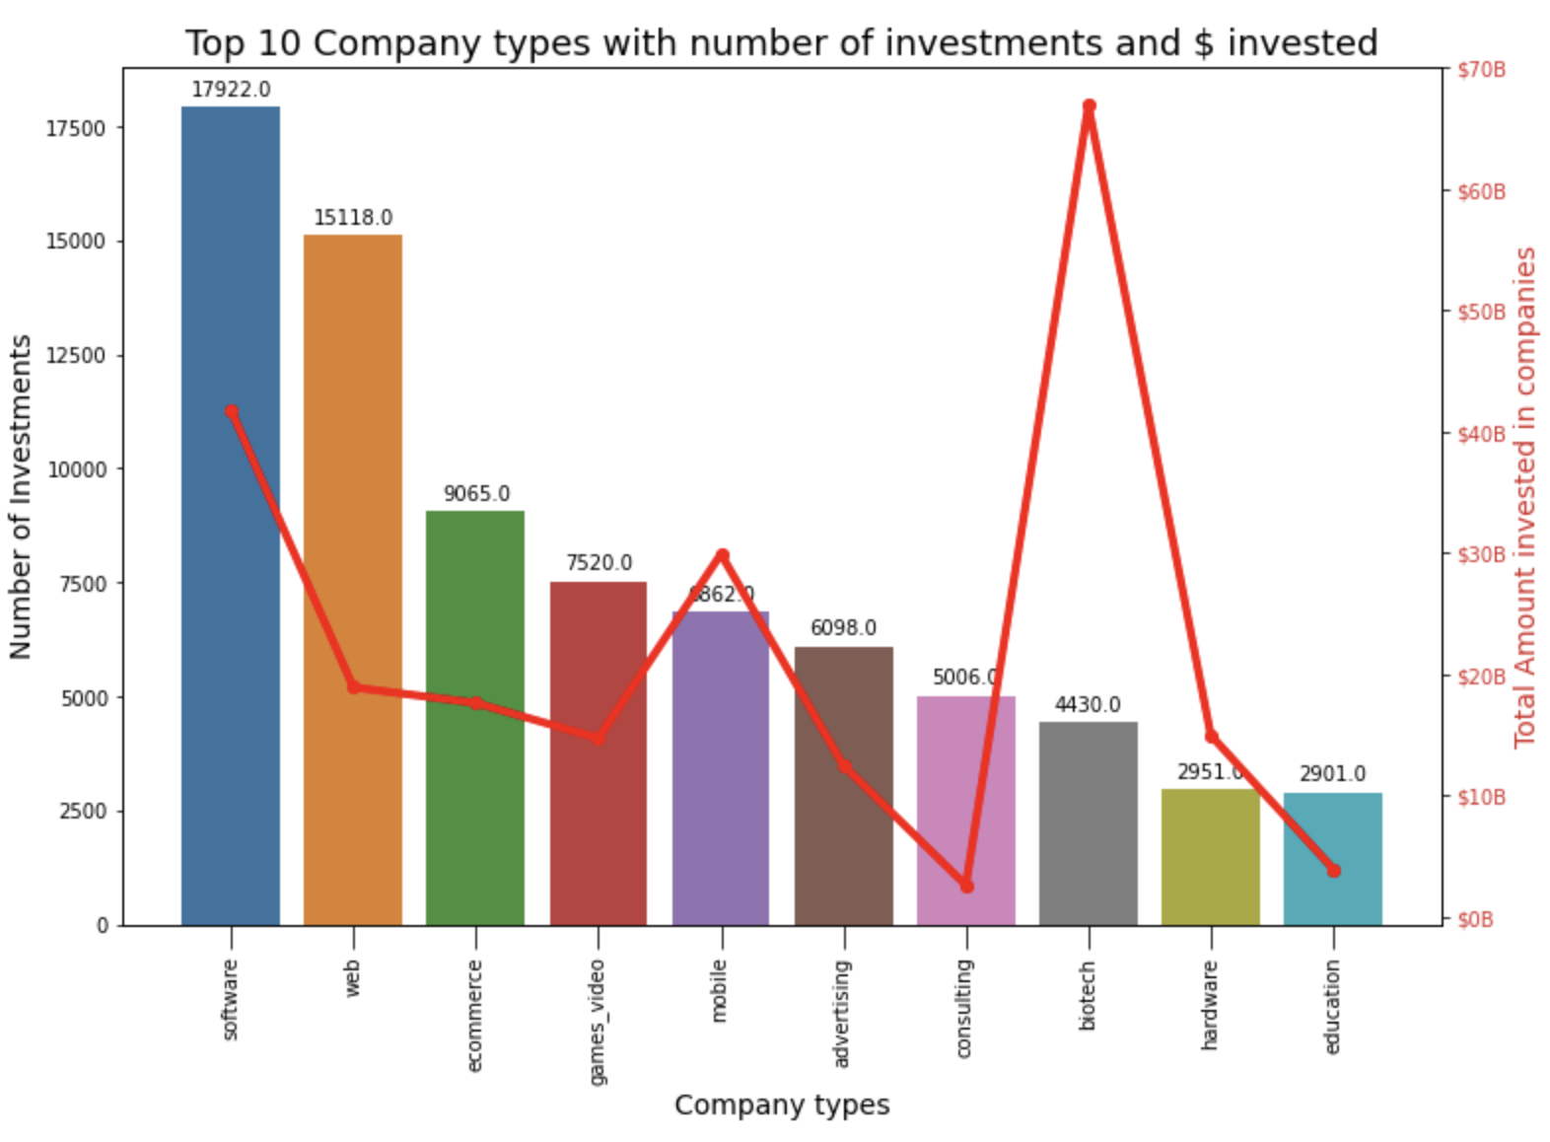
Startup industries
Biotech companies get about 40% more investments than Software companies.
while number of investment is only 1/3 of number of investment for Software.

Slide 8
Analyzing Startup Industries
Is there a significant difference in average funding amount in between different startups industries ?
Biotech → (Mean = $21.5M)
Health → (Mean= $14.3M)
Difference of 2.3
Biotech → (Mean = $21.5M)
Software → (Mean = $9M)
Difference of 11.4
Hardware → (Mean = $15.4M)
Software → (Mean = $9M)
Difference of 4.5
Mobile → (Mean = $24M)
Video Games → (Mean = $12M)
No significant difference found

Slide 9
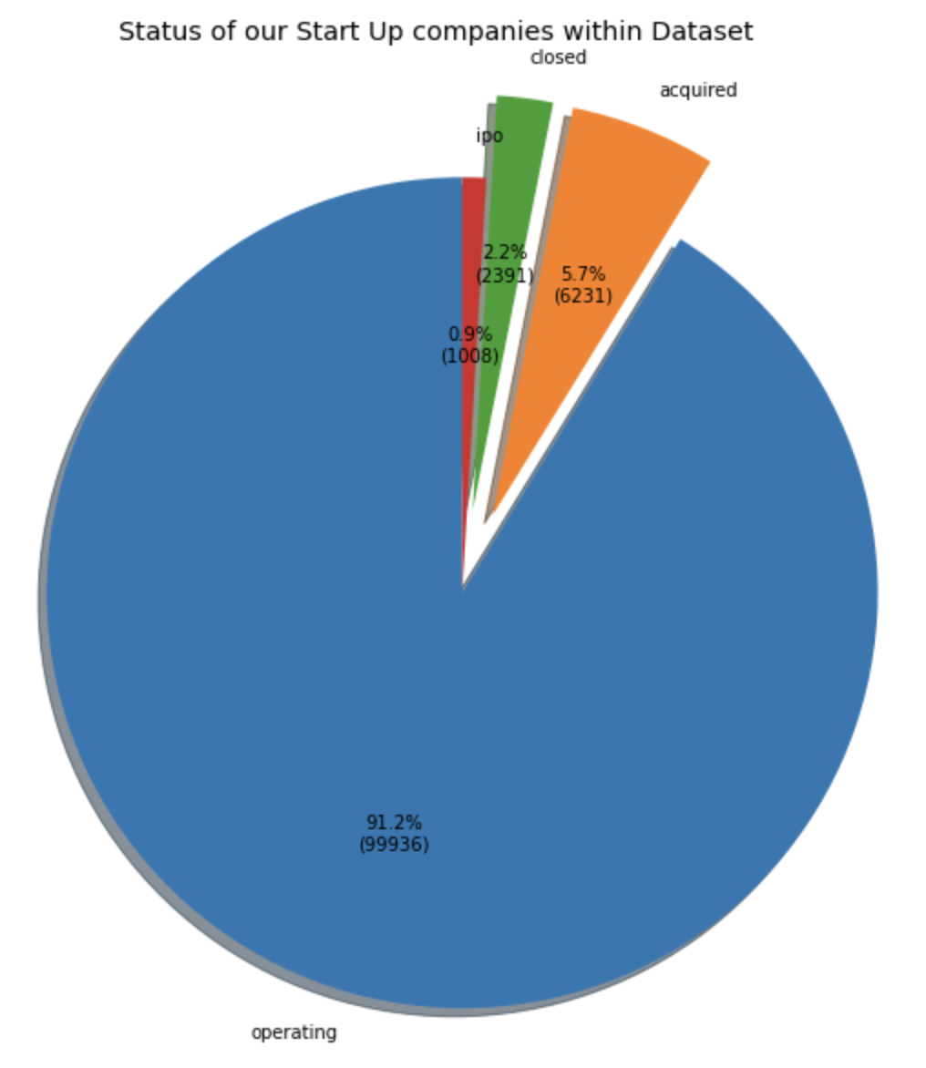
Startup status
Most startups are still operating
Only 5.7% of companies were acquired.
About 6231 Startup total

Slide 10
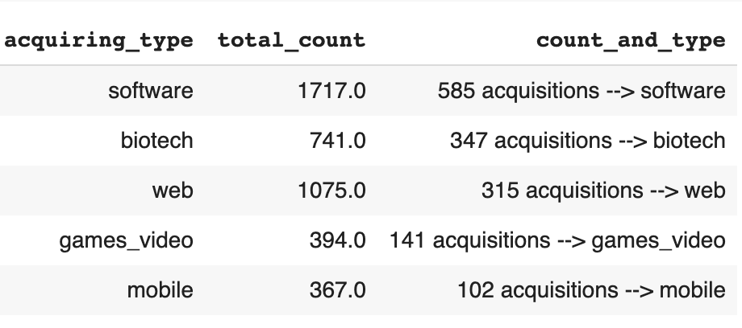
Acquired Startups
Most acquisitions for Software and web
Companies acquire their peers

Slide 11
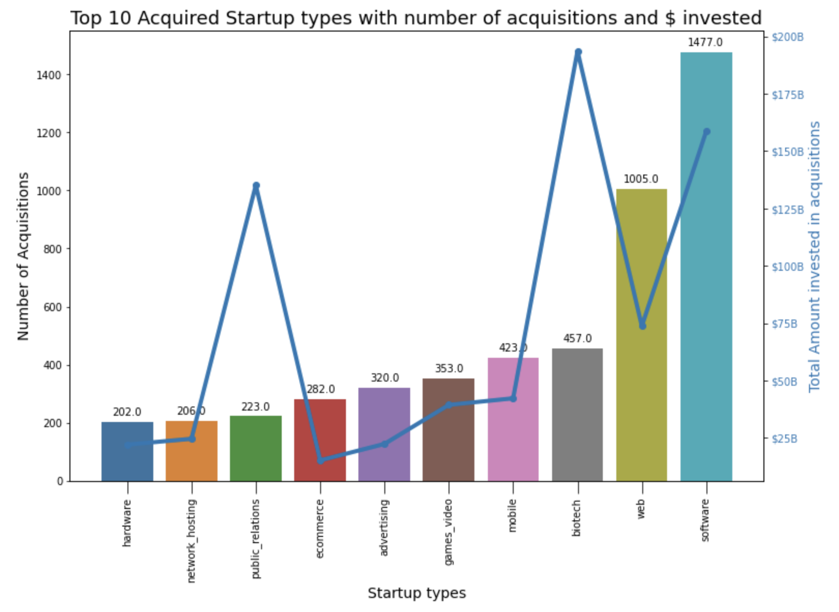
Acquired Startups
Biotech companies get acquired at a much higher price in average.
Public relations price for acquisition may be this high because of an outlier.

Slide 12
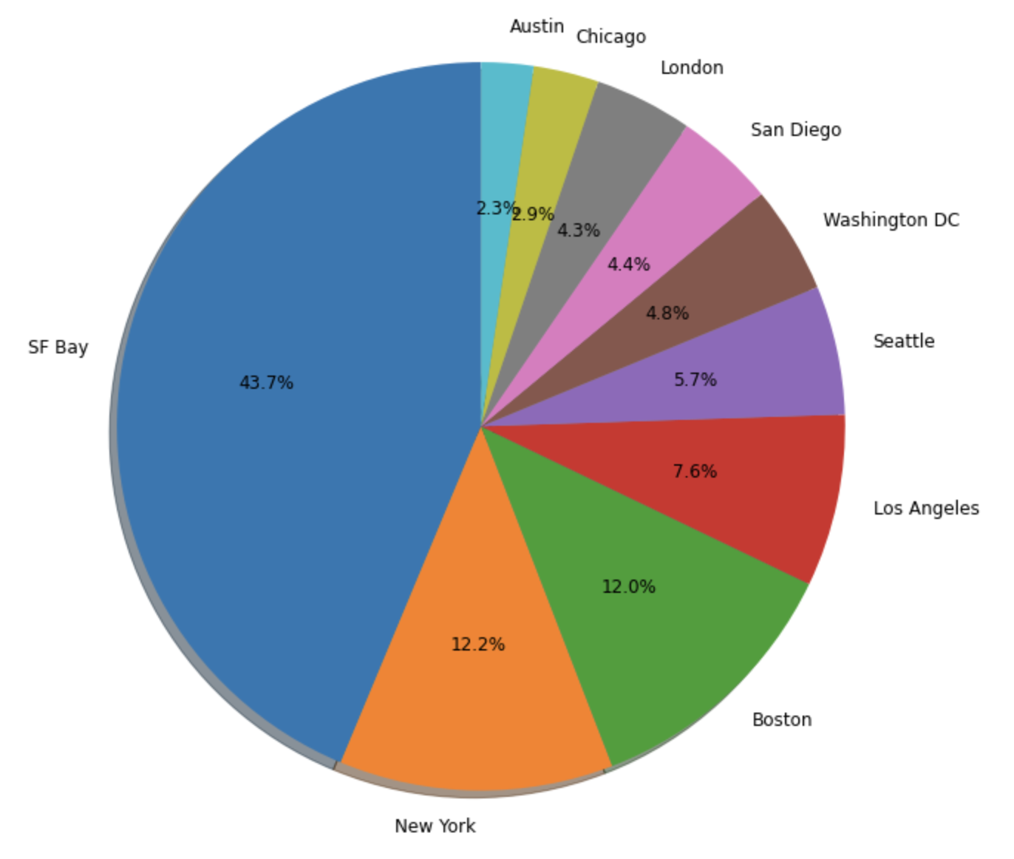
Regions per Total investments
43.7% total investments are for companies in SF Bay
SF Bay: $105B
NY: $29.3B
Boston: $28.87B
Los Angeles: $18.41B

Slide 13
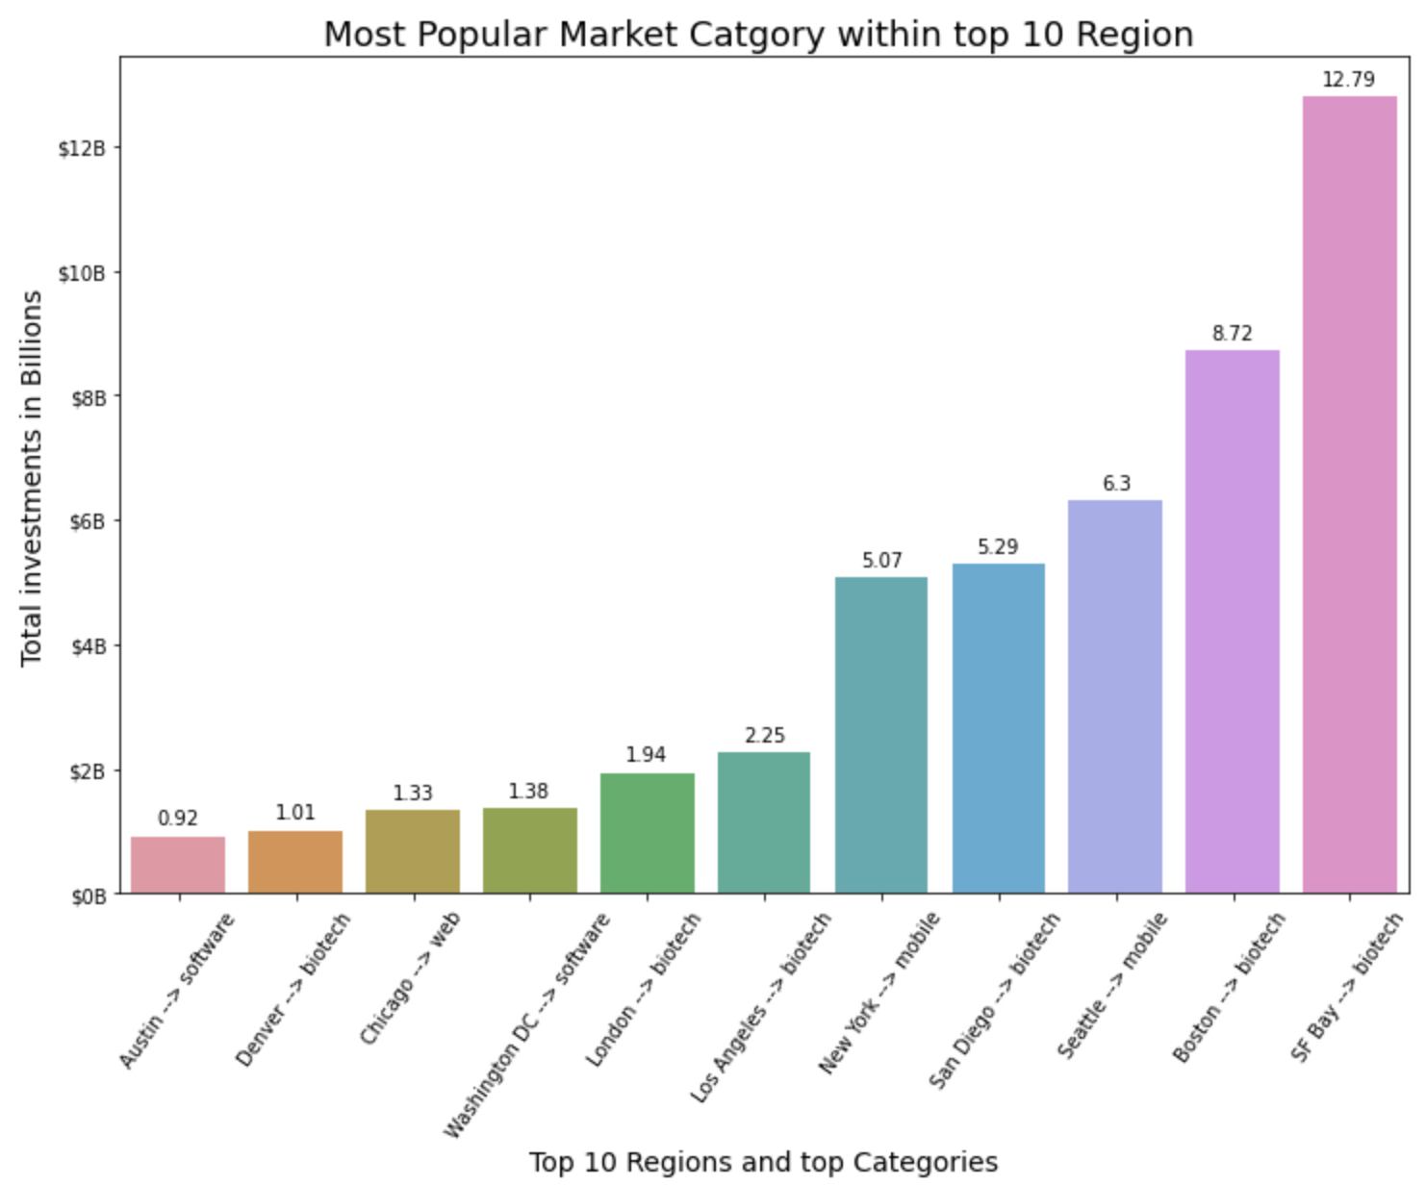
Most Popular industries within Regions
→ Biotech: most popular within 6 different Regions

Slide 14
Startup Industries within Regions
Is there a significant difference in average funding amount in between the same startups industries but in different regions ?
Biotech in SF Bay → (Mean = $34M)
Biotech in LA → (Mean= $23M)
Difference of 2.08
Biotech in Boston → (Mean = $32M)
Biotech in SF Bay → (Mean = $34M)
No significant difference found
Biotech in LA → (Mean = $23M)
Biotech in Boston → (Mean = $32M)
No significant difference found
Mobile in NY → (Mean = $41M)
Mobile in Seattle → (Mean = $125M)
No significant difference found

Slide 15
Conclusion and Recommendations
Investment over time
→ Biotech has become the most funded industry in recent years.
Startup Industries
Biotech startups bring higher valuation and higher investment capital than any other industry.
Acquired Startups
→ Software startups get most acquired.
Biotech startups are acquired at higher prices than other industries.
Most industries tend to acquire their industry peers.
Startup Regions
→ Lots of Startups are in the Bay Area but our analysis seem to indicate that the startup region does not make a significant difference in total investment for an industry.

Slide 16
Thank you
Questions ?

