Slide 1
Data introduction
1460 Houses total across 23 neighborhoods
Sale Price analyzed over 12 categories
Notes:
I’ve looked at our data and decided to analyze categories that could possibly raise questions. What I mean by that is that I tried to identify categories that could make a difference in the sale price other than just the size or type of the property.
I did look at the pool of neighborhoods we have and identified the ones that seem to average the higher sale prices

Slide 2
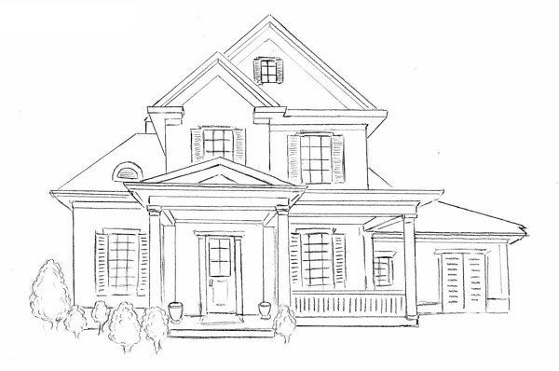
The ‘perfect’ set up
Exterior Appearance
Foundation material
As much bathrooms as bedrooms
Basement has full bath
Kitchen appearance
Wood deck or no wood deck
Privacy
Lot configuration
Fence or no fence
When to buy
Normal or Abnormal Sale
Better time of the year to buy ?

Slide 3
Exterior Appearance
Notes:
Anova test to make sure there was a difference in between all of our groups

Slide 4


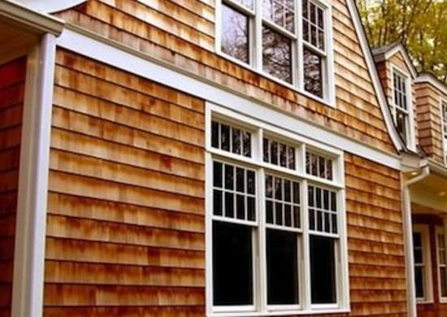
Exterior Appearance
Wood siding Vs Cement Board siding
Notes:
Higher and upper range of our groups. Used a t-test

Slide 5


Exterior Appearance
Brick Face Vs Cement Board
Notes:
Further inestigations. Used t-test as well

Slide 6
Foundation material
Brick & Tile Vs Poured Concrete
Cinder Block Vs Poured Concrete
Brick & Tile Vs Cinder Block
Notes:
Anova then t-test

Slide 7
One bath for each bedrooms
29% of total number of houses
Average sale price: $210,744
25% increase
71% of total number of houses
Average sale price: $168,796
Notes:
Used a t-test

Slide 8

Basement has full bath
Houses with at least one full bath in basement:
41% of total house set
Average Sale price: $202,745
22% increase
Houses without bathroom in basement:
59% of total house set
Average Sale Price: $165,521
Notes:
T-test

Slide 9
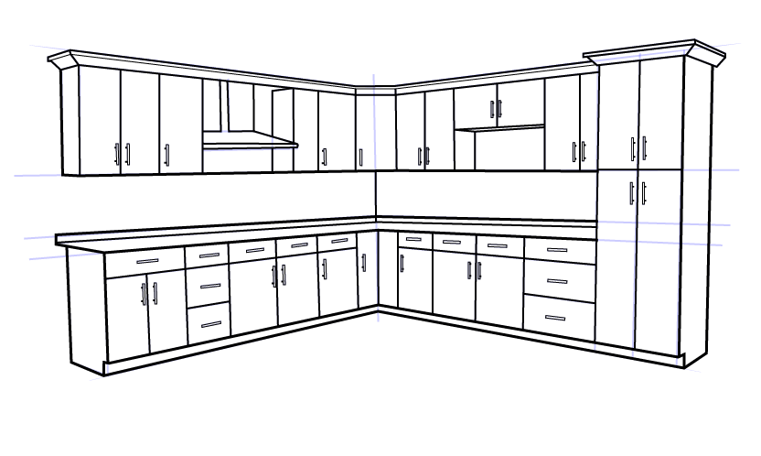
Kitchen appearance
Fair → Excellent
$222,989 (68%) Increase in Price
Good → Excellent
$116,439 (35%) Increase in Price
Notes:
Talk about large difference

Slide 10
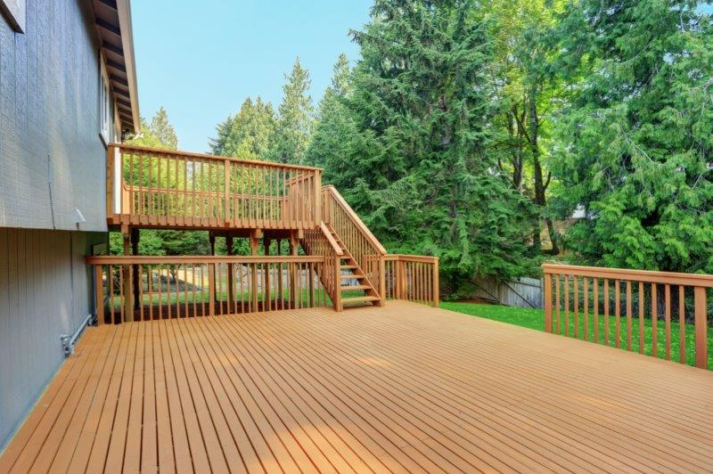
Wood deck or no wood deck
Houses with a wood deck:
48% of total number of houses
Average sale price: $205,586
29% increase
Houses without a deck:
52% of total number of houses
Average sale price: $158,265
Notes:
T-test

Slide 11
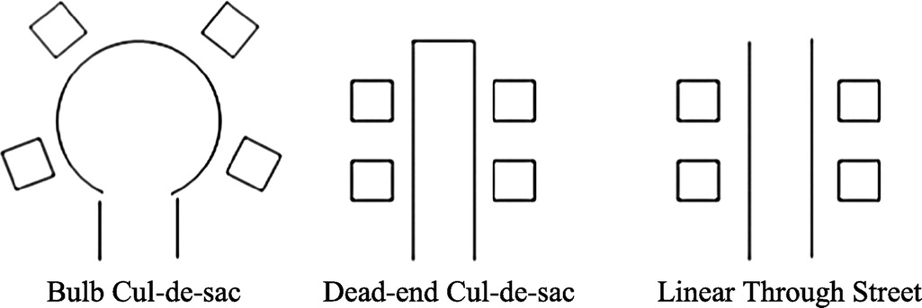
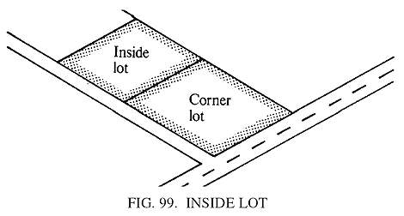
Privacy
Lot Configuration
Difference between Corner Lots and Cul de Sac Lots
No difference between Corner Lots and Inside Lots
Overall Average Sale prices:
Cul de Sac Lots > Inside and Corner Lots
Notes:
Don’t forget to mention about using t-test

Slide 12
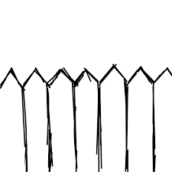
Privacy
Fenced Properties
*Surprisingly
Houses with fence average sale price:
$152,912
Houses with no fence average sale price:
$187,596
22% increase
Notes:
T-test

Slide 13
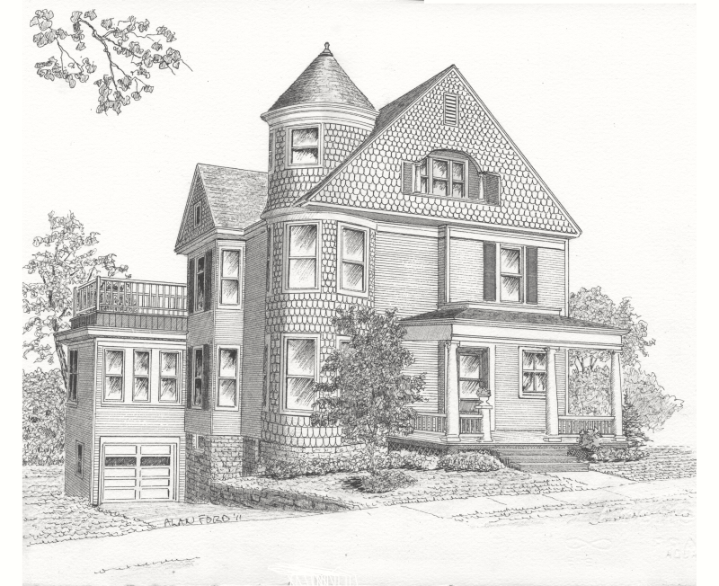
When to buy
Normal or Abnormal Sale
Best month of the year to buy
Notes:
When to buy cheap

Slide 14

Normal or Abnormal Sale
Abnormal Sales:
Trades, Foreclosures, Short Sales
*Surprisingly
18% of total Sales
Average Sale Price: $207,071
18% higher than Normal Sales Average Price
Notes:
Our two group population numbers are high enough for our t-test

Slide 15


Best month of the year to buy
April
Average Sale Price: $171,503
October
Average Sale Price: $195,683
Anova: No significant difference between months houses are sold.
T-test: Some difference in average sale price between April and October
P-value = 0,0522
Notes:
Anova
Then t-test

Slide 16
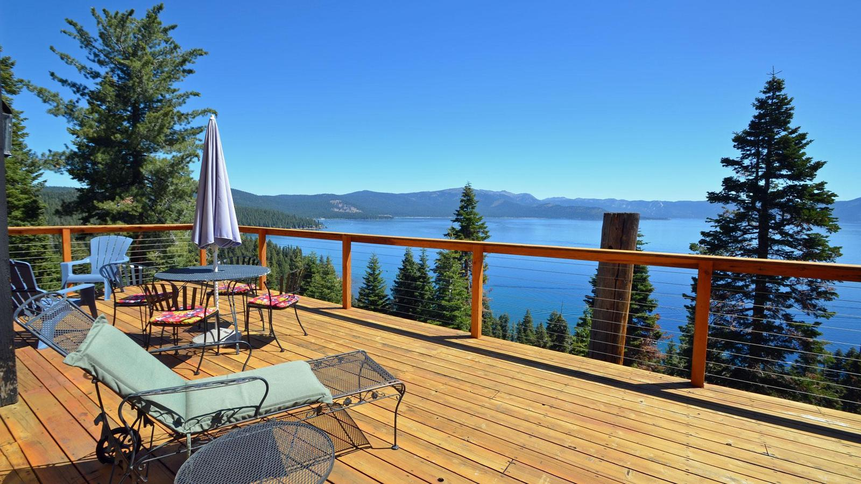
The ‘perfect’ set up
Exterior Appearance → Cement Board
Foundation material → Poured Concrete
As much bathrooms as bedrooms → Yes !
Basement has full bath → Yes !
Kitchen appearance → Good to Excellent
Wood deck or no wood deck → Wood deck
Privacy
Lot configuration → Cul de sac
Fence or no fence → No significance
Buy in the spring
Notes:
Recommendations

Slide 17
Questions ? Thanks !
Notes:
Questions And thank You !

