Slide 1
Farm To Table
Progress Report

Slide 2
Work we’ve done
User based website using Django
Models
user ( buyer / seller ): register/login/logout/
products: register/remove (authenticated)
comments: add/edit comments (authenticated)
Views
user specific
Site Structure
Html templates: links

Slide 3
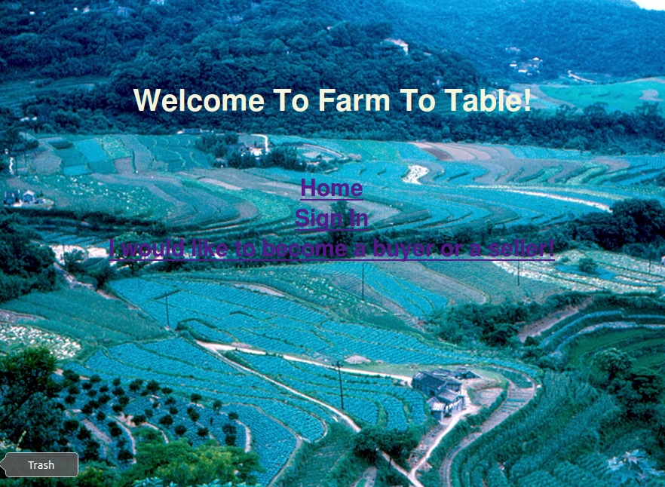
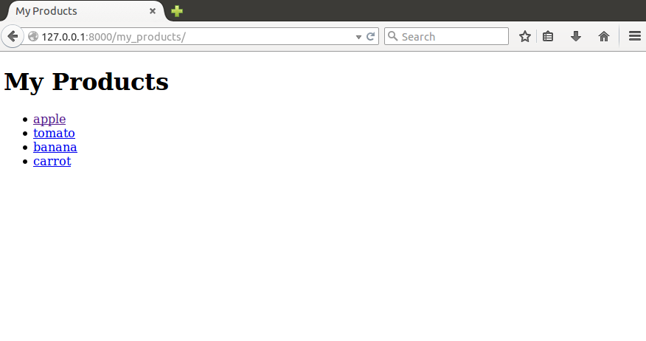
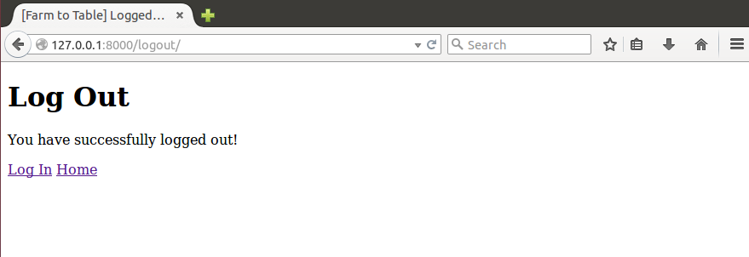
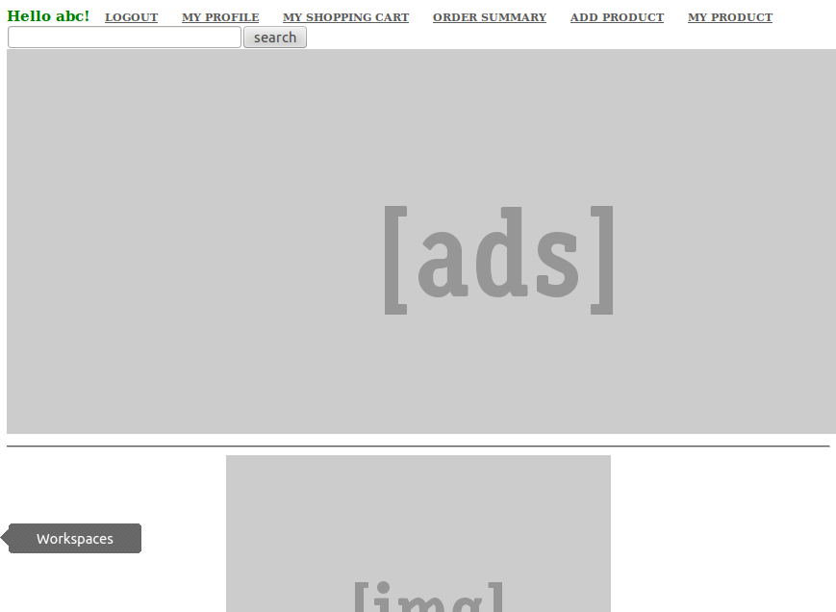
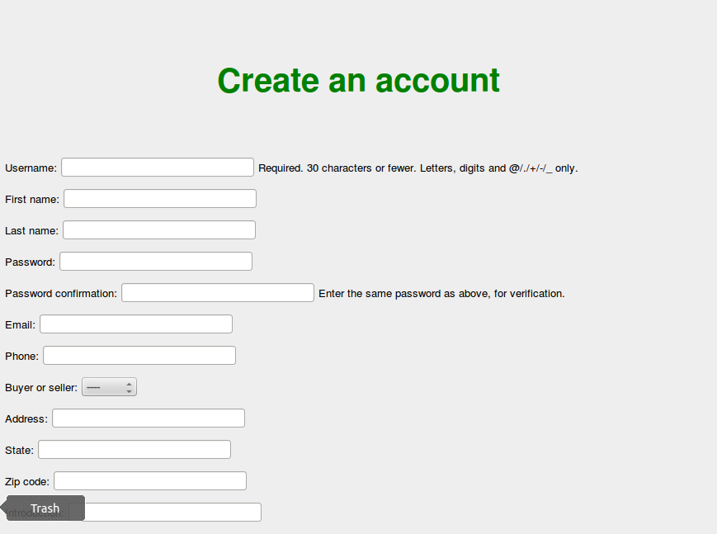
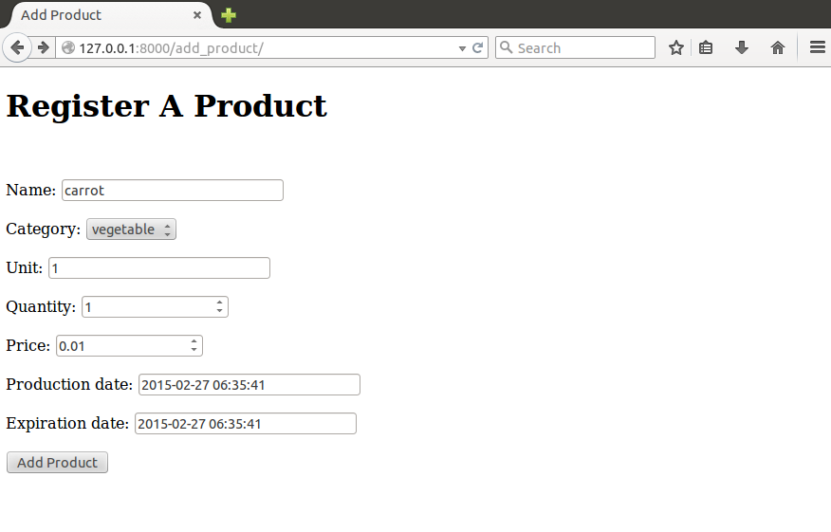
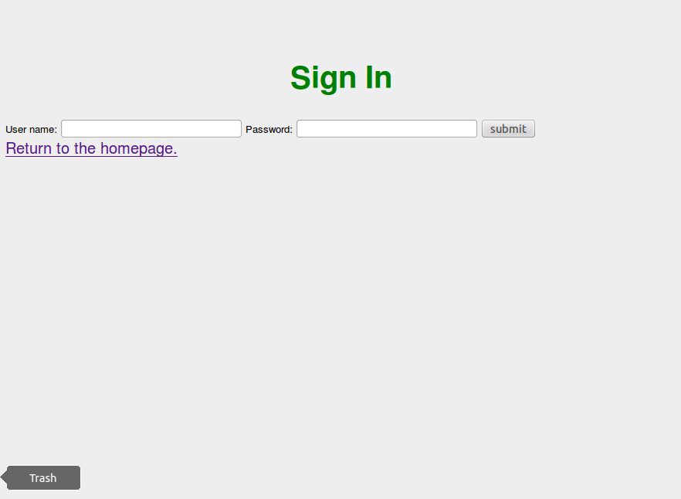
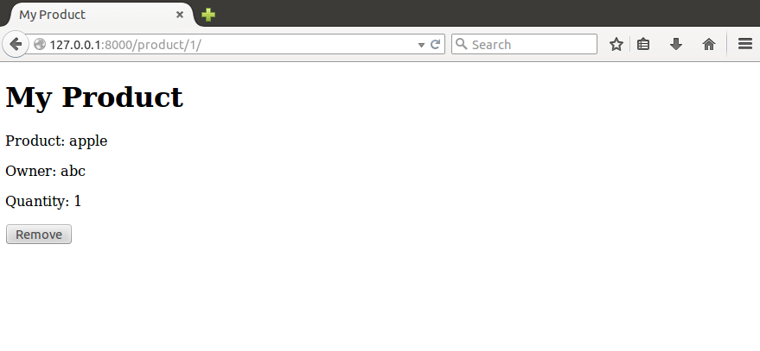
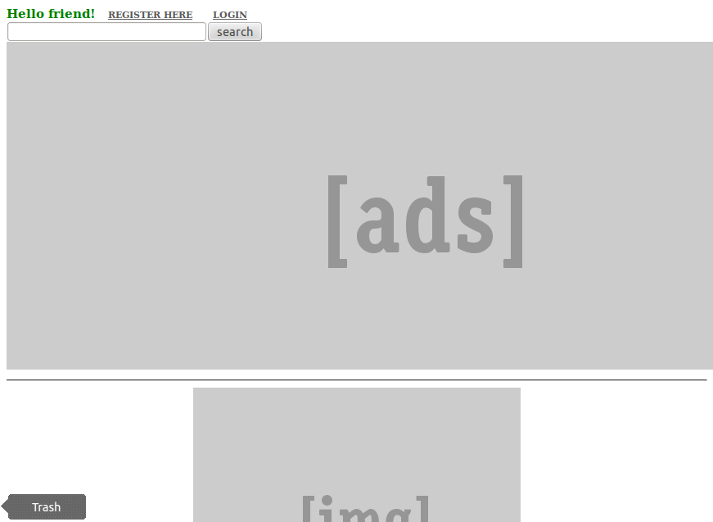

Slide 4
Work in Progress
Three-way search
popularity
price
date
Recommendation
based on keywords in orders and search terms
Order processing

Slide 5
Future obstacles
Chicken-egg problem
Enough entries to test our searches and recommendation
Implement payment:
Django Merchant: Off-site Processing
Should we simulate this process?

