Slide 1
Classifying Facts and Opinions

Slide 2
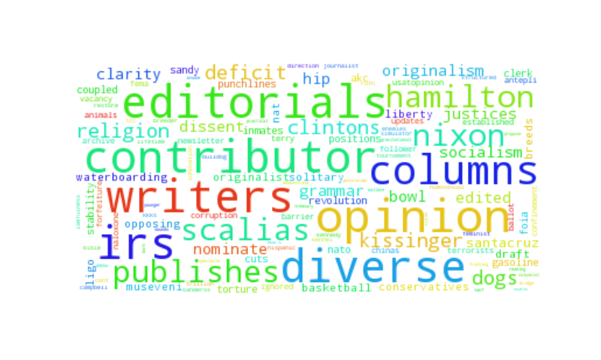
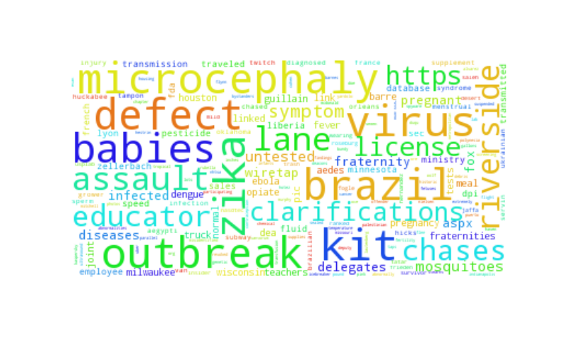
Problem
Large amount of information
Limited time and judgement
Prioritize information intake

Slide 3
Progress from midterm
Data collection:
Changed news sources; Added noise; Preprocessing: get_words(); summary statistics.
Feature Generation:
WordNet: “opinion seed words” ; POS tags: individual tags versus using word-tag pairs; Stopwords: included; proportion of shared words, stop words, and opinion indicators in the article.
Model:
Parameter sweep; Evaluation: learning curve
User Interface:
Prettified interface and pickled model

Slide 4
Summary Statistics

Slide 5
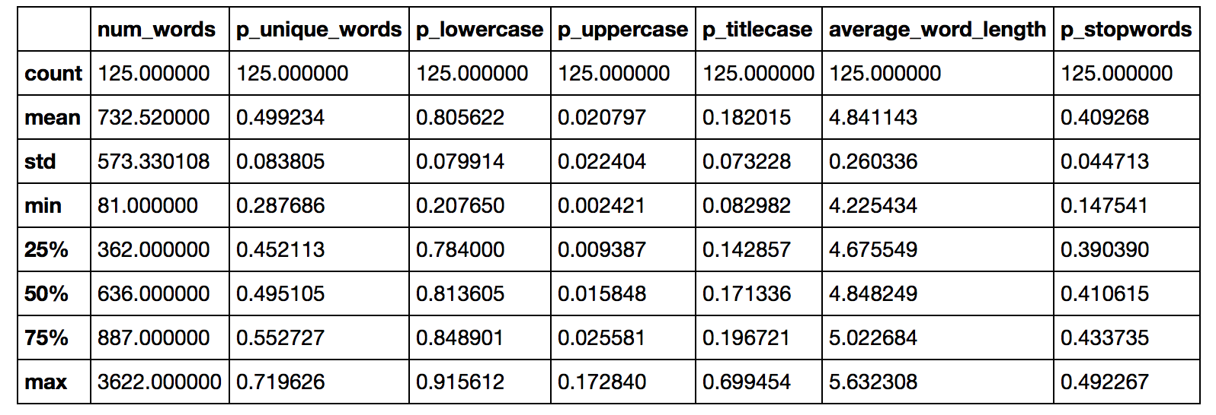
Summary Statistics: News

Slide 6
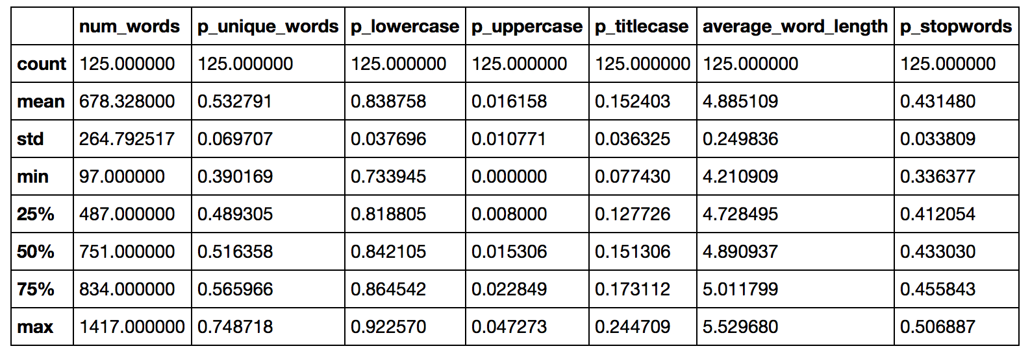
Summary Statistics: Opinion

Slide 7
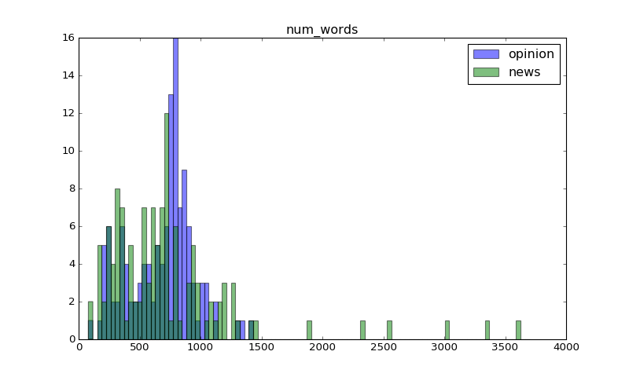
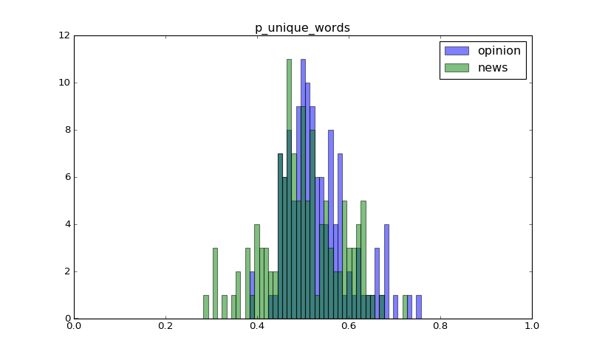
Number of words

Slide 8
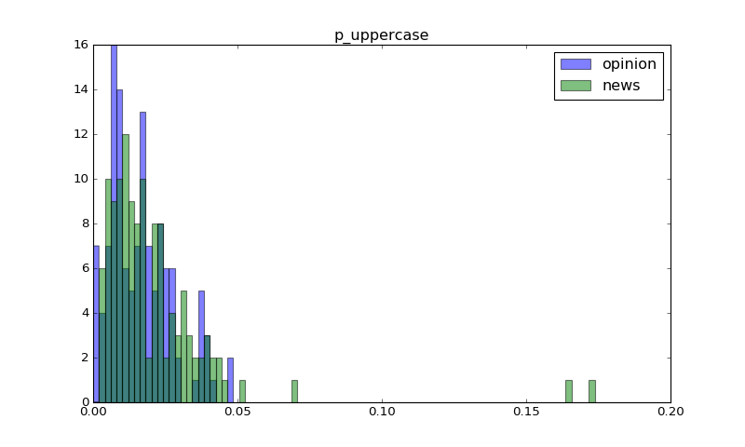
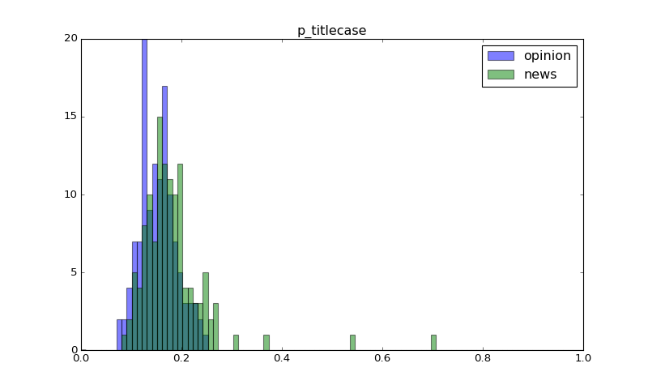
Summary Statistics

Slide 9
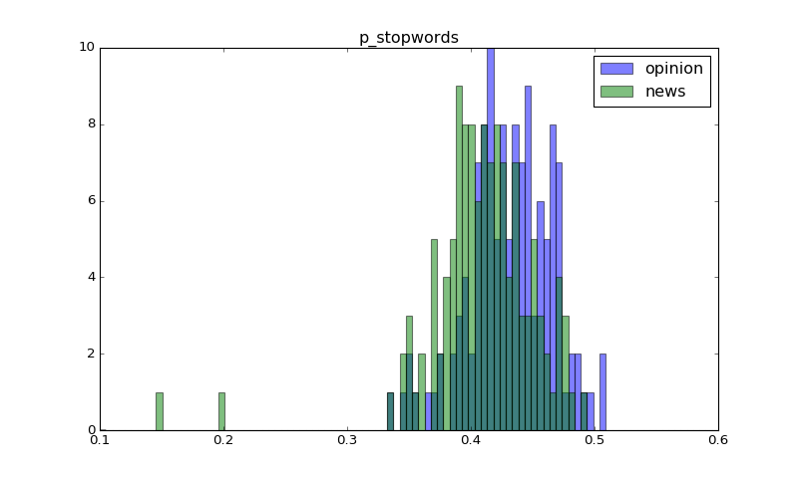
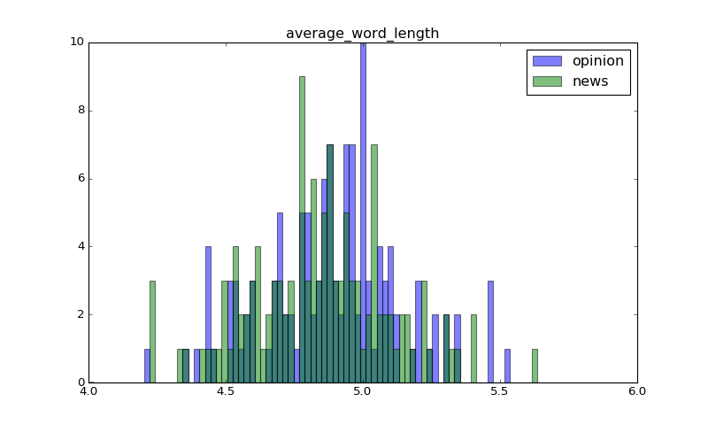
Stop words and word length

Slide 10
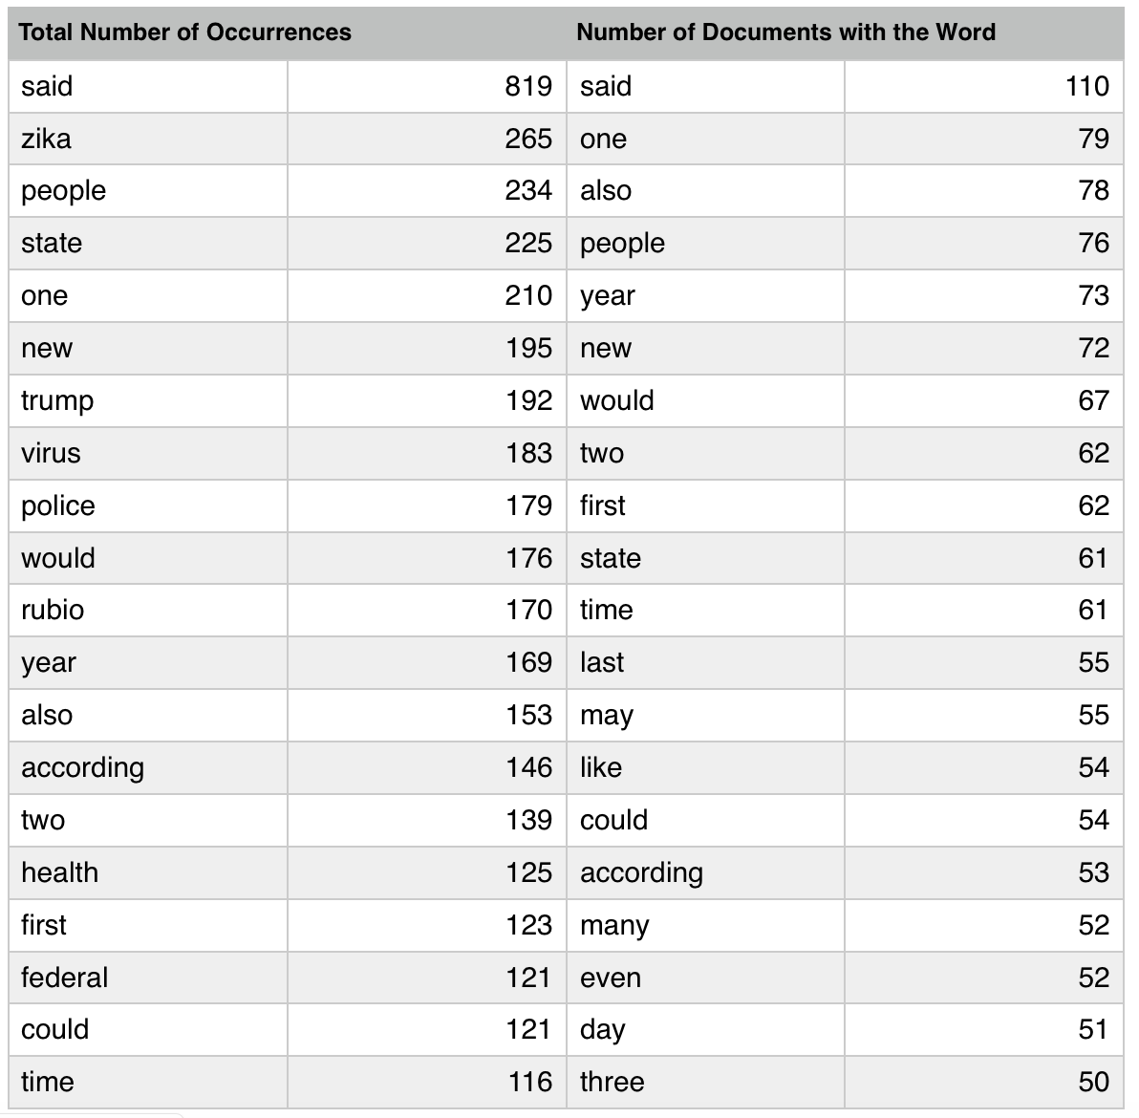
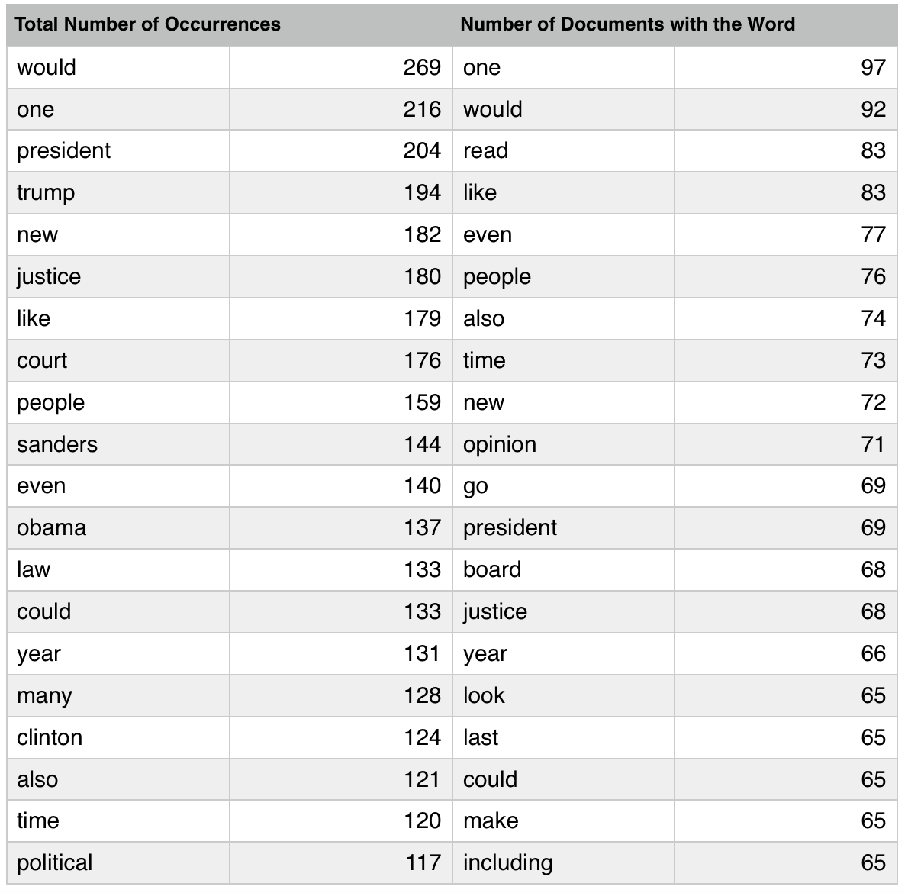
News
Opinions

Slide 11
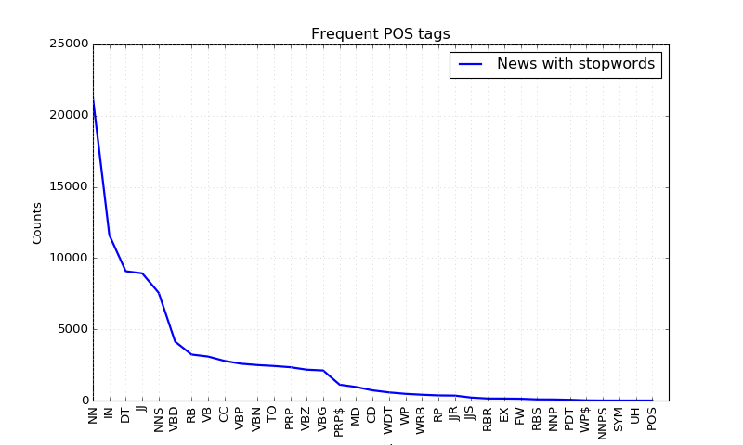
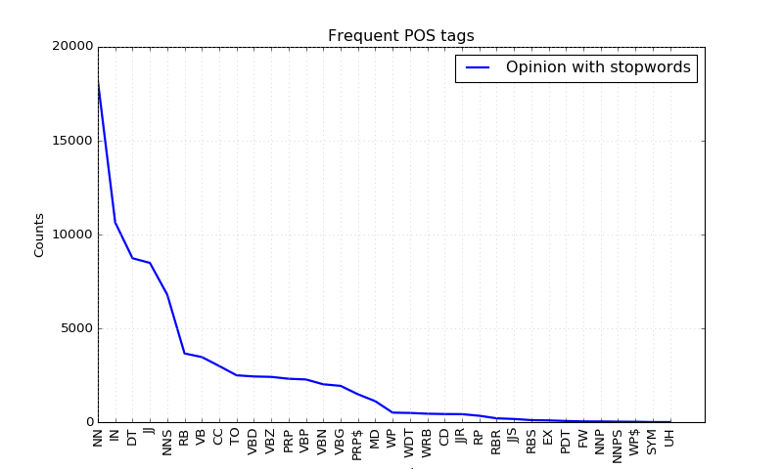
Frequent POS Tags with Stopwords

Slide 12
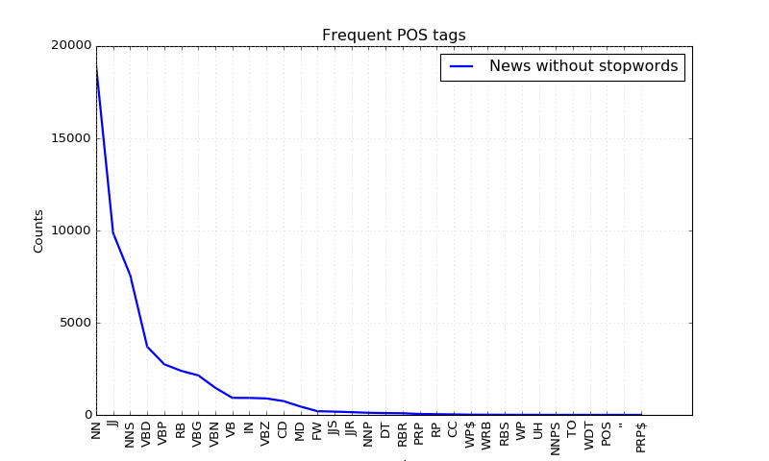
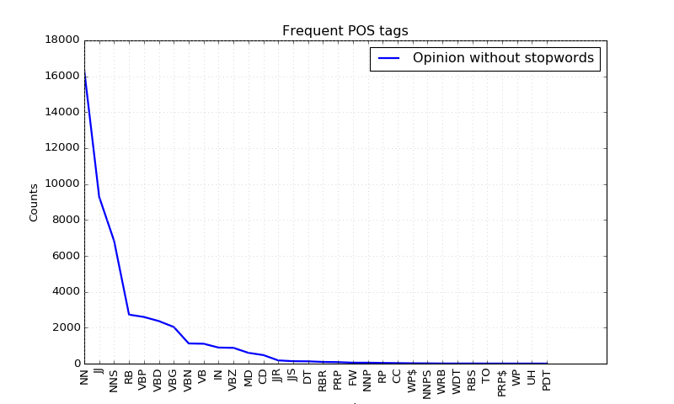
Frequent POS Tags without Stopwords

Slide 13
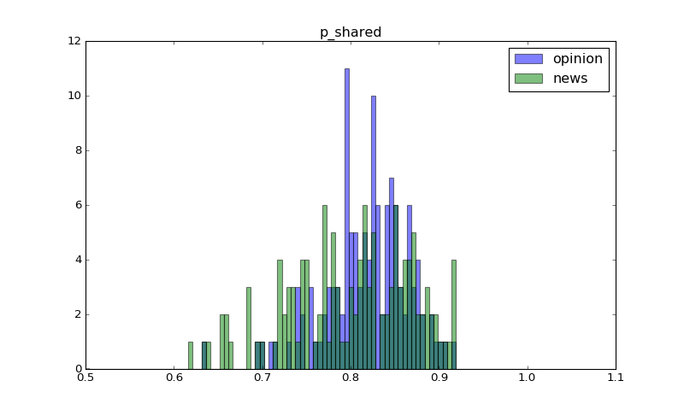

Slide 14
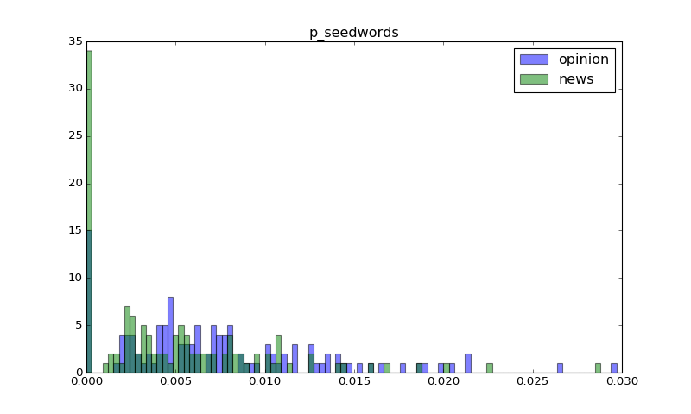

Slide 15
Model & Evaluation

Slide 16
Decisions
Inclusion of stopwords
Parameter selection
Specifics of POS tag features
Selecting the sets of features: unigrams, bigrams, POS tags, other indicators

Slide 17
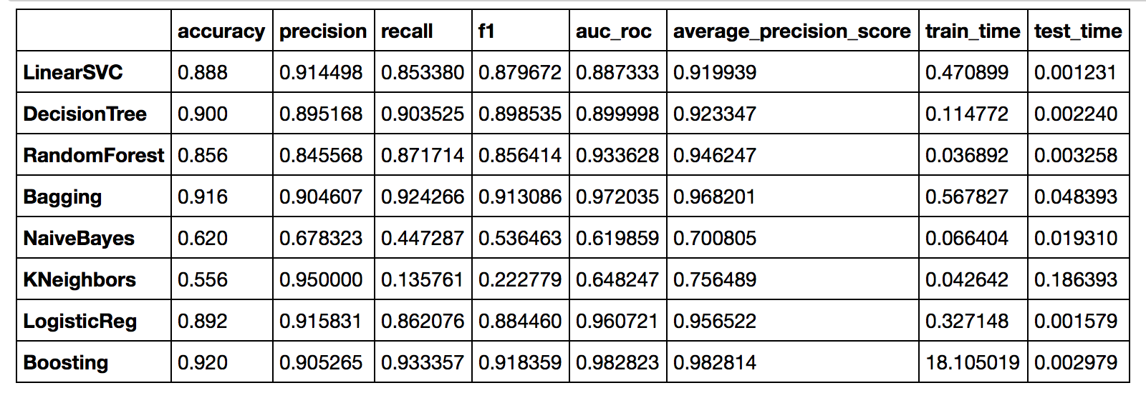
Unigram without stop words

Slide 18
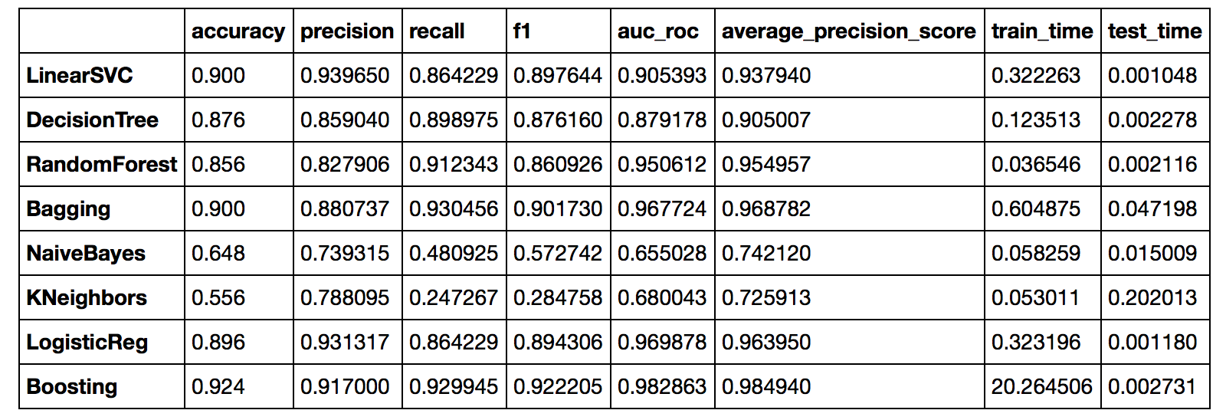
Unigram with stop words

Slide 19
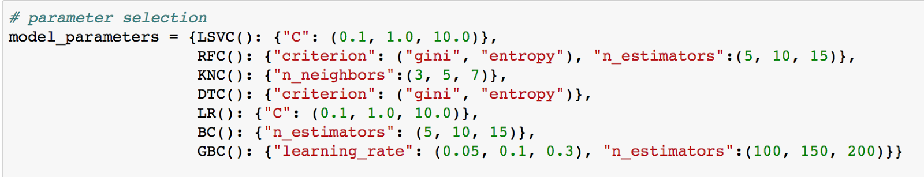
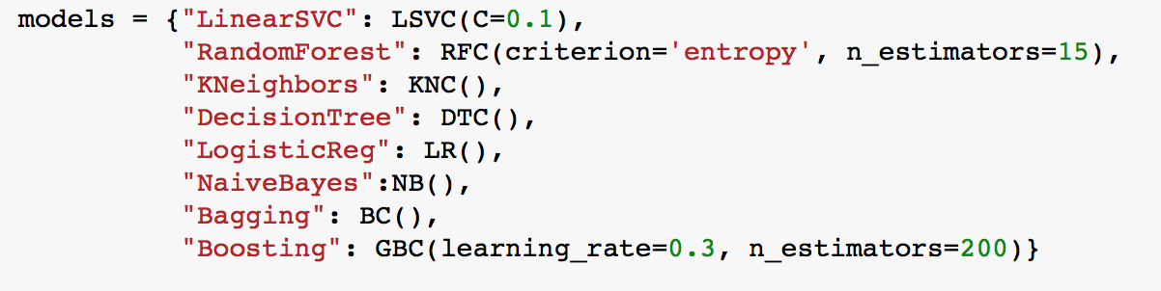

Slide 20
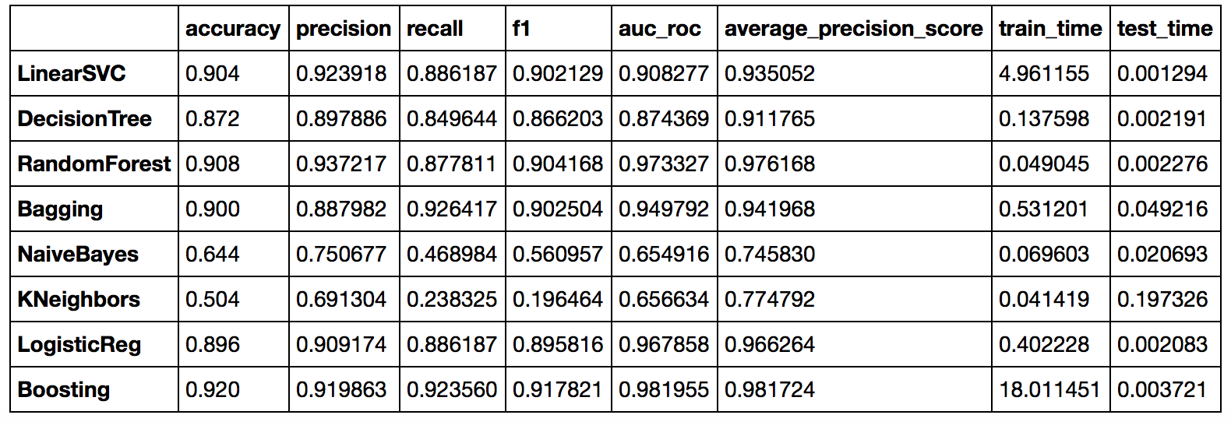
Individual POS tags

Slide 21
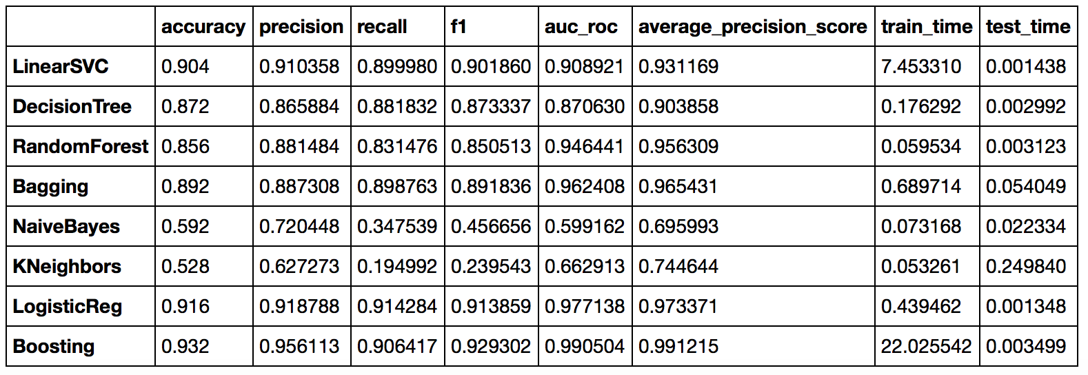
Word-tag pairs

Slide 22
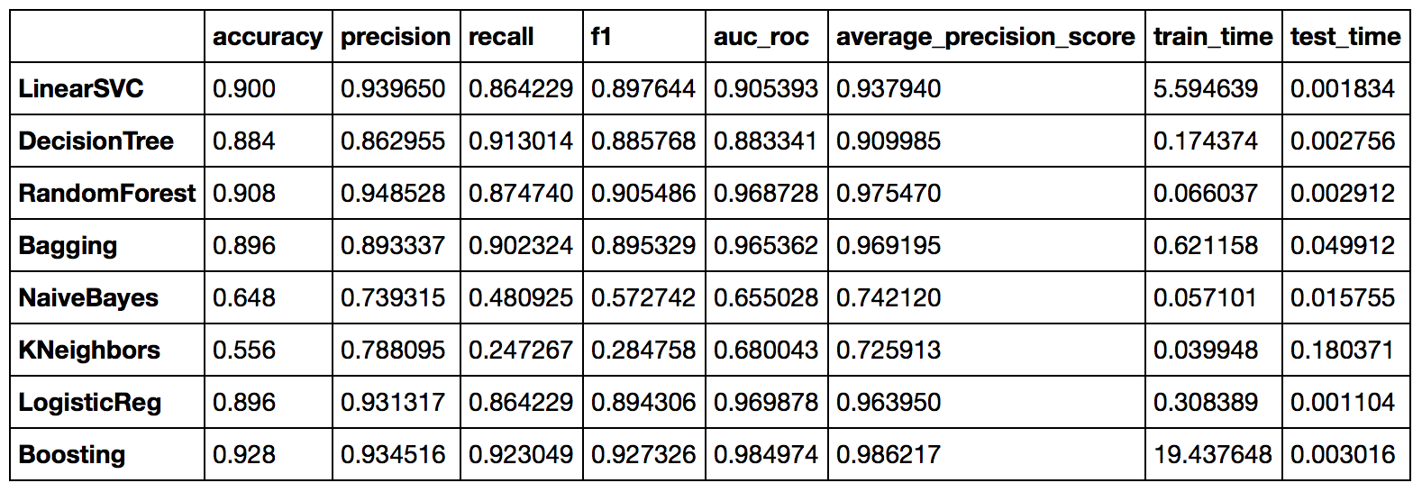
Unigram

Slide 23
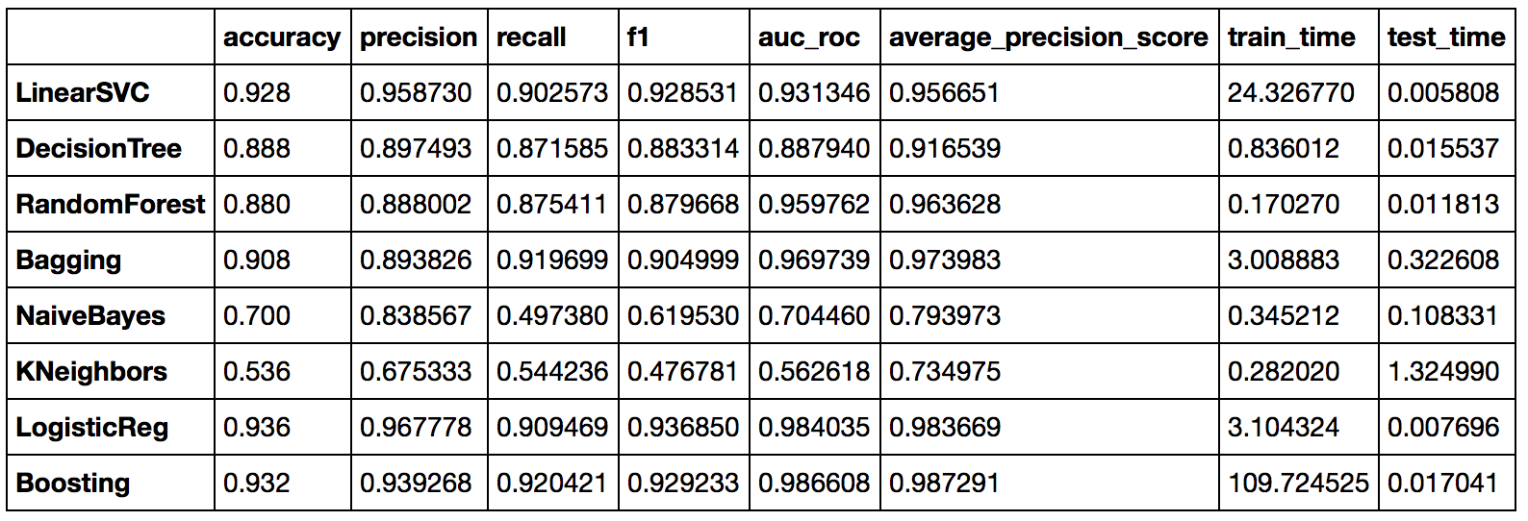
Unigram, Bigram

Slide 24
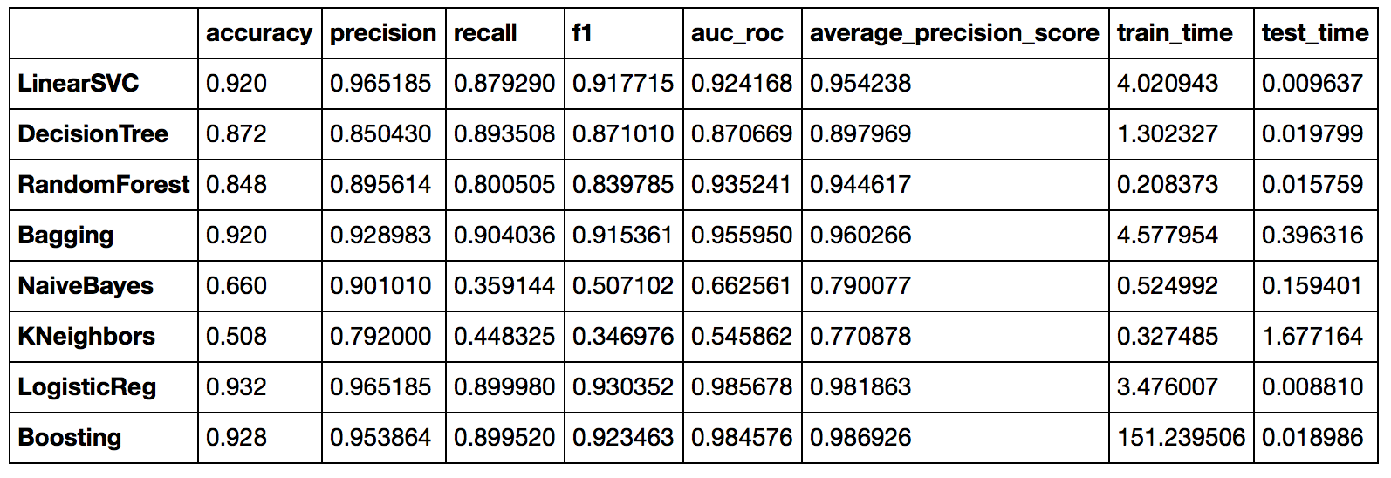
Unigram, bigram, POS tag

Slide 25
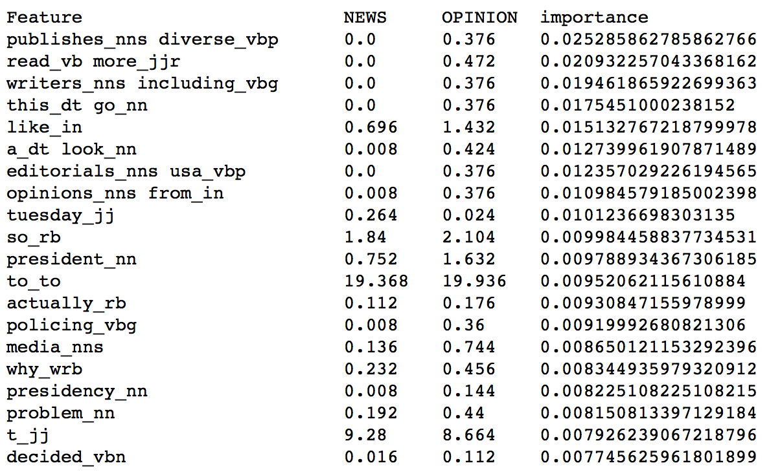
Final Model
Logistic Regression
default parameters
Include stopwords
Unigrams, bigrams and POS tags (word-tag pairs)

Slide 26
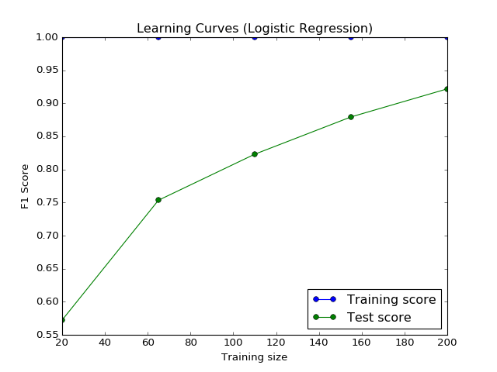

Slide 27
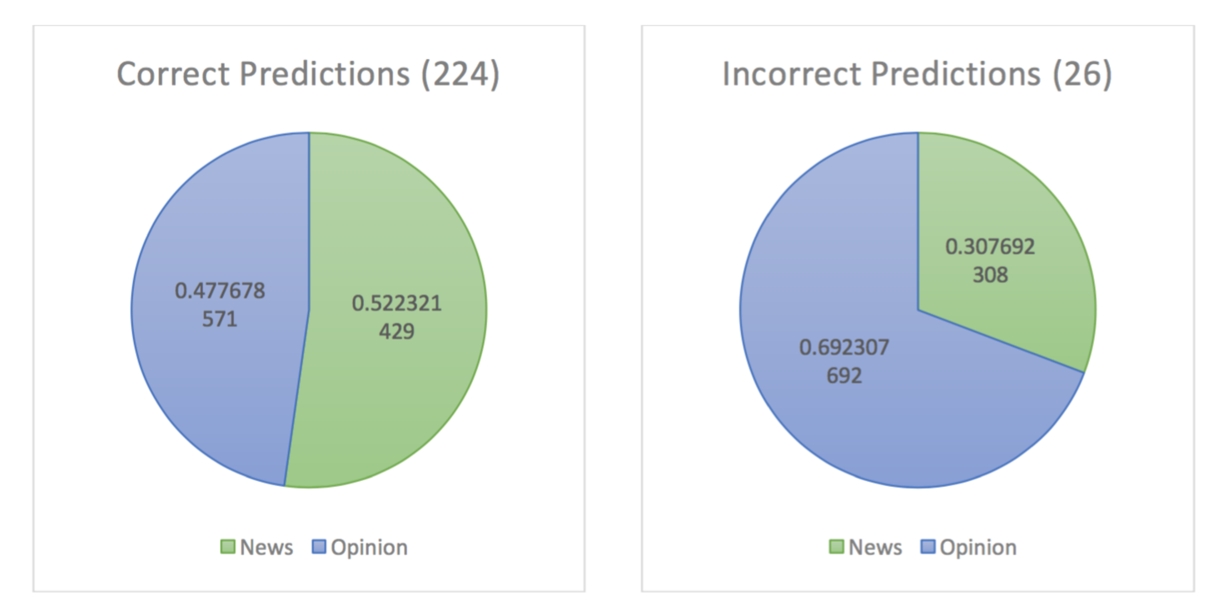

Slide 28
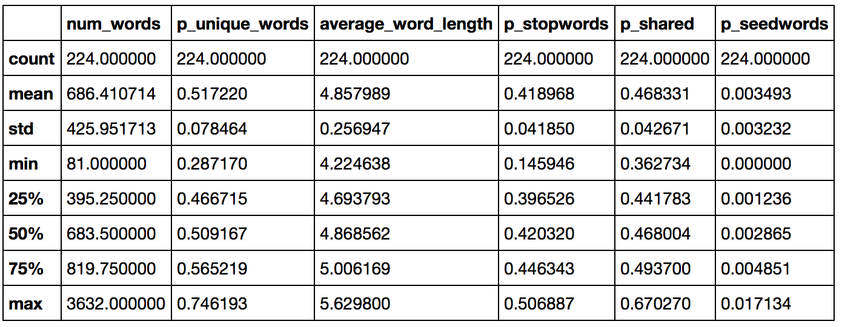
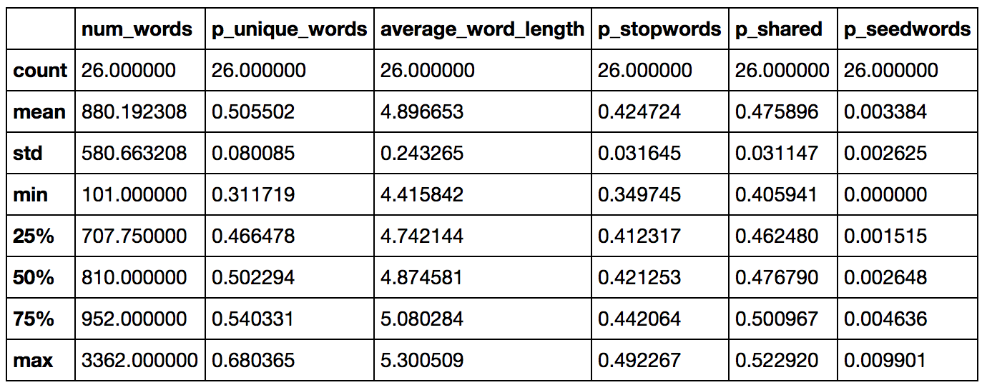

Slide 29
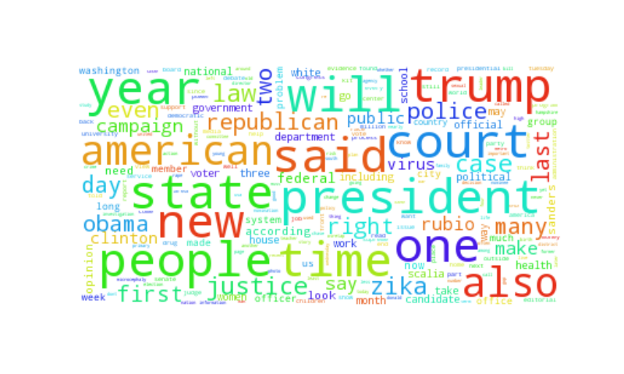
Limitations
Short text classification
Topics of articles

