Slide 1
Classifying Subjectivity Using News Sources
Xiaorui & Lingwei

Slide 2
Introduction
The goal of our project is to distinguish subjective and factual remarks in news articles. We will approximate subjective remarks by using articles in the opinion sections, assuming that articles from the opinion sections are subjective while the articles in the other categories are objective.
We will scrape articles from http://www.factcheck.org/askfactcheck/ as our source dataset for all things considered truth. For opinions, we will use articles from http://www.usatoday.com/opinion/. We will build our corpus and assign labels to help us build the classifiers.

Slide 3
Progress Track
Literature review: some but needs more
Data collection: 200 => 100 from each
Preprocessing: basic scraping
Feature generation: POS, TF-IDF, Negation, Bi-gram.
First pass of the model
User interface: Used flask for a proof of concept

Slide 4
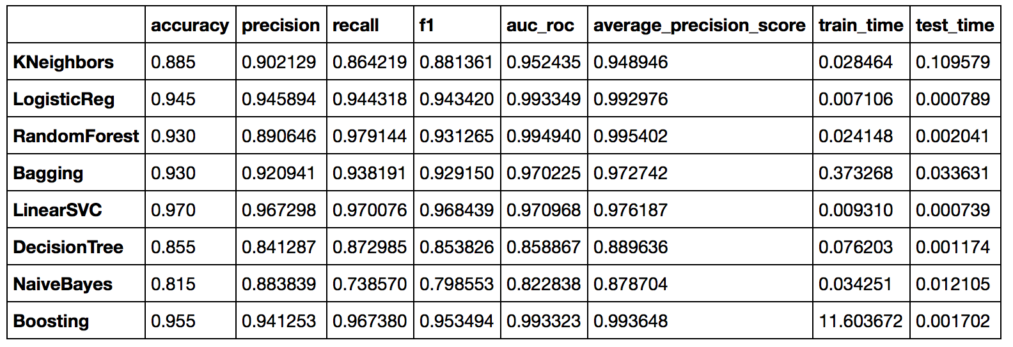
Evaluation Results
Unigrams

Slide 5
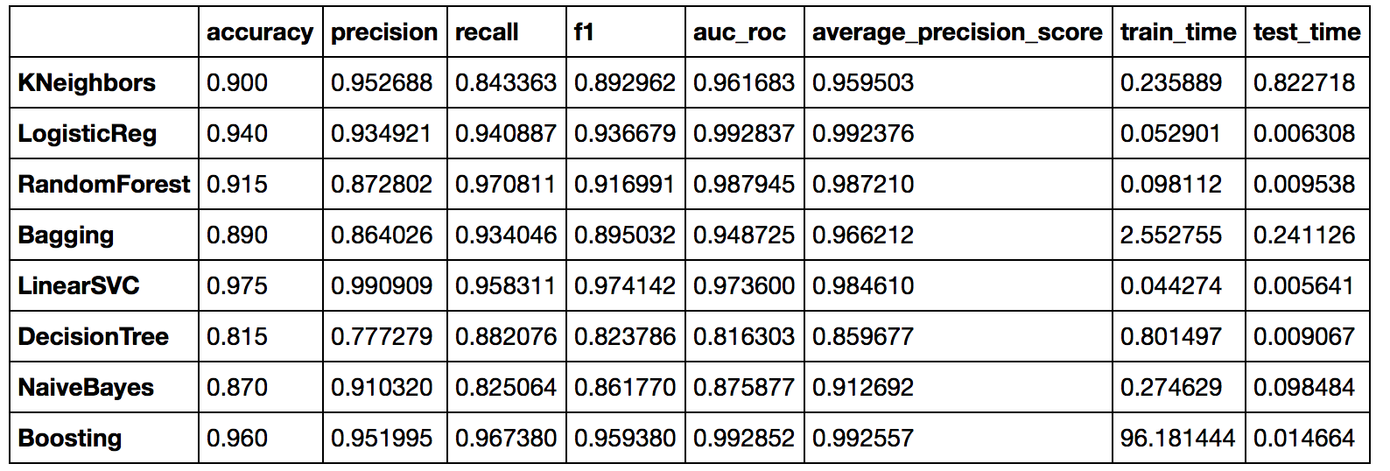
Evaluation Results
Unigrams and Bigrams

Slide 6
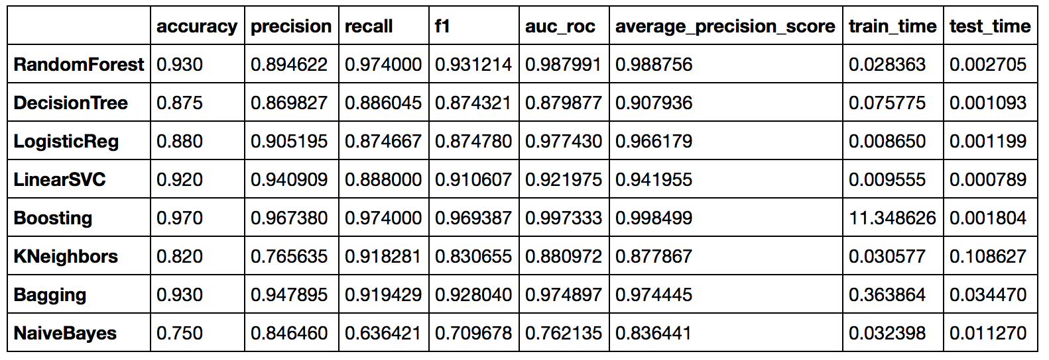
Evaluation Results
Unigrams and POS tags

Slide 7
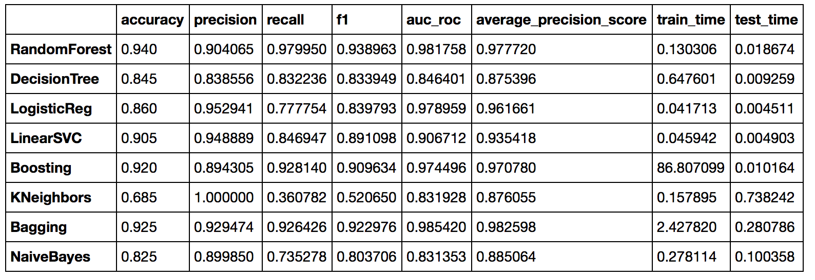
Evaluation Results
Unigrams, Bigrams, and POS tags

Slide 8
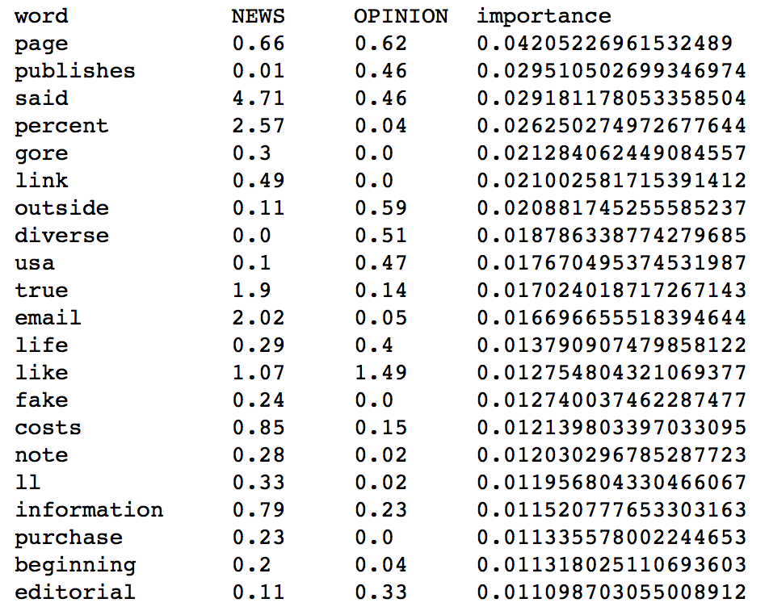
Important Features

Slide 9
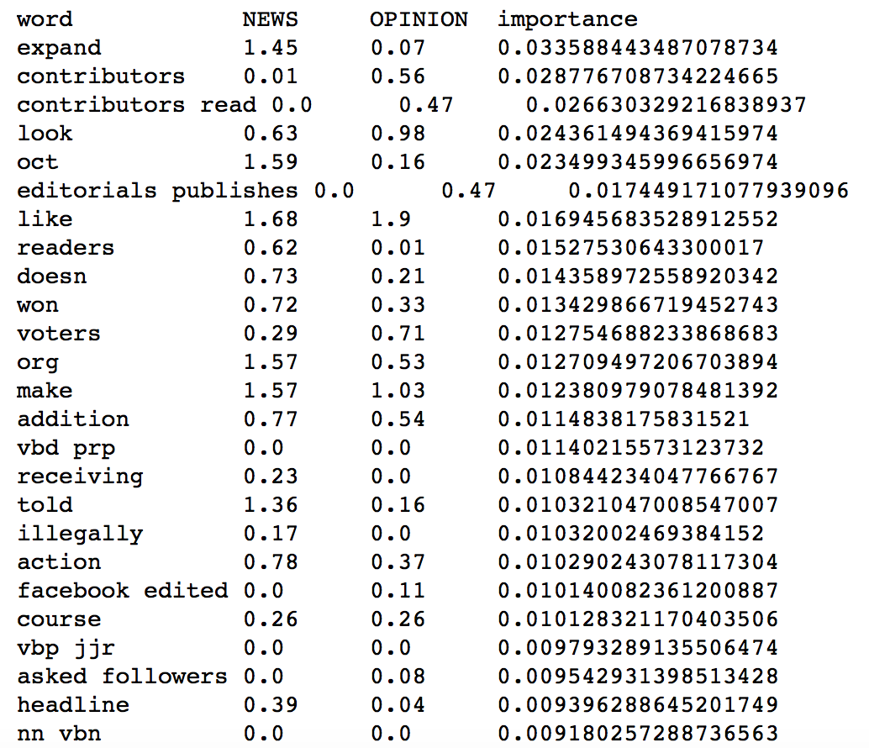
Important Features

Slide 10
Adaptation and Obstacles
Differences between the writing styles rather than the real difference in facts and opinions?
Cleaner webscraping
Accurate results for long texts but not good at classifying short texts: plot of text length vs correct classification.

Slide 11
Adaptation and Obstacles
Feature generation:
Past tenses and modifiers?
Looking for advice on what other useful features
User interface:
Significant time to train the classifier.

Slide 12
Next Steps
Improve the preprocessing functions to generate better web scrape output
Add more features to the models: more literature review. opinion seed words. Stemmer and wordnet for more features.
Implement feature selection?
Improve the design and functionality of the user interface

