Slide 1
nQUIC: Noise-Based Packet Protection
Mathias Hall-Andersen David Wong
NCC Group NCC Group
Nick Sullivan Alishah Chator
Cloudflare Cloudflare

Slide 2
The Traditional HTTPS Stack
HTTP
TLS
TCP
IP

Slide 3
The Traditional HTTPS Stack
HTTP
TLS
TCP
Ossification
IP

Slide 4
The QUIC way of doing things
HTTP
HTTP
QUIC
TLS
TCP
UDP
IP

Slide 5
Problem solved?...Not so fast!
Standard QUIC uses TLS 1.3 as its Cryptographic Handshake

Slide 6
Problem solved?...Not so fast!
Standard QUIC uses TLS 1.3 as its Cryptographic Handshake
TLS is a major improvement on previous versions but still has some shortcomings:

Slide 7
Problem solved?...Not so fast!
Standard QUIC uses TLS 1.3 as its Cryptographic Handshake
TLS is a major improvement on previous versions but still has some shortcomings:
Complex in both implementation and state machine

Slide 8
Problem solved?...Not so fast!
Standard QUIC uses TLS 1.3 as its Cryptographic Handshake
TLS is a major improvement on previous versions but still has some shortcomings:
Complex in both implementation and state machine
Current design does not have a full security proof

Slide 9
Problem solved?...Not so fast!
Standard QUIC uses TLS 1.3 as its Cryptographic Handshake
TLS is a major improvement on previous versions but still has some shortcomings:
Complex in both implementation and state machine
Current design does not have a full security proof
Risk of ossification due to legacy support

Slide 10
Problem solved?...Not so fast!
Standard QUIC uses TLS 1.3 as its Cryptographic Handshake
TLS is a major improvement on previous versions but still has some shortcomings:
Complex in both implementation and state machine
Current design does not have a full security proof
Risk of ossification due to legacy support
Additionally, existing TLS implementations must be significantly modified to integrate with QUIC

Slide 11
An Alternative Handshake Protocol
These problems motivate finding a protocol with a simpler state machine, less complexity, and stronger security guarantees.

Slide 12
An Alternative Handshake Protocol
These problems motivate finding a protocol with a simpler state machine, less complexity, and stronger security guarantees.
That brings us to the Noise Framework

Slide 13
What is Noise
A framework for specifying Cryptographic Handshakes

Slide 14
What is Noise
A framework for specifying Cryptographic Handshakes
A variety of protocols can be specified using the simple Noise language

Slide 15
What is Noise
A framework for specifying Cryptographic Handshakes
A variety of protocols can be specified using the simple Noise language
These protocols can vary in their guarantees and complexity

Slide 16
What is Noise
A framework for specifying Cryptographic Handshakes
A variety of protocols can be specified using the simple Noise language
These protocols can vary in their guarantees and complexity
However, once a protocol is selected, the handshake proceeds in a straightforward fashion

Slide 17
What is Noise
The Noise language consists of tokens, which combine into message patterns, when combine into handshake patterns

Slide 18
What is Noise
The Noise language consists of tokens, which combine into message patterns, when combine into handshake patterns
s
s
e
e
Public Key Tokens

Slide 19
What is Noise
The Noise language consists of tokens, which combine into message patterns, when combine into handshake patterns
s
s
s s
e s
e
e
e e
s e
Public Key Tokens
DH Tokens

Slide 20
What is Noise
Here is a basic example handshake pattern
e
payload
e
e e
payload

Slide 21
What is Noise
Here is a basic example handshake pattern
e
Initiator sends a public ephemeral DH share

Slide 22
What is Noise
Here is a basic example handshake pattern
e
payload
Initiator sends a public ephemeral DH share
A cleartext payload is also sent over

Slide 23
What is Noise
Here is a basic example handshake pattern
e
payload
Initiator sends a public ephemeral DH share
A cleartext payload is also sent over
e
Responder sends a public ephemeral DH share

Slide 24
What is Noise
Here is a basic example handshake pattern
e
payload
Initiator sends a public ephemeral DH share
A cleartext payload is also sent over
e
e e
Responder sends a public ephemeral DH share
A DHKE is performed using these keys to obtain

Slide 25
What is Noise
Here is a basic example handshake pattern
e
payload
Initiator sends a public ephemeral DH share
A cleartext payload is also sent over
e
e e
Responder sends a public ephemeral DH share
payload
A DHKE is performed using these keys to obtain
Responder sends payload encrypted under a derived key

Slide 26
What is Noise
Here is a basic example handshake pattern
Noise does additional processing to mix all handshake data into the derived key
e
payload
Initiator sends a public ephemeral DH share
A cleartext payload is also sent over
e
e e
Responder sends a public ephemeral DH share
payload
A DHKE is performed using these keys to obtain
Responder sends payload encrypted under a derived key

Slide 27
Noise vs TLS
Once a handshake pattern is selected, noise follows a simple linear state machine

Slide 28
Noise vs TLS
Once a handshake pattern is selected, Noise follows a simple linear state machine
Noise is easy to prove secure

Slide 29
Noise vs TLS
Once a handshake pattern is selected, Noise follows a simple linear state machine
Noise is easy to prove secure
Noise is generally implemented as a “build your own protocol” library

Slide 30
Noise vs TLS
Once a handshake pattern is selected, Noise follows a simple linear state machine
Noise is easy to prove secure
Noise is generally implemented as a “build your own protocol” library
Noise lacks cryptographic agility

Slide 31
Peer Authentication and Pinning
Traditionally, Authentication of peers in TLS involves a PKI

Slide 32

Peer Authentication and Pinning
Traditionally, Authentication of peers in TLS involves a PKI
Leaf
Intermediary
Root
Chain of Trust

Slide 33
Peer Authentication and Pinning
Traditionally, Authentication of peers in TLS involves a PKI
However this is not necessary in a centrally managed setting
Leaf
Intermediary
Root
Chain of Trust

Slide 34
Peer Authentication and Pinning
Pinning instructs a peer to expect a specific key

Slide 35
Peer Authentication and Pinning
Pinning instructs a peer to expect a specific key
This is similar to the Preshared Symmetric Keys (PSKs) setting

Slide 36
Peer Authentication and Pinning
Pinning instructs a peer to expect a specific key
This is similar to the Preshared Symmetric Keys (PSKs) setting
However, PSKs require many more keys, since every pair of endpoints must have its own unique key

Slide 37
Peer Authentication and Pinning
Pinning instructs a peer to expect a specific key
This is similar to the Preshared Symmetric Keys (PSKs) setting
However, PSKs require many more keys, since every pair of endpoints must have its own unique key
vs

Slide 38
Peer Authentication and Pinning
nQUIC is designed for the public key pinning setting

Slide 39
Peer Authentication and Pinning
nQUIC is designed for the public key pinning setting
This applies to cases where:
Public keys or Certificate Chains are obtained out-of-band

Slide 40
Peer Authentication and Pinning
nQUIC is designed for the public key pinning setting
This applies to cases where:
Public keys or Certificate Chains are obtained out-of-band
Peers are bootstrapped with keys

Slide 41
Peer Authentication and Pinning
nQUIC is designed for the public key pinning setting
This applies to cases where:
Public keys or Certificate Chains are obtained out-of-band
Peers are bootstrapped with keys
Public keys are managed by a trusted key management service

Slide 42
nQUIC
Motivated by simplicity while still satisfying the following requirements:
Authenticated Key Exchange
Authentication of Transport Parameters
Authenticated Version Negotiation
Authenticated Negotiation of Application Protocol
Address Validation

Slide 43
nQUIC
Motivated by simplicity while still satisfying the following requirements:
Authenticated Key Exchange
Feature of Noise
Authentication of Transport Parameters
Authenticated Version Negotiation
Authenticated Negotiation of Application Protocol
Address Validation

Slide 44
nQUIC
Motivated by simplicity while still satisfying the following requirements:
Authenticated Key Exchange
Feature of Noise
Authentication of Transport Parameters
Can be placed in the payload field
Authenticated Version Negotiation
Authenticated Negotiation of Application Protocol
Address Validation

Slide 45
nQUIC
Motivated by simplicity while still satisfying the following requirements:
Authenticated Key Exchange
Feature of Noise
Authentication of Transport Parameters
Can be placed in the payload field
Authenticated Version Negotiation
Can be placed in the payload field
Authenticated Negotiation of Application Protocol
Address Validation

Slide 46
nQUIC
Motivated by simplicity while still satisfying the following requirements:
Authenticated Key Exchange
Feature of Noise
Authentication of Transport Parameters
Can be placed in the payload field
Authenticated Version Negotiation
Can be placed in the payload field
Authenticated Negotiation of Application Protocol
ALPN data can be placed in transport parameters
Address Validation

Slide 47
nQUIC
Motivated by simplicity while still satisfying the following requirements:
Authenticated Key Exchange
Feature of Noise
Authentication of Transport Parameters
Can be placed in the payload field
Authenticated Version Negotiation
Can be placed in the payload field
Authenticated Negotiation of Application Protocol
ALPN data can be placed in transport parameters
Address Validation
Handled by QUIC address validation tokens

Slide 48
nQUIC’s Noise Pattern
We needed a handshake that:

Slide 49
nQUIC’s Noise Pattern
We needed a handshake that:
Authenticates the server

Slide 50
nQUIC’s Noise Pattern
We needed a handshake that:
Authenticates the server
Optionally authenticates the client

Slide 51
nQUIC’s Noise Pattern
We needed a handshake that:
Authenticates the server
Optionally authenticates the client
Encrypts transport parameters

Slide 52
nQUIC’s Noise Pattern
In order to achieve this we selected the IK pattern:
s
e
e s
s
s s
payload
e
e e
e s
payload

Slide 53
nQUIC’s Noise Pattern
In order to achieve this we selected the IK pattern:
Server shares static key in advance
s

Slide 54
nQUIC’s Noise Pattern
In order to achieve this we selected the IK pattern:
Server shares static key in advance
s
Client payload secured by client ephemeral and server static keys
e
e s
s
s s
payload

Slide 55
nQUIC’s Noise Pattern
In order to achieve this we selected the IK pattern:
Server shares static key in advance
s
Client payload secured by client ephemeral and server static keys
e
e s
s
s s
payload
Server payload secured by both parties ephemeral keys
e
e e
e s
payload

Slide 56
nQUIC’s Noise Pattern
Disable client auth using Dummy Keys
In order to achieve this we selected the IK pattern:
Server shares static key in advance
s
Client payload secured by client ephemeral and server static keys
e
e s
s
s s
payload
Server payload secured by both parties ephemeral keys
e
e e
e s
payload

Slide 57
Why IK?
There were other Noise patterns that offered similar guarantees

Slide 58
Why IK?
There were other Noise patterns that offered similar guarantees
Some patterns did not require server to share static key beforehand

Slide 59
Why IK?
There were other Noise patterns that offered similar guarantees
Some patterns did not require server to share static key beforehand
Supports more settings, but also may require a PKI

Slide 60
Why IK?
There were other Noise patterns that offered similar guarantees
Some patterns did not require server to share static key beforehand
Supports more settings, but also may require a PKI
The XK Pattern also sends server static key beforehand, but is 3 rounds

Slide 61
XK IK
s
s
e
e s
e
e s
s
s s
e
e e
e
e e
e s
s
s e

Slide 62
XK IK
s
s
e
e s
e
e s
s
s s
e
e e
e
e e
e s
s
s e
- More rounds

Slide 63
XK IK
s
s
e
e s
e
e s
s
s s
e
e e
e
e e
e s
s
s e
- More DHs
- More rounds

Slide 64
XK IK
s
s
e
e s
e
e s
s
s s
e
e e
e
e e
e s
s
s e
- More DHs
- Weaker Security of first message
- More rounds

Slide 65
XK IK
s
s
e
e s
e
e s
s
s s
e
e e
e
e e
e s
s
s e
- More DHs
- Weaker Security of first message
- More rounds
Ultimately, we found network latency to be the most serious constraint

Slide 66
Anatomy of nQUIC
Handshake
Prologue
Noise
Noise
QUIC Frames
CRYPTO
CRYPTO
PADDING
CRYPTO
STREAM
QUIC Packets
Initial
Initial
Short Header
UDP
Datagram
Datagram
Datagram
I -> R
R -> I
I -> R

Slide 67
Anatomy of nQUIC
Hostname Selection
Handshake
Prologue
Noise
Noise
QUIC Frames
CRYPTO
CRYPTO
PADDING
CRYPTO
STREAM
QUIC Packets
Initial
Initial
Short Header
UDP
Datagram
Datagram
Datagram
I -> R
R -> I
I -> R

Slide 68
Anatomy of nQUIC
Hostname Selection
Handshake Request
Handshake
Prologue
Noise
Noise
QUIC Frames
CRYPTO
CRYPTO
PADDING
CRYPTO
STREAM
QUIC Packets
Initial
Initial
Short Header
UDP
Datagram
Datagram
Datagram
I -> R
R -> I
I -> R

Slide 69
Anatomy of nQUIC
Hostname Selection
Handshake Request
Handshake Response
Handshake
Prologue
Noise
Noise
QUIC Frames
CRYPTO
CRYPTO
PADDING
CRYPTO
STREAM
QUIC Packets
Initial
Initial
Short Header
UDP
Datagram
Datagram
Datagram
I -> R
R -> I
I -> R

Slide 70
Anatomy of nQUIC
Hostname Selection
Handshake Request
Handshake Response
Implicit Acknowledgement
Handshake
Prologue
Noise
Noise
QUIC Frames
CRYPTO
CRYPTO
PADDING
CRYPTO
STREAM
QUIC Packets
Initial
Initial
Short Header
UDP
Datagram
Datagram
Datagram
I -> R
R -> I
I -> R

Slide 71
Hostname Selection
Problem: A server may be responsible for multiple endpoints, only one of which has the correct key.

Slide 72
Hostname Selection
Problem: A server may be responsible for multiple endpoints, only one of which has the correct key.
Has key pinning for A

Slide 73
Hostname Selection
Problem: A server may be responsible for multiple endpoints, only one of which has the correct key.
Enc(Dest:A…)
Has key pinning for A
Load Balancer or Server hosting multiple endpoints on same machine

Slide 74
Hostname Selection
Problem: A server may be responsible for multiple endpoints, only one of which has the correct key.
A
Enc(Dest:A…)
B
Has key pinning for A
Load Balancer or Server hosting multiple endpoints on same machine
C

Slide 75
Hostname Selection
Problem: A server may be responsible for multiple endpoints, only one of which has the correct key.
A
?
Enc(Dest:A…)
B
Has key pinning for A
Load Balancer or Server hosting multiple endpoints on same machine
C

Slide 76
Hostname Selection
For TLS, SNI solves this by including the server id as part of the TLS negotiation
A
B
Has key pinning for A
Load Balancer or Server hosting multiple endpoints on same machine
C

Slide 77
Hostname Selection
For TLS, SNI solves this by including the server id as part of the TLS negotiation
A
TLS handshake (“I am talking to A”)
B
Has key pinning for A
Load Balancer or Server hosting multiple endpoints on same machine
C

Slide 78
Hostname Selection
For TLS, SNI solves this by including the server id as part of the TLS negotiation
A
TLS handshake (“I am talking to A”)
B
Enc(Dest:A…)
Has key pinning for A
Load Balancer or Server hosting multiple endpoints on same machine
C

Slide 79
Hostname Selection
For TLS, SNI solves this by including the server id as part of the TLS negotiation
A
TLS handshake (“I am talking to A”)
B
Enc(Dest:A…)
Has key pinning for A
Load Balancer or Server hosting multiple endpoints on same machine
C

Slide 80
Hostname Selection
Noise has a Prologue field that requires both parties to initialize the handshake with the same value

Slide 81
Hostname Selection
Noise has a Prologue field that requires both parties to initialize the handshake with the same value
We can use this field to support SNI

Slide 82
Hostname Selection
Noise has a Prologue field that requires both parties to initialize the handshake with the same value
We can use this field to support SNI
If we need to hide this data from the forwarding server we can encrypt it using the N pattern:
s
e
e s

Slide 83
Handshake Request
Indicates the start of the cryptographic handshake
Transmits encrypted client transport parameters
Optionally presents client’s Identity
Ephemeral (32 bytes)
Client Static (32 + 16 bytes)
Encrypted Transport Parameters (n + 16 bytes)

Slide 84
Handshake Response
Completes Negotiation of Transport Keys
Transmits encrypted server transport parameters
Proves server’s identity
After this step, final keys are derived and passed to QUIC packet protector
Ephemeral (32 bytes)
Encrypted Transport Parameters (n + 16 bytes)

Slide 85
Implicit Acknowledgement
In order to avoid replay or Key Compromise attacks, client must immediately send a packet encrypted under transport keys upon completing the handshake

Slide 86
Implicit Acknowledgement
In order to avoid replay or Key Compromise attacks, client must immediately send a packet encrypted under transport keys upon completing the handshake
Only after this does the server consider the handshake finished

Slide 87
Implicit Acknowledgement
In order to avoid replay or Key Compromise attacks, client must immediately send a packet encrypted under transport keys upon completing the handshake
Only after this does the server consider the handshake finished
If application data is not available a PADDING or PING frame is sent

Slide 88
Implicit Acknowledgement
In order to avoid replay or Key Compromise attacks, client must immediately send a packet encrypted under transport keys upon completing the handshake
Only after this does the server consider the handshake finished
If application data is not available a PADDING or PING frame is sent
Clients ACK frames are not sufficient for this

Slide 89
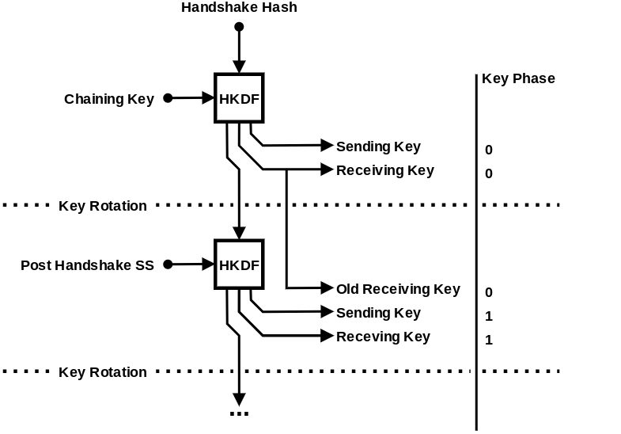
Ratcheting in nQUIC

Slide 90
Ratcheting in nQUIC
Initial Transport keys

Slide 91
Ratcheting in nQUIC
Initial Transport keys
Chain State

Slide 92
Ratcheting in nQUIC
Initial Transport keys
Chain State
Computed with additional DH shares exchanged

Slide 93
Ratcheting in nQUIC
Initial Transport keys
Chain State
Key phase determines which key to use
Computed with additional DH shares exchanged

Slide 94
Interoperability
nQUIC is intended to be a minimal update to QUIC-TLS

Slide 95
Interoperability
nQUIC is intended to be a minimal update to QUIC-TLS
Potentially can be specified as a new QUIC version compatible with existing RFCs

Slide 96
Interoperability
nQUIC is intended to be a minimal update to QUIC-TLS
Potentially can be specified as a new QUIC version compatible with existing RFCs
Since versions with the upper 16 bits clear are reserved for future IETF use we chose 0xff00000b for nQUIC

Slide 97
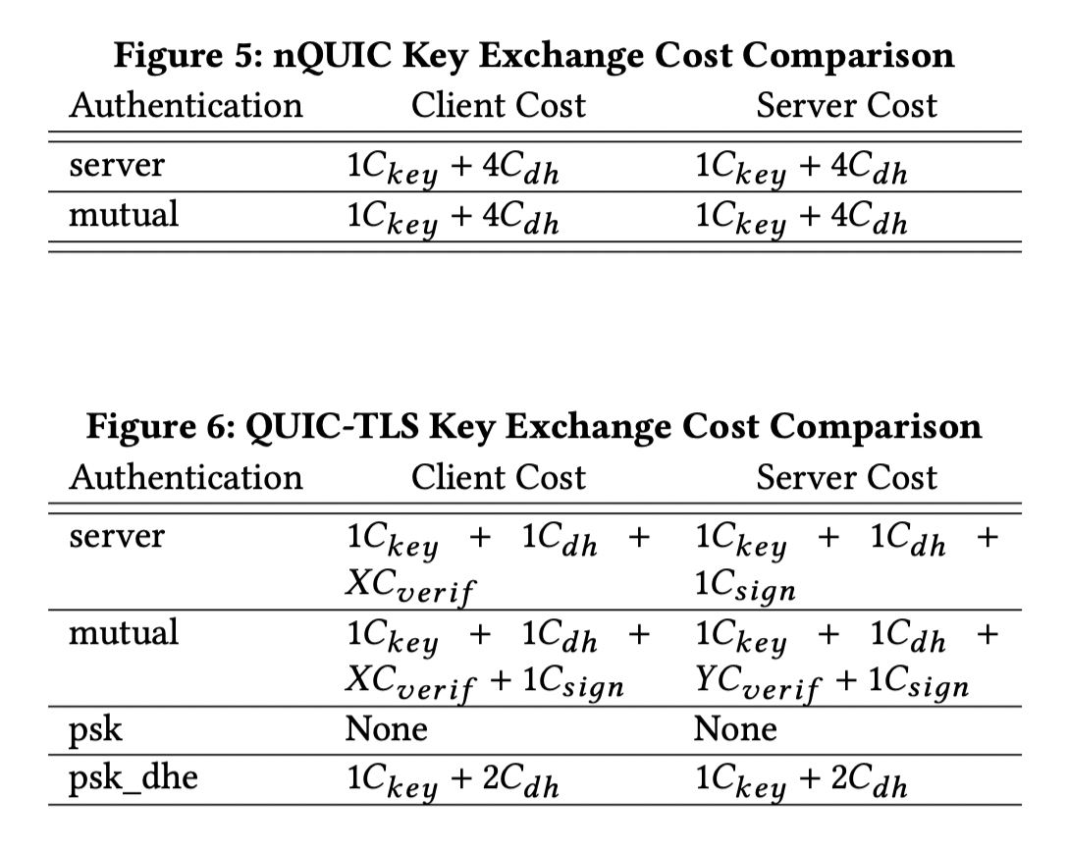
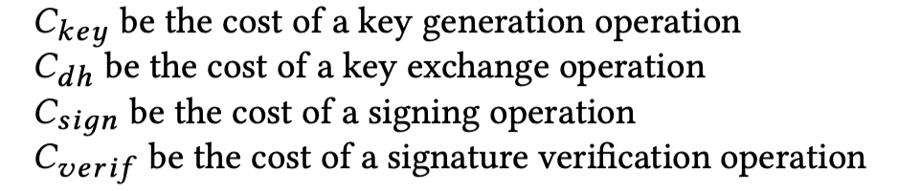
Cost Comparison

Slide 98
Performance Evaluation
The key difference in nQUIC and QUIC-TLS is the handshake

Slide 99
Performance Evaluation
The key difference in nQUIC and QUIC-TLS is the handshake
We created proof of concept implementations of nQUIC in Rust and Go

Slide 100
Performance Evaluation
The key difference in nQUIC and QUIC-TLS is the handshake
We created proof of concept implementations of nQUIC in Rust and Go
These libraries where significantly smaller than the QUIC libraries they were based on

Slide 101
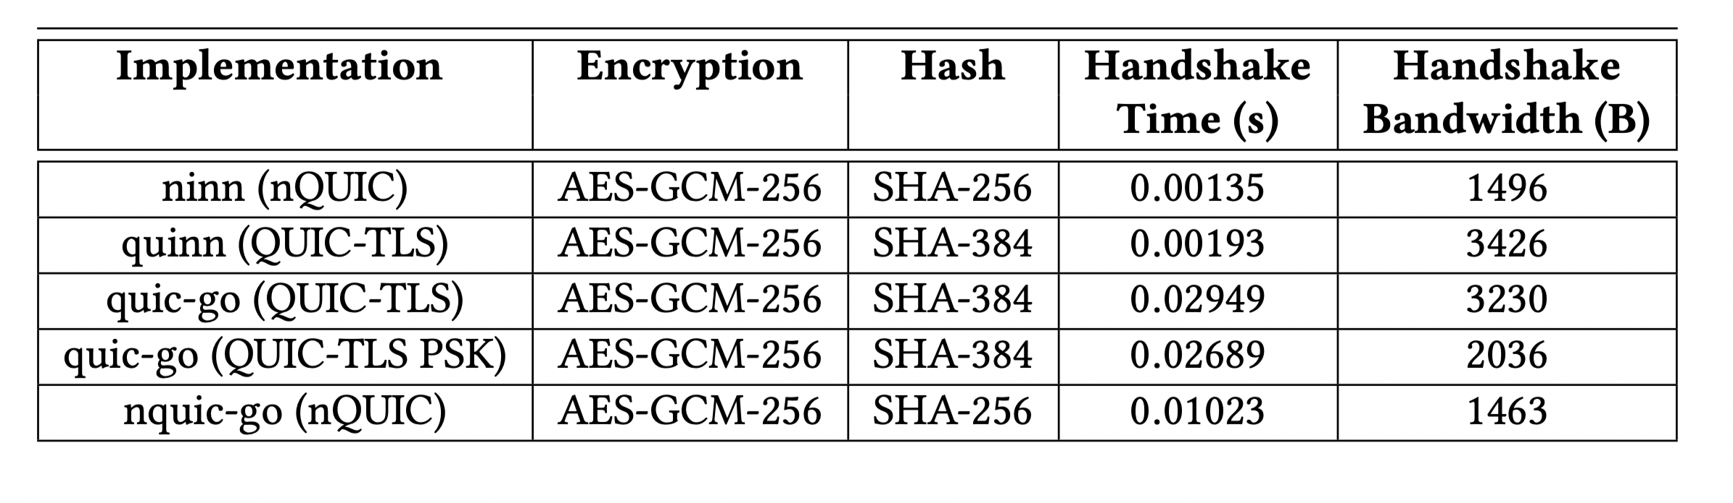
Performance Evaluation

Slide 102
Conclusion
nQUIC offers the following advantages:

Slide 103
Conclusion
nQUIC offers the following advantages:
Improved performance

Slide 104
Conclusion
nQUIC offers the following advantages:
Improved performance
Simple implementations

Slide 105
Conclusion
nQUIC offers the following advantages:
Improved performance
Simple implementations
Clearer Security properties

Slide 106
Conclusion
nQUIC offers the following advantages:
Improved performance
Simple implementations
Clearer Security properties
Supporting a variety of handshake protocols will help avoid ossification

Slide 107
Conclusion
nQUIC offers the following advantages:
Improved performance
Simple implementations
Clearer Security properties
Supporting a variety of handshake protocols will help avoid ossification
We plan to bring nQUIC to the QUIC WG for discussion soon!

Slide 108
Questions?
Thank you!

