Slide 1
nQUIC: Noise-Based Packet Protection
Mathias Hall-Andersen* David Wong*
University of Copenhagen Facebook
Nick Sullivan Alishah Chator†
Cloudflare Johns Hopkins University
*Work done while at NCC Group
†Work done while at Cloudflare

Slide 2
The Traditional HTTPS Stack
HTTP
TLS
TCP
IP

Slide 3
The Traditional HTTPS Stack
HTTP
Multiplexed Streams
TLS
TCP
IP

Slide 4
The Traditional HTTPS Stack
HTTP
Multiplexed Streams
TLS
Security
TCP
IP

Slide 5
The Traditional HTTPS Stack
HTTP
Multiplexed Streams
TLS
Security
TCP
Reliability
IP

Slide 6
The Traditional HTTPS Stack
HTTP
TLS
TCP
Ossification
IP

Slide 7
The QUIC way of doing things
HTTP
HTTP
QUIC
TLS
TCP
UDP
IP

Slide 8
The QUIC way of doing things
HTTP
HTTP
QUIC
TLS
Multiplexed Streams
Security
Reliability
TCP
UDP
IP

Slide 9
Securing Protocols with TLS

Slide 10
Securing Protocols with TLS: TCP
TLS Handshake Layer
TLS Record Layer
TCP

Slide 11
Securing Protocols with TLS: TCP
TLS Handshake Layer
Handshake messages, Application data, TLS alerts
TLS Record Layer
TCP

Slide 12
Securing Protocols with TLS: TCP
TLS Handshake Layer
Handshake messages, Application data, TLS alerts
TLS Record Layer
Applies cryptographic protection
TCP

Slide 13
Securing Protocols with TLS: TCP
TLS Handshake Layer
Handshake messages, Application data, TLS alerts
TLS Record Layer
Applies cryptographic protection
TCP
Reliable transport

Slide 14
Securing Protocols with TLS: QUIC
TLS Handshake/Alerts
Application Data
QUIC

Slide 15
Securing Protocols with TLS: QUIC
TLS Handshake/Alerts
Application Data
QUIC
Supplies both packet protection and reliable transport

Slide 16
Handshake Modularity
QUIC
Extract keys from handshake
TLS Handshake/Alerts

Slide 17
Handshake Modularity
QUIC
Extract keys from handshake
TLS Handshake/Alerts
Use keys to
protect packets
QUIC
Packet Protector

Slide 18
Handshake Modularity
QUIC
Extract keys from handshake
TLS Handshake/Alerts
Use keys to
protect packets
QUIC
Packet Protector

Slide 19
Handshake Modularity
QUIC
Extract keys from handshake
TLS Handshake/Alerts
Use keys to
protect packets
QUIC
Packet Protector
Separation between how handshake is performed and how the keys are used

Slide 20
Handshake Modularity
QUIC
Extract keys from handshake
TLS Handshake/Alerts
Use keys to
protect packets
QUIC
Packet Protector
Separation between how handshake is performed and how the keys are used

Slide 21
Handshake Modularity?
QUIC
Extract keys from handshake
TLS Handshake/Alerts
Use keys to
protect packets
QUIC
Packet Protector

Slide 22
Handshake Modularity?
QUIC
Extract keys from handshake
TLS Handshake/Alerts
Use keys to
protect packets
Specifications focus on TLS 1.3 limits advantages of modularity
QUIC
Packet Protector

Slide 23
Handshake Modularity?
QUIC
Extract keys from handshake
TLS Handshake/Alerts
Use keys to
protect packets
Specifications focus on TLS 1.3 limits advantages of modularity
- Avoiding complexity when not needed
QUIC
Packet Protector

Slide 24
Handshake Modularity?
QUIC
Extract keys from handshake
TLS Handshake/Alerts
Use keys to
protect packets
Specifications focus on TLS 1.3 limits advantages of modularity
- Avoiding complexity when not needed
QUIC
Packet Protector
- Swapping in new protocols with full security proofs

Slide 25
Handshake Modularity?
QUIC
Extract keys from handshake
TLS Handshake/Alerts
Use keys to
protect packets
Specifications focus on TLS 1.3 limits advantages of modularity
- Avoiding complexity when not needed
QUIC
Packet Protector
- Swapping in new protocols with full security proofs
- Legacy support not always needed

Slide 26
Handshake Modularity?
QUIC
Extract keys from handshake
TLS Handshake/Alerts
Use keys to
protect packets
Specifications focus on TLS 1.3 limits advantages of modularity
- Avoiding complexity when not needed
QUIC
Packet Protector
- Swapping in new protocols with full security proofs
- Legacy support not always needed
In addition, TLS implementations need significant modification before integrating with QUIC

Slide 27
Are there circumstances we can do better than TLS 1.3?

Slide 28
What is Noise
A framework for specifying Cryptographic Handshakes

Slide 29
What is Noise
A framework for specifying Cryptographic Handshakes
A variety of protocols can be specified using the simple Noise language

Slide 30
What is Noise
A framework for specifying Cryptographic Handshakes
A variety of protocols can be specified using the simple Noise language
These protocols can vary in their guarantees and complexity

Slide 31
What is Noise
A framework for specifying Cryptographic Handshakes
A variety of protocols can be specified using the simple Noise language
These protocols can vary in their guarantees and complexity
However, once a protocol is selected, the handshake proceeds in a straightforward fashion

Slide 32
What is Noise
The Noise language consists of tokens, which combine into message patterns, when combine into handshake patterns

Slide 33
What is Noise
The Noise language consists of tokens, which combine into message patterns, when combine into handshake patterns
s
s
e
e
Public Key Tokens

Slide 34
What is Noise
The Noise language consists of tokens, which combine into message patterns, when combine into handshake patterns
s
s
s s
e s
e
e
e e
s e
Public Key Tokens
DH Tokens

Slide 35
What is Noise
Here is a basic example handshake pattern
e
payload
e
e e
payload

Slide 36
What is Noise
Here is a basic example handshake pattern
e
Initiator sends a public ephemeral DH share

Slide 37
What is Noise
Here is a basic example handshake pattern
e
payload
Initiator sends a public ephemeral DH share
A cleartext payload is also sent over

Slide 38
What is Noise
Here is a basic example handshake pattern
e
payload
Initiator sends a public ephemeral DH share
A cleartext payload is also sent over
e
Responder sends a public ephemeral DH share

Slide 39
What is Noise
Here is a basic example handshake pattern
e
payload
Initiator sends a public ephemeral DH share
A cleartext payload is also sent over
e
e e
Responder sends a public ephemeral DH share
A DHKE is performed using these keys to obtain

Slide 40
What is Noise
Here is a basic example handshake pattern
e
payload
Initiator sends a public ephemeral DH share
A cleartext payload is also sent over
e
e e
Responder sends a public ephemeral DH share
payload
A DHKE is performed using these keys to obtain
Responder sends payload encrypted under a derived key

Slide 41
What is Noise
Here is a basic example handshake pattern
Noise does additional processing to mix all handshake data into the derived key
e
payload
Initiator sends a public ephemeral DH share
A cleartext payload is also sent over
e
e e
Responder sends a public ephemeral DH share
payload
A DHKE is performed using these keys to obtain
Responder sends payload encrypted under a derived key

Slide 42
Noise vs TLS
Once a handshake pattern is selected, noise follows a simple linear state machine

Slide 43
Noise vs TLS
Once a handshake pattern is selected, Noise follows a simple linear state machine
Noise is easy to prove secure

Slide 44
Noise vs TLS
Once a handshake pattern is selected, Noise follows a simple linear state machine
Noise is easy to prove secure
Noise is generally implemented as a “build your own protocol” library

Slide 45
Noise vs TLS
Once a handshake pattern is selected, Noise follows a simple linear state machine
Noise is easy to prove secure
Noise is generally implemented as a “build your own protocol” library
Noise lacks cryptographic agility

Slide 46
Peer Authentication and Pinning
Traditionally, Authentication of peers in TLS involves a PKI

Slide 47

Peer Authentication and Pinning
Traditionally, Authentication of peers in TLS involves a PKI
Leaf
Intermediary
Root
Chain of Trust

Slide 48
Peer Authentication and Pinning
Traditionally, Authentication of peers in TLS involves a PKI
However this is not necessary in a centrally managed setting
Leaf
Intermediary
Root
Chain of Trust

Slide 49
Peer Authentication and Pinning
Pinning instructs a peer to expect a specific key

Slide 50
Peer Authentication and Pinning
Pinning instructs a peer to expect a specific key
This is similar to the Preshared Symmetric Keys (PSKs) setting

Slide 51
Peer Authentication and Pinning
Pinning instructs a peer to expect a specific key
This is similar to the Preshared Symmetric Keys (PSKs) setting
However, PSKs require many more keys, since every pair of endpoints must have its own unique key

Slide 52
Peer Authentication and Pinning
Pinning instructs a peer to expect a specific key
This is similar to the Preshared Symmetric Keys (PSKs) setting
However, PSKs require many more keys, since every pair of endpoints must have its own unique key
vs

Slide 53
Peer Authentication and Pinning
nQUIC is designed for the public key pinning setting

Slide 54
Peer Authentication and Pinning
nQUIC is designed for the public key pinning setting
This applies to cases where:
Public keys or Certificate Chains are obtained out-of-band

Slide 55
Peer Authentication and Pinning
nQUIC is designed for the public key pinning setting
This applies to cases where:
Public keys or Certificate Chains are obtained out-of-band
Peers are bootstrapped with keys

Slide 56
Peer Authentication and Pinning
nQUIC is designed for the public key pinning setting
This applies to cases where:
Public keys or Certificate Chains are obtained out-of-band
Peers are bootstrapped with keys
Public keys are managed by a trusted key management service

Slide 57
nQUIC
Motivated by simplicity while still satisfying the following requirements:
Authenticated Key Exchange
Authentication of Transport Parameters
Authenticated Version Negotiation
Authenticated Negotiation of Application Protocol
Address Validation

Slide 58
nQUIC
Motivated by simplicity while still satisfying the following requirements:
Authenticated Key Exchange
Feature of Noise
Authentication of Transport Parameters
Can be placed in the payload field
Authenticated Version Negotiation
Can be placed in the payload field
Authenticated Negotiation of Application Protocol
ALPN data can be placed in transport parameters
Address Validation
Handled by QUIC address validation tokens

Slide 59
nQUIC’s Noise Pattern
We needed a handshake that:

Slide 60
nQUIC’s Noise Pattern
We needed a handshake that:
Authenticates the server

Slide 61
nQUIC’s Noise Pattern
We needed a handshake that:
Authenticates the server
Optionally authenticates the client

Slide 62
nQUIC’s Noise Pattern
We needed a handshake that:
Authenticates the server
Optionally authenticates the client
Encrypts transport parameters

Slide 63
nQUIC’s Noise Pattern
In order to achieve this we selected the IK pattern:
s
e
e s
s
s s
payload
e
e e
e s
payload

Slide 64
nQUIC’s Noise Pattern
In order to achieve this we selected the IK pattern:
Server shares static key in advance
s

Slide 65
nQUIC’s Noise Pattern
In order to achieve this we selected the IK pattern:
Server shares static key in advance
s
Client payload secured by client ephemeral and server static keys
e
e s
s
s s
payload

Slide 66
nQUIC’s Noise Pattern
In order to achieve this we selected the IK pattern:
Server shares static key in advance
s
Client payload secured by client ephemeral and server static keys
e
e s
s
s s
payload
Server payload secured by both parties ephemeral keys
e
e e
e s
payload

Slide 67
nQUIC’s Noise Pattern
Disable client auth using Dummy Keys
In order to achieve this we selected the IK pattern:
Server shares static key in advance
s
Client payload secured by client ephemeral and server static keys
e
e s
s
s s
payload
Server payload secured by both parties ephemeral keys
e
e e
e s
payload

Slide 68
Why IK?
There were other Noise patterns that offered similar guarantees

Slide 69
Why IK?
There were other Noise patterns that offered similar guarantees
Some patterns did not require server to share static key beforehand

Slide 70
Why IK?
There were other Noise patterns that offered similar guarantees
Some patterns did not require server to share static key beforehand
Supports more settings, but also may require a PKI

Slide 71
Why IK?
There were other Noise patterns that offered similar guarantees
Some patterns did not require server to share static key beforehand
Supports more settings, but also may require a PKI
The XK Pattern also sends server static key beforehand, but is 3 rounds

Slide 72
XK IK
s
s
e
e s
e
e s
s
s s
e
e e
e
e e
e s
s
s e

Slide 73
XK IK
s
s
e
e s
e
e s
s
s s
e
e e
e
e e
e s
s
s e
- More rounds

Slide 74
XK IK
s
s
e
e s
e
e s
s
s s
e
e e
e
e e
e s
s
s e
- More DHs
- More rounds

Slide 75
XK IK
s
s
e
e s
e
e s
s
s s
e
e e
e
e e
e s
s
s e
- More DHs
- Weaker Security of first message
- More rounds

Slide 76
XK IK
s
s
e
e s
e
e s
s
s s
e
e e
e
e e
e s
s
s e
- More DHs
- Weaker Security of first message
- More rounds
Ultimately, we found network latency to be the most serious constraint

Slide 77
Anatomy of nQUIC
Handshake
Prologue
Noise
Noise
QUIC Frames
CRYPTO
CRYPTO
PADDING
CRYPTO
STREAM
QUIC Packets
Initial
Initial
Short Header
UDP
Datagram
Datagram
Datagram
I -> R
R -> I
I -> R

Slide 78
Anatomy of nQUIC
Hostname Selection
Handshake
Prologue
Noise
Noise
QUIC Frames
CRYPTO
CRYPTO
PADDING
CRYPTO
STREAM
QUIC Packets
Initial
Initial
Short Header
UDP
Datagram
Datagram
Datagram
I -> R
R -> I
I -> R

Slide 79
Anatomy of nQUIC
Hostname Selection
Handshake Request
Handshake
Prologue
Noise
Noise
QUIC Frames
CRYPTO
CRYPTO
PADDING
CRYPTO
STREAM
QUIC Packets
Initial
Initial
Short Header
UDP
Datagram
Datagram
Datagram
I -> R
R -> I
I -> R

Slide 80
Anatomy of nQUIC
Hostname Selection
Handshake Request
Handshake Response
Handshake
Prologue
Noise
Noise
QUIC Frames
CRYPTO
CRYPTO
PADDING
CRYPTO
STREAM
QUIC Packets
Initial
Initial
Short Header
UDP
Datagram
Datagram
Datagram
I -> R
R -> I
I -> R

Slide 81
Anatomy of nQUIC
Hostname Selection
Handshake Request
Handshake Response
Implicit Acknowledgement
Handshake
Prologue
Noise
Noise
QUIC Frames
CRYPTO
CRYPTO
PADDING
CRYPTO
STREAM
QUIC Packets
Initial
Initial
Short Header
UDP
Datagram
Datagram
Datagram
I -> R
R -> I
I -> R

Slide 82
Hostname Selection
Problem: A server may be responsible for multiple endpoints, only one of which has the correct key.

Slide 83
Hostname Selection
Problem: A server may be responsible for multiple endpoints, only one of which has the correct key.
Has key pinning for A

Slide 84
Hostname Selection
Problem: A server may be responsible for multiple endpoints, only one of which has the correct key.
Enc(Dest:A…)
Has key pinning for A
Load Balancer or Server hosting multiple endpoints on same machine

Slide 85
Hostname Selection
Problem: A server may be responsible for multiple endpoints, only one of which has the correct key.
A
Enc(Dest:A…)
B
Has key pinning for A
Load Balancer or Server hosting multiple endpoints on same machine
C

Slide 86
Hostname Selection
Problem: A server may be responsible for multiple endpoints, only one of which has the correct key.
A
?
Enc(Dest:A…)
B
Has key pinning for A
Load Balancer or Server hosting multiple endpoints on same machine
C

Slide 87
Hostname Selection
For TLS, SNI solves this by including the server id as part of the TLS negotiation
A
B
Has key pinning for A
Load Balancer or Server hosting multiple endpoints on same machine
C

Slide 88
Hostname Selection
For TLS, SNI solves this by including the server id as part of the TLS negotiation
A
TLS handshake (“I am talking to A”)
B
Has key pinning for A
Load Balancer or Server hosting multiple endpoints on same machine
C

Slide 89
Hostname Selection
For TLS, SNI solves this by including the server id as part of the TLS negotiation
A
TLS handshake (“I am talking to A”)
B
Enc(Dest:A…)
Has key pinning for A
Load Balancer or Server hosting multiple endpoints on same machine
C

Slide 90
Hostname Selection
For TLS, SNI solves this by including the server id as part of the TLS negotiation
A
TLS handshake (“I am talking to A”)
B
Enc(Dest:A…)
Has key pinning for A
Load Balancer or Server hosting multiple endpoints on same machine
C

Slide 91
Hostname Selection
Noise has a Prologue field that requires both parties to initialize the handshake with the same value

Slide 92
Hostname Selection
Noise has a Prologue field that requires both parties to initialize the handshake with the same value
We can use this field to support SNI

Slide 93
Hostname Selection
Noise has a Prologue field that requires both parties to initialize the handshake with the same value
We can use this field to support SNI
If we need to hide this data from the forwarding server we can encrypt it using the N pattern:
s
e
e s

Slide 94
Handshake Request
Indicates the start of the cryptographic handshake
Transmits encrypted client transport parameters
Optionally presents client’s Identity
Ephemeral (32 bytes)
Client Static (32 + 16 bytes)
Encrypted Transport Parameters (n + 16 bytes)

Slide 95
Handshake Response
Completes Negotiation of Transport Keys
Transmits encrypted server transport parameters
Proves server’s identity
After this step, final keys are derived and passed to QUIC packet protector
Ephemeral (32 bytes)
Encrypted Transport Parameters (n + 16 bytes)

Slide 96
Implicit Acknowledgement
In order to avoid replay or Key Compromise attacks, client must immediately send a packet encrypted under transport keys upon completing the handshake

Slide 97
Implicit Acknowledgement
In order to avoid replay or Key Compromise attacks, client must immediately send a packet encrypted under transport keys upon completing the handshake
Only after this does the server consider the handshake finished

Slide 98
Implicit Acknowledgement
In order to avoid replay or Key Compromise attacks, client must immediately send a packet encrypted under transport keys upon completing the handshake
Only after this does the server consider the handshake finished
If application data is not available a PADDING or PING frame is sent

Slide 99
Implicit Acknowledgement
In order to avoid replay or Key Compromise attacks, client must immediately send a packet encrypted under transport keys upon completing the handshake
Only after this does the server consider the handshake finished
If application data is not available a PADDING or PING frame is sent
Clients ACK frames are not sufficient for this

Slide 100
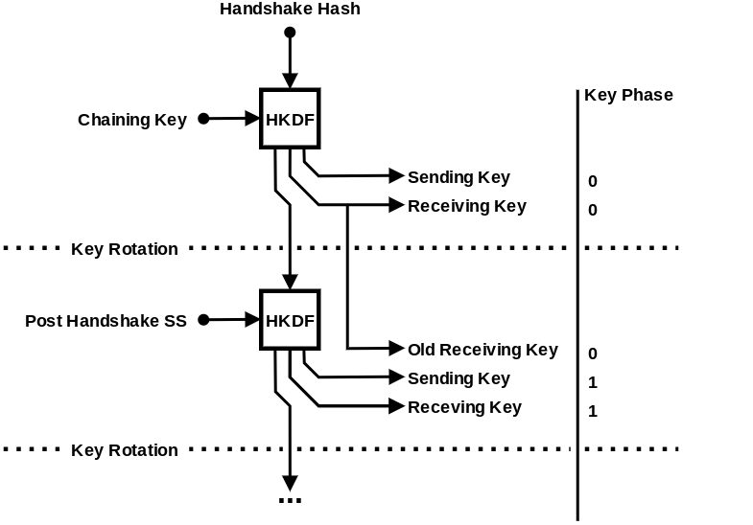
Ratcheting in nQUIC

Slide 101
Ratcheting in nQUIC
Initial Transport keys

Slide 102
Ratcheting in nQUIC
Initial Transport keys
Chain State

Slide 103
Ratcheting in nQUIC
Initial Transport keys
Chain State
Computed with additional DH shares exchanged

Slide 104
Ratcheting in nQUIC
Initial Transport keys
Chain State
Key phase determines which key to use
Computed with additional DH shares exchanged

Slide 105
Interoperability
nQUIC is intended to be a minimal update to QUIC-TLS

Slide 106
Interoperability
nQUIC is intended to be a minimal update to QUIC-TLS
Potentially can be specified as a new QUIC version compatible with existing RFCs

Slide 107
Interoperability
nQUIC is intended to be a minimal update to QUIC-TLS
Potentially can be specified as a new QUIC version compatible with existing RFCs
Since versions with the upper 16 bits clear are reserved for future IETF use we chose 0xff00000b for nQUIC

Slide 108
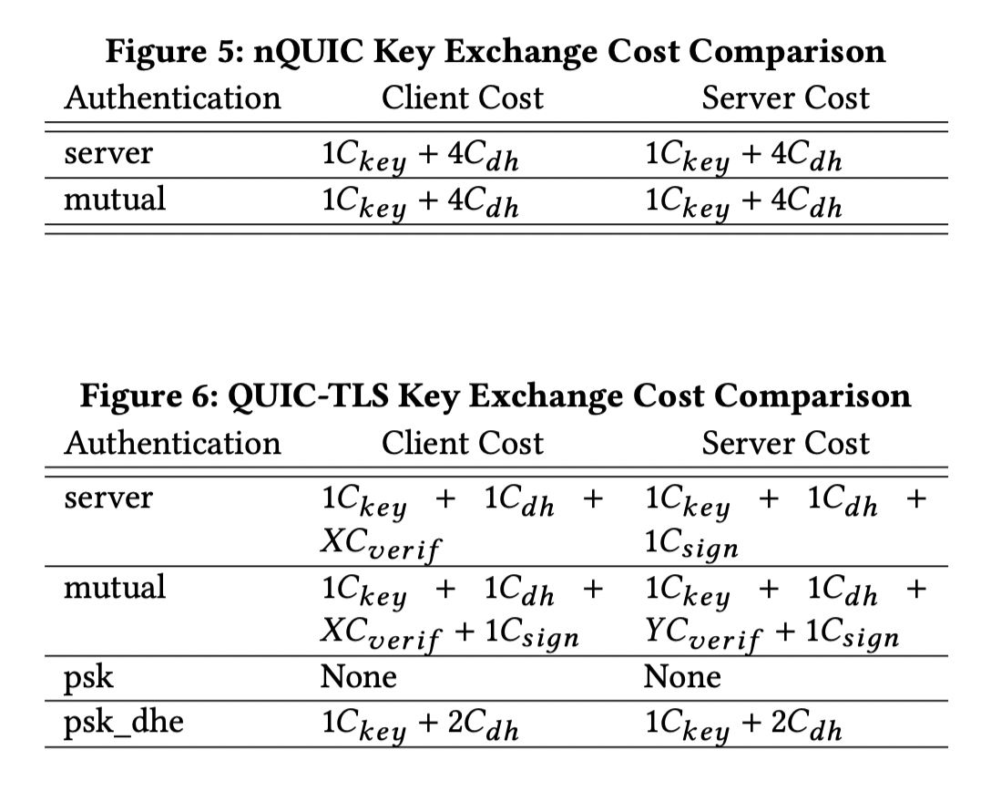
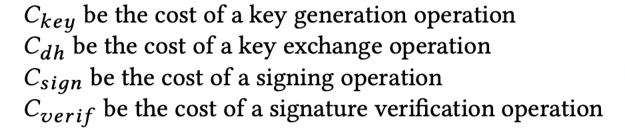
Cost Comparison

Slide 109
Performance Evaluation
The key difference in nQUIC and QUIC-TLS is the handshake

Slide 110
Performance Evaluation
The key difference in nQUIC and QUIC-TLS is the handshake
We created proof of concept implementations of nQUIC in Rust and Go

Slide 111
Performance Evaluation
The key difference in nQUIC and QUIC-TLS is the handshake
We created proof of concept implementations of nQUIC in Rust and Go
These libraries where significantly smaller than the QUIC libraries they were based on

Slide 112
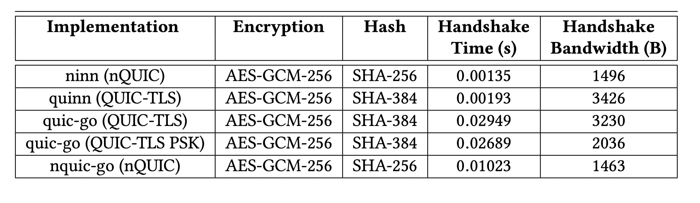
Performance Evaluation

Slide 113
Moving Forward
Noise is adding tokens to support KEMs and digital signatures
nQUIC can be extended to Post Quantum handshakes without invalidating formal analysis
Groups (such as Denis Kolegov) currently implementing PQ noise patterns for nQUIC and performing a comprehensive measurement study

Slide 114
Conclusion
nQUIC offers the following advantages:

Slide 115
Conclusion
nQUIC offers the following advantages:
Improved performance

Slide 116
Conclusion
nQUIC offers the following advantages:
Improved performance
Simple implementations

Slide 117
Conclusion
nQUIC offers the following advantages:
Improved performance
Simple implementations
Clearer Security properties

Slide 118
Conclusion
nQUIC offers the following advantages:
Improved performance
Simple implementations
Clearer Security properties
Supporting a variety of handshake protocols will help avoid ossification and allow for scenario specific optimizations

Slide 119
Questions?
Thank you!

