Slide 1




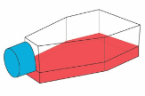
Day 0
Day 1
CD14⁺
CD4⁺
ATAC-seq
fresh
FACS
separation
CD14⁺
CD4⁺
Fixation
24h
ATAC-seq
fixed
PBMCs isolation
90 mL
blood
Culture 30 min
Freezing
~70x10⁶
PBMCs
thawing
FACS
separation
CD14⁺
CD4⁺
ATAC-seq
fixed
Day 0
Day 7

