Slide 1
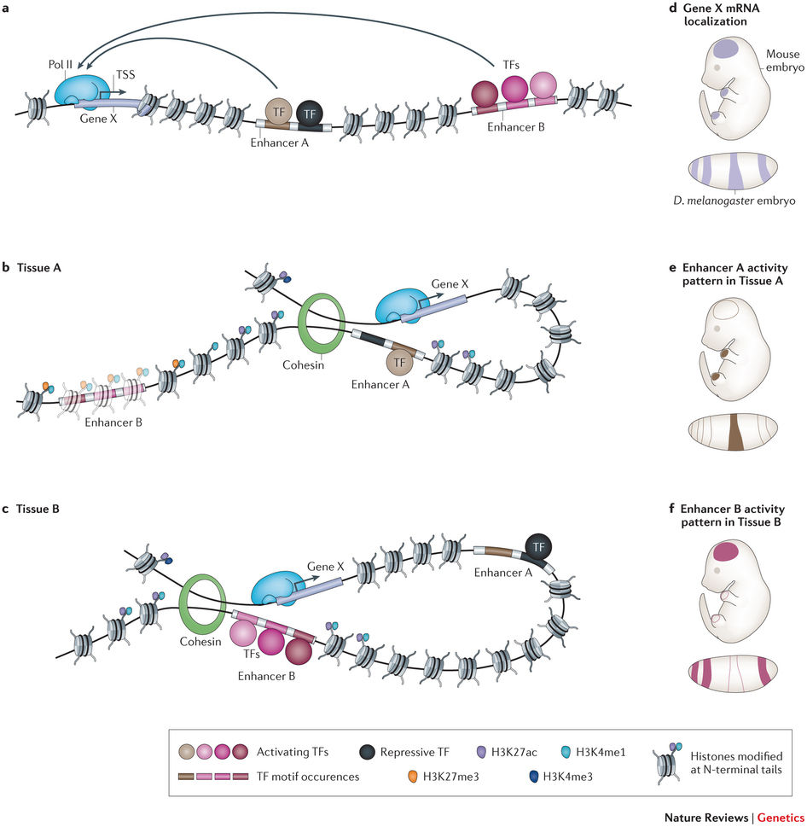
ChIP– Is the promoter active?
RNA – Is this gene expressed?
ChIP– Is Cohesin/CTCF present?
ChIP– Is the chromatin open/closed?
Enhancer active/poised?
DNA – Methylated?
DNA – Do variants alter binding?
ATAC– Is the enhancer/gene accessible?
https://www.nature.com/articles/nrg3863
https://www.nature.com/articles/nrg2957
Capture-C – Is DNA looping occurring?
https://www.nature.com/articles/nrg3682

Slide 2
TSS Gene A
Enh2
PolII
TF
TF
Enh1
Enh4
CTCF
Ins
PolII
TF
TF
TF
Enh4
Silnc
TSS Gene B

