Slide 1
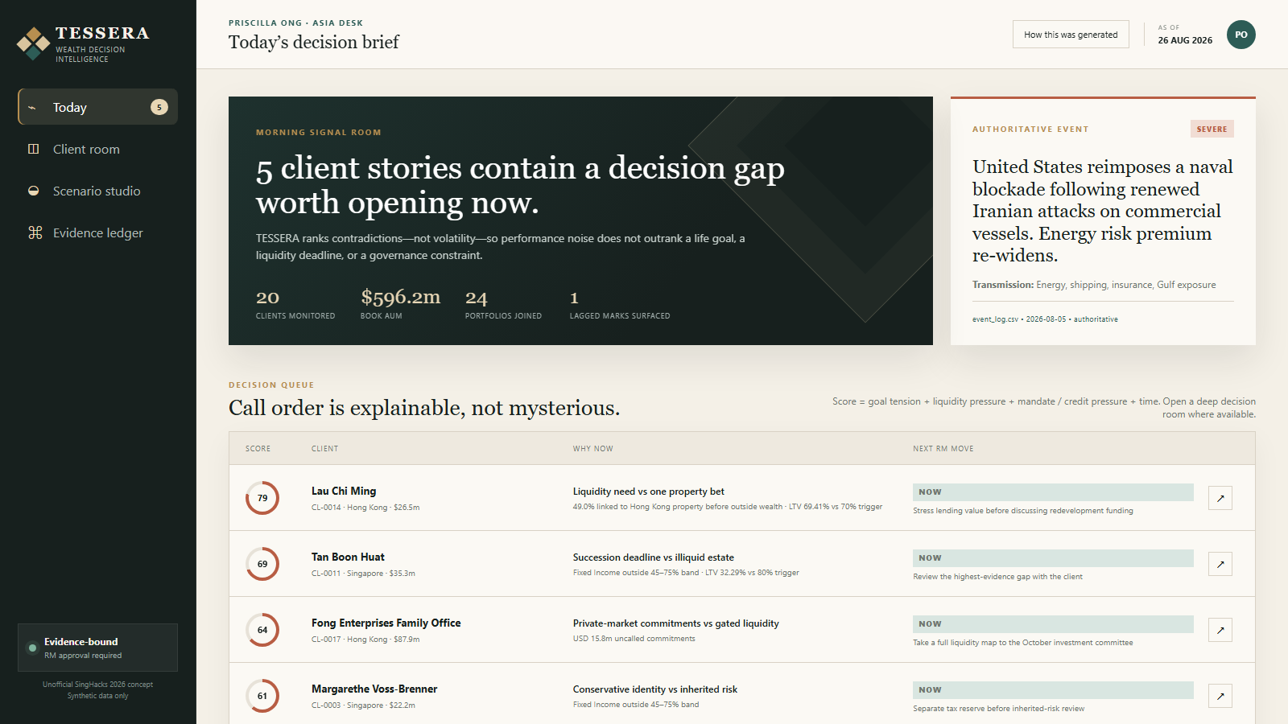
TESSERA
WEALTH DECISION INTELLIGENCE
SINGHACKS 2026 · LIVE PRODUCT
The portfolio report
is not the story.
TESSERA finds the contradiction worth an RM's attention—then grounds the conversation in current evidence, transparent scenarios and policy.
LIVE ON VERCEL · 05 SEP 2026
20
24
5
1
CLIENTS
PORTFOLIOS
SNAPSHOTS
RELATIONSHIP MANAGER
Synthetic challenge data · Scenarios are illustrative, not forecasts · RM approval required
01
Notes:
0:00–0:15 — Twenty clients, one RM, and far more data than one person can review before markets open. A portfolio report can be accurate and still miss the conversation that matters. TESSERA finds that conversation.

Slide 2
OUR USP
We rank client contradictions—not market noise.
Unlike a generic copilot, TESSERA calculates first, retrieves controlled context and leaves the decision with the RM.
01
CONTRADICTION-FIRST
20 / 24
Every client and portfolio ranked
Intent × look-through risk × future needs × policy
02
LOOK-THROUGH
42.1%+
Hidden concentration through the FCN
Portfolio + product + outside-business context
03
EVIDENCE-BOUND
154
Controlled passages prepared for Chroma
Client-scoped + as-of-filtered + source-labelled
CALCULATE FIRST · RETRIEVE RELEVANT EVIDENCE · GENERATE LAST · RM DECIDES
Source: current engine, retrieval corpus and control implementation · verified 05 Sep 2026
02
Notes:
0:15–0:40 — Our USP is simple: we do not rank yesterday’s volatility; we rank contradictions between what the client wants and what the evidence says. These are three curated decision rooms, not the numerical top three: Lau proves concentration plus collateral risk, Abdullah proves look-through and outside-business correlation, and Cheung proves honest handling of conflicting records.

Slide 3
THE TESSERA SYSTEM
Deterministic truth, controlled context and policy become one RM decision loop.
When enabled, Chroma expands recall without changing the facts: calculations and suitability remain deterministic.
01
02
03
04
WHAT CHANGED
WHAT IS HIDDEN
WHAT IS ALLOWED
WHAT WILL THE RM DO
Replay five snapshots; use temporal joins; link only authoritative events.
Look through wrappers; retrieve client-scoped notes, rules and instruments from Chroma.
Apply mandate, liquidity, credit and data checks before any narrative.
Rehearse transparent sensitivities; approve, edit or reject with rationale.
1
2
3
4
EVIDENCE PASSPORT
Source row + as-of date
Retrieval scope + confidence
Mandate + suitability
Scenario assumptions
RM decision + rationale
Architecture · deterministic engine + feature-gated Chroma retrieval + Vercel delivery · no model can override a hard stop
03
Notes:
0:40–1:00 — TESSERA turns fragmented records into four RM questions: what happened, what could happen, what should we consider, and what will the RM say? Suitability and data controls run before wording, every answer carries its evidence passport, and Priscilla remains responsible for the advice.

Slide 4
SCENARIO PROOF · ABDULLAH AL-MANSOORI
Abdullah’s successful thesis recreated the risk he asked us to diversify away from.
42.1%+ is only the bank-held floor; his Gulf business shares the risk, and a USD 5m need starts in 2027.
COUNTERFACTUALS, NOT FORECASTS
LOOK-THROUGH FLOOR
42.1%+
“If the Strait reopened next month, how much of this year’s gain are you willing to give back?”
bank-held shipping & energy exposure
−6.3%
STRAIT REOPENS
Shipping & energy FCN
12.9%
−USD 2.02m
Pacific Orient Shipping
11.4%
Normalization shocks to FCN, shipping and energy
BLOCKADE WORSENS
+4.7%
Global energy majors
8.9%
+USD 1.50m
Asia shipping & logistics
8.9%
Risk-premium extension, no probability assigned
+ Gulf logistics business is qualitative and excluded from the percentage
NEXT RM MOVE
Ring-fence seed capital; map the USD 2.6m cash gap.
Source: holdings.csv · instruments.csv SYN-SP-0505 · event_log.csv 2026-08-05 · scenarios are illustrative
04
Notes:
1:00–1:25 — Abdullah asked to diversify away from Gulf shipping. Yet 42.1% of his bank-held portfolio is linked to shipping and energy after looking through the FCN—and his operating business depends on the same conditions. He also needs USD 5m for a Singapore family office, versus USD 2.4m in cash. His recent gains make this contradiction harder to see. LIVE DEMO 1:25–2:30: open Abdullah’s decision room; show client says / portfolio does / future demands; toggle Strait reopens and blockade worsens; open the evidence passport; finish on ring-fencing the seed capital. Say explicitly that scenarios are sensitivities, not forecasts.

Slide 5
LIVE PROTOTYPE → BANK-SCALE PATH
The trust loop is live; scaling is an integration and governance problem—not an invention problem.
Today's Vercel deployment proves the workflow. Full scale hardens identity, data, policy and operations.
RUNNING NOW
FULL-SCALE EVOLUTION
11
tessera/engine.py
deterministic joins · controls · ranking · scenarios
✓
Read-only connectors to portfolio, CRM, credit and approved events
SOURCE DATASETS JOINED
✓
Private networking, SSO/RBAC and book-level entitlements
20 / 24
tessera/retrieval.py
Chroma Cloud · client scope · as-of guard · feature-gated
✓
Versioned policy-as-code with maker-checker approval
CLIENTS / PORTFOLIOS RANKED
api/ + web/
production app on Vercel
✓
Event-driven scoring plus hybrid exact + semantic retrieval
154
✓
Continuous evaluation for traceability, overrides and drift
CONTROLLED PASSAGES PREPARED
tests/
38 regressions + retrieval fallback coverage
38 / 38
✓
Shadow mode → assisted workflow → approved automation
PYTHON TESTS PASS
LIVE → singhacks-jb-wealth-intelligence.vercel.app
Verified 05 Sep 2026: 38 Python tests · JavaScript syntax · live Vercel health · vector retrieval fails closed
05
Notes:
2:30–2:45 — This is not a slide mock-up. The prototype joins eleven datasets, ranks the full client book, opens a review room for every client, recalculates scenarios, and logs RM decisions. Eighteen tests pass. In production, the adapters change; the evidence, control, and decision workflow remains.

Slide 6
THE CLOSE
Make the portfolio defensible.
Make the future discussable.
Make the RM indispensable.
30-DAY SHADOW PILOT
1 DESK
REAL DECISIONS
TESSERA turns portfolio contradictions into evidence-backed, scenario-aware conversations—while the Relationship Manager remains accountable.
No client-facing automation.
Measure behaviour before expansion.
DEMO
singhacks-jb-wealth-intelligence.vercel.app
SUCCESS = TIME SAVED · TRACEABILITY · OVERRIDE QUALITY
CODE REPOSITORY
github.com/alicia112233/SingHacks2026 · grant judge access if private
ASK: SPONSOR A 30-DAY SHADOW PILOT, THEN SCALE ONLY WHAT THE EVIDENCE SUPPORTS.
Synthetic challenge data · unofficial concept · not investment advice
06
Notes:
2:45–3:00 — TESSERA makes the portfolio defensible, the future discussable, and the RM indispensable. Our ask is a shadow-mode pilot with real RM decisions: prove decision quality first, then earn the right to generate. Stop here for Q&A; slides A1–A3 are backups only. Before submission, replace the visible team-photo, team-name, and public-repository placeholders.

Slide 7
CLIENT PROOF · LAU CHI MING
Four wrappers create one 49.0% property bet—and just 0.59 LTV points remain.
The asset-class report fragments the risk. Look-through and credit math put it back together.
BANK-HELD PORTFOLIO LOOK-THROUGH
THE REPORTED HEADROOM IS NOT THE TRIGGER BUFFER
69.41%
70.00%
Direct Mid-Levels property
19.6%
CURRENT LTV
MARGIN-CALL TRIGGER
TRIGGER
Golden Harbour perpetual
12.9%
CURRENT
Golden Harbour equity
9.5%
HKD 25.56m
HKD 0.71m
Golden Harbour accumulator
7.0%
REPORTED HEADROOM: LENDING VALUE MINUS DRAWN
ACTUAL LENDING-VALUE CUSHION TO 70%
+ operating business exposure outside the dataset
A 0.85% fall in eligible lending value reaches the trigger.
Source: holdings.csv · instruments.csv · credit_facilities.csv CF-0002 · planned_cash_needs.csv CN-013 · synthetic data
A1
Notes:
Q&A BACKUP — Why Lau? Four wrappers create a 49.0% property exposure, HKD 60m is due, and facility LTV sits 0.59 points below the trigger. The real cushion is HKD 0.71m, not the much larger reported headroom field.

Slide 8
TRUST PROOF · CHEUNG KWOK WING
The trustworthy answer begins with: “We need to verify your draw.”
A model that silently picks the convenient number is not an advisory system.
THE RECORDS DISAGREE
CONVERSATION OPEN
USD 1.10m
≠
USD 1.28m
“The issue is not whether the bonds repay—it is whether their timetable still fits yours.”
LATEST RM NOTE · N-016
PLANNED NEED · CN-012
CONFIDENCE ↓ · TURN THE CONFLICT INTO THE FIRST QUESTION
RM-approved draft · no trade instruction
THE LIFE HORIZON AND THE ASSET HORIZON HAVE DRIFTED APART
2026
2038
2045
AGE 71
TODAY
12-YEAR HORIZON
ENDS
LARGEST BOND
MATURES
66.6%
20.8%
1.5 yrs
Value paths include flows; do not call the decline ‘performance’ without attribution.
FIXED INCOME
ONE TREASURY DUE 2045
CASH-ONLY RUNWAY AT USD 1.28M
Source: holdings.csv 2026-08-26 · planned_cash_needs.csv CN-012 · rm_notes.json N-016 · synthetic data
A2
Notes:
Q&A BACKUP — Why Cheung? The planned need and latest RM note conflict. TESSERA does not invent a convenient answer; it lowers confidence and turns verification into the first client question.

Slide 9
GOVERNANCE BY CONSTRUCTION
The model may write the sentence. It cannot choose its own facts—or its own evidence.
Deterministic calculations, scoped Chroma retrieval, policy-before-language and a human ledger make trust architectural.
01
02
03
04
05
06
Bank records
Temporal joins
Policy compiler
Scoped retrieval
Model panel
RM decision
5 snapshots + notes
as-of safe + lag flags
mandate + event authority
client + GLOBAL · as-of safe
source-labelled context
approve / edit / reject
FIVE NON-NEGOTIABLES
01
02
03
04
05
Authoritative events
Suitability first
Conflicts stay visible
Least-privilege context
Human accountability
2026 market claims only from event_log.csv
mandate, exclusions, credit and liquidity before prose
uncertainty becomes a question, never an average
client scope + date guard + purpose-limited packet
decision, edit and rationale remain attached
Prototype governance: 0 duplicate-grain rows · 0 orphan references · 1 lagged mark · 1 surfaced conflict · retrieval feature-gated
A3
Notes:
Q&A BACKUP — How does this fit a bank? Read-only bank records feed temporal joins and a versioned policy compiler. Any language model is purpose-limited and privately hosted. The RM’s approve, edit, or reject decision remains attached to the evidence.

