Slide 1
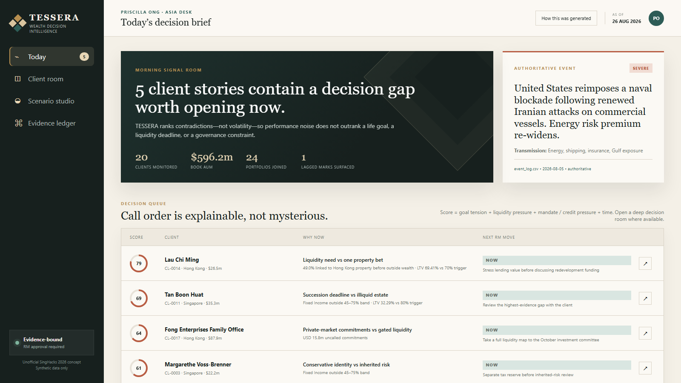
TESSERA
WEALTH DECISION INTELLIGENCE
SINGHACKS 2026 · UNOFFICIAL CONCEPT
The portfolio report
is not the story.
TESSERA finds the contradiction that deserves a conversation—then makes the evidence, scenario and next move inspectable.
RUNNING PROTOTYPE · 26 AUG 2026
20
24
5
1
CLIENTS
PORTFOLIOS
SNAPSHOTS
RELATIONSHIP MANAGER
Synthetic challenge data · Scenarios are illustrative, not forecasts · RM approval required
01
Notes:
0:00–0:15 — Twenty clients, one RM, and far more data than one person can review before markets open. A portfolio report can be accurate and still miss the conversation that matters. TESSERA finds that conversation.

Slide 2
OUR USP
We rank client contradictions—not market noise.
Then we go deep on three distinct, defensible decision rooms—with every claim traceable to evidence.
A
LAU CHI MING
49.0%+
Four wrappers of Hong Kong property
HKD 60m due; LTV 69.41% vs 70%
B
ABDULLAH AL-MANSOORI
42.1%+
Shipping & energy after FCN look-through
Portfolio meant to diversify Gulf business
C
CHEUNG KWOK WING
2045
Longest bond maturity
Age 71; annual draw amount conflicts
DECISION GAP = INTENT × LOOK-THROUGH RISK × FUTURE NEEDS × POLICY
Source: TESSERA calculations from current holdings, instruments, facilities, cash needs and RM notes · 26 Aug 2026
02
Notes:
0:15–0:40 — Our USP is simple: we do not rank yesterday’s volatility; we rank contradictions between what the client wants and what the evidence says. These are three curated decision rooms, not the numerical top three: Lau proves concentration plus collateral risk, Abdullah proves look-through and outside-business correlation, and Cheung proves honest handling of conflicting records.

Slide 3
THE TESSERA SYSTEM
Time, context and policy become one RM-controlled decision loop.
Four questions organize the product; one evidence passport travels with every answer.
01
02
03
04
WHAT HAPPENED
WHAT COULD HAPPEN
WHAT SHOULD WE CONSIDER
WHAT WILL THE RM SAY
Replay five snapshots; separate value path from performance; link only controlled events.
Look through instruments; expose assumptions; rehearse both sides of a scenario.
Compile reversible options after mandate, liquidity, credit and data checks.
Draft the opening, proof, question and caveat; approve, edit or reject.
1
2
3
4
EVIDENCE PASSPORT
Source row + as-of date
Authority + confidence
Mandate + suitability
Scenario assumptions
RM decision + rationale
Product architecture · deterministic evidence compiler in prototype; purpose-limited private model in production
03
Notes:
0:40–1:00 — TESSERA turns fragmented records into four RM questions: what happened, what could happen, what should we consider, and what will the RM say? Suitability and data controls run before wording, every answer carries its evidence passport, and Priscilla remains responsible for the advice.

Slide 4
SCENARIO PROOF · ABDULLAH AL-MANSOORI
Abdullah’s successful thesis recreated the risk he asked us to diversify away from.
42.1%+ is only the bank-held floor; his Gulf business shares the risk, and a USD 5m need starts in 2027.
COUNTERFACTUALS, NOT FORECASTS
LOOK-THROUGH FLOOR
42.1%+
“If the Strait reopened next month, how much of this year’s gain are you willing to give back?”
bank-held shipping & energy exposure
−6.3%
STRAIT REOPENS
Shipping & energy FCN
12.9%
−USD 2.02m
Pacific Orient Shipping
11.4%
Normalization shocks to FCN, shipping and energy
BLOCKADE WORSENS
+4.7%
Global energy majors
8.9%
+USD 1.50m
Asia shipping & logistics
8.9%
Risk-premium extension, no probability assigned
+ Gulf logistics business is qualitative and excluded from the percentage
NEXT RM MOVE
Ring-fence seed capital; map the USD 2.6m cash gap.
Source: holdings.csv · instruments.csv SYN-SP-0505 · event_log.csv 2026-08-05 · scenarios are illustrative
04
Notes:
1:00–1:25 — Abdullah asked to diversify away from Gulf shipping. Yet 42.1% of his bank-held portfolio is linked to shipping and energy after looking through the FCN—and his operating business depends on the same conditions. He also needs USD 5m for a Singapore family office, versus USD 2.4m in cash. His recent gains make this contradiction harder to see. LIVE DEMO 1:25–2:30: open Abdullah’s decision room; show client says / portfolio does / future demands; toggle Strait reopens and blockade worsens; open the evidence passport; finish on ring-fencing the seed capital. Say explicitly that scenarios are sensitivities, not forecasts.

Slide 5
WORKING PROTOTYPE
The trust-critical loop is working end to end—not mocked in slides.
A dependency-light prototype recalculates the evidence bundle directly from the supplied files on every request.
RUNNING SYSTEM
IMPLEMENTED DECISION LOOP
11
app.py
local API + static server
✓
Five-snapshot replay with no performance overclaim
SOURCE DATASETS JOINED
✓
Cross-portfolio + structured-product look-through
20 / 24
tessera/engine.py
joins · checks · ranking · scenarios · evidence
✓
Mandate, exclusion, liquidity, credit and data checks
CLIENTS / PORTFOLIOS RANKED
web/
interactive RM workbench
✓
Transparent scenario sensitivities—no probabilities
3
✓
Conversation brief + evidence passport
DEEP DECISION ROOMS
tests/
regression suite for calculations and control logic
18 / 18
✓
RM approve / edit actions logged in demo state
PYTHON TESTS PASS
python app.py → localhost:8000
Verification: 18 Python tests pass · JavaScript syntax check passes · local HTTP health and API endpoints pass
05
Notes:
2:30–2:45 — This is not a slide mock-up. The prototype joins eleven datasets, ranks the full client book, opens a review room for every client, recalculates scenarios, and logs RM decisions. Eighteen tests pass. In production, the adapters change; the evidence, control, and decision workflow remains.

Slide 6
THE CLOSE
Make the portfolio defensible.
Make the future discussable.
Make the RM indispensable.
TEAM PICTURE
INSERT REAL
GROUP PHOTO
TESSERA turns portfolio contradictions into evidence-backed, scenario-aware conversations—with the Relationship Manager always in control.
No team image was present in the repository.
Replace this editable placeholder before hand-in.
DEMO
python app.py → localhost:8000
TEAM NAME · MEMBER NAMES
CODE REPOSITORY
This submission repository · replace with public review URL if needed
ASK: PILOT TESSERA IN SHADOW MODE WITH REAL RM DECISIONS, THEN EARN THE RIGHT TO GENERATE.
Synthetic challenge data · unofficial concept · not investment advice
06
Notes:
2:45–3:00 — TESSERA makes the portfolio defensible, the future discussable, and the RM indispensable. Our ask is a shadow-mode pilot with real RM decisions: prove decision quality first, then earn the right to generate. Stop here for Q&A; slides A1–A3 are backups only. Before submission, replace the visible team-photo, team-name, and public-repository placeholders.

Slide 7
CLIENT PROOF · LAU CHI MING
Four wrappers create one 49.0% property bet—and just 0.59 LTV points remain.
The asset-class report fragments the risk. Look-through and credit math put it back together.
BANK-HELD PORTFOLIO LOOK-THROUGH
THE REPORTED HEADROOM IS NOT THE TRIGGER BUFFER
69.41%
70.00%
Direct Mid-Levels property
19.6%
CURRENT LTV
MARGIN-CALL TRIGGER
TRIGGER
Golden Harbour perpetual
12.9%
CURRENT
Golden Harbour equity
9.5%
HKD 25.56m
HKD 0.71m
Golden Harbour accumulator
7.0%
REPORTED HEADROOM: LENDING VALUE MINUS DRAWN
ACTUAL LENDING-VALUE CUSHION TO 70%
+ operating business exposure outside the dataset
A 0.85% fall in eligible lending value reaches the trigger.
Source: holdings.csv · instruments.csv · credit_facilities.csv CF-0002 · planned_cash_needs.csv CN-013 · synthetic data
A1
Notes:
Q&A BACKUP — Why Lau? Four wrappers create a 49.0% property exposure, HKD 60m is due, and facility LTV sits 0.59 points below the trigger. The real cushion is HKD 0.71m, not the much larger reported headroom field.

Slide 8
TRUST PROOF · CHEUNG KWOK WING
The trustworthy answer begins with: “We need to verify your draw.”
A model that silently picks the convenient number is not an advisory system.
THE RECORDS DISAGREE
CONVERSATION OPEN
USD 1.10m
≠
USD 1.28m
“The issue is not whether the bonds repay—it is whether their timetable still fits yours.”
LATEST RM NOTE · N-016
PLANNED NEED · CN-012
CONFIDENCE ↓ · TURN THE CONFLICT INTO THE FIRST QUESTION
RM-approved draft · no trade instruction
THE LIFE HORIZON AND THE ASSET HORIZON HAVE DRIFTED APART
2026
2038
2045
AGE 71
TODAY
12-YEAR HORIZON
ENDS
LARGEST BOND
MATURES
66.6%
20.8%
1.5 yrs
Value paths include flows; do not call the decline ‘performance’ without attribution.
FIXED INCOME
ONE TREASURY DUE 2045
CASH-ONLY RUNWAY AT USD 1.28M
Source: holdings.csv 2026-08-26 · planned_cash_needs.csv CN-012 · rm_notes.json N-016 · synthetic data
A2
Notes:
Q&A BACKUP — Why Cheung? The planned need and latest RM note conflict. TESSERA does not invent a convenient answer; it lowers confidence and turns verification into the first client question.

Slide 9
GOVERNANCE BY CONSTRUCTION
The model may write the sentence. It cannot choose its own facts.
Purpose-limited evidence, policy-before-language and a human decision ledger make trust part of the architecture.
01
02
03
04
05
06
Bank records
Temporal joins
Policy compiler
Evidence bundle
Private model
RM decision
5 snapshots + notes
as-of safe + lag flags
mandate + event authority
minimum relevant rows
narrative inside bank
approve / edit / reject
FIVE NON-NEGOTIABLES
01
02
03
04
05
Authoritative events
Suitability first
Conflicts stay visible
Zero public-LLM egress
Human accountability
2026 market claims only from event_log.csv
mandate, exclusions, credit and liquidity before prose
uncertainty becomes a question, never an average
private deployment + purpose-limited evidence
decision, edit and rationale remain attached
Prototype governance: 0 duplicate-grain rows · 0 orphan references · 1 lagged mark · 1 surfaced record conflict
A3
Notes:
Q&A BACKUP — How does this fit a bank? Read-only bank records feed temporal joins and a versioned policy compiler. Any language model is purpose-limited and privately hosted. The RM’s approve, edit, or reject decision remains attached to the evidence.

