Slide 1
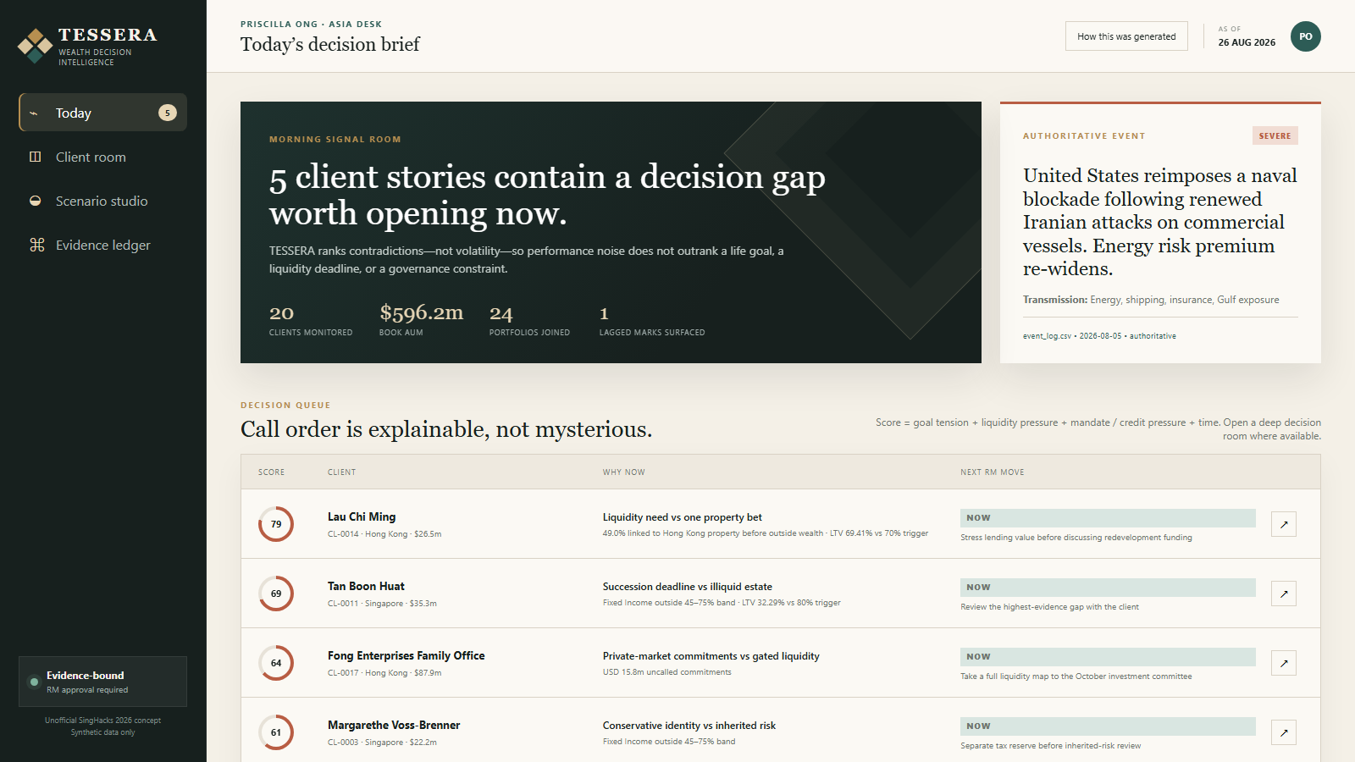
TESSERA
WEALTH DECISION INTELLIGENCE
SINGHACKS 2026 · UNOFFICIAL CONCEPT
The portfolio report
is not the story.
TESSERA finds the contradiction that deserves a conversation—then makes the evidence, scenario and next move inspectable.
RUNNING PROTOTYPE · 26 AUG 2026
20
24
5
1
CLIENTS
PORTFOLIOS
SNAPSHOTS
RELATIONSHIP MANAGER
Synthetic challenge data · Scenarios are illustrative, not forecasts · RM approval required
01

Slide 2
THE PROBLEM
A static report can be accurate—and still miss the decision that matters.
Private-wealth decisions live across client language, instrument behavior, future liabilities and policy—not inside one performance chart.
CLIENT SAYS
PORTFOLIO DOES
FUTURE DEMANDS
THE
DECISION
GAP
“I do not want to sell anything at a loss.”
66.6% fixed income; 20.8% in one Treasury due 2045.
Annual draw recorded as both USD 1.10m and USD 1.28m.
Verify the need before recommending the trade.
ONE CLIENT DECISION CROSSES
CLIENTS
HOLDINGS
INSTRUMENTS
CASH NEEDS
RM NOTES
EVENTS
MANDATE
Today’s tools usually describe each source. The RM still has to synthesize the contradiction—manually, repeatedly and under time pressure.
Source: clients.csv · holdings.csv · planned_cash_needs.csv · rm_notes.json · synthetic data
02

Slide 3
THE PRODUCT INSIGHT
Contradictions are the highest-signal unit of advice.
TESSERA ranks the gap between a client’s story and the evidence—not whichever asset moved most yesterday.
01
LAU CHI MING
49.0%+
Four wrappers of Hong Kong property
HKD 60m due; LTV 69.41% vs 70%
02
ABDULLAH AL-MANSOORI
42.1%+
Shipping & energy after FCN look-through
Portfolio meant to diversify Gulf business
03
CHEUNG KWOK WING
2045
Longest bond maturity
Age 71; annual draw amount conflicts
DECISION GAP = INTENT × PORTFOLIO × FUTURE × POLICY
Source: TESSERA calculations from current holdings, instruments, facilities, cash needs and RM notes · 26 Aug 2026
03

Slide 4
THE TESSERA SYSTEM
Time, context and policy become one RM-controlled decision loop.
Three questions organize the product; one evidence passport travels with every answer.
01
02
03
04
WHAT HAPPENED
WHAT COULD HAPPEN
WHAT SHOULD WE CONSIDER
WHAT WILL THE RM SAY
Replay five snapshots; separate value path from performance; link only controlled events.
Look through instruments; expose assumptions; rehearse both sides of a scenario.
Compile reversible options after mandate, liquidity, credit and data checks.
Draft the opening, proof, question and caveat; approve, edit or reject.
1
2
3
4
EVIDENCE PASSPORT
Source row + as-of date
Authority + confidence
Mandate + suitability
Scenario assumptions
RM decision + rationale
Product architecture · deterministic evidence compiler in prototype; purpose-limited private model in production
04

Slide 5
THE RM EXPERIENCE
One RM can see the five conversations that matter before markets open.
05
CAPACITY-AWARE
WHY NOW IS VISIBLE
Only five conversations enter Now.
Every score opens into exact evidence and the next RM move.

Slide 6
CLIENT PROOF · LAU CHI MING
Four wrappers create one 49.0% property bet—and just 0.59 LTV points remain.
The asset-class report fragments the risk. Look-through and credit math put it back together.
BANK-HELD PORTFOLIO LOOK-THROUGH
THE REPORTED HEADROOM IS NOT THE TRIGGER BUFFER
69.41%
70.00%
Direct Mid-Levels property
19.6%
CURRENT LTV
MARGIN-CALL TRIGGER
TRIGGER
Golden Harbour perpetual
12.9%
CURRENT
Golden Harbour equity
9.5%
HKD 25.56m
HKD 0.71m
Golden Harbour accumulator
7.0%
REPORTED HEADROOM: LENDING VALUE MINUS DRAWN
ACTUAL LENDING-VALUE CUSHION TO 70%
+ operating business exposure outside the dataset
A 0.85% fall in eligible lending value reaches the trigger.
Source: holdings.csv · instruments.csv · credit_facilities.csv CF-0002 · planned_cash_needs.csv CN-013 · synthetic data
06

Slide 7
SCENARIO PROOF · ABDULLAH AL-MANSOORI
The diversification portfolio quietly became a second shipping-and-energy bet.
Recent gains make the contradiction harder to see—and more important to rehearse in both directions.
COUNTERFACTUALS, NOT FORECASTS
LOOK-THROUGH FLOOR
42.1%+
“If the Strait reopened next month, how much of this year’s gain are you willing to give back?”
bank-held shipping & energy exposure
−6.3%
STRAIT REOPENS
Shipping & energy FCN
12.9%
−USD 2.02m
Pacific Orient Shipping
11.4%
Normalization shocks to FCN, shipping and energy
BLOCKADE WORSENS
+4.7%
Global energy majors
8.9%
+USD 1.50m
Asia shipping & logistics
8.9%
Risk-premium extension, no probability assigned
+ Gulf logistics business is qualitative and excluded from the percentage
NEXT RM MOVE
Ring-fence USD 5m of 2027 seed capital before extending the thesis.
Source: holdings.csv · instruments.csv SYN-SP-0505 · event_log.csv 2026-08-05 · scenarios are illustrative
07

Slide 8
TRUST PROOF · CHEUNG KWOK WING
The trustworthy answer begins with: “We need to verify your draw.”
A model that silently picks the convenient number is not an advisory system.
THE RECORDS DISAGREE
CONVERSATION OPEN
USD 1.10m
≠
USD 1.28m
“The issue is not whether the bonds repay—it is whether their timetable still fits yours.”
LATEST RM NOTE · N-016
PLANNED NEED · CN-012
CONFIDENCE ↓ · TURN THE CONFLICT INTO THE FIRST QUESTION
RM-approved draft · no trade instruction
THE LIFE HORIZON AND THE ASSET HORIZON HAVE DRIFTED APART
2026
2038
2045
AGE 71
TODAY
12-YEAR HORIZON
ENDS
LARGEST BOND
MATURES
66.6%
20.8%
1.5 yrs
Value paths include flows; do not call the decline ‘performance’ without attribution.
FIXED INCOME
ONE TREASURY DUE 2045
CASH-ONLY RUNWAY AT USD 1.28M
Source: holdings.csv 2026-08-26 · planned_cash_needs.csv CN-012 · rm_notes.json N-016 · synthetic data
08

Slide 9
GOVERNANCE BY CONSTRUCTION
The model may write the sentence. It cannot choose its own facts.
Purpose-limited evidence, policy-before-language and a human decision ledger make trust part of the architecture.
01
02
03
04
05
06
Bank records
Temporal joins
Policy compiler
Evidence bundle
Private model
RM decision
5 snapshots + notes
as-of safe + lag flags
mandate + event authority
minimum relevant rows
narrative inside bank
approve / edit / reject
FIVE NON-NEGOTIABLES
01
02
03
04
05
Authoritative events
Suitability first
Conflicts stay visible
Zero public-LLM egress
Human accountability
2026 market claims only from event_log.csv
mandate, exclusions, credit and liquidity before prose
uncertainty becomes a question, never an average
private deployment + purpose-limited evidence
decision, edit and rationale remain attached
Prototype governance: 0 duplicate-grain rows · 0 orphan references · 1 lagged mark · 1 surfaced record conflict
09

Slide 10
WORK DONE SO FAR
The trust-critical loop is working end to end—not mocked in slides.
A dependency-light prototype recalculates the evidence bundle directly from the supplied files on every request.
RUNNING SYSTEM
IMPLEMENTED DECISION LOOP
11
app.py
local API + static server
✓
Five-snapshot replay with no performance overclaim
SOURCE DATASETS JOINED
✓
Cross-portfolio + structured-product look-through
20 / 24
tessera/engine.py
joins · checks · ranking · scenarios · evidence
✓
Mandate, exclusion, liquidity, credit and data checks
CLIENTS / PORTFOLIOS RANKED
web/
interactive RM workbench
✓
Transparent scenario sensitivities—no probabilities
3
✓
Conversation brief + evidence passport
DEEP DECISION ROOMS
tests/
regression suite for calculations and control logic
8 / 8
✓
RM approve / edit actions logged in demo state
ANALYTICAL & GOVERNANCE TESTS
python app.py → localhost:8000
Verification: Python unit tests 8/8 pass · JavaScript syntax check passes · local HTTP health and API endpoints pass
10

Slide 11
FROM PROTOTYPE TO PILOT
A 12-week shadow-to-live pilot can prove decision quality before scaling generation.
Start with RM decisions and evidence quality; only then optimize language, scale and commercial outcomes.
PROPOSED PILOT
01
WEEKS 1–4
02
WEEKS 5–8
03
WEEKS 9–12
Historical replay
Shadow mode
Controlled live
3 RMs · ~60 clients
Tune contradictions against known decisions; no client output.
Compare queue with RM judgement.
Record false positives, omissions and overrides.
Draft briefs for selected meetings.
RM approval mandatory; compliance samples the ledger.
VALUE HYPOTHESIS TO TEST
Better signal selection
→
Faster meeting prep
→
More timely conversations
→
Trust + risk control
fewer noisy alerts
evidence already compiled
right client, right moment
retention, engagement, conduct
MEASURE: minutes to brief · evidence coverage · RM override rate · priority conversations completed · suitability exceptions
Pilot scope and measures are proposals, not achieved adoption or financial results
11

Slide 12
THE CLOSE
Make the portfolio defensible.
Make the future discussable.
Make the RM indispensable.
TEAM PICTURE
INSERT REAL
GROUP PHOTO
TESSERA turns portfolio contradictions into evidence-backed, scenario-aware conversations—with the Relationship Manager always in control.
No team image was present in the repository.
Replace this editable placeholder before hand-in.
DEMO
python app.py → localhost:8000
TEAM NAME · MEMBER NAMES
CODE REPOSITORY
This submission repository · replace with public review URL if needed
ASK: PILOT TESSERA IN SHADOW MODE WITH REAL RM DECISIONS, THEN EARN THE RIGHT TO GENERATE.
Synthetic challenge data · unofficial concept · not investment advice
12

