Slide 1
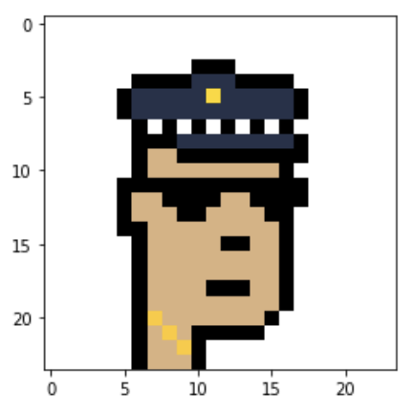
.
.
.
“Male”
.
.
.
.
.
.
.
.
.
.
.
.
.
.
.
“Female”
0
0
0
0
0
1
1
1
0
0
“Other”
1
1
1
1
0
1
1
1
1
0
1
0
1
0
0
24 x 24 x 4
bitmap image
(24 pixels x 24 pixels
with 4 bits for color*)
* 4 bits reproduces a
color palette of 16 colors
Conv2D
32, 5 x 5
relu
Conv2D
32, 5 x 5
relu
Dense
1,000
relu
Dense
500
relu
Dense
250
relu
Dense
3
softmax
MaxPooling
2 x 2
MaxPooling
2 x 2
Flatten
Bitmap normalization
(each pixel is represented numerically by a color value 0-255 inside a numpy array. Normalization is achieved by dividing each number by 255.
Dropout
50%
Dropout
50%
INPUT
CONVOLUTIONAL LAYERS
NEURAL NETWORK LAYERS
OUTPUT LAYER

