Slide 1

The interactive game to save energy, cut bills, and promote sustainability!

Slide 2
What is our game?
We have created a game in Unity where our avatar runs around the MCS building in the hopes of saving Energy by interacting with various appliances and objects around the building such as Computers, Kettles, Windows, Radiators and Light Switches.
The avatar is tasked with trying to keep the energy counter below a certain threshold to score a rank at the end of the game of either A, B, C or D.
The appliances will react in accordance to the data obtained from the sensors that have been scattered around the MCS building.

Slide 3
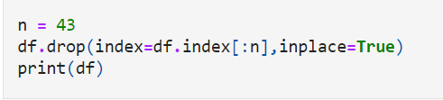
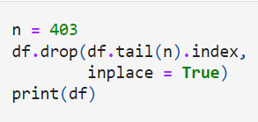
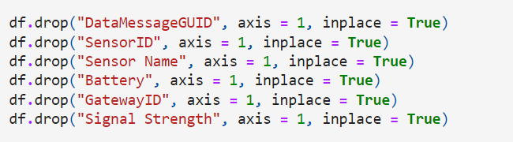
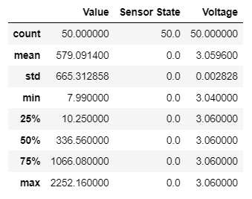
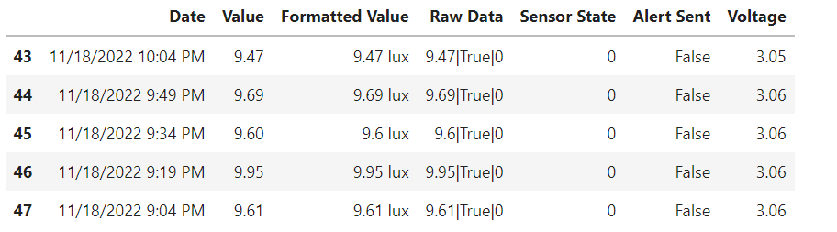
How Have we collected data?
We have used Scikit learn and various statistical methods to obtain various values such as the mean, Maximum and minimum and various graphs from the sensors to draw patterns.
We Firstly cleaned up the datasets and took subsets from the arbitrarily chosen day of the 18/11/22, and specifically chosen a 12 hour period usually consisting of 9am to 9pm to ignore data from overnight as it tended to cause the data to shift one way or another as it usually tended towards 0.

Slide 4
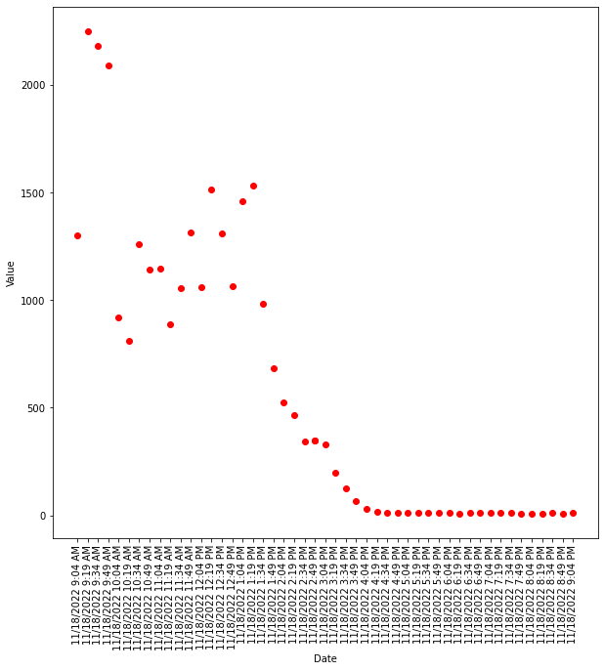
Example of how data has been used to influence the game
Scatter graph showing the light values obtained by the sensors, and it is shown that the lights are at their peak at the start of their day and then gradually decrease until around after 5pm where it starts to plateau and hits a minimum of 7.99
With this data we have created the game so that the chances of lights being on around 9am will be the highest, and then it will fluctuate randomly between the mean value between 10am – 3pm and then begin to plateau 4pm onwards.

Slide 5


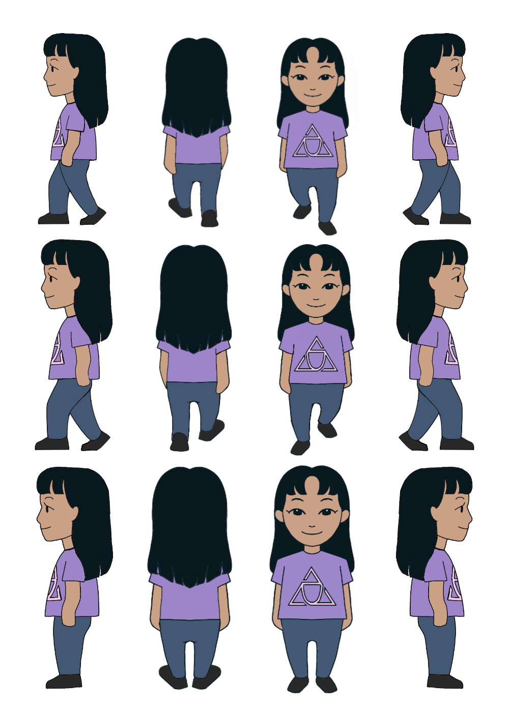



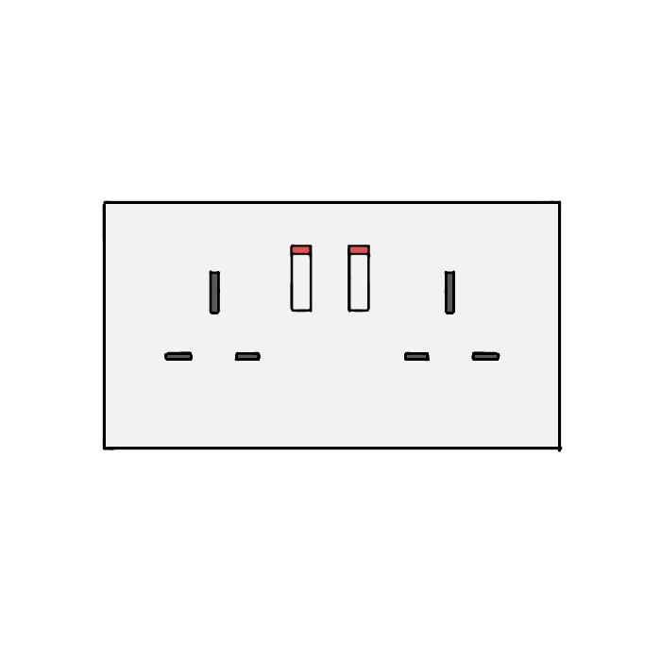
Sprites in game
All sprites and assets in the game have been hand drawn by our incredibly talented team member Hannah! Here is the drawing of our main avatar character and some of the icons with their on/off animations!

