Slide 1
2010
Ale001
2011
Ale001
Par003
Vår004
Her004
Ler010
Her005-Her003-Göt009b
Ale001-Vår009-Göt009a
Göt016
Par003
Vår004
Vår009
Ler010
Her004
Ale001
Her003-Göt009a-Her005
Göt009b-Göt016
Göt009a
Göt009a
Göt009b
Göt009b
10
Göt016
20
Göt016
Her003
Her003
Number of eggs
Number of eggs
5
Her004
10
Her004
Her005
Her005
Ler010
Ler010
0
Par003
0
Par003
1
2
3
4
5
Vår004
1
2
3
4
5
Vår004
Phenology index
Vår009
Phenology index
Vår009
Ale001
Ale001
Par003
Vår004
Her004
Ler010
Her005-Göt009b-Her003
Ale001-Göt009a-Vår009
Göt016
Par003
Vår004
Ler010-Vår009-Her004
Ale001-Her005-Göt009a
Her003-Göt009b-Göt016
Göt009a
40
Göt009a
15
Göt009b
Göt009b
Göt016
30
Göt016
10
Her003
Her003
Number of eggs
Number of eggs
Her004
20
Her004
5
Her005
Her005
10
Ler010
Ler010
0
Par003
0
Par003
1
2
3
4
5
6
Vår004
1
2
3
4
5
6
Vår004
Most advanced bud
Vår009
Most advanced bud
Vår009

Slide 2
2010
Ale001
2011
I*
J*
F*
H*
G*-C*-E
A*-B*-K
D
Göt009a
I*
J*
K*-H*-F*
A*-G*-B*
E*-C*-D*
15
40
Göt009b
Göt016
30
10
Her003
Number of eggs
Number of eggs
Her004
20
5
Her005
10
Ler010
0
Par003
0
1
2
3
4
5
6
Vår004
1
2
3
4
5
6
Late flowering
Early flowering
Vår009
Late flowering
Early flowering
Phenology
Phenology

Slide 3
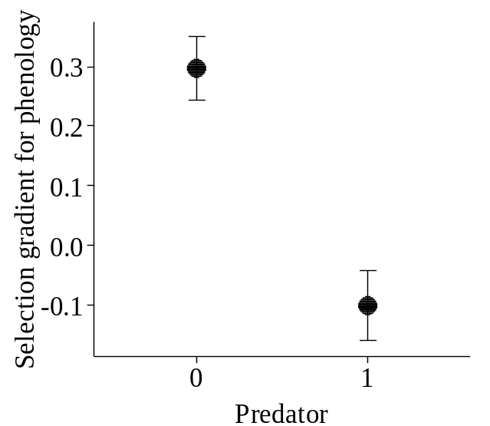
2010
p = 0.001
2011
p < 0.001
A)
B)
0.2
0.1
Selection gradient for phenology
(early flowering)
0.0
-0.1
-0.2
0
1
p = 0.750
p = 0.040
0.15
0.10
0.2
Selection gradient for shoot height
0.0
0.05
-0.2
0
1
0
1
M. alcon
M. alcon

Slide 4
2010
R² = 0.001; p = 0.846
2011
R² = 0.265; p = 0.105
A)
B)
0.2
0.0
0.0
Selection gradient for
phenology (early flowering)
-0.2
-0.2
-0.4
-0.4
-0.6
0
1
2
3
4
0
2
4
6
8
10
12
R² = 0.583; p = 0.006
R² = 0.166; p = 0.214
0.8
1.2
Selection gradient for
flower number
0.8
0.4
0.4
0.0
0.0
0
1
2
3
4
0
2
4
6
8
10
12
Mean number of eggs

Slide 5
p = 0.045
0.8
M. alcon presence
0.4
0.0
-3
-1
0
1
2
3
Myrmica abundance (log)

Slide 6
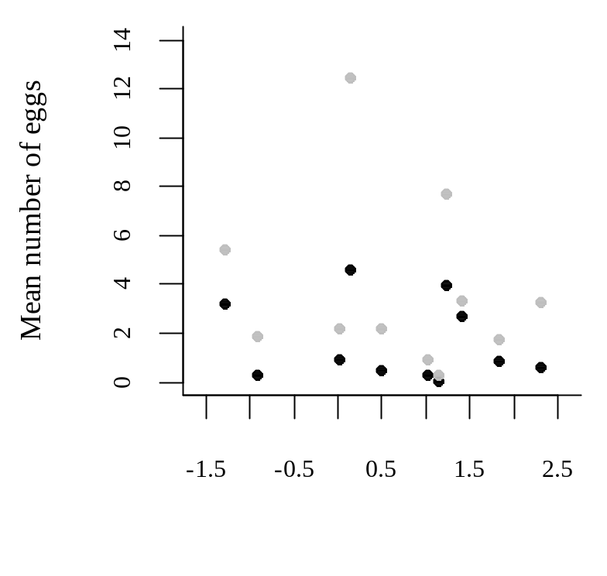
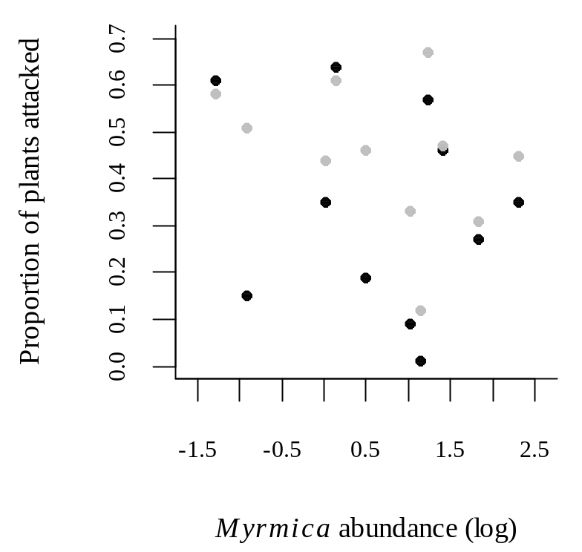
A)
B)
C)
1.0
e
0.8
c
n
e
s
e
r
0.6
p
n
o
c
0.4
l
a
.
P
0.2
0.0
-4
-2
0
2
4

Slide 7
1.0
e
0.8
c
n
e
s
e
r
0.6
p
n
o
c
0.4
l
a
.
P
0.2
0.0
-4
-2
0
2
4
Myrmica abundance (log)

Slide 8
Additional analyses
2010
p < 0.001
2011
p < 0.001
A)
B)
0.4
0.4
0.2
0.2
Selection gradient for
phenology (early flowering)
0.0
0.0
-0.2
-0.2
0
1
0
1
p = 0.850
p = 0.046
0.4
0.4
0.2
0.2
Selection gradient for
shoot height
0.0
0.0
-0.2
-0.2
0
1
0
1
M. alcon
M. alcon

Slide 9
Additional analyses

Slide 10
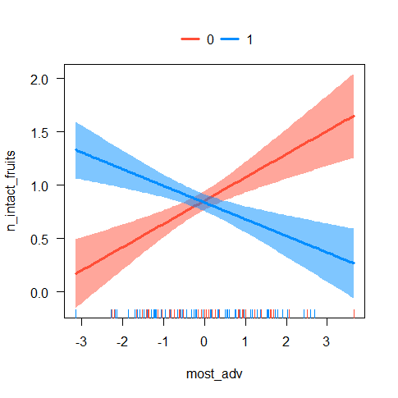
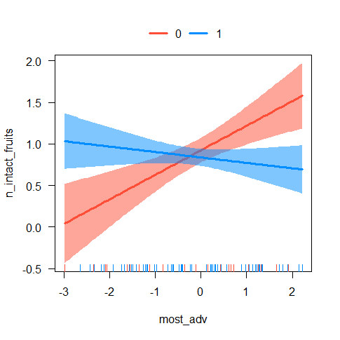
2010
2011

Slide 11
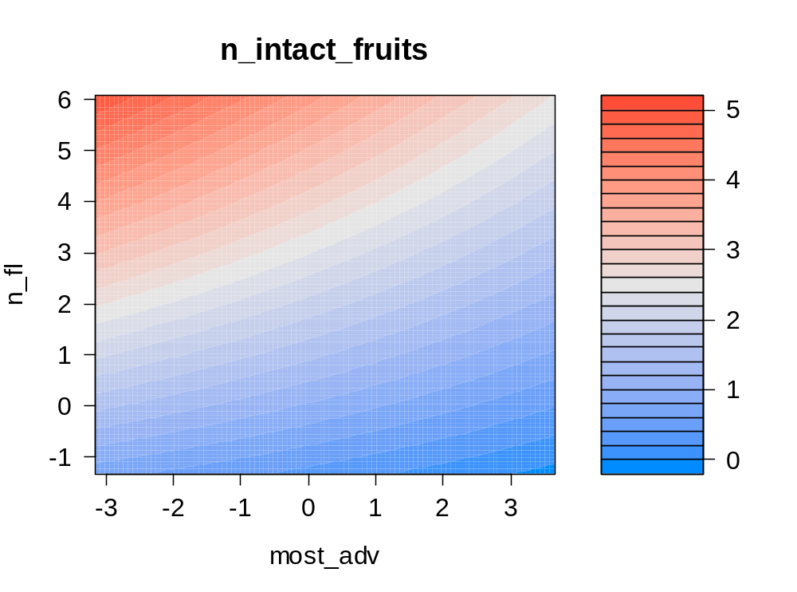
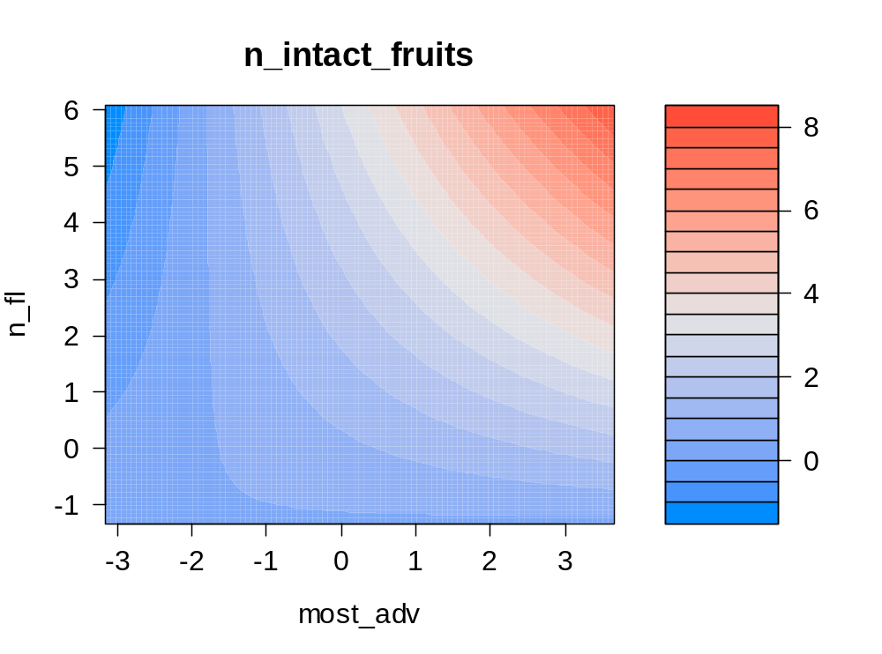
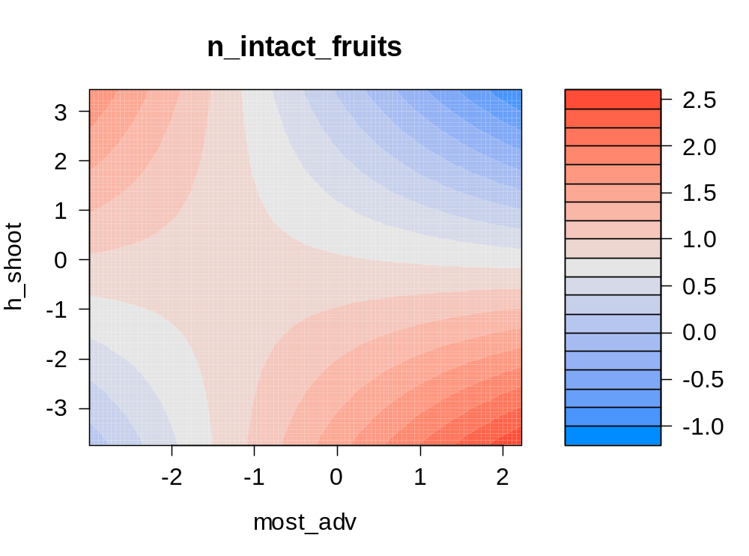
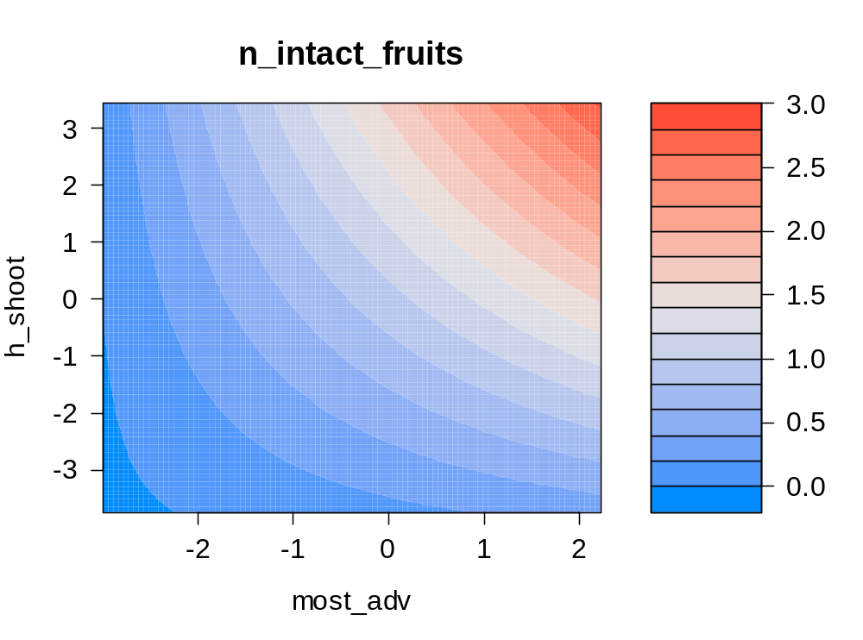
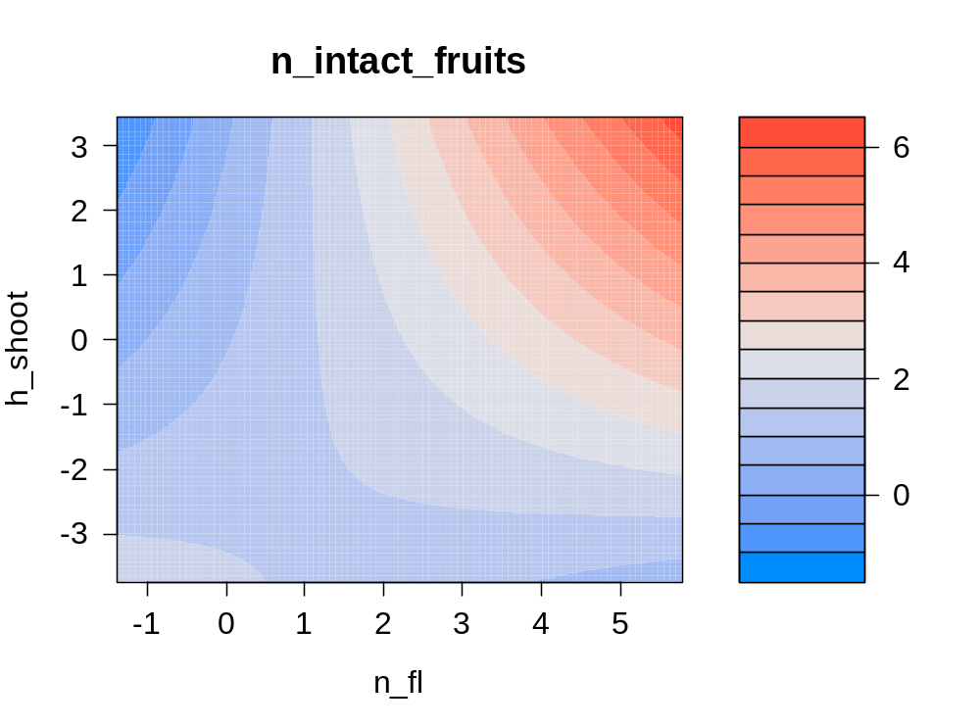
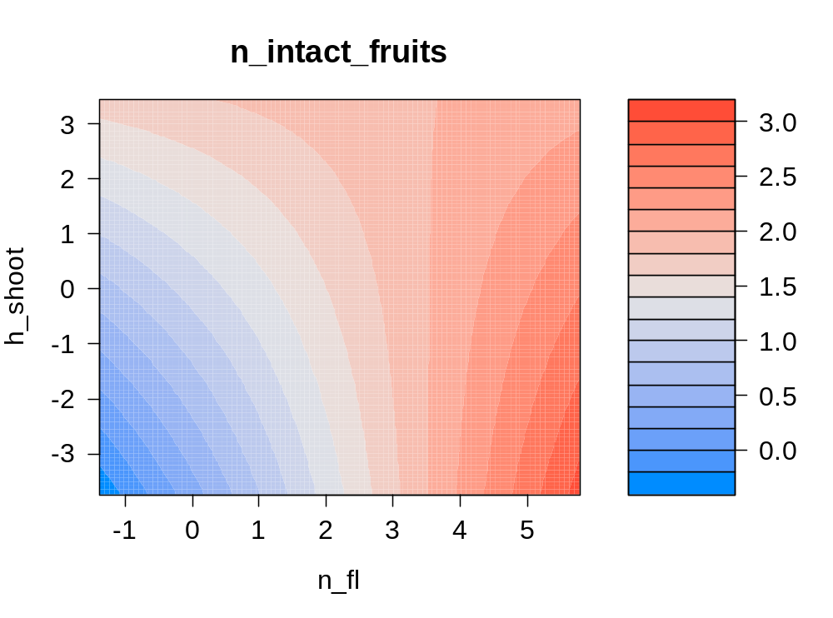
With predator
Without predator
A)
B)
C)

Slide 12
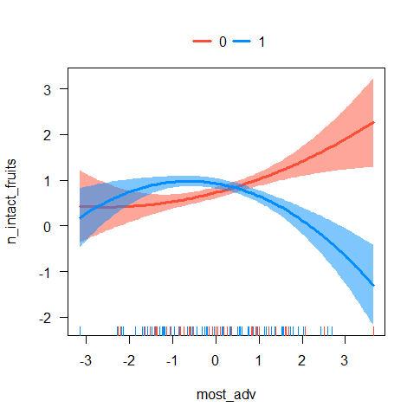
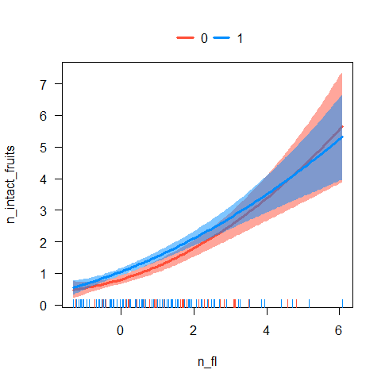
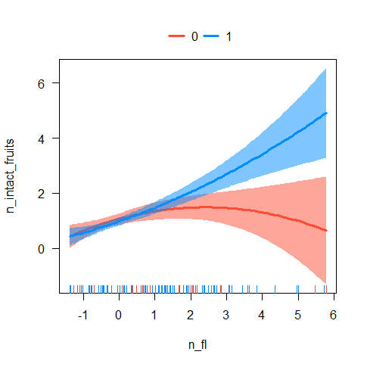
A)
B)
2010
2010
2011

Slide 13
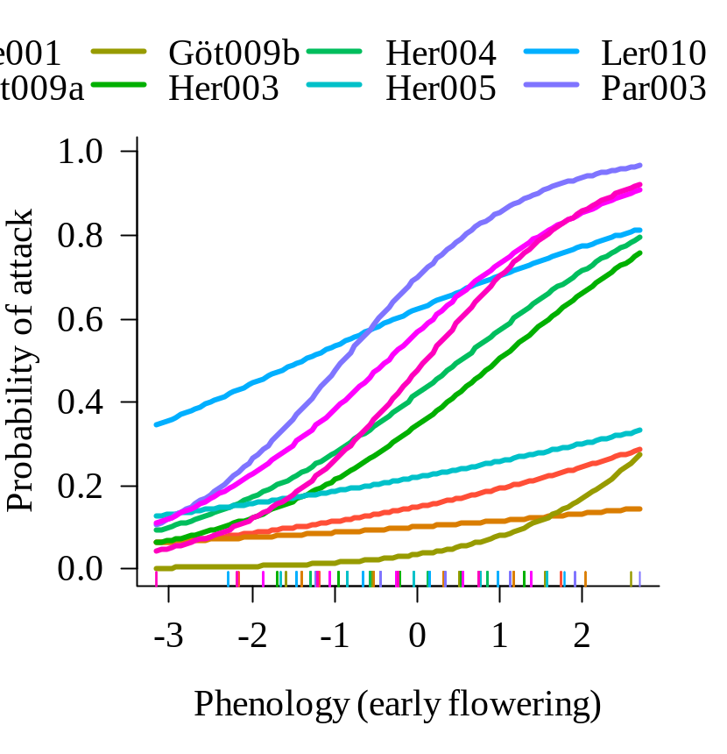
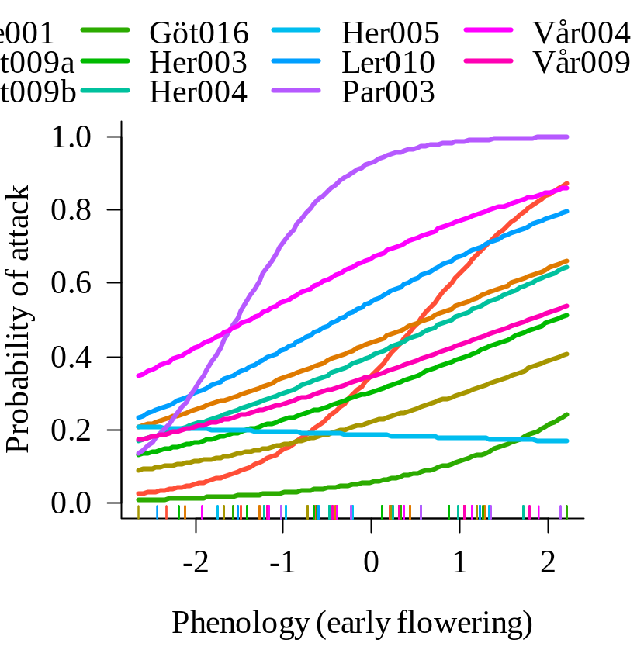
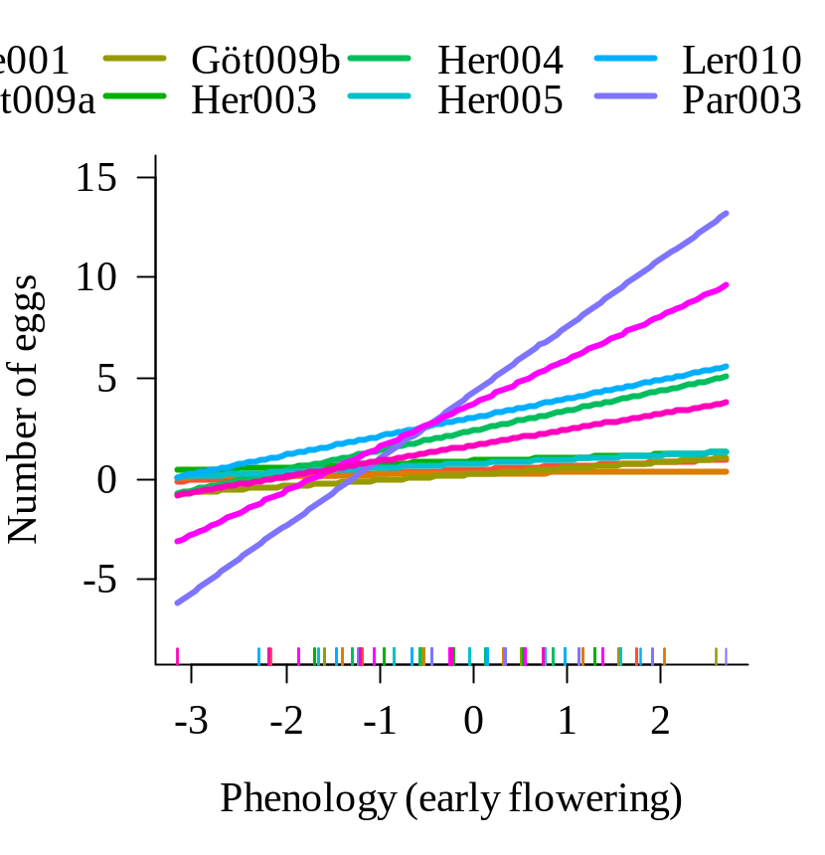
2010
2011
A)
B)
A
B
C
D
E
F
G
H
I
J
K

Slide 14
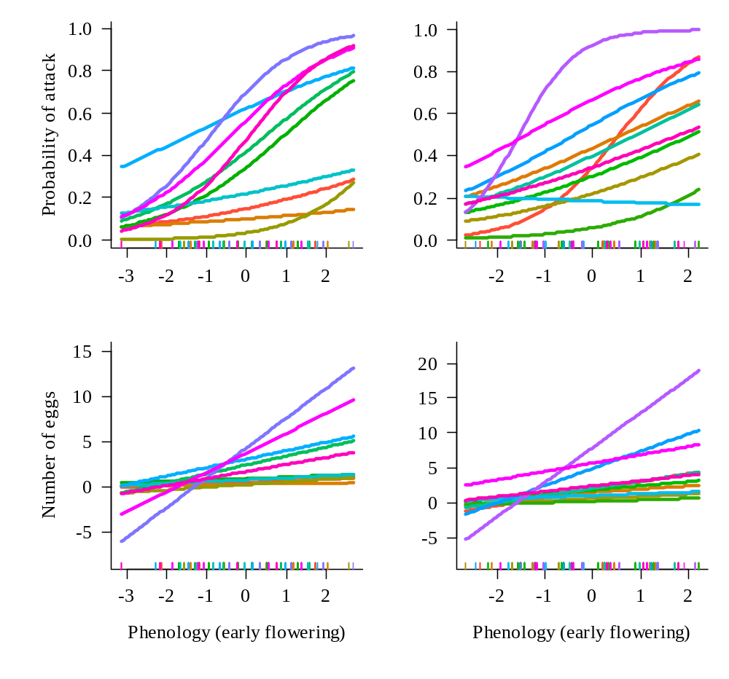
A)
B)
2010
2011
A
B
C
D
E
F
G
H
I
J
K

Slide 15
1.0
1.0
0.8
0.8
0.6
0.6
Probability of attack
0.4
0.4
0.2
0.2
0.0
0.0
0
2
4
6
-1
0
1
2
3
4
5
6

Slide 16
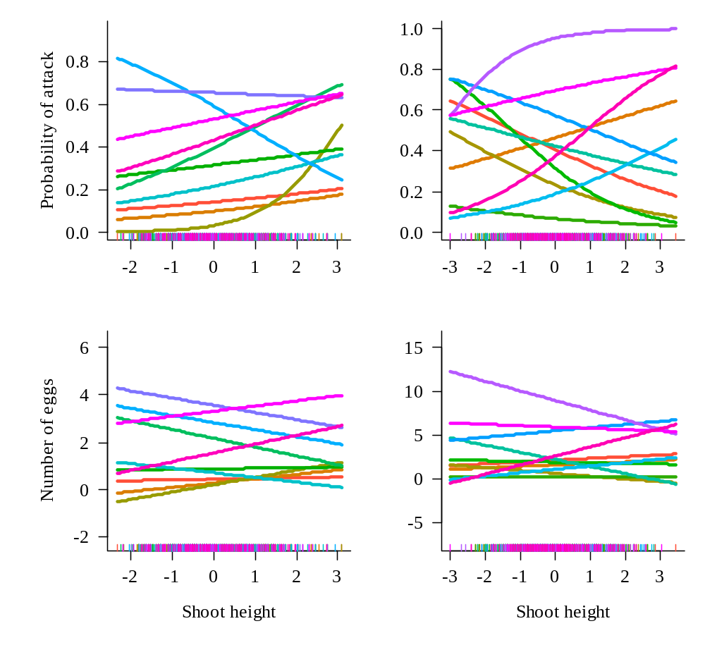
A)
B)
2010
2011
A
B
C
D
E
F
G
H
I
J
K

Slide 17
Phenology
(early flowering)
Phenology
(early flowering)
0.25
0.08
-0.13
0.40
0.02
-0.24
0.33
Shoot
height
0.05
Probability
of attack
-0.17
Number of
intact fruits
0.48
Shoot
height
0.08
Probability
of attack
-0.29
Number of
intact fruits
0.63
0.24
0.68
0.49
0.32
0.49
Number of
flowers
-0.08
Number of
flowers
0.10
Phenology
(early flowering)
Phenology
(early flowering)
0.47
0.25
0.07
0.52
0.30
-0.15
0.49
Shoot
height
0.26
Probability
of attack
-0.10
Number of
intact fruits
0.66
Shoot
height
0.05
Probability
of attack
-0.01
Number of
intact fruits
0.37
-0.05
0.78
0.73
-0.13
0.47
Number of
flowers
-0.04
Number of
flowers
0.09
Phenology
(early flowering)
Phenology
(early flowering)
0.49
0.21
-0.11
0.08
-0.33
0.38
0.55
Shoot
height
0.17
Probability
of attack
-0.21
Number of
intact fruits
Shoot
height
0.08
Probability
of attack
-0.02
Number of
intact fruits
0.50
0.67
0.35
0.43
0.41
0.54
0.29
Number of
flowers
0.01
Number of
flowers
-0.01

Slide 18
Phenology
(early flowering)
Phenology
(early flowering)
0.15
-0.09
0.32
0.34
-0.25
0.29
Shoot
height
-0.17
Probability
of attack
-0.22
Number of
intact fruits
0.39
Shoot
height
0.00
Probability
of attack
-0.18
Number of
intact fruits
0.28
0.58
0.41
0.39
0.33
0.19
-0.03
Number of
flowers
0.04
Number of
flowers
0.17
Phenology
(early flowering)
Phenology
(early flowering)
0.10
0.29
0.07
0.57
0.39
0.02
0.24
Shoot
height
0.08
Probability
of attack
0.13
Number of
intact fruits
0.58
Shoot
height
0.11
Probability
of attack
-0.18
Number of
intact fruits
0.58
0.29
0.10
0.70
-0.29
0.78
Number of
flowers
0.29
Number of
flowers
0.03

Slide 19
Phenology
(early flowering)
Phenology
(early flowering)
0.38
0.39
-0.06
0.30
0.16
0.12
0.61
Shoot
height
-0.13
Probability
of attack
-0.20
Number of
intact fruits
0.61
Shoot
height
0.09
Probability
of attack
-0.52
Number of
intact fruits
0.71
0.37
0.92
0.53
0.37
0.51
Number of
flowers
-0.41
Number of
flowers
0.06
Phenology
(early flowering)
Phenology
(early flowering)
0.58
0.12
0.01
0.28
0.22
-0.06
0.53
Shoot
height
-0.14
Probability
of attack
-0.08
Number of
intact fruits
0.59
Shoot
height
-0.07
Probability
of attack
0.26
Number of
intact fruits
0.81
0.51
0.27
0.42
0.26
0.15
Number of
flowers
0.25
Number of
flowers
-0.02
Phenology
(early flowering)
Phenology
(early flowering)
0.25
0.18
-0.10
0.56
0.19
-0.09
0.46
Shoot
height
-0.17
Probability
of attack
-0.16
Number of
intact fruits
0.62
Shoot
height
-0.04
Probability
of attack
-0.26
Number of
intact fruits
0.64
0.52
0.58
0.67
0.37
0.35
Number of
flowers
-0.10
Number of
flowers
-0.01

Slide 20
Phenology
(early flowering)
Phenology
(early flowering)
0.18
0.00
0.14
0.12
0.24
0.01
0.54
Shoot
height
0.17
Probability
of attack
-0.25
Number of
intact fruits
0.44
Shoot
height
-0.12
Probability
of attack
-0.55
Number of
intact fruits
0.58
0.46
0.25
0.52
0.21
0.62
Number of
flowers
-0.25
Number of
flowers
-0.14
Phenology
(early flowering)
Phenology
(early flowering)
0.33
0.49
0.06
0.23
0.23
0.05
0.39
Shoot
height
0.30
Probability
of attack
-0.62
Number of
intact fruits
0.52
Shoot
height
0.10
Probability
of attack
0.02
Number of
intact fruits
0.53
0.00
0.00
0.44
0.33
0.09
Number of
flowers
-0.03
Number of
flowers
0.08
Phenology
(early flowering)
0.61
0.27
0.06
0.75
Shoot
height
0.23
Probability
of attack
-0.37
Number of
intact fruits
0.70
0.22
0.84
Number of
flowers
-0.12

Slide 21
Phenology
(early flowering)
Phenology
(early flowering)
0.25
0.15
-0.12
0.40
0.06
-0.23
0.33
Shoot
height
0.02
Number
of eggs
-0.21
Number of
intact fruits
0.48
Shoot
height
0.20
Number
of eggs
-0.27
Number of
intact fruits
0.63
0.18
0.67
0.49
0.23
0.46
Number of
flowers
-0.08
Number of
flowers
0.13
Phenology
(early flowering)
Phenology
(early flowering)
0.47
0.28
0.08
0.52
0.10
-0.13
0.49
Shoot
height
0.29
Number
of eggs
-0.10
Number of
intact fruits
0.66
Shoot
height
0.01
Number
of eggs
-0.15
Number of
intact fruits
0.37
-0.07
0.78
0.73
0.12
0.49
Number of
flowers
-0.03
Number of
flowers
0.09
Phenology
(early flowering)
Phenology
(early flowering)
0.23
-0.05
0.38
0.12
-0.31
0.49
0.55
Shoot
height
-0.09
Number
of eggs
-0.49
Number of
intact fruits
0.50
Shoot
height
-0.11
Number
of eggs
-0.14
Number of
intact fruits
0.67
0.59
0.65
0.54
0.51
0.48
Number of
flowers
-0.07
Number of
flowers
-0.03

Slide 22
Phenology
(early flowering)
Phenology
(early flowering)
0.29
0.23
-0.08
0.32
0.46
-0.26
0.28
Shoot
height
-0.07
Number
of eggs
-0.20
Number of
intact fruits
0.39
Shoot
height
-0.04
Number
of eggs
-0.12
Number of
intact fruits
0.58
0.38
0.38
0.33
0.39
-0.02
Number of
flowers
0.06
Number of
flowers
0.16
Phenology
(early flowering)
Phenology
(early flowering)
0.10
0.40
0.03
0.57
0.26
0.02
0.24
Shoot
height
0.04
Number
of eggs
0.19
Number of
intact fruits
0.58
Shoot
height
0.12
Number
of eggs
-0.28
Number of
intact fruits
0.58
0.33
0.07
0.70
-0.16
0.79
Number of
flowers
0.29
Number of
flowers
0.04

Slide 23
Phenology
(early flowering)
Phenology
(early flowering)
0.38
0.31
-0.05
0.30
0.16
0.10
0.61
Shoot
height
0.05
Number
of eggs
-0.30
Number of
intact fruits
0.61
Shoot
height
0.06
Number
of eggs
-0.40
Number of
intact fruits
0.71
0.23
0.91
0.53
0.39
0.48
Number of
flowers
-0.36
Number of
flowers
0.04
Phenology
(early flowering)
Phenology
(early flowering)
0.17
0.01
0.28
0.17
-0.02
0.58
Shoot
height
-0.18
Number
of eggs
-0.10
Number of
intact fruits
0.59
Shoot
height
-0.01
Number
of eggs
0.13
Number of
intact fruits
0.53
0.28
0.42
0.30
0.18
0.81
0.57
Number of
flowers
Number of
flowers
-0.03
0.24
Phenology
(early flowering)
Phenology
(early flowering)
0.18
-0.09
0.56
0.17
-0.10
0.25
Shoot
height
-0.02
Number
of eggs
-0.22
Number of
intact fruits
0.62
Shoot
height
-0.13
Number
of eggs
-0.23
Number of
intact fruits
0.46
0.64
0.32
0.57
0.67
0.64
0.40
Number of
flowers
-0.08
Number of
flowers
-0.03

Slide 24
Phenology
(early flowering)
Phenology
(early flowering)
0.07
0.15
0.12
0.38
0.10
0.18
0.54
Shoot
height
0.10
Number
of eggs
-0.22
Number of
intact fruits
0.44
Shoot
height
0.06
Number
of eggs
-0.58
Number of
intact fruits
0.58
0.54
0.26
0.52
0.20
0.62
Number of
flowers
-0.27
Number of
flowers
-0.04
Phenology
(early flowering)
Phenology
(early flowering)
0.33
0.25
-0.17
0.13
0.07
0.23
0.39
Shoot
height
-0.06
Number
of eggs
-0.30
Number of
intact fruits
Shoot
height
-0.02
Number
of eggs
-0.15
Number of
intact fruits
0.52
0.53
0.68
0.20
0.44
0.66
0.19
Number of
flowers
-0.23
Number of
flowers
0.07
Phenology
(early flowering)
0.61
0.14
0.06
0.75
Shoot
height
0.20
Number
of eggs
-0.73
Number of
intact fruits
0.70
0.44
1.08
Number of
flowers
-0.06

Slide 25
0.4
2010
2011
0.2
Selection gradient for
phenology
0.0
-0.2
0
1
P. alcon

Slide 26
2010
2011
15
40
30
10
Number of eggs
20
5
10
0
0
1
2
3
4
5
6
1
2
3
4
5
6
Phenology (early flowering)
Phenology (early flowering)
A
B
C
D
E
F
G
H
I
J
K

Slide 27
2010
2011
15
40
10
30
Number of eggs
20
5
10
0
0
1
2
3
4
5
6
2
3
4
5
6
7
8
Phenology (early flowering)
Phenology (early flowering)
A
B
C
D
E
F
G
H
I
J
K

