Slide 1
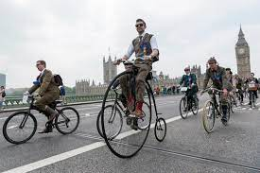
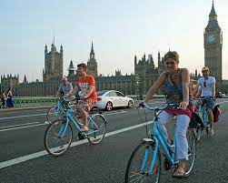
Bike Demand Visualization Project
Free or affordable access to bicycles has been provided for short-distance trips in an urban area as an alternative to motorized public transport or private vehicles. Thus, it is aimed to reduce traffic congestion, noise and air pollution.

Slide 2
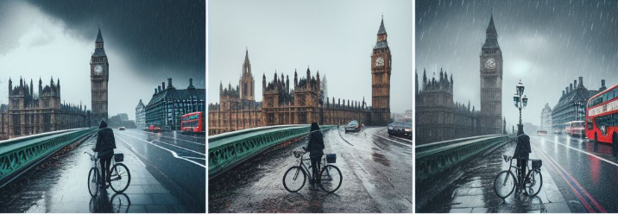
The aim of this project is to reveal the current patterns in the data by showing the historical data of London bike shares with visualization tools.
This will allow us to X-ray the data as part of the EDA process before setting up a machine learning model.

Slide 3
Features
timestamp - timestamp field for grouping the data
cnt - the count of a new bike shares
t1 - real temperature in C
t2 - temperature in C “feels like”
hum - humidity in percentage
wind_speed - wind speed in km/h
weather_code - category of the weather
is_holiday - boolean field - 1 holiday / 0 non holiday
is_weekend - boolean field - 1 if the day is weekend
season - category field meteorological seasons: 0-spring ; 1-summer; 2-fall; 3-winter.
"weather_code" category description:
1 = Clear ; mostly clear but have some values with haze/fog/patches of fog/ fog in vicinity
2 = scattered clouds / few clouds
3 = Broken clouds 4 = Cloudy 7 = Rain/ light Rain shower/ Light rain
10 = rain with thunderstorm 26 = snowfall 94 = Freezing Fog

Slide 4
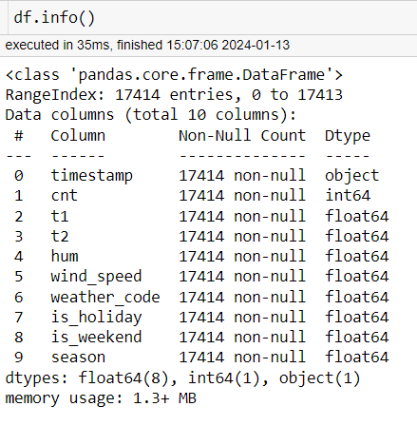
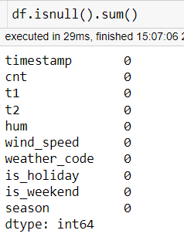
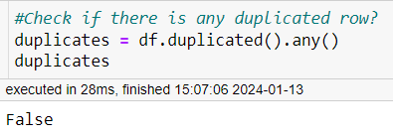
Check missing values and if there are any dublicate rows or not.

Slide 5
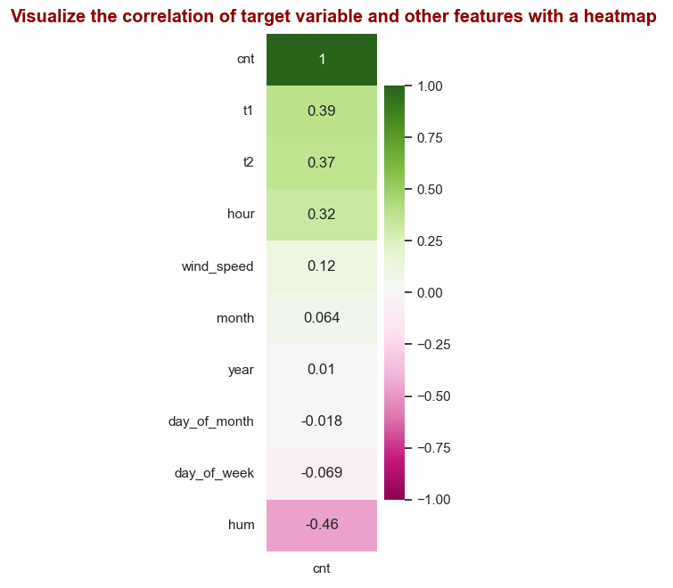
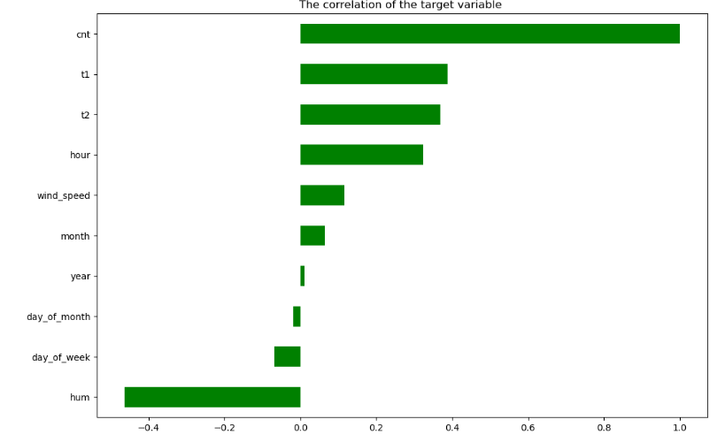
t1(0.39), t2(0.37) and hour(0.32) have the highest correlation with the count of a new bike shares.
Since the correlation of t1 and t2 is very close, t2 can be discarded and continue with t1
It is clear from the negative correlation in humidity(-0.46) that the count of a new bike shares decreases when humidity increases.

Slide 6
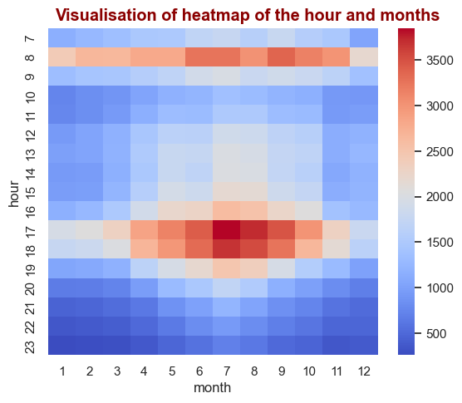
During commuting and rush hours in 8 A.M. and 17,18 P.M., and in the 7th and 8th month, the usage of bicycle intensified.

Slide 7
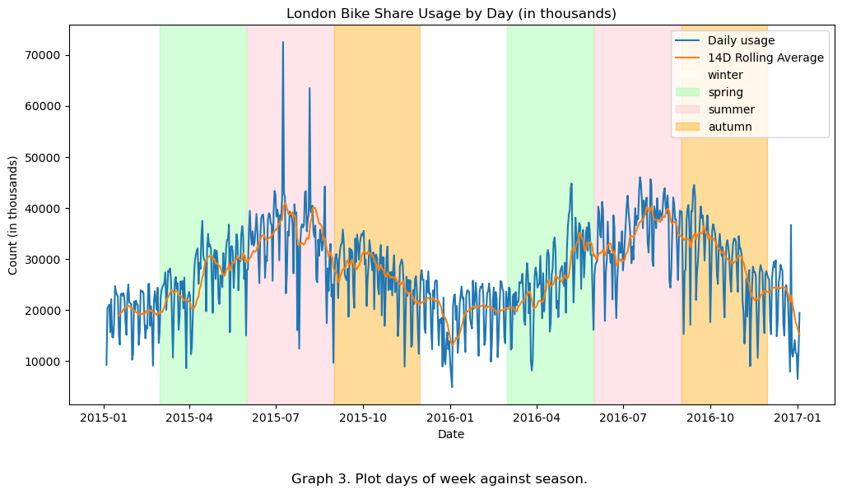
The use of bicycle reaches its maximum in June,July,August which are months of summer season and falls to a minimum in December,January,February which are months of winter season.

Slide 8
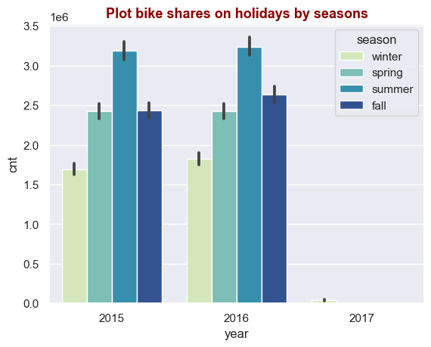
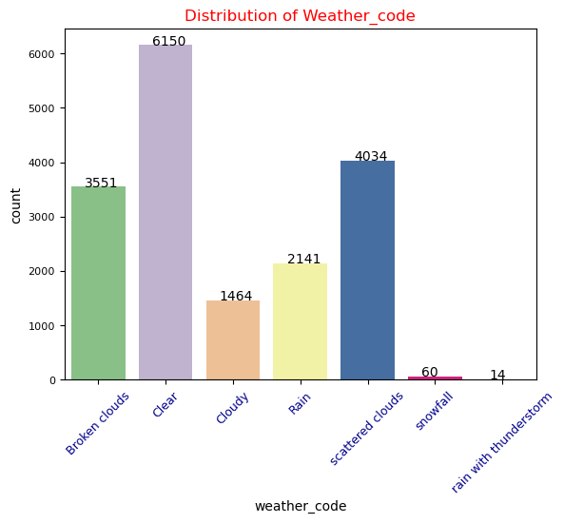
In both years, the use of bicycle reaches its maximum in summer season and falls to a minimum in winter season.
Similarly, the use of bicycle reaches its maximum maximum in clear weather and minimum in snowfall ,rain with thunderstorm.

Slide 9
Thanks for listening..
Yasemin AĞIRMAN
Ali ÇOLAK

