Slide 1
Virtual File Systems in Samba 3.0
  Alexander Bokovoy
  ab@samba.org
  Samba Team,
  Optifacio Software Services
  CIFS 2003 conference,
  San Jose, 11-15 August

Slide 2



Virtual file systems
General approach to extend a storage:
  Most operating systems support abstraction of a storage on a low level (Kernel-level VFS)
  Some applications provide storage abstraction as well (application-level VFS)
Follow common UNIX™ paradigm:
  Do one thing at time but do it best
Virtual file system concept is often understood differently in different contexts:
  As means to gather data using different protocols through an unified user interface
  As means to assimilate incompatible interfaces between different protocols
  As means to organize storage itself

Slide 3



Virtual file systems (cont.)
Kernel-level VFS:
  Local file systems:
    Easy to create thing-in-itself, interoperability is left up to higher level:
      more than 40 in Linux 2.4 series
    One ring to rule them all – same code handles both client access and backend storage
  Network file systems:
    Tend to solve interoperability issues:
      Act as connectors between remote storages
    More complicated than local ones
    Use client-server architecture
    Server-side is often implemented in user space

Slide 4

Virtual file systems (cont.)
Application-level VFS
  Grand unified access method:
    Consistency in representation for user:
      regular files and folders
      Compressed “folders”
      local and “remote” resources merged together from user point of view
    Consistency in application development:
      same API for higher layers: everything is a file
      meta-data abstraction: different formats faded into one “meta-format”
  Least surprised way for developer to extend a storage: tradition matters!

Slide 5
Virtual file systems (cont.)
Disadvantages of VFS:
  Loss of some semantic attributes:
    lower layers have to fall in line with higher ones
  Loss of context information:
    Higher layers usually split operation into a number of lower layers' ones:
      Where to track user activity?
      Where to perform transaction rollback?
Possible solutions:
  Multi-level virtualization
  Vertical push of context between layers

Slide 6

Samba 3.0
Common modularized architecture:
  Everything can be served as external module:
    Pluggable password and authentication
    Pluggable character sets
    Pluggable RPC pipes
    Pluggable ID mapping
And ...
    Pluggable virtual file systems

Slide 7
Samba 3.0 VFS features
Common module infrastructure
Unified module configuration
Stackable modules
Generic testing infrastructure
Full coverage of file system operations
Simplified module source code
Documentation (not exactly VFS ...):
  Docbook XML 4.2 as source format
  Easy integration with Samba official manual pages
  Migration guide for VFS developers

Slide 8
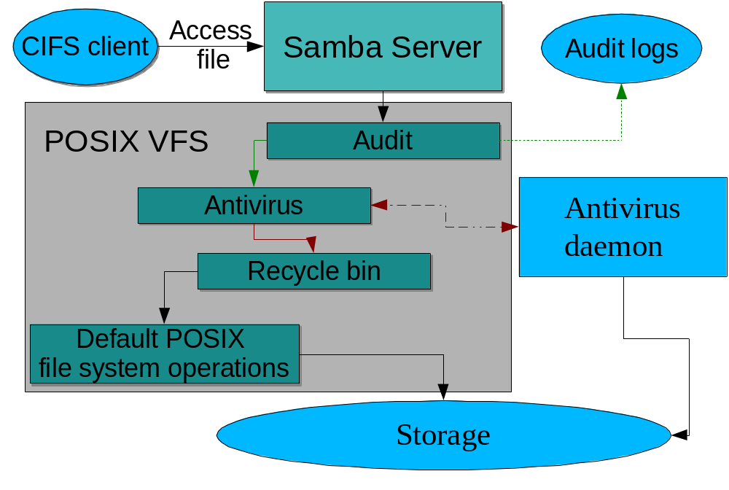
Samba 3.0 VFS example

Slide 9
Common module infrastructure
Subsystem management in Samba 3.0 is regularized:
  Modules can be compiled dynamically or statically
  Modules probed in known locations during loading
  Modules can register events
  Same binary object could provide modules for different subsystems

Slide 10

Unified module configuration
In Samba 2.2:
  Modules were left on its own to get and process its options
  Want to store options in smb.conf? Hack Samba source!
In Samba 3.0:
  Parametric options add more freedom:
    Each module can have own option domain (no more name conflicts)
    Different types of data supported (string, list, integer, boolean, etc)
    Option format is standardized:
      domain: name = value
  No need to hack Samba source anymore

Slide 11
Stackable modules
In Samba 2.2:
  One module per share, therefore:
  Multiple actions have to be coded in one module
In Samba 3.0:
  Multiple modules per share
  Different types of modules supported:
    “Opaque” modules
    “Transparent” modules
  Order of module execution is configurable
  Per-module, per-connection local storage
  One module can be loaded several times for the same share with different 'roles'

Slide 12
Generic testing infrastructure
Modules can be loaded either to SMBD daemon or to specific vfstest utility
Vfstest utility allows:
  Load dynamic modules
  Test VFS operations without network access
  Push predefined data through VFS stack
  Scriptable testing
  Debugging on different levels of verbosity

Slide 13
Full coverage of file operations
In Samba 2.2:
  62 file system operations:
    Disk management
    Directory access
    File access
    NT ACLs
    POSIX ACLs
  Inconsistency: some operations were outside VFS
In Samba 3.0:
  76 file system operations
New subsystems:
  Extended attributes
  Quota management

Slide 14

Simplified module source code
Typical Samba 2.2 VFS module code:
  File operations' functions
  Local static table of pointers to functions
  Configuration parsing (external configuration file)
  Initialization functions:
    Copy passed default operations
    Override defined operations with local ones
    Return pointer to local static table of VFS operations merged with passed default one
Defects:
  Hard to maintain, easy to overlook changes in API
  No resistance against passed NULL pointers as hooks

Slide 15
Simplified module source code
Typical Samba 3.0 VFS module code:
  File operations' functions
  Static mapping table between operations and functions including operation type (opaque or transparent)
  Initialization function:
    Register VFS module using common modules' API
  Configuration options:
    Access smb.conf parametrical options where needed
  Local per-module, per-connection storage:
    No need for persistent variables in module code

Slide 16
Documentation for VFS modules
Samba 3.0 uses completely new approach to maintain documentation for configuration options:
  Options documented using Docbook XML 4.2
  One option description – one source XML file
  Options categorized and split to subdirectories according to a category
  Manual page is generated using set of XSLTs
VFS developers and distribution vendors could:
  Generate own manual pages using same approach
  Add documentation to main smb.conf(5) manual

Slide 17
VFS developers' guide
Samba 3.0 developers documentation includes chapter on VFS modules development:
  How to write module from scratch
  How to migrate module for Samba 2.2 to Samba 3.0
  How to store data on per-connection basis
  How to distribute modules
Samba 3.0 VFS examples include:
  Module to perform connection audit
  Module to support AppleTalk interoperability
  Module to store default quotas
  Module to organize recycle bin for removed files

Slide 18
Available third-party modules
DatabaseFS: access MySQL database as file system:
    http://www.css.tayloru.edu/~elorimer/databasefs/index.php
OpenAntivirus: scan files for viruses with several commercial and open source antivirus solutions:
    http://www.openantivirus.org/
DrWeb-samba: virus scanner for DrWeb antivirus:
    http://www.sald.com/
    ftp://ftp.drweb.ru/pub/unix/betas/

