Slide 1
Decision Supporting System in Intensive Care Unit
Veronica Latzinnik, Almog Elharar
Supervised by dr. kira Radinsky and bellinson hospital

Slide 2
Goals
Develop a tool to predict patients’ survival better than currently used metrics (APACHE II score)
On the first day of admission
Several days ahead
Update the prediction on a rolling basis
Explore the possibility of grouping the patients into clusters, and personalize treatment

Slide 3
Challenges
Infrastructure – working within the hospitals’ network
Dataset - missing values, unbalanced classes, not a big amount of examples
Justification of the predictions

Slide 4
General statistics
2004-2014
~7000 patients, 22% mortality rate
Some parameters missing
When filling with personal means – ~2000 with sufficient data
When also filling with global medians - ~5000 with sufficient data

Slide 5
List of features used
Total Haemoglobin
Arterial Pressure Diastolic (mmHg)
Arterial Pressure Systolic (mmHg)
Base excess (vt) (mmol/l)
PH (ABG)
Bilirubin(Total) (mg/dl)
Creatinine (mg/dl)
isChronicBackground
Urea
Age
End Tidal CO2 (mmHg)
Inspired Oxygen (%)
GastricResidue
GCS
Gluco-stick (mg%)
Glucose ABG (mg%)
Haematocrit
Magnesium (mmol/l)
PaCO2
Gender
Gluco-stick (mg%)
Glucose ABG (mg%)
Haematocrit
Heart Rate (bpm)
isVentilated
כמות שניתנה KCALENT
כמות שניתנה KCALIV
Lactate ABG (mmol/l)
White Cell Count (10^9/l)
PaO2
Platelets (10^9/l)
PotassiumABG
Pre-albumin (mg/dl)
PROTEINI כמות בסיס ניתנה
Total Respiratory Rate (insp/min)
SpO2
Na-ABG (mmol/l)
Calcium (mg/ml)
Additional features engineered – mean, std, min, max, diff from yesterday

Slide 6
Main tasks
Predicting mortality in the next several days based on each day
Predicting mortality during the admission based on first day
Predicting mortality during the admission based on previous sequence of days
Reasonability of prediction
Creation of clusters

Slide 7
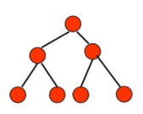
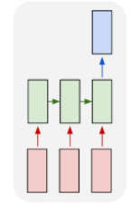
Methods used
Decision trees – good for visualization, not so good performance
Recurrent neural network for classifying and encoding
Ensemble trees – xgboost, gave the best results
Logistic regression to “explain” xgboost results
K-means for clustering

Slide 8
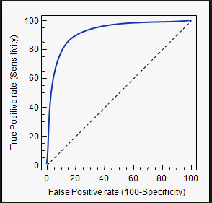
Results summary
Used the AUC metric – area under the ROC curve (false positive vs. true positive)

Slide 9
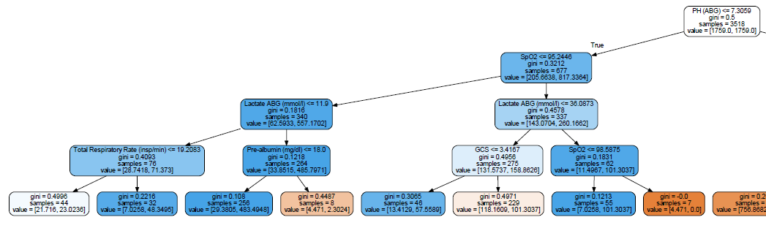
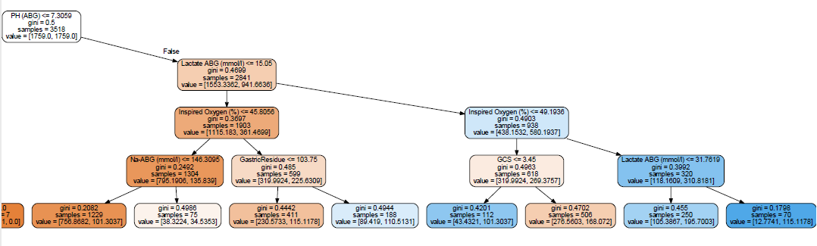
Results summary
Decision trees – AUC 70

Slide 10
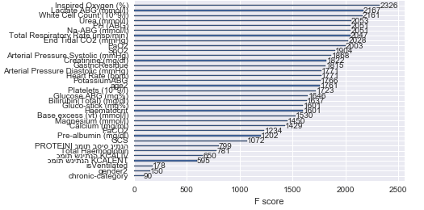
Results summary
Prediction of general mortality based on the first day
Comparing to APACHE II
Only ~800 patients with apache score available
When training on the rest and testing on those with apache:
Xgboost - AUC 0.83
APACHE II - AUC 0.76
Feature importance:

Slide 11
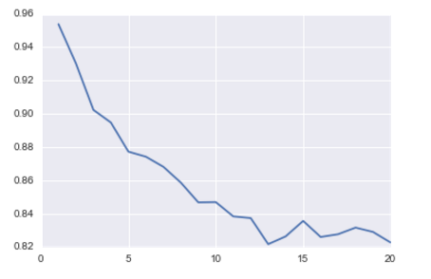
Results summary
Prediction of mortality in the next few days:
AUC
Days forward

Slide 12
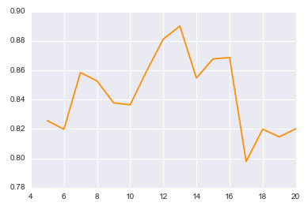
Results summary
Prediction of mortality based on a previous sequence of days
As expected, the longer to the admission the better we can predict, except for an unexplained drop around day 17
AUC
Days that passed

Slide 13
Results summary - reasoning
TotalHaemoglobin | 8.95
ArterialPressureDiastolic(mmHg) | 61.78947368
ArterialPressureSystolic(mmHg) | 110.4210526
Base excess(vt)(mmol/l) | -6.5
PH(ABG) | 7.26
Bilirubin(Total)(mg/dl) | 0.62
Creatinine(mg/dl) | 1.7
chronic-category | 0
EndTidalCO2(mmHg) | 44.85714286
InspiredOxygen(%) | 64.94
GastricResidue | 500
GCS | 4
Gluco-stick(mg%) | 119.8
GlucoseABG(mg%) | 153.3333333
Haematocrit | 35.25
HeartRate(bpm) | 126.2631579
isVentilated | 0
כמותשניתנהKCALENT | 530
כמותשניתנהKCALIV | 19.11866667
LactateABG(mmol/l) | 30.5
WhiteCellCount(10^9/l) | 13.9
Magnesium(mmol/l) | 1.795
PaCO2 | 42.2
PaO2 | 85.8
Platelets(10^9/l) | 214
PotassiumABG | 4.05
Pre-albumin(mg/dl) | 10
PROTEINIכמותבסיסניתנה | 21.00075
TotalRespiratoryRate(insp/min) | 9.77777778
SpO2 | 93.68421053
Na-ABG(mmol/l) | 145
Urea(mmol/l) | 99.5
Calcium(mg/ml) | 7.81666667
For each patient, we can try to explain why the algorithm predicted a result by fitting linear regression on xgboost’s results
Combined weights = patient’s features vector * regression coefficients vector
For example:
A patient with the following features was given mortality probability of 0.87 by xgboost
The features with the largest combined weights are marked
Does it make sense?

Slide 14
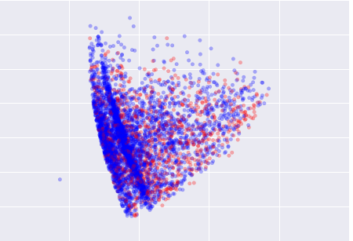
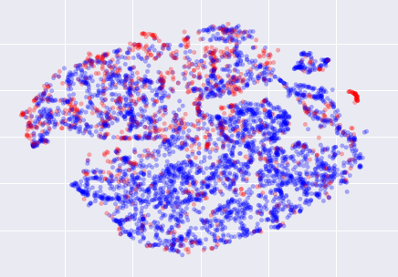
Results summary - clustering
Tried to plot the data in lower dimensions to see if some clusters appear
PCA
T-SNE
Didn’t work very well

Slide 15
Results summary - clustering
Using K-means algorithm we can divide the patients into several clusters, each with different number of patients and different mortality rate
We can “describe” each cluster by performing t-tests to find the parameters who’s means and variance are significantly different than the others

Slide 16
Results summary - clustering
 | Cluster1 | Cluster2 | Cluster3 | Cluster4 | Cluster5 | Cluster6
% of patients | 26 | 4 | 16 | 30 | 20 | 4
number of patients | 1236 | 180 | 740 | 1422 | 912 | 199
% mortality | 0.101133 | 0.894444 | 0.258108 | 0.082278 | 0.390351 | 0.286432
Relatively high | Haematocrit | Lactate ABG | PaCO2 | PH | Urea | isVentilated
values | Arterial pressure diastolic | Inspired Oxygen | Base excess | Gender | Creatinine | End Tidal CO2
 | Calcium | PotassiumABG | Platelets | SPO2 | PotassiumABG | Glucose ABG
 | Total Haemoglobin | Heart Rate | Inspired Oxygen |  | GCS | PaCO2
 | Arterial pressure systolic | White cells count | End Tidal CO2 |  | GastricResidue
 | Glucose ABG | Total Respiratory Rate | Na-ABG
 | Gluco-stick |  | Age
Relatively low | Urea | SPO2 | PAO2 | Age | Base excess | Arterial pressure diastolic
values | Creatinine | PH | SPO2 | Urea | Age | GCS
 | Heart Rate | Base excess |  | Haematocrit | PH | Inspired Oxygen
 |  | Arterial pressure diastolic |  | Creatinine | Arterial pressure diastolic
 |  | Arterial pressure systolic |  | Glucose ABG | Haematocrit
 |  |  |  | Gluco-stick | Calcium
 |  |  |  | Na-ABG | Gender
 |  |  |  | PaCO2 | Platelets
 |  |  |  | Inspired Oxygen

Slide 17
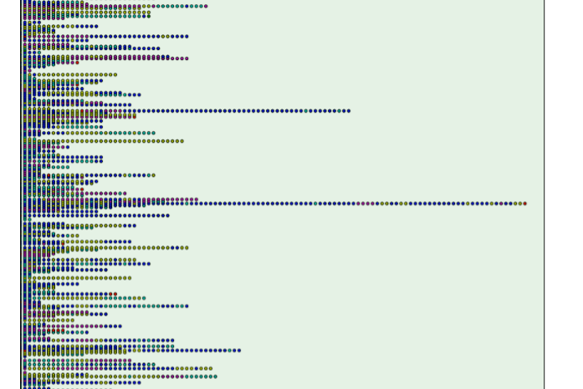
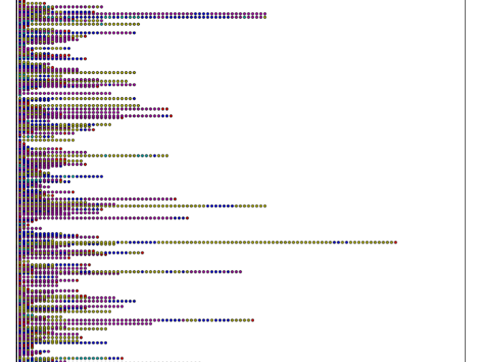
Results summary - clustering

Slide 18
System Components
User interface – a website where the user can query a patients ID and receive his status and explanation (Angular, Flask)
Database – for storing patients data, trained models and the websites’ info (MongoDB)
Back end – DB regular updates, data cleaning and merging, feature engineering, machine learning algorithms (Python)

Slide 19
Lessons learned
Cleaning and manipulating the data takes most of the time
Better to work on the project during the summer
Understand the prerequisites better – more software engineering, less algorithmic work

Slide 20
Thank you!

