Slide 1
DeFi and some of its vulnerabilities
Alireza Darvishi

Slide 2
Introduction to DeFi
Discussion on some available attacks
Front running attacks
Attacks using Flash loans
Profit maximizing of the attacks

Slide 3
Introduction to DeFi
Blockchains enabled us to transact funds in a trustless system and without any centralized authority.
Smart contracts allow execution of complicated transactions in a non-custodial, permission less and openly auditable way.
Some Types of DeFi:
Exchange markets
Lending markets
Portfolio management
Derivatives
Privacy-preserving Mixers

Slide 4
Decentralized Exchanges
These DeFi protocols enabled the non-custodial exchange of on-chain digital assets.
Wrapped(e.g. WBTC) tokens facilitate cross-chain exchanges.
Order book DEXs or Automated Market Makers (AMMs)
Liquidity providers vs liquidity takers
Arbitrage availability on different AMMs
DEX aggregators (like 1inch)

Slide 5
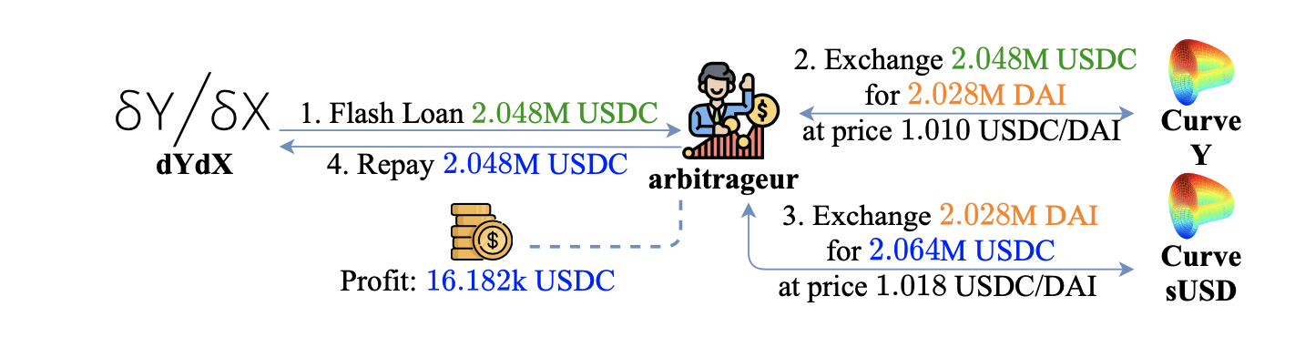
Lending Markets
over-collateralized loans and flash loans.
over-collateralized loans incentives users to pay back debt.
Liquidators and their incentives.
Some stable coins work with collateral incentives
Flash loans require borrower to pay back the debt with interest in the same block.
Flash loans are possible because of atomic property. (Transaction fails if the loan is not repaid)
No need for upfront collateral
Example for flash loan: Arbitrage

Slide 6
Front running attacks
Displacement Attacks
front-running a transaction that registers a domain name
front-run a cancel transaction in an order book DEX and fill the order
reporting a bug as part of a bug bounty scheme
Double-spending attacks using higher fees
Multi-transaction Sandwich Attacks
Liquidity Taker Attacks Taker in an AMM
Liquidity Provider Attacks Taker in an AMM
Liquidity Taker Attacks Taker in an order book DEX
Miner Extractable Value
A miner poll can prioritize its own transactions for an ICO
A miner can change order of transactions to maximize its profit

Slide 7
Attacks using Flash loans
Single Transaction Sandwich Attacks
a single risk-free transaction
Flash Loan Arbitrage
Oracle Manipulation Attacks
Attack on Harvest with manipulation of Curve
Attack on bZx with manipulation of Uniswap and Kyber
Wash Trading
Collateral Swapping

Slide 8
Harvest attack with manipulation of Curve
Take out a flash loan of 18.3 million USDT and 50 million USDC.
Convert 17.2 million USDT into USDC on Curve, pushing up Curve's USDC prices.
Deposit 50 million USDC into Harvest, and thanks to elevated USDC prices receive 51.5 million shares (known as fUSDC)
Convert the USDC back into USDT on Curve, pushing prices back down.
Withdraw 50.6 million USDC. In other words, convert 51.5 million fUSDC into 50.6 million USDC at prevailing rates.
Notes:
https://www.finder.com.au/harvest-finance-farm-hack-explained-simply https://medium.com/harvest-finance/harvest-flashloan-economic-attack-post-mortem-3cf900d65217

Slide 9
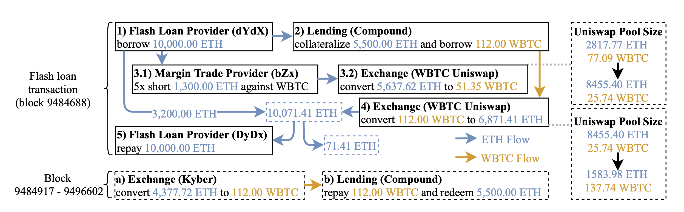
bZx attack with manipulation of Uniswap
Notes:
https://www.finder.com.au/harvest-finance-farm-hack-explained-simply https://medium.com/harvest-finance/harvest-flashloan-economic-attack-post-mortem-3cf900d65217

Slide 10
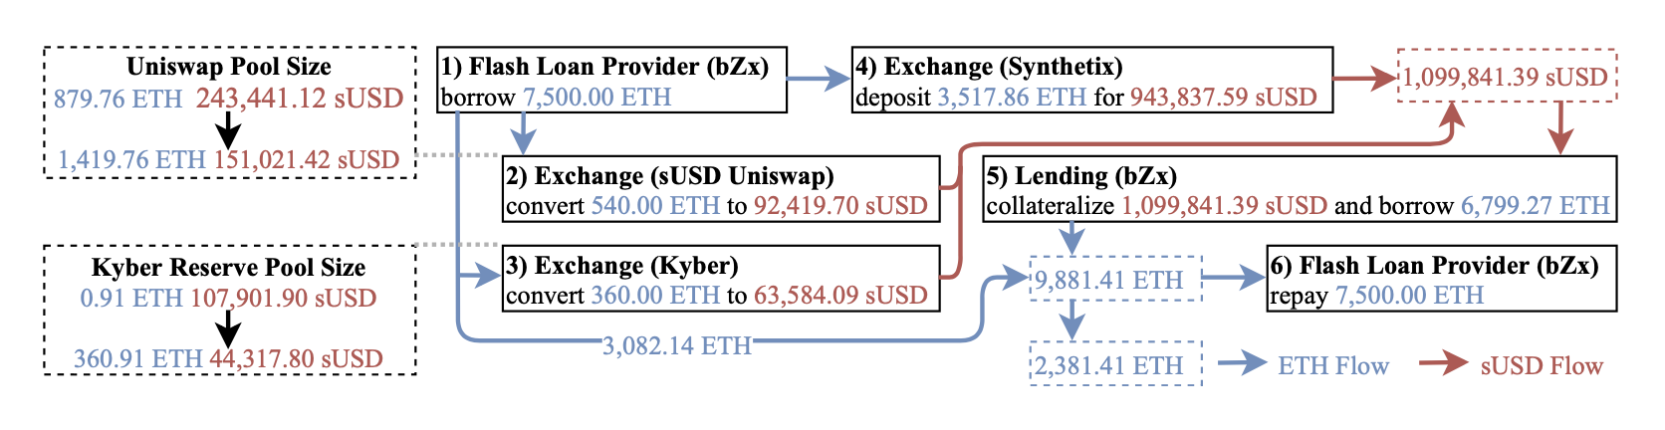
bZx attack with manipulation of Uniswap and Kyber
Notes:
https://www.finder.com.au/harvest-finance-farm-hack-explained-simply https://medium.com/harvest-finance/harvest-flashloan-economic-attack-post-mortem-3cf900d65217

Slide 11
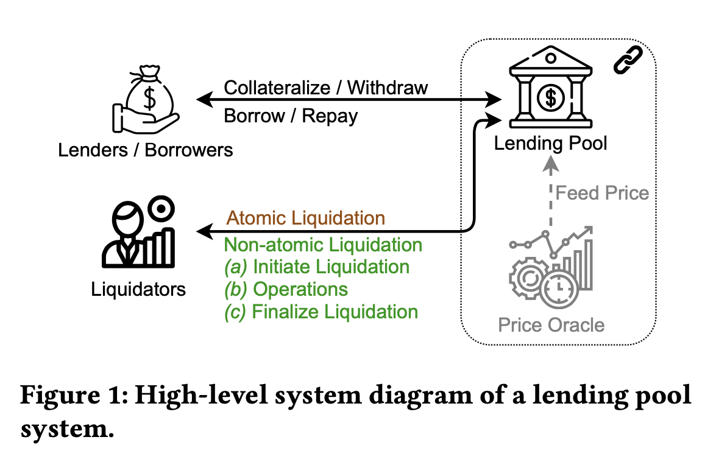
Lending market mechanism

Slide 12
Liquidation mechanisms
Auction Liquidation
A loan becomes eligible for liquidation
A liquidator starts the auction process
Interested liquidators provide their bids
The auction ends according to the rules set forth in the auction contract
Fixed Spread Liquidation
Liquidator can buy colaterall at a discounted price
Avoids hour-long liquidation auctions
Enables using flash-loans

Slide 13
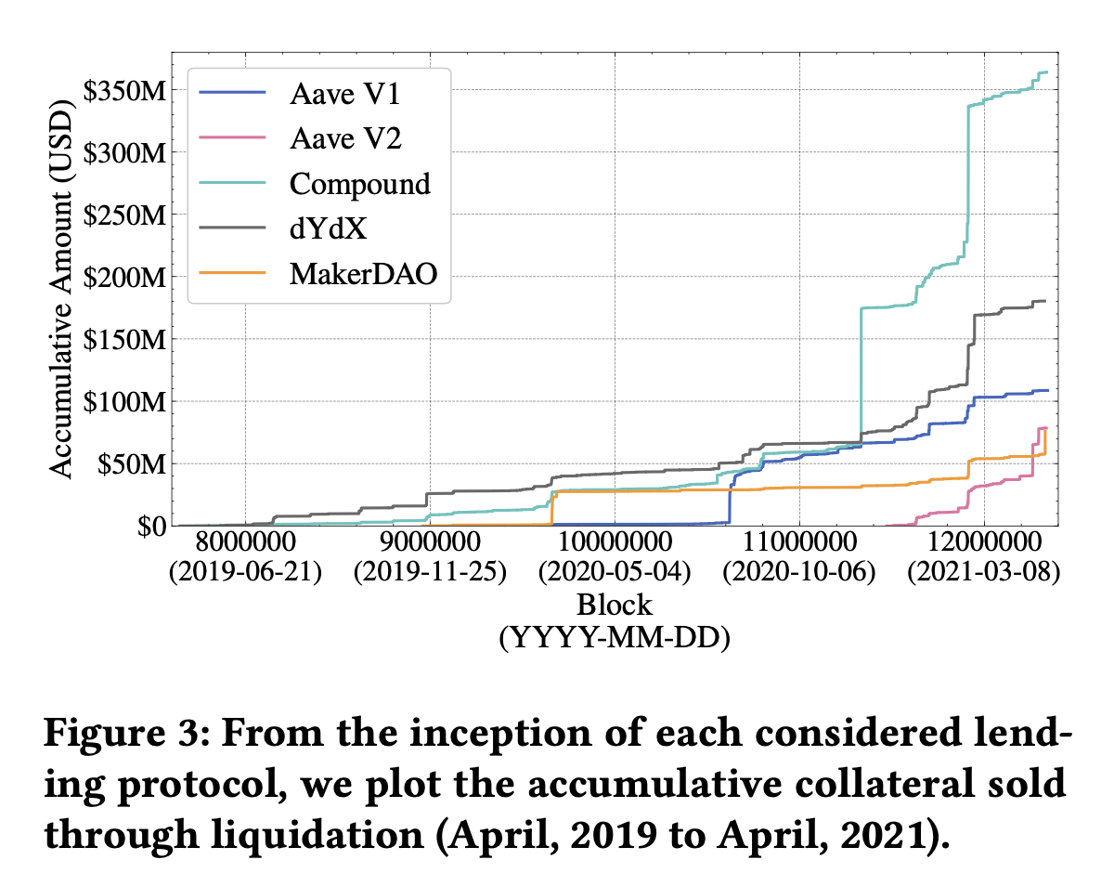
Accumulative collateral sold through liquidation

Slide 14
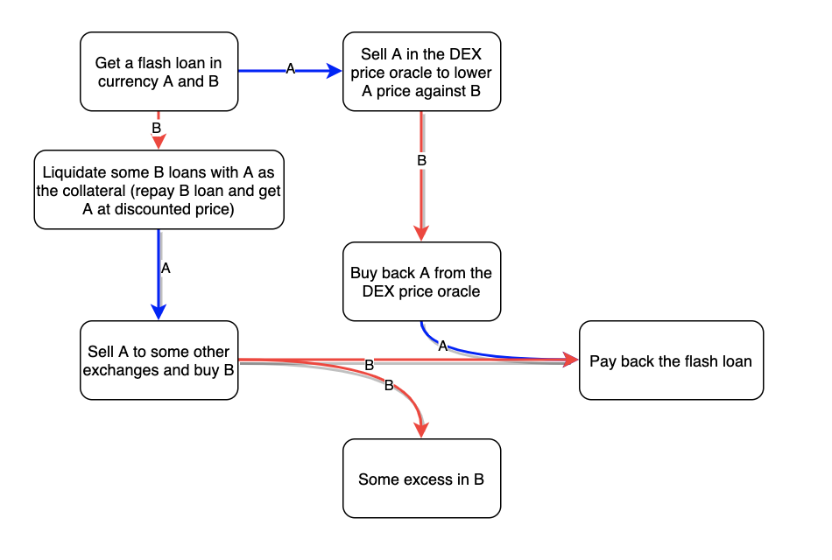
Proposed attack

Slide 15
A defence to the attack
A contract can use off-chain data as price feeds.
This make manipulation off the price harder.
Chainlink provide off-chain data on-chain.
Although it is riskeir to manipulate a centralized exchange, it had happened, and made $89 million worth loans liquidated.
DAI price as a stable coin pegged to 1$ price, went up 30% for more than an hour in Coinbase pro.

Slide 16
Some other Defences
Use the moving average of a short period as the price
Use lagged prices as the price oracle
A commit-and-reveal mechanism for liquidation
…

Slide 17
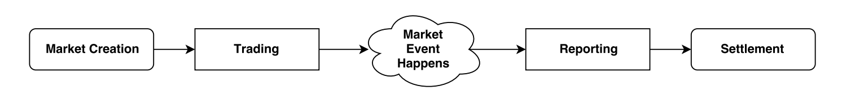
Proposed oracle manipulations
Oracle manipulation in a prediction market (eg.Augur,Gnosis)
What is a prediction market
How a prediction market’s oracle work
Price oracle manipulation of a lending market to liquidate collatral of borrowers
over-collateralized loans incentives users to pay back debt.
Liquidators and their incentives.

Slide 18
Maximizing profit

Slide 19
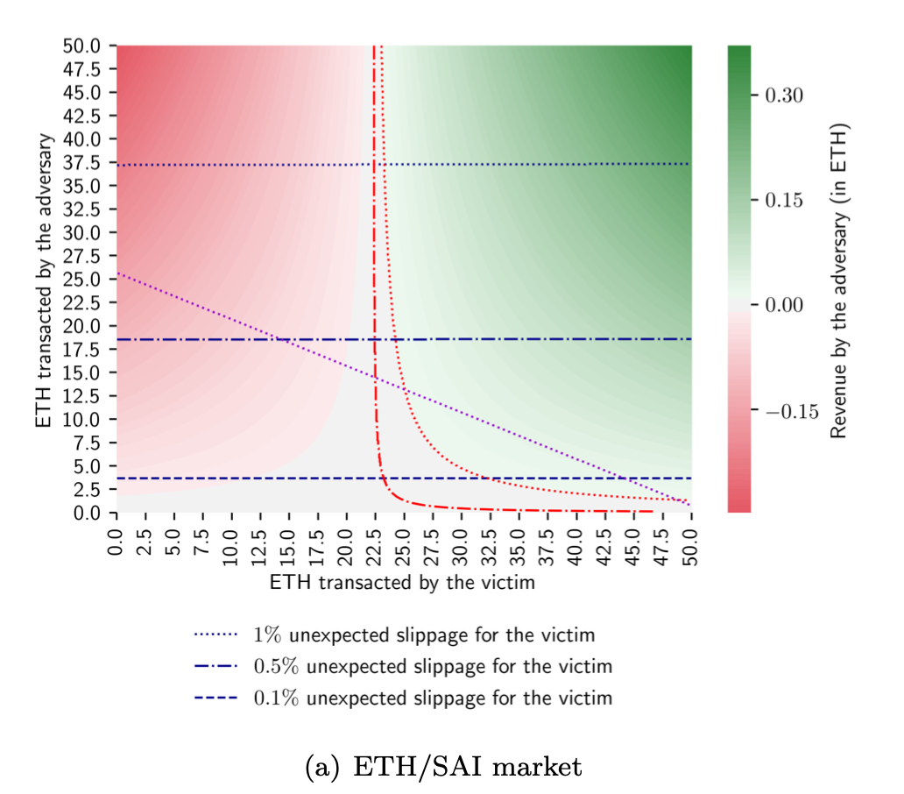
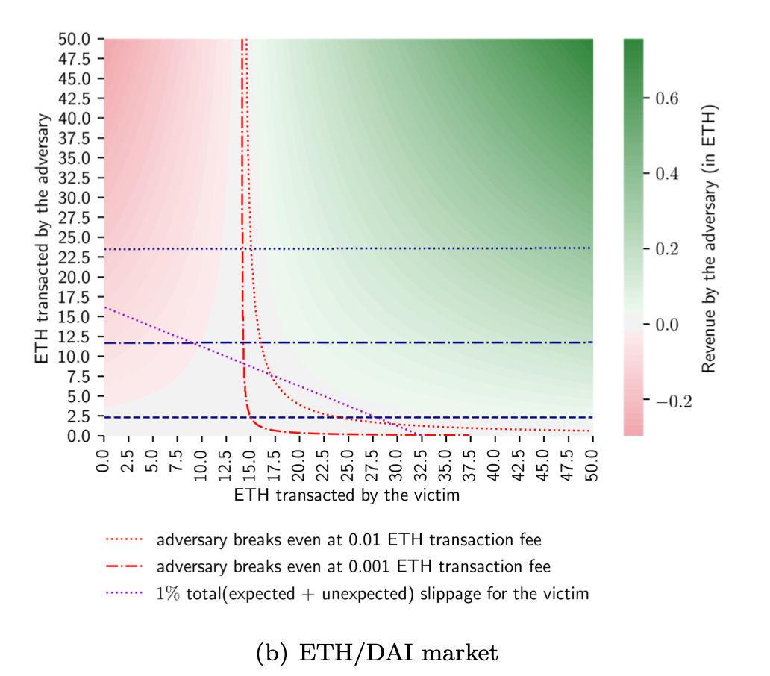
Liquidity Taker Attacks Taker in an AMM

Slide 20
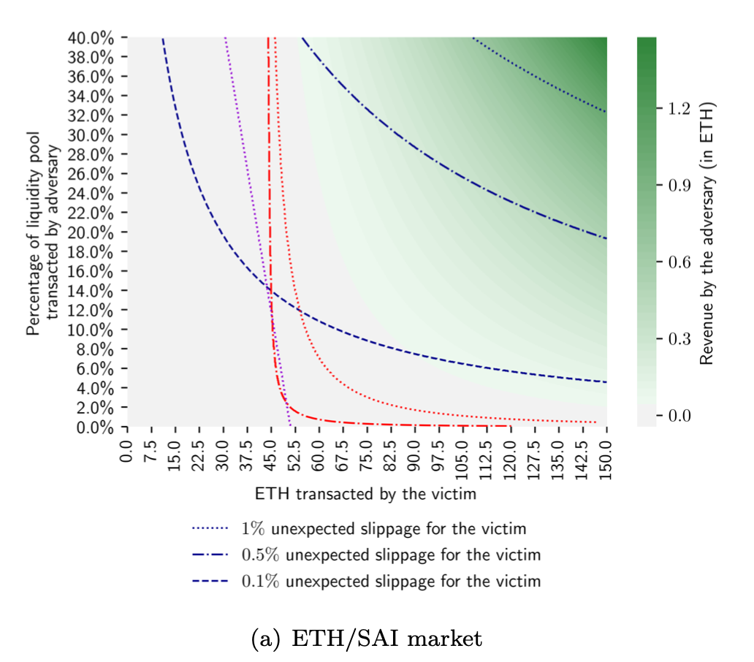
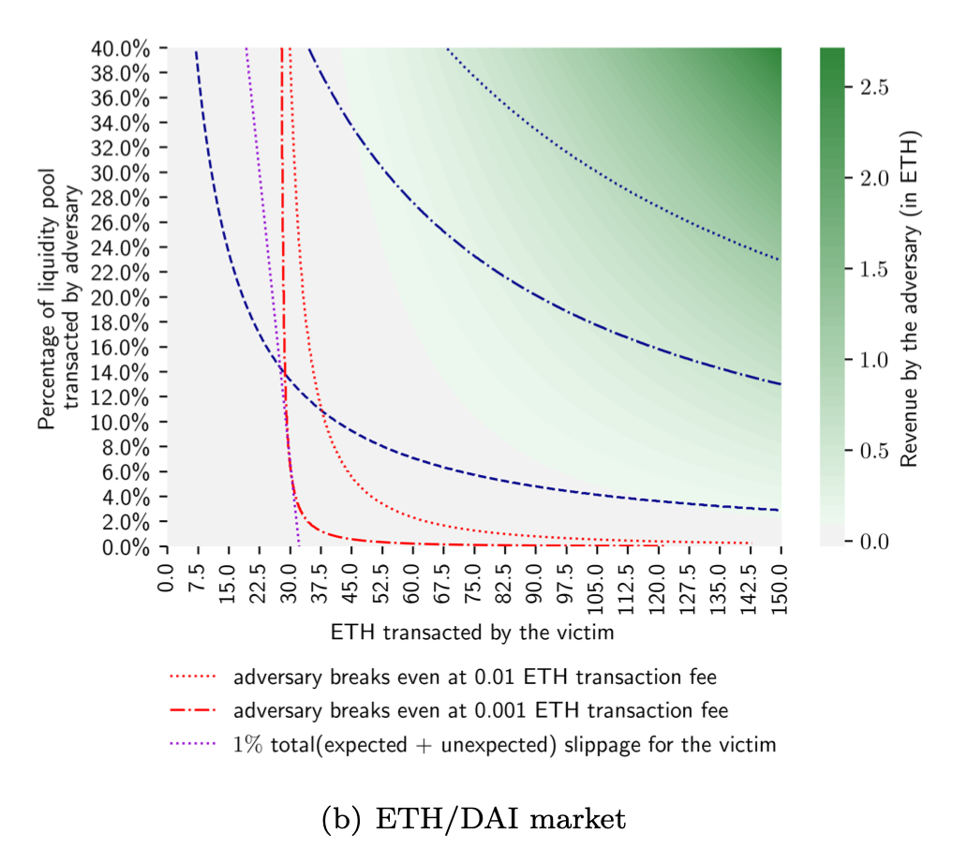
Liquidity Provider Attacks Taker in an AMM

Slide 21
Some defenses
Splitting a transaction to a few DEXs or few transactions
Setting maximum slippage
Multi-Party Computation
Commit-and-Reveal Protocols
Confidential Transactions

Slide 22
Some defenses
Develop winning strategies to keep ahead of the competition
​Capitalize on low hanging fruit to identify a ballpark value
​Visualize customer directed convergence​
Iterative approaches to corporate strategy
​Establish a management framework from the inside​

Slide 23
Conclusion

Slide 24
THANK YOU
Alireza Darvishi

