Slide 1
Prove System: a new framework for improving programming skills

Slide 2
Table of Contents
Introduction
Prove System Framework
Verification Module
Fault Localization Module
Example Demo
Conclusion

Slide 3
Introduction
Teaching experience shows that programming is time consuming and can be acquired with substantial practice
Students need to know whether their solutions are correct or incorrect and the root causes of their errors

Slide 4
Motivation
The need of practice on a substantial size of programming exercises from students
The need of a programming tutor tool for programming-related instructors
Further, the need of an automated system for validating the quality of software

Slide 5
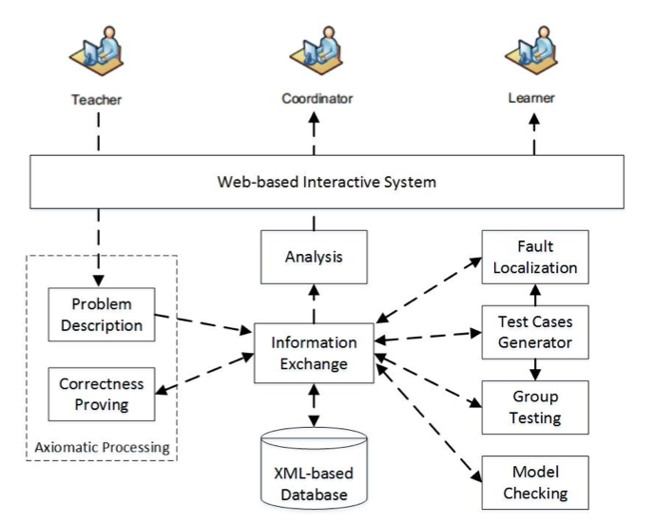
Prove System Framework

Slide 6
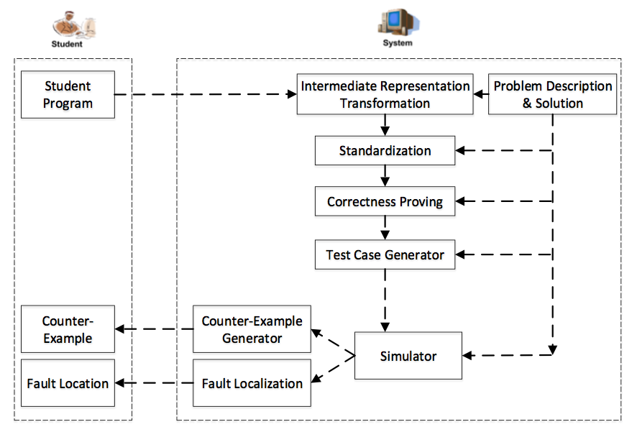
Process Flow

Slide 7
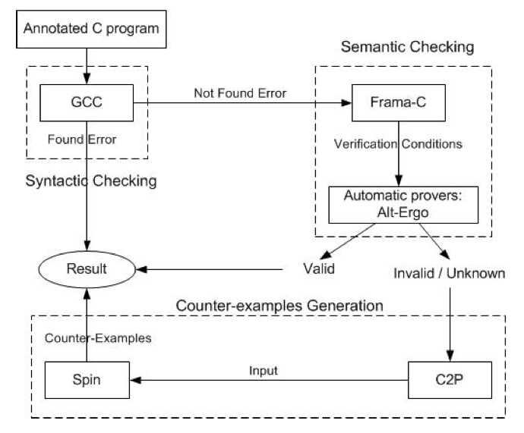
Verification Module

Slide 8
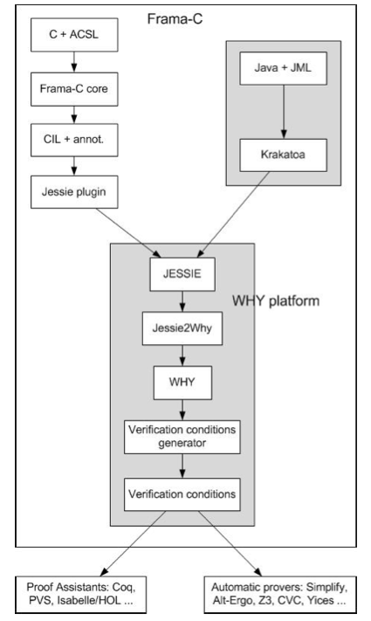
Frama-C Framework

Slide 9
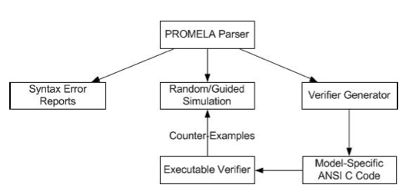
Spin Model

Slide 10
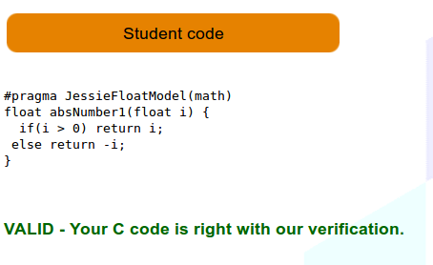
Verification Result Example

Slide 11
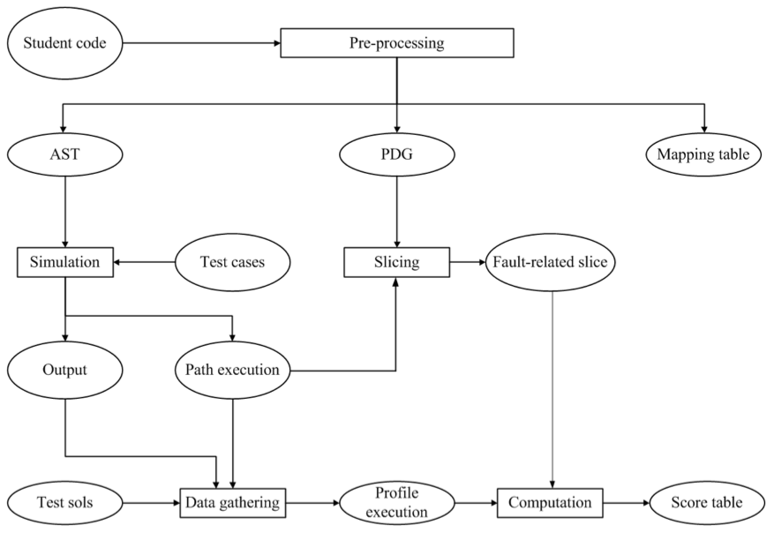
Fault Localization Module

Slide 12
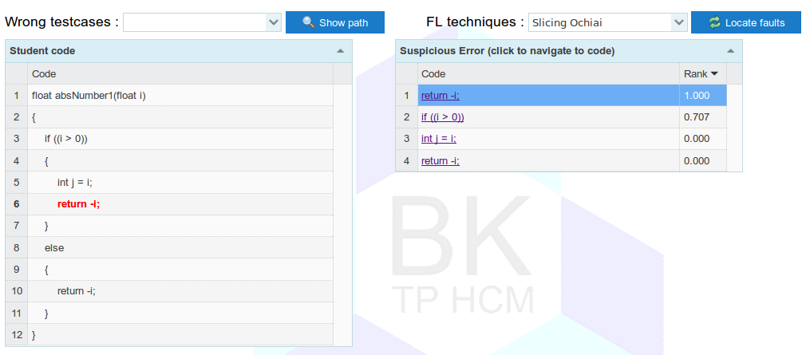
Fault Localization Result Example

Slide 13
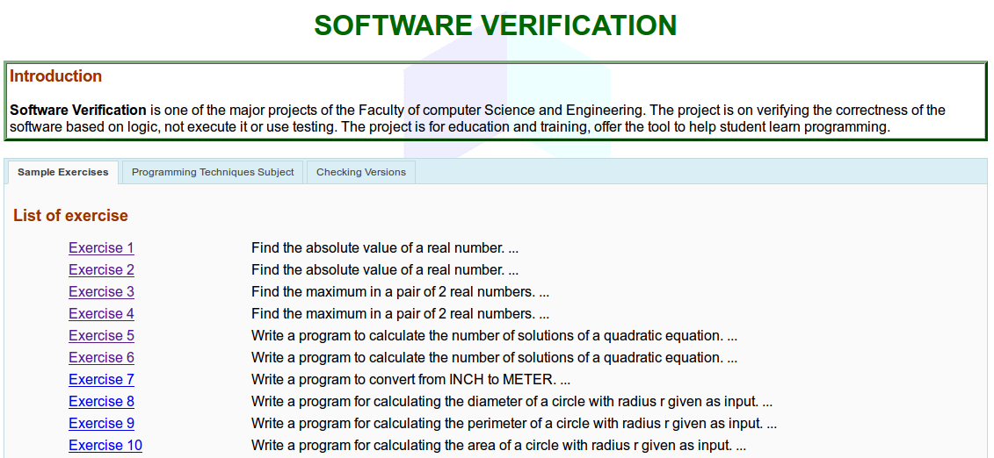
Example Demo

Slide 14
Conclusion
A framework of Prove System is believed to be a powerful web-based tutoring tool for improving programming skills for students
The system still needs improvement

