Slide 1



Epilepsy
EpiVision - 2020
Supervisor:
Mr. Samyan Qayyum Wahla

Slide 2
Epilepsy
Epilepsy is a disease of the brain defined by any of the following conditions:
At least two unprovoked seizures occurring more than 24 hours apart
One unprovoked (or reflex) seizure and a probability of further seizures similar to the general recurrence risk (at least 60%) after two unprovoked seizures, occurring over the next 10 years
Diagnosis of an epilepsy syndrome

Slide 3
Classification of Epilepsy
Epilepsies are classified as:
Generalized epilepsy
Focal epilepsy
Combined Generalized and Focal Epilepsy
Unknown Epilepsy

Slide 4
Epileptic seizures
A seizure is a transient occurrence of symptoms and/or signs due to abnormal excessive or synchronous neuronal activity in the brain.
Any of us could potentially have a single epileptic seizure at some point in our lives. This is not the same as having epilepsy, which is a tendency to have seizures that start in the brain.
Epileptic seizures start in the brain.
Epilepsy is not a disease, or an illness and it is not catching. It is the most common serious neurological condition.

Slide 5
Are all seizures the same?
Epileptic seizures start in the brain. Although there are other types of seizures which may look like epileptic seizures, but they do not start in the brain.
Some seizures are caused by conditions such as
Low blood sugar (hypoglycemia)
Change to the way the heart is working.
Some very young children have ‘febrile convulsions’ (jerking movements) when they have a high temperature.
In these slides, wherever a word seizure is used, it means Epileptic Seizures

Slide 6
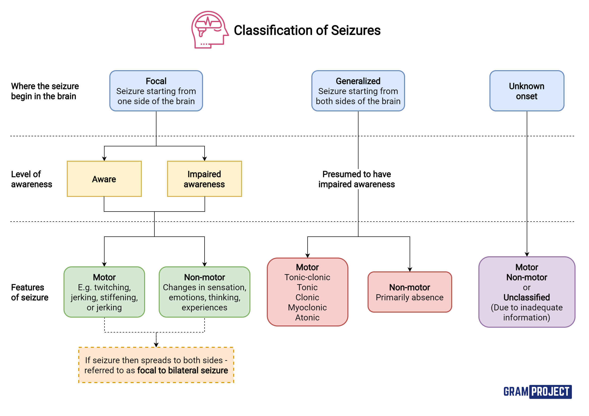
Classification of Seizures
Seizures are divided into groups depending on:
• Where they start in the brain (onset)
• Whether or not a person's awareness is affected
• Whether or not seizures involve other symptoms, such as movement or no movement
Notes:
Onset means start

Slide 7
Classification of Seizures
Depending on where they start, Epileptic seizures fall broadly into the following types:
Focal onset seizures
Generalized onset seizures
Unknown onset seizures

Slide 8
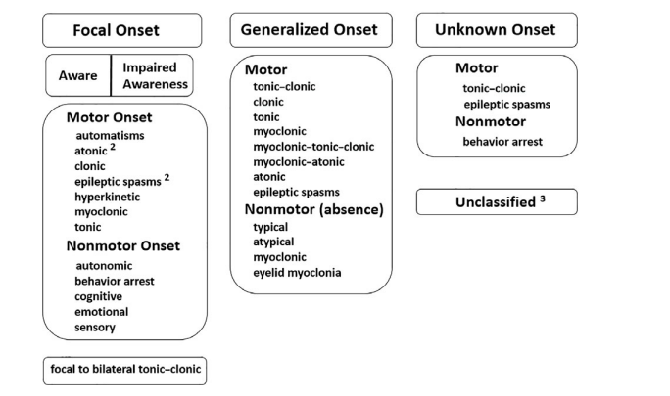
Classification of Seizures

Slide 9
Myths and Facts
Epilepsy is usually only diagnosed after a person has had more than one seizure and not all seizures are due to epilepsy.
The Greek philosopher Hippocrates (460-377 BC) was the first person to think that epilepsy starts in the brain.

Slide 10
Facts
Most seizures happen suddenly without warning, last a short time (a few seconds or minutes), and stop by themselves.
Seizures can be different for each person.
Just knowing that someone has epilepsy does not tell you what their epilepsy is like, or what type of seizures they have
Calling seizures ‘major’ or ‘minor’ does not tell you what happens to the person during a seizure.
Average seizure duration is 30 sec

Slide 11
Facts
Some people have more than one type of seizure.
Not all seizures involve jerking or shaking movements. Some people seem vacant, wander around, or are confused during a seizure.
Some people have seizures when they are awake, called ‘awake seizures. Some people have seizures while they are asleep, called ‘asleep seizures’ (or ‘nocturnal seizures’).
Injuries can happen during seizures, but many people don’t hurt themselves, and don’t need to go to hospital or see a doctor.

Slide 12
Motor Onset Seizures
A motor onset seizure involves motor activity (movement) and may be due to either an increase or decrease in contraction in a muscle or group of muscles. Depending on the muscle groups involved and the way they are affected, the movement features of a motor onset seizure may be simple or more complex.

Slide 13
Videos

Slide 14
Focal onset Seizures

Slide 15
Generalized onset Seizures

Slide 16
Classification of Seizures
FOCAL
Where the seizure begin in the brain

